Slide 1
League of Legends Item Balancing Recommendations
Sebastian Alvis

Slide 2
Dataframes
Matches
itemIDs, championIDs, item purchase times, win Boolean
Items
Item ID, name, tags, total gold
Champions
Champion ID, name, tags
Custom Item Dataframe
Item ID, # purchased in matches, pick rate, # wins with item, win rate, # unique champions that purchased item, total gold, tags

Slide 3
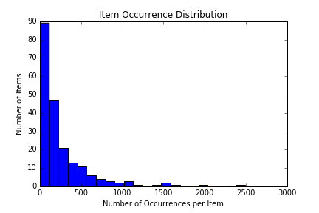
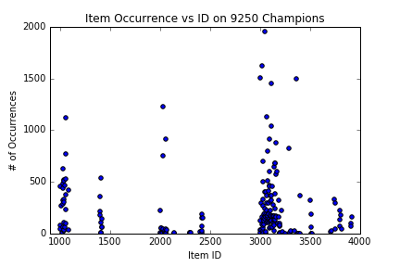
Item Occurrence
The highest 7 points around ID 3000 are wards and boots.
The high points around 2000 are refillable potion and control ward.
The high point around ID 1000 is Doran’s Blade.
Most full items are of ID > 3000

Slide 4
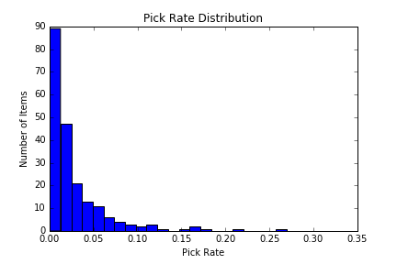
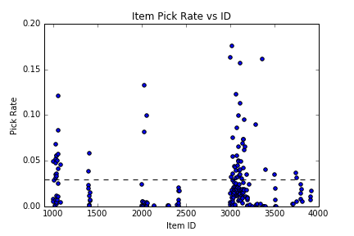
Item Pick Rate
Same distributions, but the numbers are now normalized

Slide 5
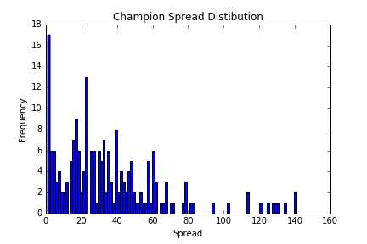
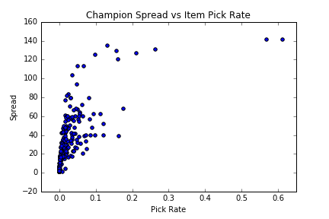
Champion Spread
How many unique champions does each item get built on?

Slide 6
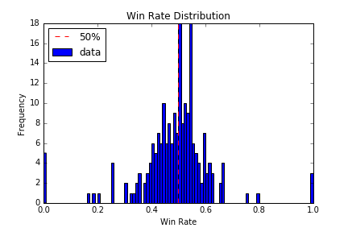
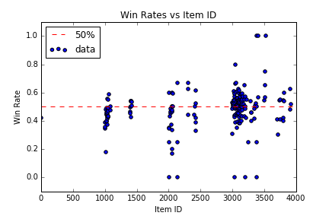
Win Rates
The probability that a player wins with a given item

Slide 7
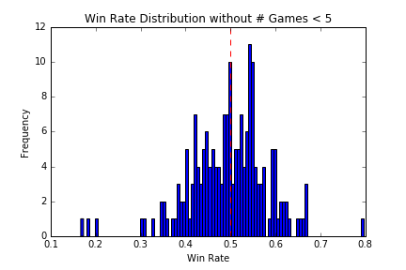
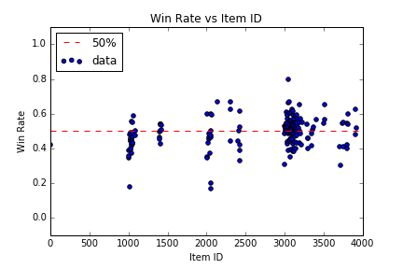
Win Rates (excluding items with < 5 games)
Removed items that had fewer than 5 games in my data

Slide 8
Correlations??

Slide 9
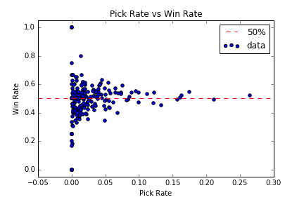
Pick Rate vs Win Rate
No Obvious correlation yet

Slide 10
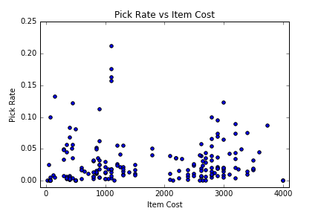
Pick Rate vs Item Cost

Slide 11
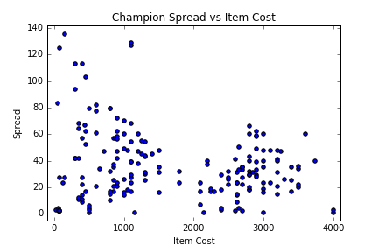
Champion Spread vs Item Cost

Slide 12
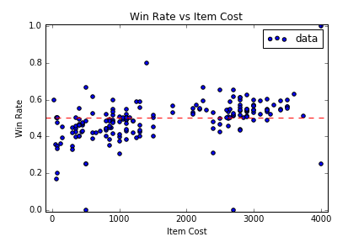
Win Rate vs Item Cost
This shows that finishing an item is good for your chances of winning

Slide 13
Aggregate by Item Tags
Items can be grouped into sets based on the bonuses they give
Example tags:
Damage
SpellDamage
Health
Armor
SpellBlock
AttackSpeed

Slide 14
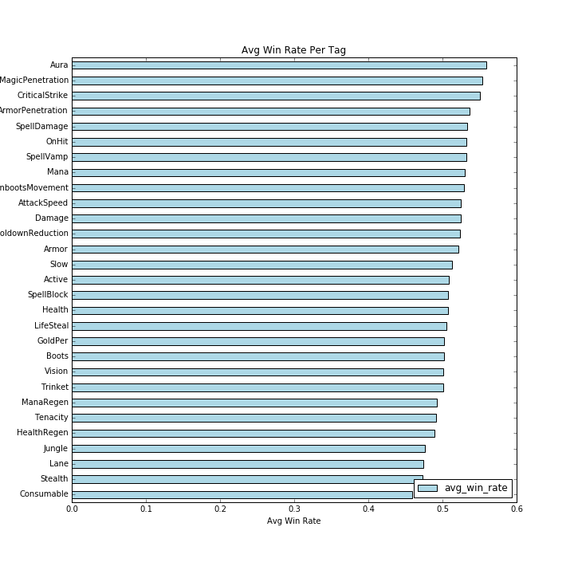
Win Rate Per Tag

Slide 15
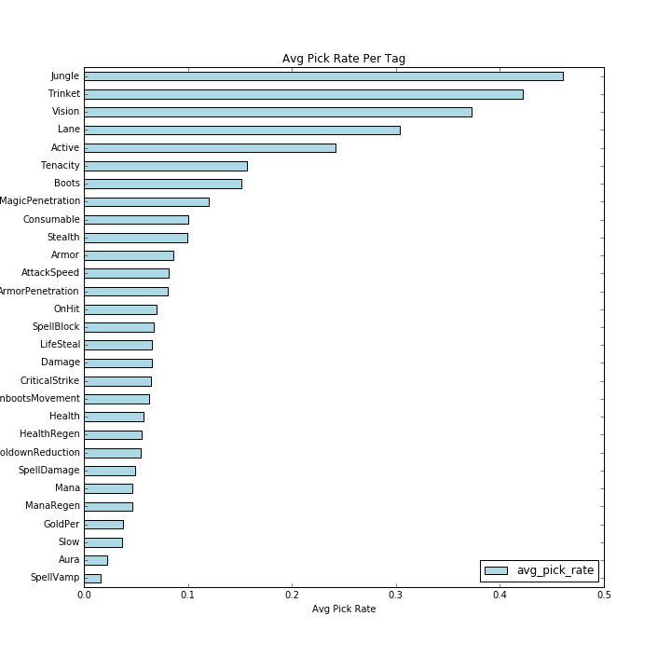
Pick Rate vs Tag

Slide 16
Purchase Timing

Slide 17
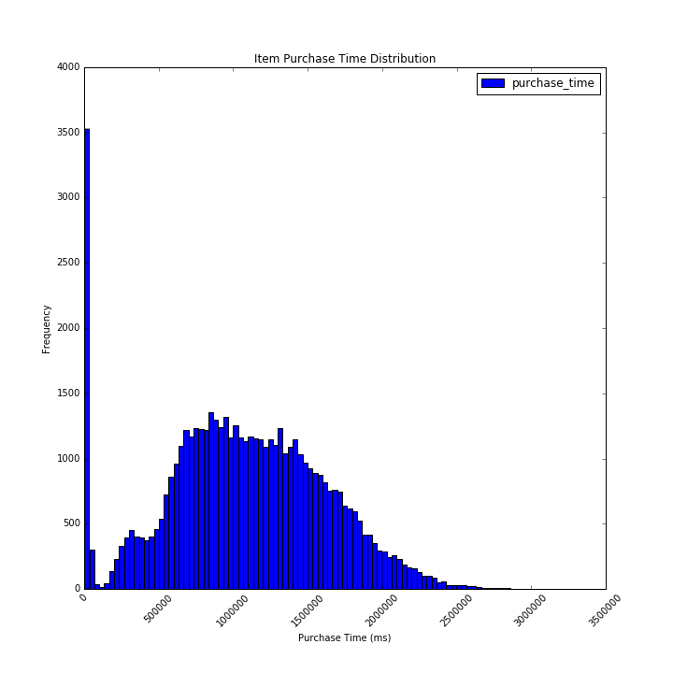
Item Purchase Time
This is for all the items that a player ends the game with.

Slide 18
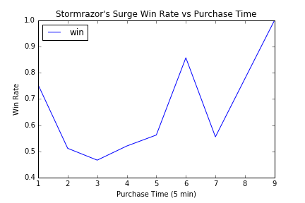
Example Item: Stormrazor’s Surge

