Slide 1

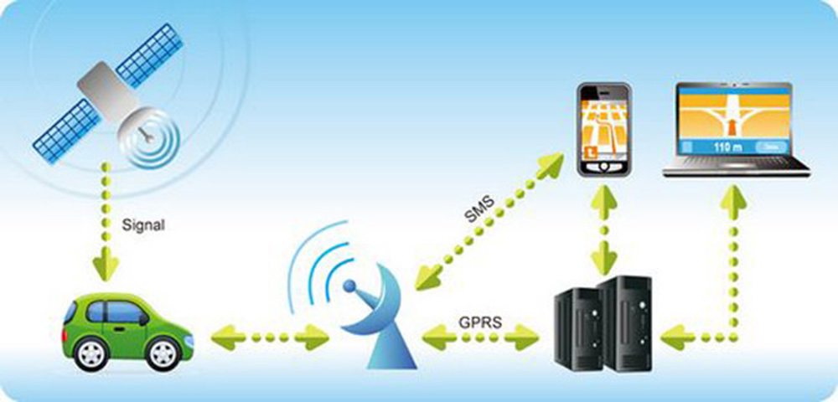
GPS Tracking Device

Slide 2
Index
Introduction
Features of GPS Tracking Devices
GPS Tracking Devices Application
Types of GPS Tracking Devices
Uses of GPS Tracking Devices
Advantages and Disadvantages
How its Works
Components of GPS Tracking Devices

Slide 3
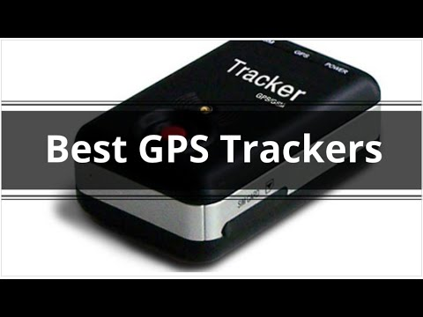
About GPS Tracking System
GPS Tracking System is a highly modern device that can track the exact location with the precision of timing as well.GPS Tracking Systems are designed for tracking vehicle fleets, equipment, people, containers, and merchandise.

Slide 4
Key features of GPS Tracking Devices
Tracking is provided by time-interval and distance-covered
Emergency notification
Geo-fencing control
Mileage data
Battery power alert
Speeding alert
Voice communication
GPRS simultaneously
Power loss
Power organization
Towing notification
Wire-tapping

Slide 5
Interesting, right?
This is just a sneak preview of the full presentation. We hope you like it! To see the rest of it, just click here to view it in full on PowerShow.com. Then, if you’d like, you can also log in to PowerShow.com to download the entire presentation for free.

