Slide 1
Presenting at Pilani Campus
October 2026
Value-Aware Team-Level Stopping for Multi-Robot Exploration using Hierarchical MARL
MARL Research Proposal (revised)
Chaitanya Goyal
Supervisor: Prof. Avinash Gautam
Notes:
Revised proposal after feedback. The project is no longer framed as an LLM-style orchestrator. It asks one question: can a hierarchical MARL policy learn when continued multi-robot exploration is no longer worth its motion, communication and coordination cost? I also show a first working prototype.

Slide 2
When should the team stop?
Classical exploration stops when no frontiers are left, or at a fixed coverage threshold.
The last part of a map is the most expensive: small, scattered pockets that need long drives, more messages and more re-planning.
So the real question is not whether the team can explore further, but whether one more cycle is worth its cost.
One run from my prototype (3 robots). Stopping at cycle 20 maps 83% of the space; the last 17 cycles add 17% more map but cut net value from 554 to 319.
Notes:
Every exploration system needs a termination rule. Classical ones stop when no frontiers are left or at a coverage threshold. The chart is one real run from my prototype: map revealed rises quickly, then flattens, while cost keeps growing linearly. Net value peaks around cycle 20. Carrying on to the last frontier adds 17% more map but loses almost half the net value.

Slide 3
Three problems, one contribution
Problem A
Problem B
Problem C
Frontier allocation
Communication
Team-level stopping
Which robot explores which frontier?
Which robots talk, and what do they share?
When is one more cycle no longer worth its cost?
Well studied: greedy, market-based, MinPos, and recent MARL methods.
Active MARL topic: learned and bandwidth-limited messaging.
Exploration systems use fixed rules; MARL work fixes the episode length.
Execution substrate
Modelled as a cost and a constraint
The contribution of this project
Frontier allocation is the machinery the robots run on, not the claim. The claim is about when the whole team should stop.
Notes:
Following the feedback, I separate three problems. A and B are active research areas already, so I treat them as the machinery the robots run on. The contribution is C: a learned, team-level, cost-aware stopping decision.

Slide 4
What is already known
Area | What exists | What is still missing
Multi-robot exploration Yamauchi 1997; Burgard et al. 2005; MinPos 2012 | Frontier-based coordination with utility and travel-cost allocation. | Termination is a fixed rule: no frontiers left, or a coverage threshold.
MARL for exploration Tan et al. 2023 (RA-L); MARVEL 2025 (ICRA) | Learned, decentralised frontier selection for multi-robot teams. | When the team stops is not a learned decision.
Hierarchical MARL Options (Sutton et al. 1999); Han et al. 2019 | Learned termination of each agent's sub-policy (dynamic termination). | Termination of the whole task, driven by expected gain versus team cost.
Optimal stopping Chow et al. 1971; Tsitsiklis & Van Roy 1999; Becker et al. 2019 | Theory and learned stopping rules for a single decision maker. | Many agents, partial observability, costs that depend on coordination.
LLM-agent orchestration Zhang 2026; Hu et al. 2025 (motivation only) | Statistical stopping rules for agent debates; a 2026 survey finds no RL-trained stop. | Same question in a different field. Not part of the proposed system.
Notes:
This is a summary of the gap analysis the supervisor asked for; the full 2 to 3 page version with 20 to 30 papers is in progress. The important change from the first proposal: the LLM orchestration survey is now motivation only. The gap is defined against the robotics, hierarchical MARL and optimal stopping literature.

Slide 5
Research questions
Can a hierarchical MARL policy learn a team-level stopping strategy that balances expected information gain against motion, communication and coordination costs during multi-robot exploration?
RQ1
Can MARL learn efficient frontier allocation?
RQ2
Can the policy tell when further exploration has low marginal value?
Level-2 policy vs greedy and market-based allocation, stopping held fixed.
Learned value estimate vs true remaining value; stop time vs hindsight-best stop.
RQ3
Does learned stopping cut time and travel without losing meaningful coverage?
RQ4
How does it scale with team size and communication limits?
Net value, coverage at stop, distance and messages against every baseline.
Train on 2 robots; test on 2 to 10 robots, 3 map sizes, 3 communication levels.
Notes:
The main question is the supervisor's suggested wording. Each sub-question maps to one experiment, so each becomes one results section.

Slide 6
Formulation
Level 1: team stopping policy
Once per cycle. Sees a team summary (map known, recent gain, frontiers, cost of a cycle). Decides continue, stop, or how many robots stay active.
Multi-agent optimal stopping under partial observability
Dec-POMDP ⟨ I, S, {Aᵢ}, P, R, {Ωᵢ}, O ⟩ with robots I, true map and poses S, local observations Ωᵢ.
Value of one cycle
r(t) = ΔI(t) − c_move·d(t) − c_comm·m(t) − c_coord
ΔI new cells mapped, d robot steps, m messages.
Stopping rule
Q(b) = E[ Σₖ r(k) | belief b, continue ]
Stop as soon as Q(b) ≤ 0: the expected marginal value of exploring further no longer covers its cost.
Robot 1
local map, picks next frontier
Robot 2
local map, picks next frontier
Robot N
local map, picks next frontier
Level 2: one policy per robot, every step, shared parameters
Trained centrally with the full map and all robot states; executed with each robot's own observations (CTDE). So the system is genuinely multi-agent.
Notes:
High level: multi-agent optimal stopping under partial observability. Level 1 is the team stopping policy, running once per exploration cycle. Level 2 is one policy per robot, running every step on local observations. Training is centralised, execution is decentralised (CTDE), which answers the question of whether this is genuinely MARL or centralised RL.

Slide 7
Phased plan
Phase 1
Phase 2
Phase 3
Phase 4
Toy environment
2D grid-world exploration
ROS2 / Gazebo
Realistic environments
N agents, M tasks, communication cost, stop action. Does the policy learn when to continue, stop, and how many agents to activate?
Partial maps, frontiers, sensing, team-size and communication tests. Most quantitative results come from here.
MRTA testbed: realistic motion and sensing. Checks that the policy transfers to a real robotics stack.
Larger maps, real robots if available.
Semester 1
First version built (week 1)
Semester 2
Future work
The ROS2/Gazebo migration continues as a separate track, so a delay there never blocks Phases 1 and 2.
Notes:
The abstract-to-robotics sequence the supervisor endorsed. Each phase only starts once the previous one works, so RL problems and simulator problems are never debugged at the same time.

Slide 8
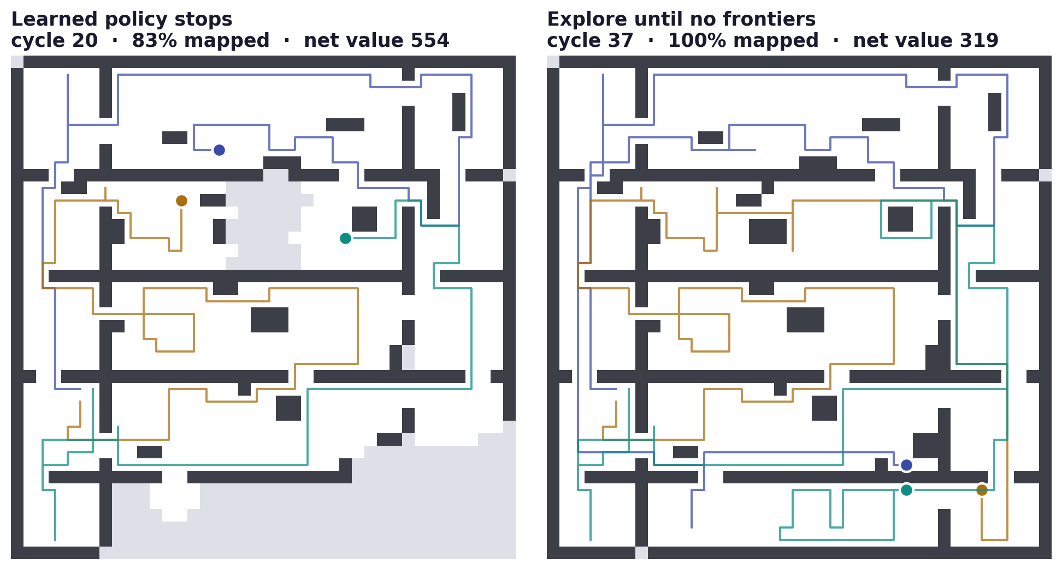
Week 1: a working prototype
What it does
Robots start together on an unknown indoor map and see 4 cells around them.
Level 2: greedy frontier allocation (fixed, not the claim).
Level 1: learned stop, trained on 2 robots.
Learner
Fitted Q-iteration: stop when estimated value of continuing ≤ 0.
Python, CPU only, about 15 minutes end to end.
Notes:
What I built this week. Random indoor maps, robots that only see 4 cells around them through line of sight, a greedy frontier allocator as Level 2, and a learned Level-1 stop. The left map is where the learned policy stops; the right is the classical rule of exploring until no frontiers remain. The policy leaves the far corner unexplored because reaching it costs more than it would reveal at these cost weights.

Slide 9
First results
Training-like setting: 2 robots, 32×32 maps, 100 unseen maps. Net value as % of the best stop in hindsight.
93%
on the training setting, tied with the best tuned rule (92%)
83% vs ≤52%
mean across 36 unseen settings (team size, map size, communication), no retraining
r = 0.87
correlation between the learned value estimate and the true remaining value
Notes:
On the setting it was trained on, the learned rule is essentially tied with the best hand-tuned rule, which was tuned for exactly that setting. The value of learning shows up on unseen settings, and in the fact that its value estimate tracks the true remaining value.

Slide 10
Does it generalise?
Learned value-aware stop
Coverage threshold (tuned)
Info-gain vs cost rule (tuned)
Explore until no frontiers
Mean % of hindsight-best value (RQ4 preview). Trained once on 2 robots, 32×32 maps, medium communication cost.
Tuned rules hold up in typical settings but collapse as teams grow or messages get expensive. Weak spots: with 2 robots the tuned threshold wins (92% vs 79%); 8 robots with costly communication is hard for every rule, which motivates letting Level 1 switch robots off.
Notes:
Trained on 2 robots, 32×32 maps, medium communication cost. Tested with no retraining on every combination of 2 to 8 robots, 32 to 64 cell maps and low to high communication cost: 36 settings, 40 maps each. Each point averages over the other two factors. Honest weak spots: with only 2 robots the tuned coverage threshold is better, and 8 robots with expensive communication is hard for every rule, which is why the next version lets the policy deactivate robots.

Slide 11
Ablations
Method | Frontier allocation | Stopping | Hierarchical | Status
Greedy frontier | greedy | fixed | – | done: 3 fixed rules
Classical MRTA | market-based / MinPos | fixed | – | planned
MARL allocation | learned | fixed | – | planned (MAPPO)
MARL + heuristic stop | learned | heuristic | – | heuristics done; MARL planned
RL allocation + stop (flat) | learned | learned | – | planned
Full hierarchical method | learned | learned, value-aware | ✓ | Level 1 done; Level 2 planned
Row 4 against row 6 answers the key question: is the improvement actually coming from the stopping policy?
Heuristic stops tested so far: one-step look-ahead, information gain vs cost, coverage threshold, fixed budget.
Notes:
The supervisor's ablation table, extended with a hierarchy column and the status in the prototype. The key comparison is MARL allocation with a strong heuristic stop against the full method: it isolates whether the improvement comes from the stopping policy.

Slide 12
Experiment matrix and metrics
Factor | Training | Testing (no retraining)
Team size | 2 robots | 2, 4, 6, 8, 10 robots
Map size | small (32×32) | small, medium (48×48), large (64×64); ROS2 maps in Phase 3
Communication | medium cost | low, medium, high cost; limited range and bandwidth
Environment | grid-world | grid-world, then ROS2/Gazebo (MRTA testbed)
Metrics, over 40+ unseen maps per setting
Net value vs hindsight-best stop
Map coverage at stop
Time to stop (cycles)
Distance travelled
Messages sent
Notes:
Train small, test large, without retraining. The matrix directly answers RQ4.

Slide 13
Timeline
Semester 1
Semester 2
1
4
8
12
16
4
8
12
16
Gap analysis (20 to 30 papers)
RL fundamentals
Dec-POMDP formulation, baselines
Phases 1-2: learned stopping
Level 2: MARL allocation (CTDE)
ROS2/Gazebo migration
Phase 3: port to Gazebo
Full matrix + ablations
Scaling, comm limits
Write-up
Week numbers within each semester.
Notes:
Literature and formulation come first, as requested. MARL for Level 2 starts only after the learned stopping result holds in the grid-world. Gazebo work runs in the background in semester 1.

Slide 14
Risks and mitigations
Risk | Mitigation
Learned stopping does not beat well-tuned heuristics | Already visible in the prototype on the training setting; the claim is robustness across team size and cost, measured by the full matrix.
Novelty overlaps with existing termination work | Structured gap analysis before implementation; novelty stated as team-level, cost-aware and learned.
MARL training is unstable or slow | Grid-world first, parameter sharing across robots, established CTDE baselines (MAPPO, QMIX).
ROS2/Gazebo migration runs late | Separate track; grid-world results stand on their own.
Paper timing | Venue decided with the supervisor after Phase 2: RA-L (rolling) or the ICRA 2028 cycle.
Notes:
The publication target is no longer fixed in advance. It will be chosen with the supervisor once the Phase 2 results are in.

Slide 15
Key references
Multi-robot exploration and allocation
Yamauchi. A frontier-based approach for autonomous exploration. CIRA 1997.
Burgard et al. Coordinated multi-robot exploration. IEEE T-RO 2005.
Gerkey & Matarić. A formal analysis and taxonomy of task allocation in multi-robot systems. IJRR 2004.
Bautin et al. MinPos: a novel frontier allocation algorithm for multi-robot exploration. ICIRA 2012.
MARL for exploration
Tan et al. Deep RL for decentralized multi-robot exploration with macro actions. IEEE RA-L 2023.
Chiun et al. MARVEL: MARL for constrained field-of-view multi-robot exploration. ICRA 2025.
Cooperative MARL and communication
Oliehoek & Amato. A Concise Introduction to Decentralized POMDPs. Springer 2016.
Foerster et al. Counterfactual multi-agent policy gradients (COMA). AAAI 2018.
Yu et al. The surprising effectiveness of PPO in cooperative multi-agent games (MAPPO). NeurIPS 2022.
Das et al. TarMAC: targeted multi-agent communication. ICML 2019.
Hierarchical RL and termination
Sutton, Precup & Singh. Between MDPs and semi-MDPs (options). Artificial Intelligence 1999.
Han et al. Multi-agent hierarchical RL with dynamic termination. PRICAI 2019.
Optimal stopping
Chow, Robbins & Siegmund. Great Expectations: The Theory of Optimal Stopping. 1971.
Tsitsiklis & Van Roy. Optimal stopping of Markov processes. IEEE TAC 1999.
Becker, Cheridito & Jentzen. Deep optimal stopping. JMLR 2019.
Ernst, Geurts & Wehenkel. Tree-based batch mode RL (fitted Q-iteration). JMLR 2005.
Motivation: LLM-agent orchestration
Zhang. RL for LLM-based multi-agent systems through orchestration traces. arXiv 2605.02801, 2026.
Hu et al. Multi-agent debate for LLM judges with adaptive stability detection. NeurIPS 2025.
Notes:
All references checked for year and venue. The full gap analysis will extend this list to 20 to 30 papers.

Slide 16
Thank you
Chaitanya Goyal
2024A7PS0557P

