Slide 1
Presenting at Pilani Campus
on [Presentation Date]
An RL-Trained Orchestrator for Multi-Robot Frontier Allocation and Stopping Decisions
MARL Research Proposal
Scholar : Chaitanya [ID]
Supervisor : Dr. Avinash Gautam
Notes:
Greetings! My name is Chaitanya, and I'm presenting my research proposal for the semester. My supervisor is Dr. Avinash Gautam. The proposed topic is an RL-trained orchestrator for multi-robot frontier allocation and stopping decisions.

Slide 2

Background and Motivation
This project extends three existing threads — not a fresh start:
Goal: combine this robotics background with a genuinely open gap in current multi-agent RL research.

Slide 3


Literature Landscape
2024 — Language as Communication
Sun, Huang, Pompili (Rutgers): arXiv:2405.11106, 2024
Core idea: replace numeric inter-agent communication with natural language
Frameworks surveyed: CoELA, RoCo, MetaGPT, SMART-LLM
Proposes: personality-enabled cooperation, human-in/on-the-loop, MARL+LLM co-design, safety
2026 — The Shift to Orchestration
Chenchen Zhang: arXiv:2605.02801, May 2026
The shift: framing moves to ORCHESTRATION — training LLM-agent teams via RL to decide when to spawn sub-agents, whom to delegate to, and when to stop
Evidence base: an 84-paper pool at github.com/xxzcc/awesome-llm-mas-rl
Role here: source of the gap analysis this project is built on

Slide 4
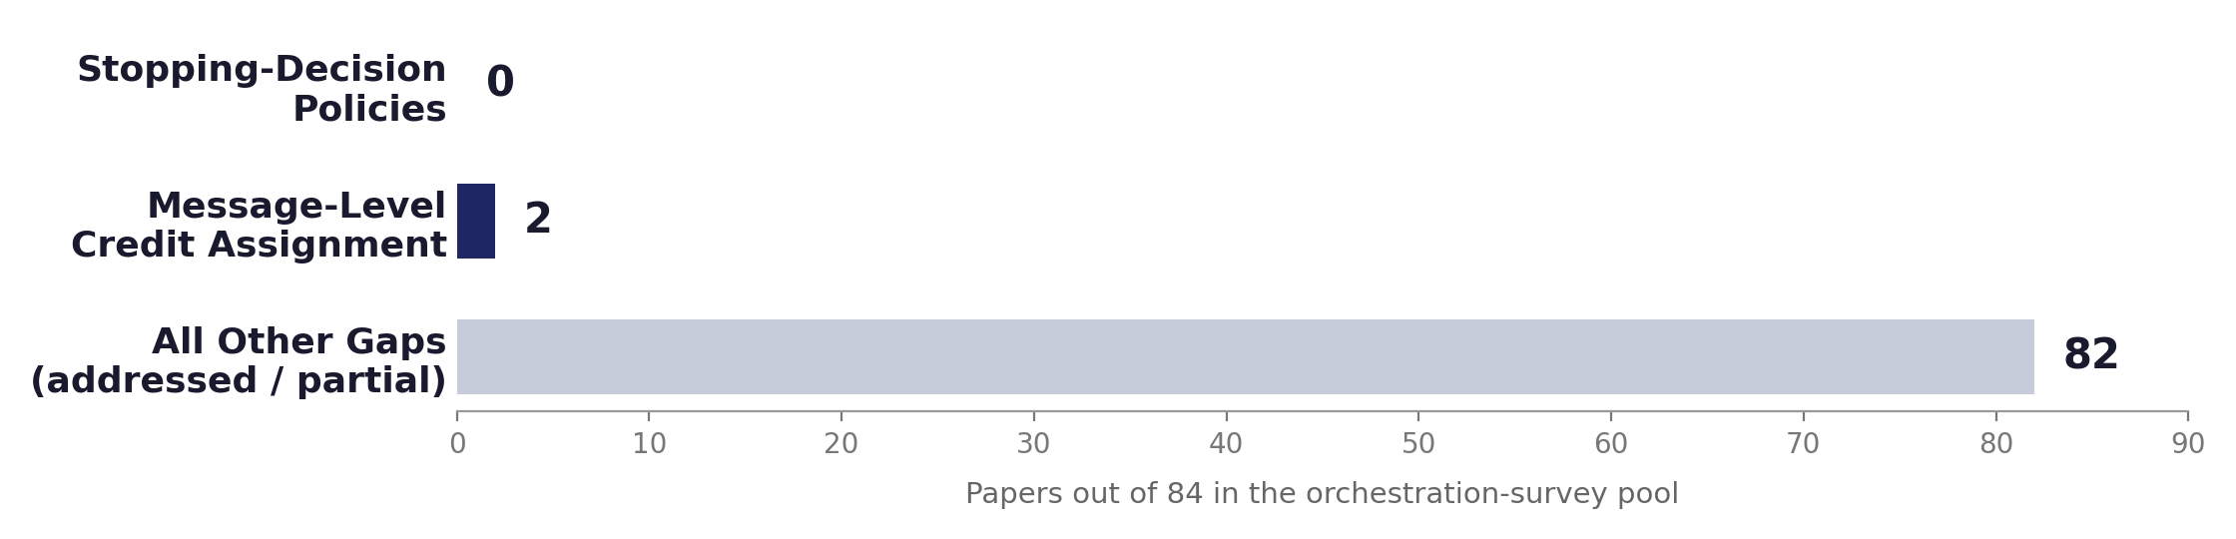
The Research Gaps
The gap: no paper trains a team to learn WHEN to stop delegating
This project: targets this gap as the lead contribution
The question: which message caused another agent to fail?
This project: treats it as a Semester-2 stretch goal, not the lead claim

Slide 5
Three Candidate Directions
Direction | Strengths | Trade-offs
Credit Assignment (COMA → 2026 paper) | Theoretically the cleanest; strong grounding in classical MARL. | A 2026 paper already occupies this space — thin room for a novel claim.
Pure Orchestration (abstract, stopping-decision) | Genuinely open gap (0/84 papers). | A full LLM-agent training pipeline from scratch costs significant time.
Robotics Hybrid (MRTA + LLM/RL) — CHOSEN | Same open gap; testbed already half-built; measurable metrics; coherent narrative. | Requires finishing the ROS2/Gazebo migration first.

Slide 6

Algorithm-First Sequencing
The approach: validate the stopping-decision idea in a fast, abstract setting before touching robotics
Risk-first: the RL idea is the one genuinely uncertain part of this project — find out early whether it works
Iteration speed: a lightweight benchmark allows testing reward formulations in minutes, not hours
Decoupling: the Gazebo testbed runs in parallel from week 1 — a stuck migration never blocks the core result
Fallback paper: a complete, evaluable result exists even if the robotics port runs into trouble late
The caveat: the robotics generalization is the actual differentiator in a crowded, fast-growing paper pool — budgeted as real Semester-2 engineering time, not a footnote

Slide 7
Problem Formulation
Element | Abstract Setting (Sem. 1) | Robotics Setting (Sem. 2)
State | Task/dialogue context and agent-team history, as used in MARFT/Puppeteer. | Frontier map, robot positions, live inter-robot message history.
Action | Delegate to an agent, communicate, or stop the round. | Reallocate a frontier to a robot, or issue a stop signal.
Reward | Task-outcome success, penalized for unnecessary rounds. | Coverage efficiency, penalized for redundant reallocation.
Baseline | MARFT’s planner–solver–verifier; Puppeteer’s orchestrator. | Same structures, reused; plus the heuristic frontier rule.

Slide 8
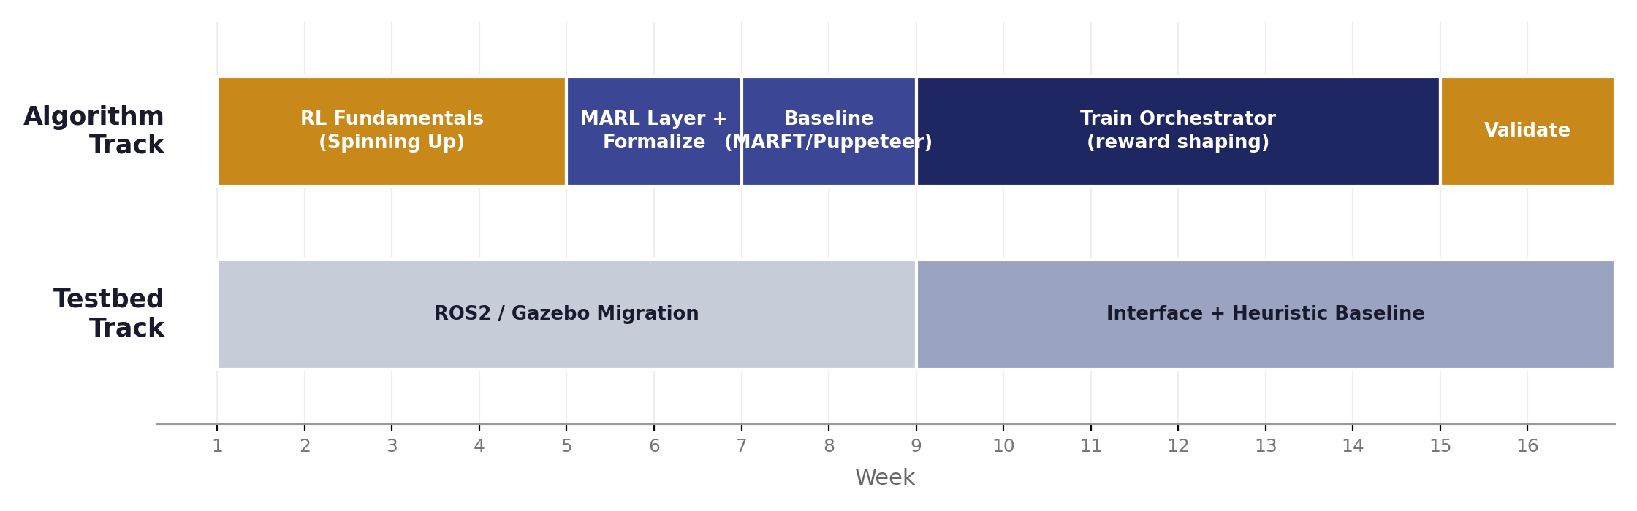
Roadmap — Semester 1
Colors mark distinct phases within each track. The two tracks run independently — the testbed never blocks the algorithm track.

Slide 9
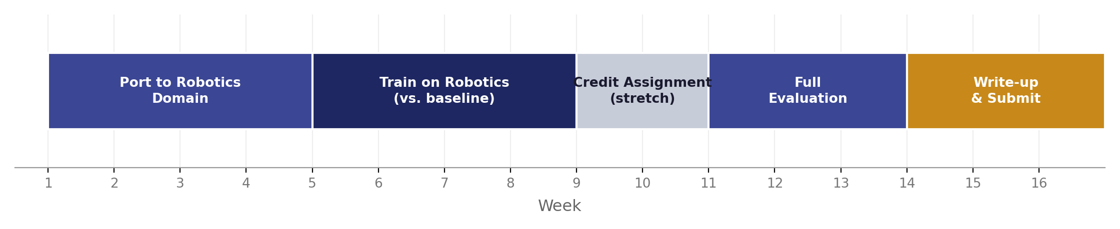
Roadmap — Semester 2
Semester 2 ports the validated idea onto the robotics testbed and produces the paper’s differentiated result.

Slide 10
Venue and Evaluation
Publication Target
Evaluation and Deliverables
Metrics: map coverage % over time, time-to-completion, redundant travel distance
Deliverable 1: a working ROS2/Gazebo testbed with a pluggable orchestration interface
Deliverable 2: a trained stopping-decision + reallocation policy
Deliverable 3: a full paper draft targeting IROS 2027
Venue | Deadline | Verdict
ICRA 2027 | 15 Sept 2026 | Already past.
AAMAS 2027 | 8 Oct 2026 | Too little runway.
IROS 2027 | 1 Mar 2027 | Primary target.
RA-L | Rolling | Fallback option.

Slide 11
Risks and Mitigations
Risk | Mitigation
Core RL idea doesn’t work as hoped | Discovered early, in the fast-iteration abstract setting.
Gazebo migration runs late | Parallel track — doesn’t block the core result.
Someone else publishes the abstract result first | The robotics generalization is the actual differentiator.
Scope creep from credit-assignment extension | Explicitly gated as a stretch goal.
IROS 2027 deadline is missed | RA-L’s rolling submission is the fallback.

Slide 12
Key References
Authors | Paper | Role
Foerster et al. | COMA — arXiv:1705.08926, AAAI 2018 | Credit-assignment baseline
Liao, Wen, Wang, Zhang | MARFT — arXiv:2504.16129, 2025 | Reference formulation
Dang et al. | Puppeteer — arXiv:2505.19591, NeurIPS 2025 | Alternative codebase
Liu, Chen, Liang, Lyu, Amato | MAGRPO — arXiv:2508.04652, AAAI 2026 | Dec-POMDP formalization
Sun, Huang, Pompili | LLM-MARL Survey — arXiv:2405.11106, 2024 | Language framing
Chenchen Zhang | Orchestration Survey — arXiv:2605.02801, 2026 | Gap analysis source

Slide 13
Thank you
Chaitanya. [ID]

