Slide 1
Predicting Forest Covertype
Using Spark ML Libraries
Devon Grossett - June 2024

Slide 2
The problem
Purpose
Method
Outcome
Predicting what type of forest cover is on a piece of land, based on geographic information
Observe differences from preprocessing
(and to use Spark ML Libraries to accomplish this)
Multinomial Logistic Regression
PySpark API
VUW Hadoop Cluster
Evaluate on test data
Three models (with three test scores)

Slide 3
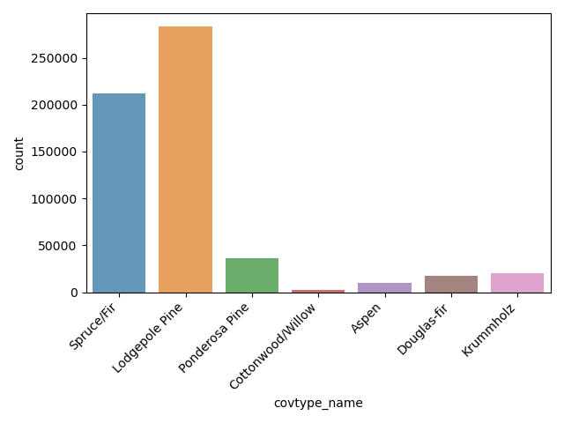
Target Classes
Lots of Spruce/Fir, Lodgepole Pine
Some Ponderosa Pine
A lot less of everything else

Slide 4
Features
Numeric:
Elevation
Slope
Aspect
Distance to Water Features: Horizontal and Vertical
Distance to Nearest Roadway: Horizontal
Distance to Nearest Wildfire Ignition Point: Horizontal
Hillshade Index at Summer Solstice: 9am, Noon, and 3pm
Categorical:
Wilderness Area (4 Levels)
Soil Type (40 Levels)
Total of 54 features, before preprocessing

Slide 5
Feature Construction
Transformations
Interactions
Reference Level
Aspect:
sin(Aspect)
cos(Aspect)
Slope * cos(Aspect)
Slope * sin(Aspect)
Slope * Elevation
Hillshade_9am, Hillshade Noon, Hillshade 3pm
Categorical features need a reference level
Drop Wilderness_Area_1 and Soil_Type_1

Slide 6
Preprocessing
No Standardization
Standardization
PCA
Raw features
No preprocessing
Standardize Features
Standardize numeric features to have
𝜇 = 0
𝜎 = 1
Reduced Dimensionality
Use only first k principal components
How many k? 10
All methods have an 80:20 train-test ratio

Slide 7
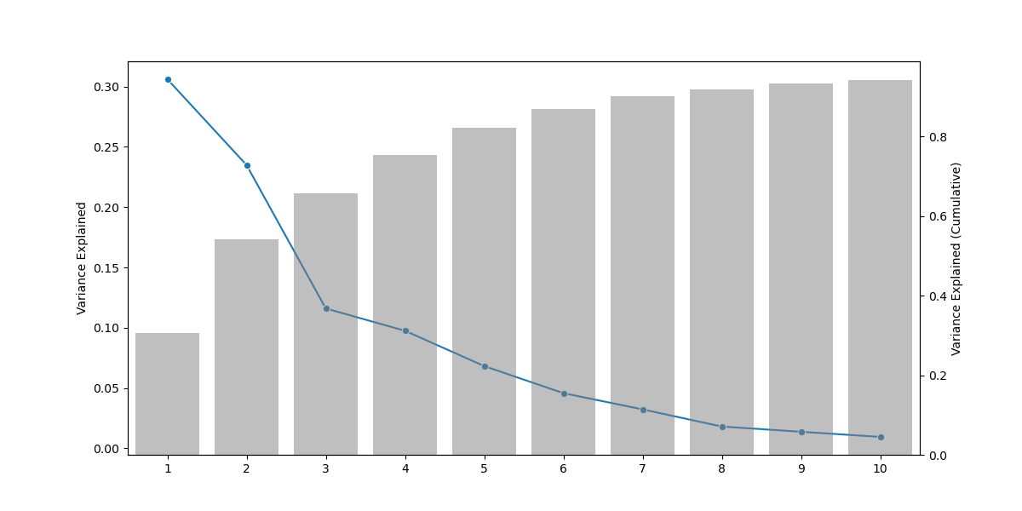
Principal Component Analysis
94% after 10 PC’s!

Slide 8
Results

Slide 9
Unstandardized Data
Forms our baseline: 72.0%, 2.2min
Depending on use, problematic class performance
Class | Precision | Recall
1 | 71.3% | 70.2%
2 | 75.2% | 80.2%
3 | 69.7% | 79.6%
4 | 65.8% | 44.4%
5 | 50.4% | 3.3%
6 | 47.7% | 28.3%
7 | 74.1% | 58.2%
Measure | Value
Training F₁ | 71.7%
Test F₁ | 72.0%
Run Time | 2.167 min
Ouch!

Slide 10
Standardized Data
Identical (to 3 decimal places) training and test score
Near identical training time (not including preprocessing)
Class Precision and Recall within a few 10ths of a percent
Class | Precision | Recall
1 | 71.3% | 70.2%
2 | 75.2% | 80.2%
3 | 69.7% | 79.6%
4 | 65.8% | 44.0%
5 | 50.8% | 3.4%
6 | 47.8% | 28.4%
7 | 74.4% | 58.2%
Measure | Value
Training F₁ | 71.7%
Test F₁ | 72.0%
Run Time | 2.201 min

Slide 11
PCA Transformed Data
Slight decrease in Train, Test F₁
Noticeable speed-up in training time
Deterioration in certain classes
Class | Precision | Recall
1 | 68.4% | 69.7%
2 | 73.6% | 78.8%
3 | 65.6% | 73.7%
4 | 67.1% | 25.6%
5 | 0.0% | 0.0%
6 | 40.7% | 21.7%
7 | 64.2% | 33.9%
Measure | Value
Training F₁ | 69.0%
Test F₁ | 69.2%
Run Time | 0.450 min
Mega Ouch!

Slide 12
Conclusion
Unstandardized vs Standardized:
Almost identical results
Both have (7 x 61) model coefficients
Unstandardized vs PCA Transformed
Decrease in model performance (3.9%)
Decrease in model training time (-79%)
Reduction to (7 x 11) model coefficients
Less interpretable coefficients

Slide 13
Appendix

Slide 14
Unstandardized Data - Confusion Matrix
Predicted
 | 1 | 2 | 3 | 4 | 5 | 6 | 7
1 | 29,847 | 11,834 | 13 | 0 | 3 | 14 | 793
2 | 10,312 | 45,624 | 542 | 1 | 32 | 326 | 38
3 | 0 | 686 | 5,688 | 111 | 16 | 636 | 0
4 | 1 | 1 | 231 | 244 | 0 | 74 | 0
5 | 12 | 1,725 | 41 | 0 | 61 | 17 | 0
6 | 0 | 800 | 1,641 | 15 | 9 | 975 | 0
7 | 1,674 | 31 | 0 | 0 | 0 | 0 | 2,372
Actual

Slide 15
Standardized Data - Confusion Matrix
Predicted
 | 1 | 2 | 3 | 4 | 5 | 6 | 7
1 | 29,859 | 11,834 | 13 | 0 | 3 | 15 | 789
2 | 10,316 | 45,622 | 539 | 1 | 34 | 326 | 37
3 | 0 | 686 | 5,667 | 111 | 16 | 637 | 0
4 | 0 | 1 | 233 | 242 | 0 | 74 | 0
5 | 12 | 1,723 | 41 | 0 | 63 | 17 | 0
6 | 0 | 799 | 1,642 | 14 | 8 | 977 | 0
7 | 1,672 | 31 | 0 | 0 | 0 | 0 | 2,374
Actual

Slide 16
PCA Transformed Data - Confusion Matrix
Predicted
 | 1 | 2 | 3 | 4 | 5 | 6 | 7
1 | 26,629 | 12,084 | 12 | 0 | 0 | 16 | 763
2 | 11,072 | 44,810 | 634 | 0 | 9 | 343 | 7
3 | 0 | 1,194 | 5,247 | 48 | 0 | 628 | 0
4 | 0 | 11 | 316 | 141 | 0 | 82 | 0
5 | 2 | 1,817 | 17 | 0 | 0 | 20 | 0
6 | 0 | 903 | 1,769 | 21 | 0 | 747 | 0
7 | 2,622 | 73 | 0 | 0 | 0 | 0 | 1,382
Actual

