Slide 1


SMART INDIA HACKATHON 2026
Explainable AI for Diabetic Retinopathy Screening in Rural India
Problem Statement ID – SIH26038
Problem Statement Title-
Explainable AI for Diabetic Retinopathy Screening in Rural India
Theme- MedTech/BioTech/HealthTech
PS Category- Software
Team Name - Arctic

Slide 2
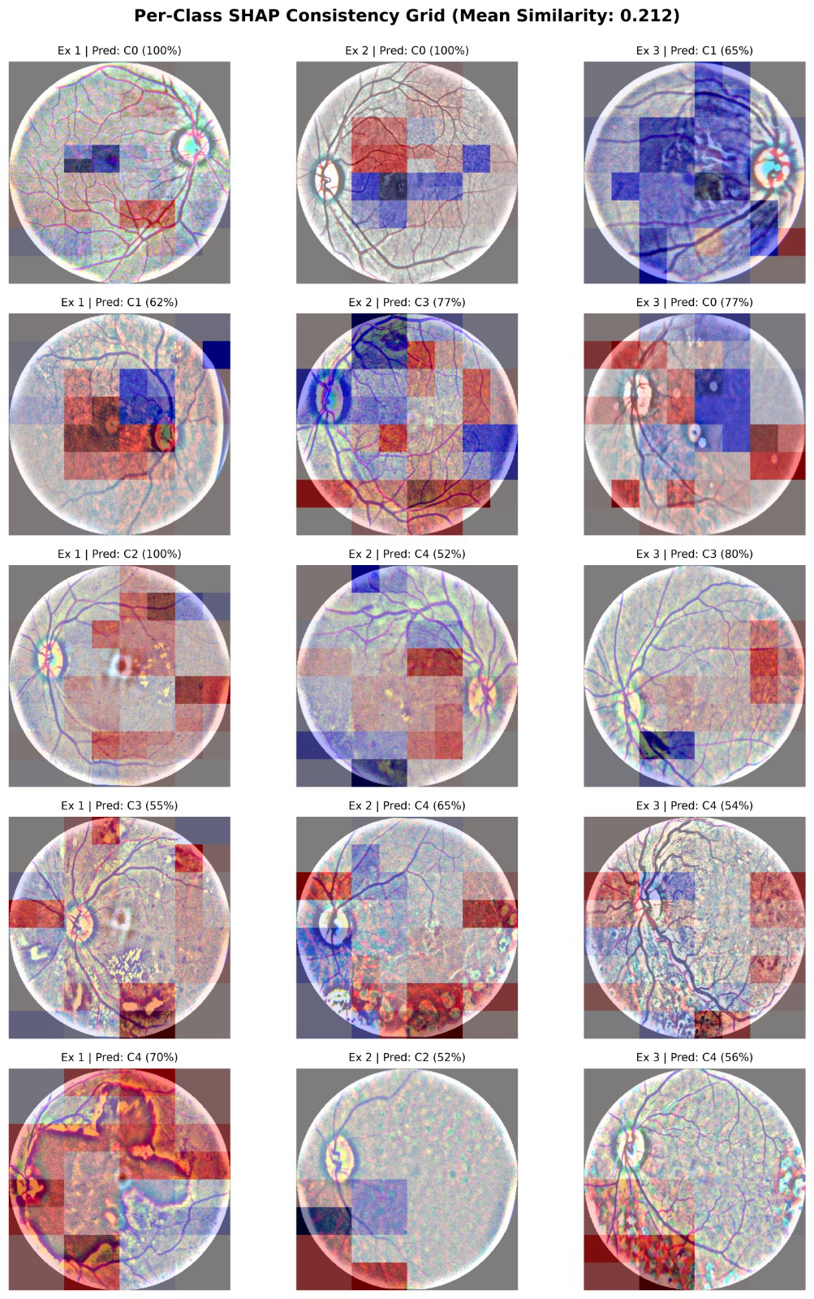
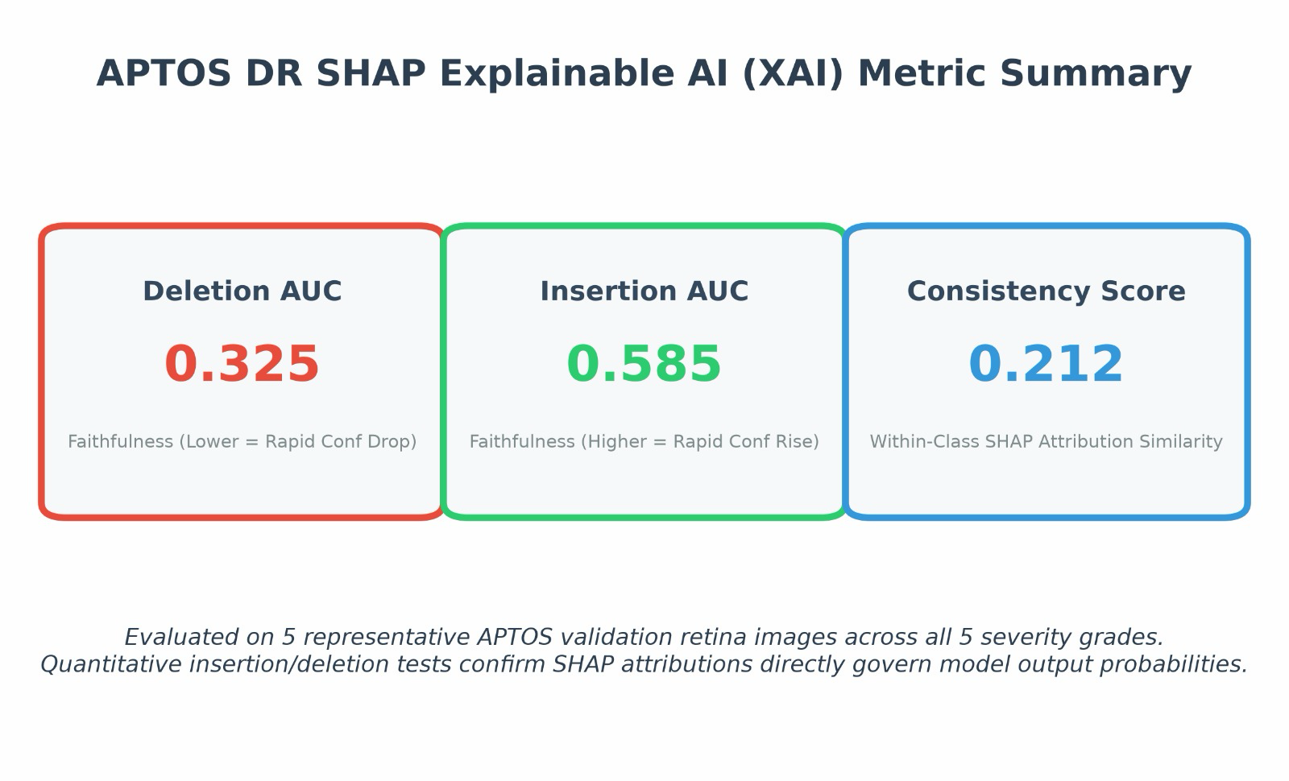
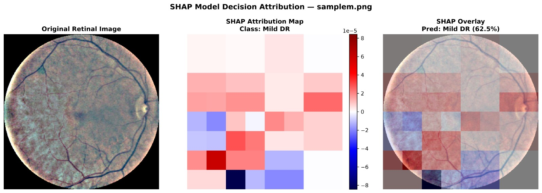
PROPOSED SOLUTION
ARCTIC
Explainable AI (XAI) Pipeline
SHAP: Game-theoretic attribution — quantifies how much each region influenced the decision
Sign Alignment: Red regions support the diagnosis; Blue regions push against it
Faithfulness: Validated via Deletion/Insertion AUC — confirms explanations aren't cosmetic
Consistency: Same-grade images show matching attribution patterns (cosine similarity check)
Transparency: Failure cases show explanations for both predicted and true class
APTOS XAI Metric Summary
SHAP Consistency Grid
SHAP Model Desicion Attribution
2

Slide 3



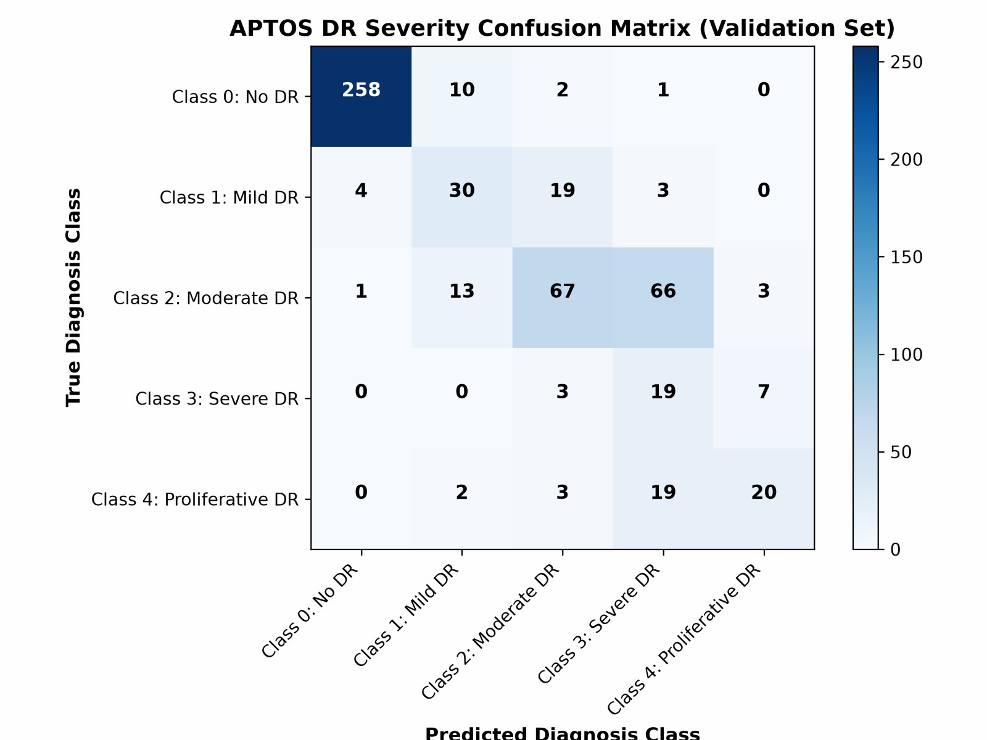
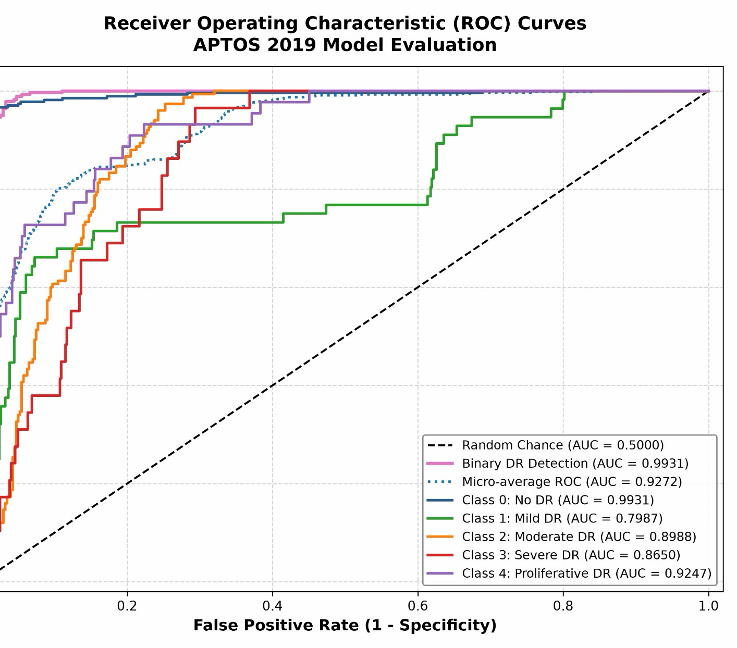
TECHNICAL APPROACH
ARCTIC
Fundus Image Input
Ben Graham Preprocessing
Swin-Tiny Transformer (384x384)
Test-Time Augmentation (3 views)
Ordinal Regression Output
(QWK-Optimized)
Training Strategy
Ordinal Regression (MSE Loss): optimizes Quadratic Weighted Kappa directly to penalize large grading errors more than adjacent mistakes.
Optimizer & Learning Rate: AdamW optimizer (LR = 1e-4) with cosine decay scheduling.
Regularization: Dropout, Batch Normalization, and Early Stopping to rigorously prevent overfitting.
Data Integrity: Strict train/test split with zero image overlap to avoid data leakage.
Generalization: Multi-source validation ensures models generalize and do not overfit to a single population.
Model Performance Metrics
Confusion Matrix
ROC Curve
1

Slide 4
FEASIBILITY AND VIABILITY
ARCTIC
Economic Feasibility
Technical Feasibility
Swin Transformer (Tiny) Backbone
384×384 High-Resolution Input
Ben Graham Retinal Crop
Contrast Enhancement
Ordinal Regression (MSE Loss, QWK-Optimized)
Test-Time Augmentation
Federated Learning — ethnicity/country-independent generalization
Parameter | RSG-Net System
Model Complexity | Swin Transformer (Tiny)
Input Size | 384×384×3
Batch Size | 64 Images
Processing | ≈23 ms/Batch
AI Throughput | ≈2,783 Images/s*
Maintenance & Safety Feasibility
Batch Normalization
Dropout (0.1)
Data Augmentation
Early Stopping
Learning-Rate Reduction
Specialist Clinical Review
Implementation Viability
Factor | Research Implementation
Dataset | APTOS 2019
Images | ≈3,662
Input | 384×384×3
Optimizer | AdamW
Epochs | 30
Batch Size | 64
Learning Rate | 1e-4
Environmental Viability
Remote / Rural Screening
Reduced Patient Travel
Digital Image-Based Screening
Low Physical Infrastructure
Telemedicine-Enabled Care
Scalable District Deployment
Economic & Operational Viability
Automated DR Screening
Reduced Manual Workload
Faster Initial Triage
Remote Screening Support
Specialist Workload Prioritization
Large-Scale Screening
4

Slide 5
IMPACT AND BENEFITS
ARCTIC
Closes a massive access gap. India's national ophthalmologist-to-population ratio is just 0.9 per 100,000, and some regions have as few as 0.3 per 100,000 — every practicing ophthalmologist is effectively required to examine roughly 3,500 diabetics a year. Automated triage means far more patients get a first-pass screening without needing a specialist physically present.
The problem is only getting bigger. India's diabetic population is projected to grow from 77 million in 2019 to over 134 million by 2045 — a scalable AI screening layer is the only way specialist capacity can keep pace with that curve.
Rural isn't a side case — it's the majority case. 74% of India's population lives in rural areas with limited access to healthcare resources, and 70% of ophthalmologists are concentrated in urban areas — so a screening tool that works off a fundus photo, not a specialist visit, directly targets where the gap is worst.
Explainability is what makes this deployable, not just accurate. A black-box severity score isn't something a rural health worker or referring physician can act on with confidence. Our XAI pipeline — with quantified faithfulness (deletion/insertion AUC) and cross-patient consistency — gives the clinician a visual, verifiable basis for every grading before a patient is referred onward. That's the difference between a model that's accurate in a lab and one a doctor will actually trust enough to use for triage.
Prioritizes scarce specialist time. Faster automated grading of the Class 0–1 (no/mild DR) majority means ophthalmologists spend their limited hours on the smaller pool of Class 2–4 cases that genuinely need them — turning a flat screening queue into a risk-ranked one.

Slide 6
RESEARCH AND REFERENCES
ARCTIC
Eligeti & Ansari (2026) – Diabetic Retinopathy Screening Assistant: an AI-powered retinal fundus analysis system using a CNN-Transformer hybrid architecture. IJCOPE.
Sakthi, Raj & Rao (2025) – Prediction and classification of diabetic retinopathy using Optical Coherence Tomography (OCT) images. IEEE International Conference.
Tajudin, Kipli & Mezlan et al. (2026) – Eye-DR: a mobile application for diabetic retinopathy screening using TFLite model conversion. Journal publication.
Rajalakshmi, Pramod Kumar & Dhara et al. (2025) – Creation of a retinal image database for an automated diabetic retinopathy screening tool in India. Scientific Reports.
Public Dataset Used: APTOS 2019 Blindness Detection Benchmark dataset.
6

