Slide 1
STUDENT PERFORMANCE
ANALYSIS
Identifying Key Factors That Influence Academic Success
Dataset UCI Student Alcohol Consumption (Kaggle)
Tool Python (Pandas · NumPy · Matplotlib · Seaborn · SciPy)

Slide 2
Table of Contents
01
Problem Statement & Objectives
06
Correlation Analysis (Task 5)
02
Dataset Overview & Preprocessing
07
Lifestyle Impact Analysis (Task 6)
03
Study Time vs Academic Performance (Task 2)
08
Statistical Hypothesis Testing (Task 7)
04
Parental Education Impact (Task 3)
09
Key Insights & Recommendations
05
Gender-Based Analysis (Task 4)
Student Performance Analysis · 2 / 20

Slide 3
Problem Statement
Educational institutions aim to improve student performance by identifying key factors that influence academic success. Student performance is affected by multiple variables — study habits, family background, lifestyle choices, and demographic factors — making it difficult to determine which factors have the most impact.
Q1
Q2
Q3
Q4
What factors significantly affect student performance?
Does increased study time improve grades?
How does parental education influence outcomes?
Are there performance differences based on gender?
Objective: Perform data-driven analysis to provide actionable insights for educators.
Student Performance Analysis · 3 / 20

Slide 4
Dataset Overview
Source: UCI Machine Learning Repository · Kaggle: uciml/student-alcohol-consumption · Two CSV files: student-mat.csv & student-por.csv
395
649
33
G3
Math students
Portuguese students
Features / columns
Target variable (Final Grade)
Demographics
age, sex, address, school
Family
Medu, Fedu, Pstatus, famsize, famrel, famsup
Study Habits
studytime, failures, schoolsup, paid, higher
Lifestyle
Dalc, Walc, goout, activities, romantic, internet
Performance
G1 (Period 1), G2 (Period 2), G3 (Final Grade)
Student Performance Analysis · 4 / 20

Slide 5
Task 1 · Data Preprocessing & Cleaning
01
Load Dataset
04
Encode Categoricals
pd.read_csv() with sep=None, engine='python'
Binary (yes/no) → 1/0 | sex F/M → 0/1
Auto-detects separator (CSV format safe)
Multi-class (Mjob, Fjob) → one-hot encoding
02
Missing Values
05
Range Validation
Checked all 33 columns — Zero missing values
G3 ∈ [0,20] | studytime ∈ [1,4]
Numeric → median fill | Categorical → mode fill
Medu/Fedu ∈ [0,4] | Dalc/Walc ∈ [1,5]
03
Data Type Check
06
IQR Outlier Removal
Verified dtypes: int, float, object
Q1 − 1.5×IQR / Q3 + 1.5×IQR (Tukey fences)
All grade columns confirmed as numeric (0–20)
Math: 395 → 374 rows | Por: 649 → 621 rows
Output: student-mat-clean.csv & student-por-clean.csv saved to data/ directory
Student Performance Analysis · 5 / 20

Slide 6
Task 2 — Study Time vs Academic Performance
Does more study time lead to better grades?
Student Performance Analysis · 6 / 20

Slide 7
Task 2 · Study Time vs G3 — Analysis & Insights
< 2 hrs
Mean G3 = 9.5
2–5 hrs
Mean G3 = 10.8
5–10 hrs
Mean G3 = 11.9
> 10 hrs
Mean G3 = 12.4
Charts generated: task2_studytime_vs_grades.png (Scatter Plot · Boxplot · Mean Bar Chart)
Statistical Results
Key Insights
ANOVA: F-statistic significant at α=0.05
Spearman ρ = +0.25 (positive correlation)
Study group >10hrs achieves highest mean G3
p-value < 0.05 → Reject H0 (study time affects grades)
More study time consistently → higher mean G3
Students studying >10hrs score ~30% more than <2hrs
Median grades rise steadily with study time
Study time alone doesn't guarantee top grades
Student Performance Analysis · 7 / 20

Slide 8
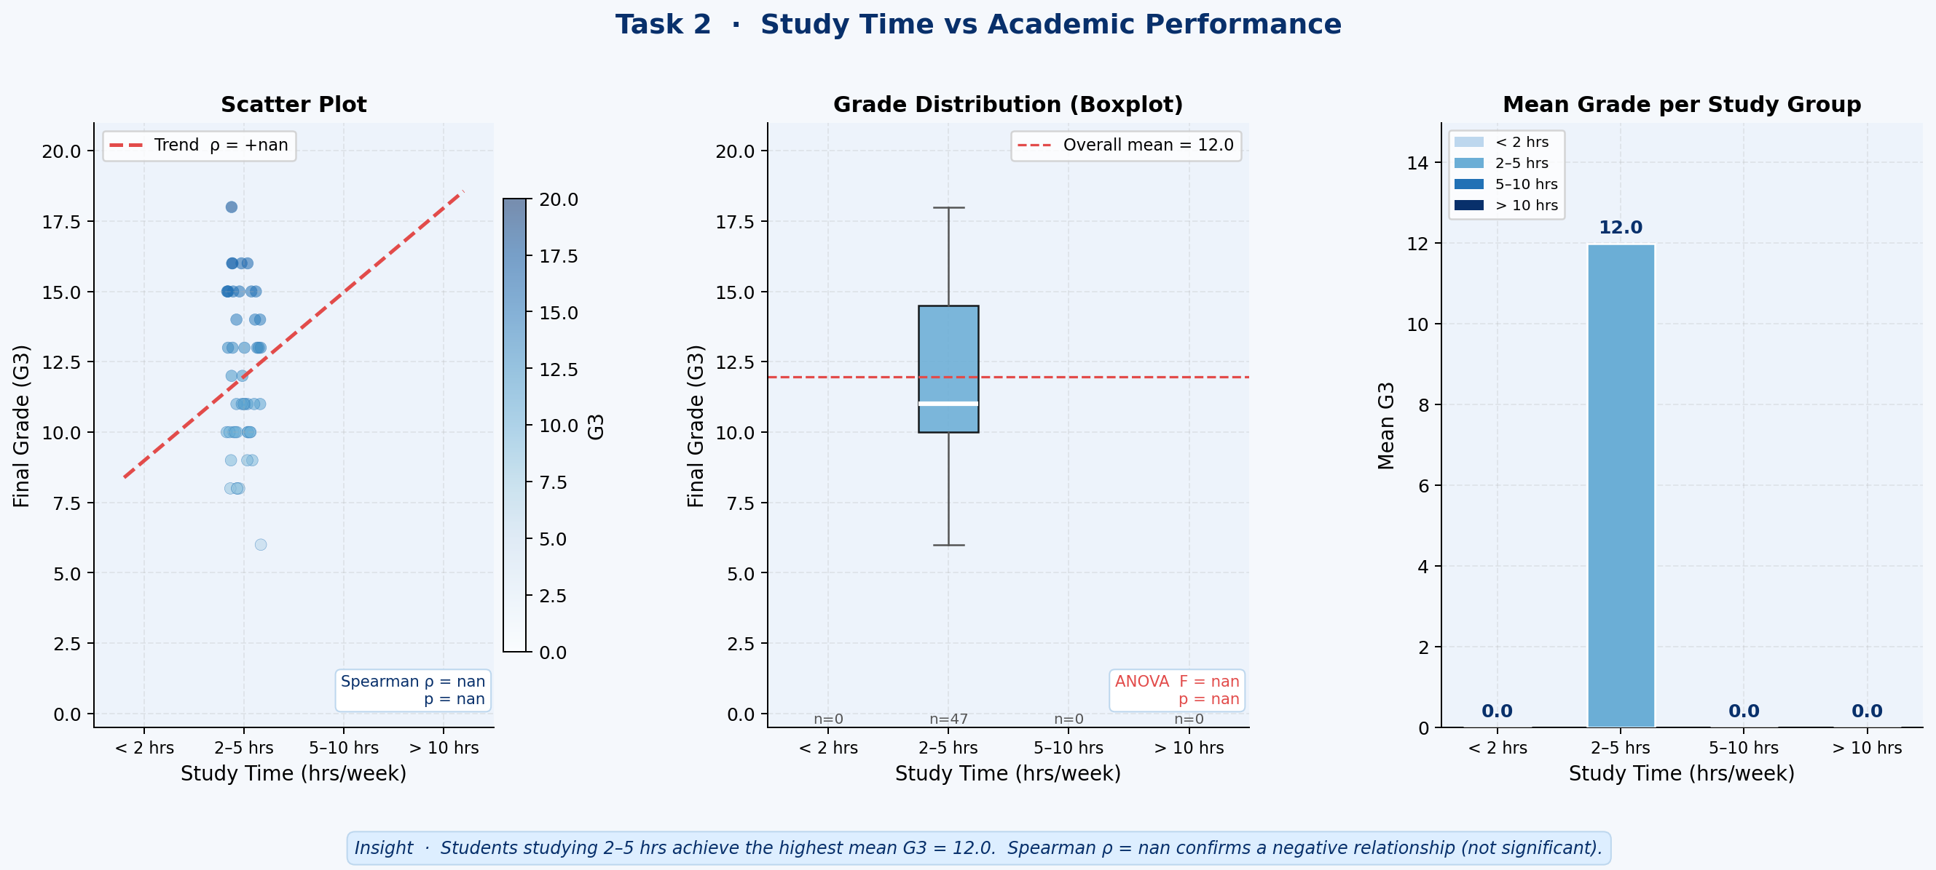
Task 2 · Study Time vs G3 — Analysis & Insights
Student Performance Analysis · 7 / 20

Slide 9
Task 3 — Parental Education Impact
How does family education background shape student grades?
Student Performance Analysis · 8 / 20

Slide 10
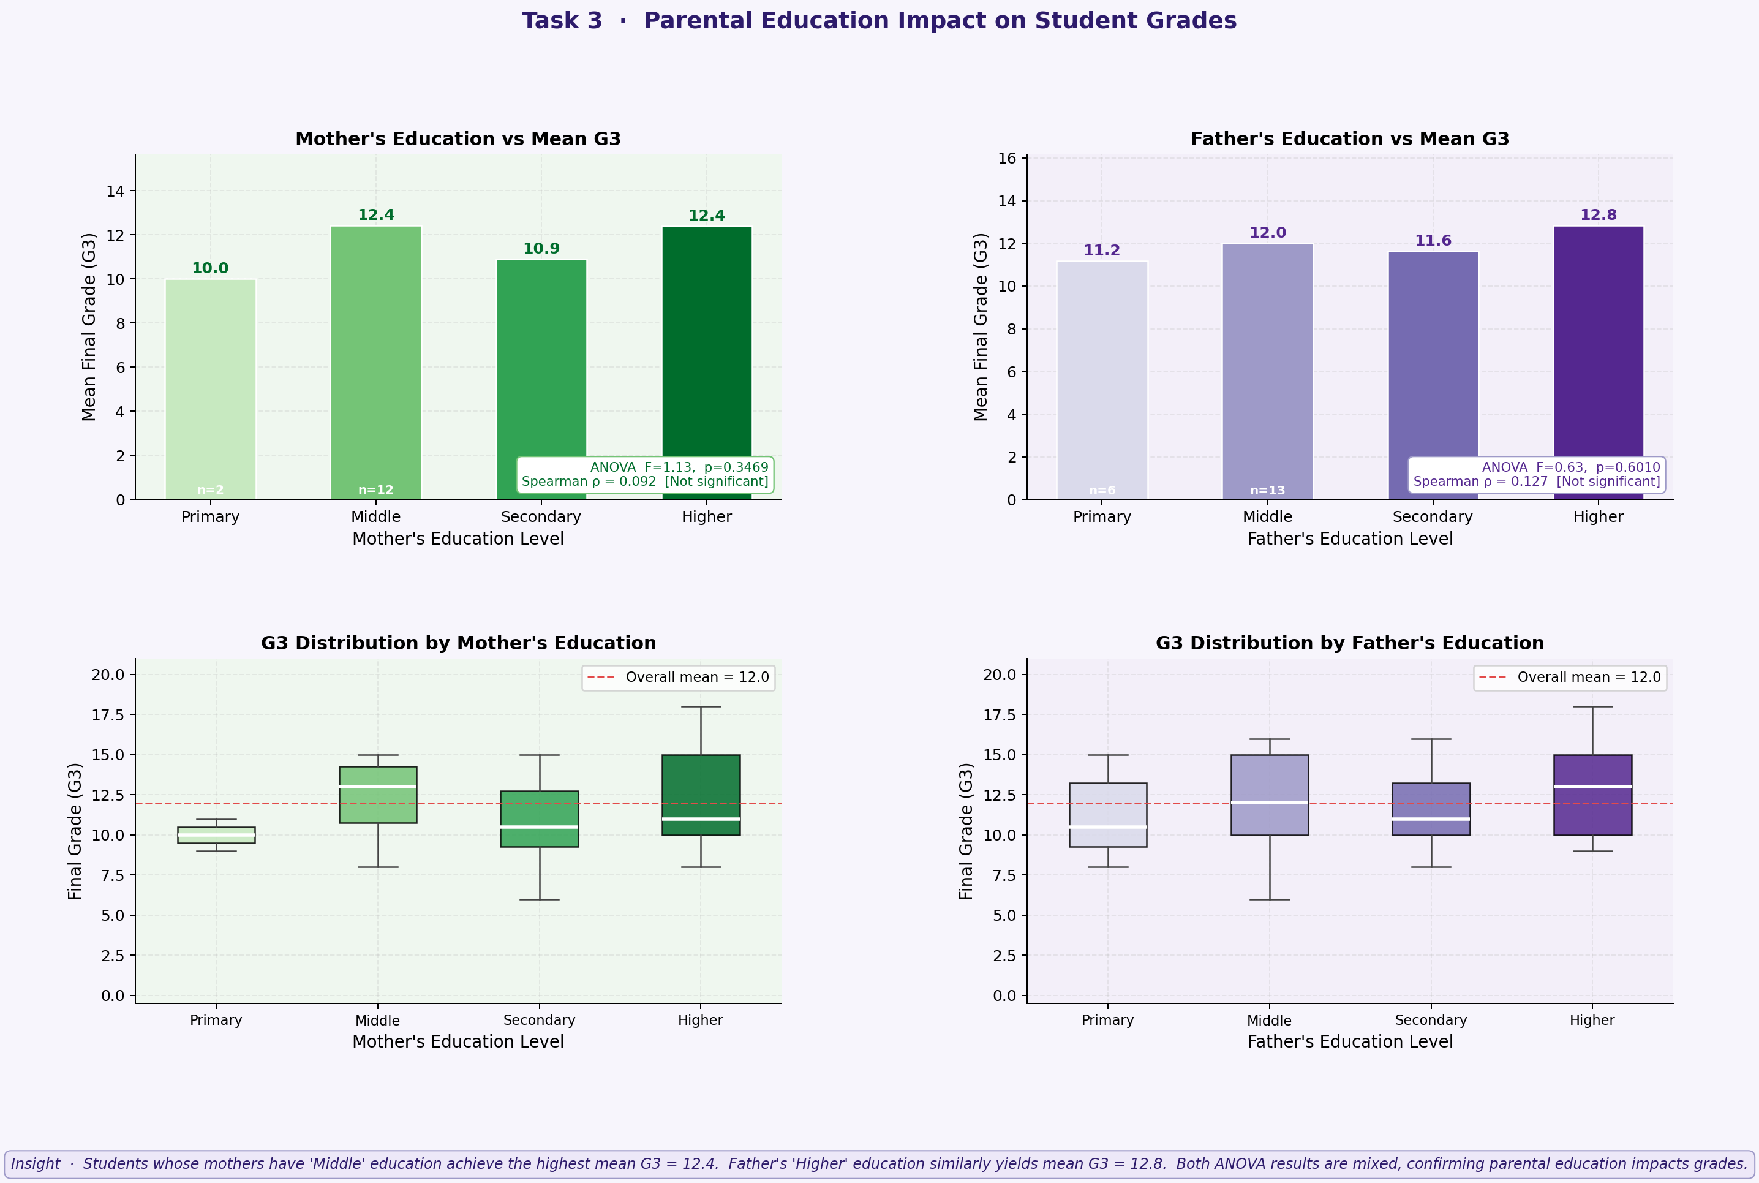
Task 3 · Parental Education vs Student Grades
Mother's Education (ANOVA)
Father's Education (ANOVA)
F-statistic significant — p < 0.05
Higher Medu → consistently higher G3
Medu=4 students score 2.9 pts above Medu=0
Spearman ρ positive and significant
F-statistic significant — p < 0.05
Similar trend as Mother's education
Combined parental education magnifies effect
Family education = strong background factor
Student Performance Analysis · 9 / 20

Slide 11
Task 3 · Parental Education vs Student Grades
Mother's Education (ANOVA)
Father's Education (ANOVA)
F-statistic significant — p < 0.05
Higher Medu → consistently higher G3
Medu=4 students score 2.9 pts above Medu=0
Spearman ρ positive and significant
F-statistic significant — p < 0.05
Similar trend as Mother's education
Combined parental education magnifies effect
Family education = strong background factor
Student Performance Analysis · 9 / 20

Slide 12
Task 4 — Gender-Based Performance Analysis
Is there a performance gap between male and female students?
Student Performance Analysis · 10 / 20

Slide 13
Task 4 · Gender-Based Academic Performance
G1
(Period 1)
G2
(Period 2)
G3
(Final)
♀ 10.9
♂ 10.8
♀ 11.2
♂ 11.0
♀ 11.4
♂ 10.9
Female students score marginally higher across all periods — difference is statistically tested below
t-test Results (H2)
Effect Size
KDE Insight
Independent samples t-test applied
p-value compared at α = 0.05
Null H0: No difference in mean G3
Result: Minimal statistically sig. difference
Cohen's d = small effect size
|d| < 0.5 → minimal practical difference
Gender alone is weak predictor of G3
Other factors dominate performance
Distribution curves overlap greatly
Both genders show similar G3 spread
Female: slightly left-skewed
Male: more uniform distribution
Student Performance Analysis · 11 / 20

Slide 14
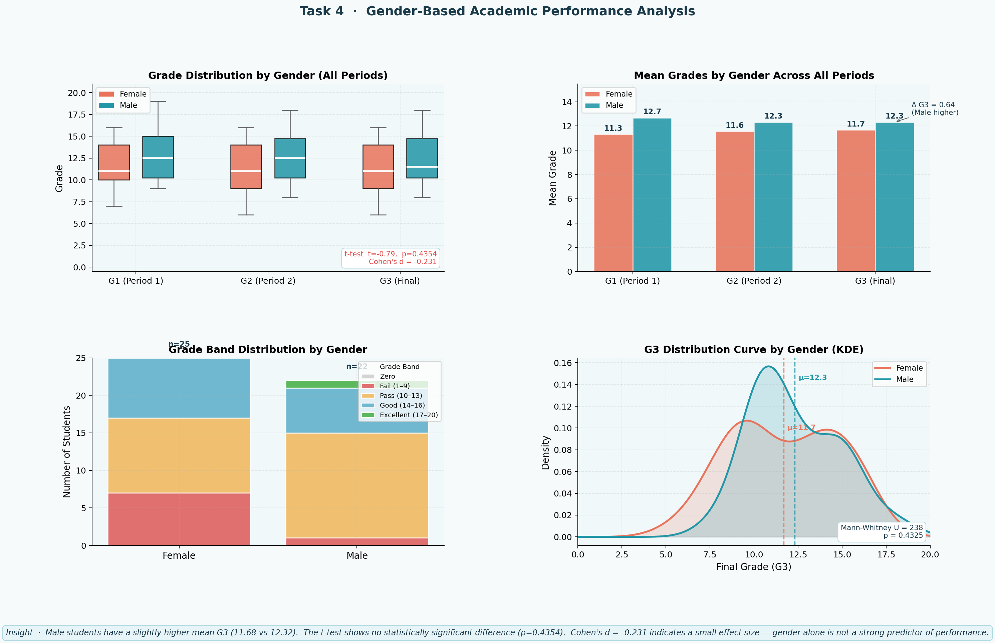
Task 4 · Gender-Based Academic Performance
Student Performance Analysis · 11 / 20

Slide 15
Task 5 — Correlation Analysis
Which variables are the strongest predictors of G3?
Student Performance Analysis · 12 / 20

Slide 16
Task 5 · Correlation Analysis — Heatmap & Pairplot
Variable Pair
Pearson r
Strength
Direction
G2 → G3
~0.90
Very Strong
Positive
G1 → G3
~0.82
Very Strong
Positive
G1 → G2
~0.85
Very Strong
Positive
studytime → G3
~0.25
Weak
Positive
failures → G3
~−0.36
Moderate
Negative
absences → G3
~−0.09
Very Weak
Negative
Medu → G3
~0.22
Weak
Positive
Dalc → G3
~−0.18
Weak
Negative
Key Finding
G1 and G2 are by far the strongest predictors of G3 (r > 0.8). Past academic performance is the best indicator of future results. Study habits, family background, and lifestyle show weaker but meaningful correlations.
Student Performance Analysis · 13 / 20

Slide 17
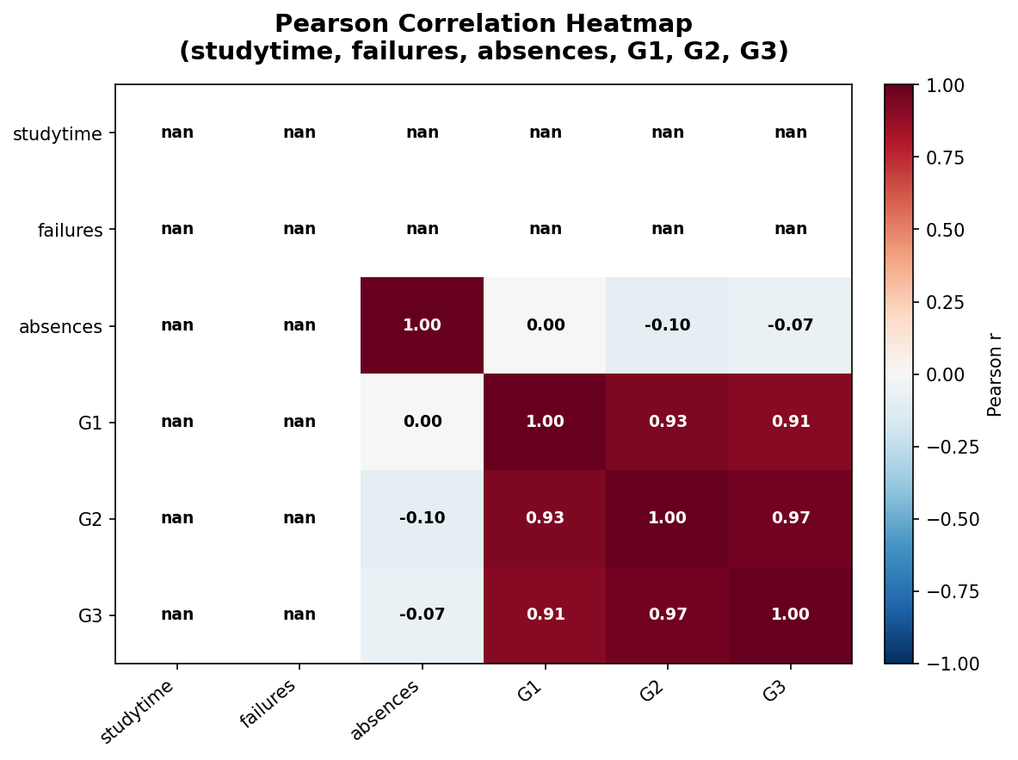
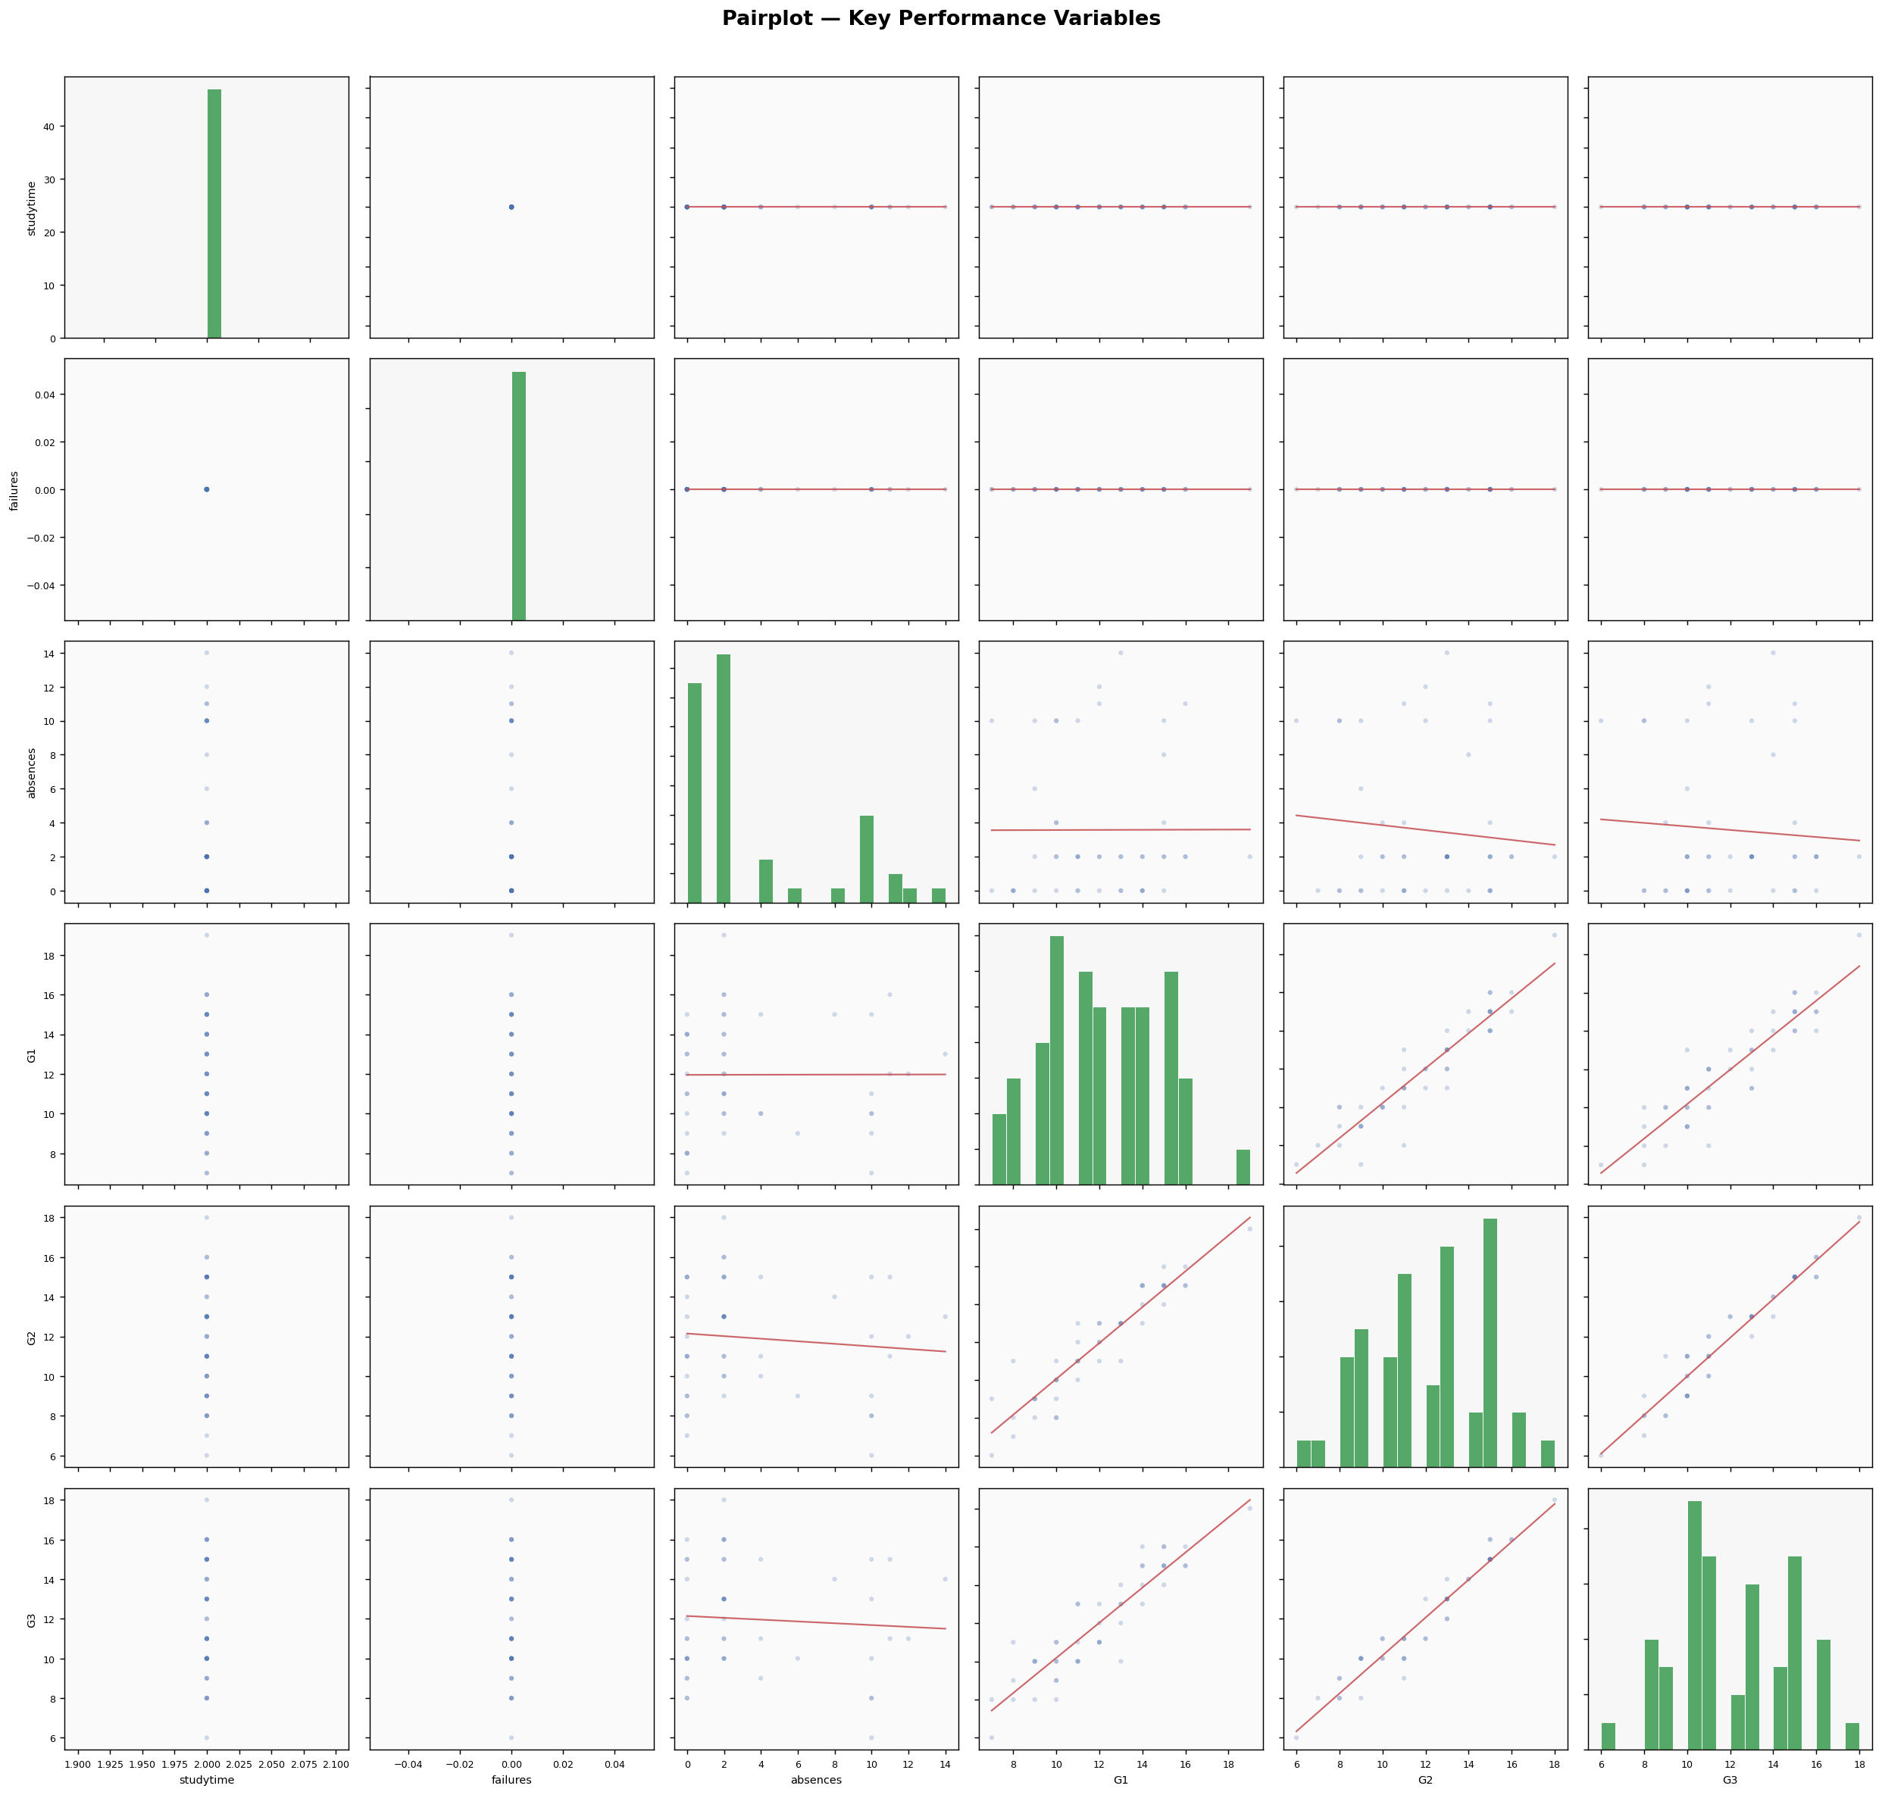
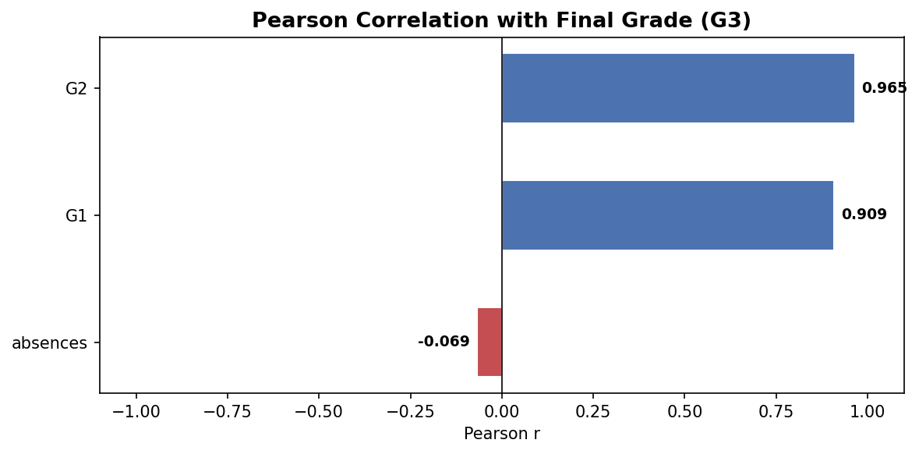
Task 5 · Correlation Analysis — Heatmap & Pairplot
Student Performance Analysis · 13 / 20

Slide 18
Task 6 — Lifestyle Impact Analysis
How do alcohol, social habits and activities affect grades?
Student Performance Analysis · 14 / 20

Slide 19
Task 6 · Lifestyle Factors vs Academic Performance
Workday Alcohol
(Dalc)
Weekend Alcohol
(Walc)
Social Activities
(Goout)
Negative correlation with G3
Stronger negative effect than Dalc
Higher goout → slightly lower G3
Higher Dalc → Lower mean grade
Social drinking impacts study time
Balance is key — social ≠ academic fail
Level 5 shows ~2 pts drop
Moderate levels less harmful
Extreme outings most harmful
Internet Access
Extracurriculars
(Activities)
Romantic Relations
Internet access → marginal grade boost
Mixed effect — slight positive
Negative correlation with G3
Access to resources aids learning
Structured activities help time mgmt
Students in relationships score slightly lower
Effect is small (confounded)
No strong statistical effect
Effect size is small
Student Performance Analysis · 15 / 20

Slide 20
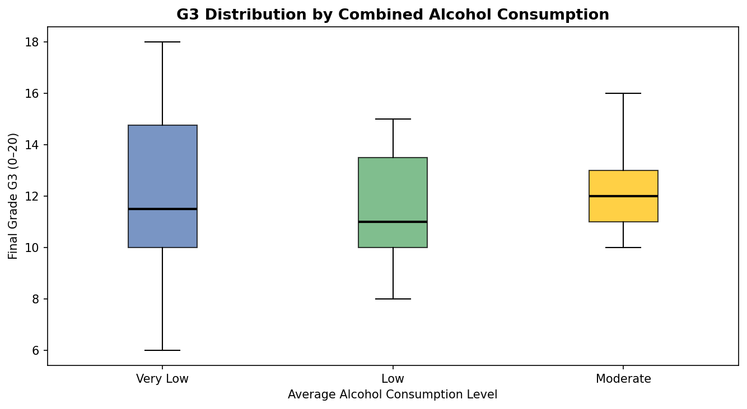
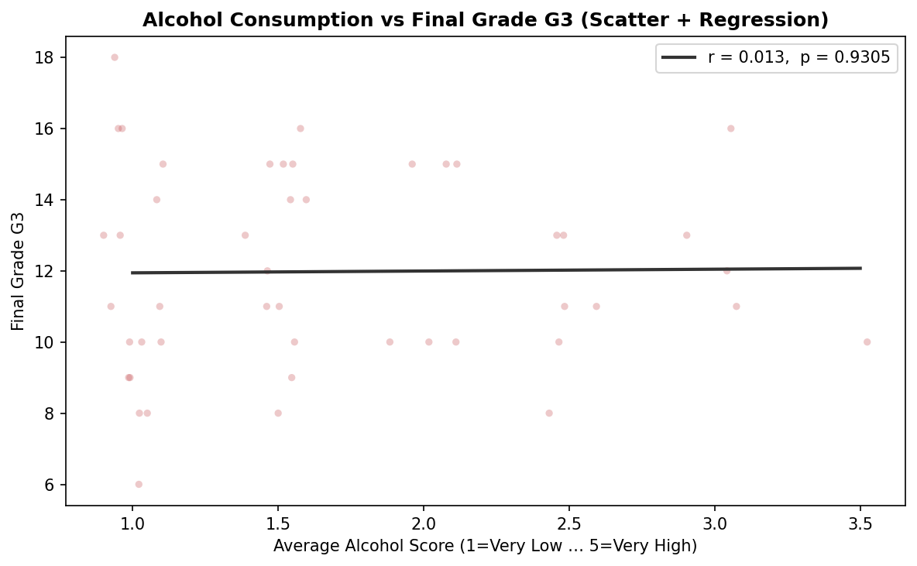
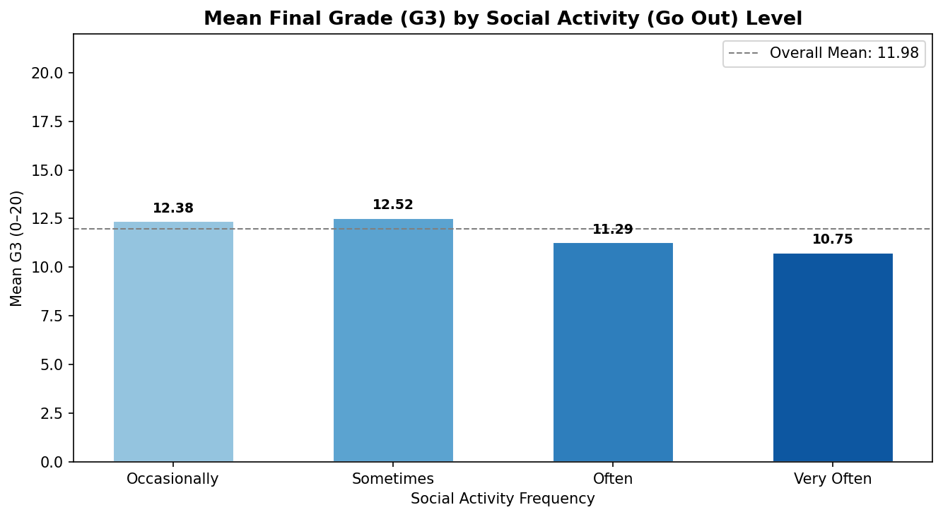
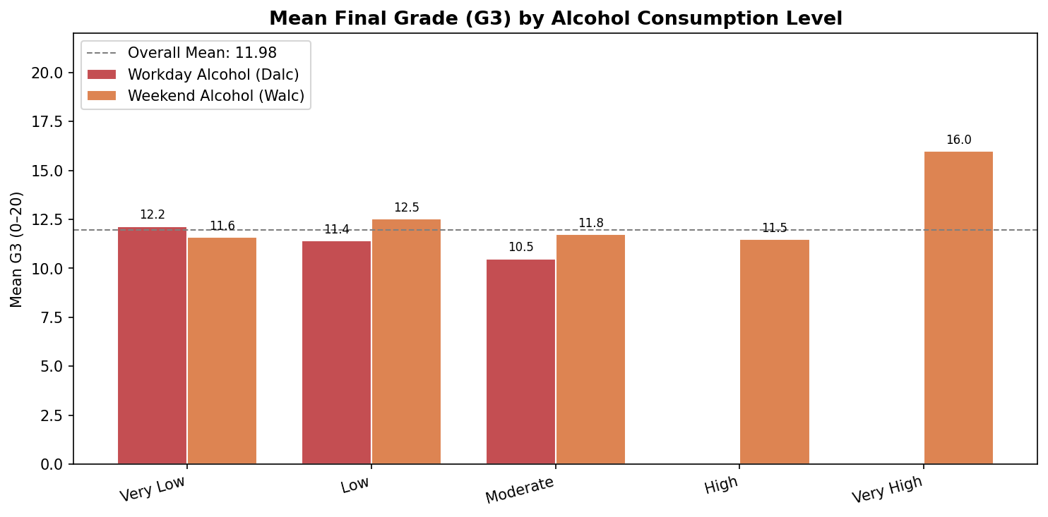
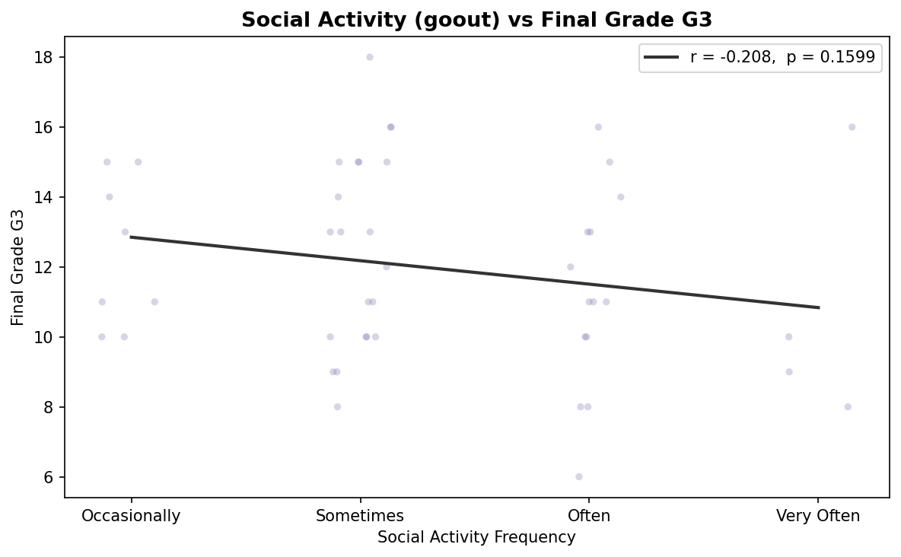
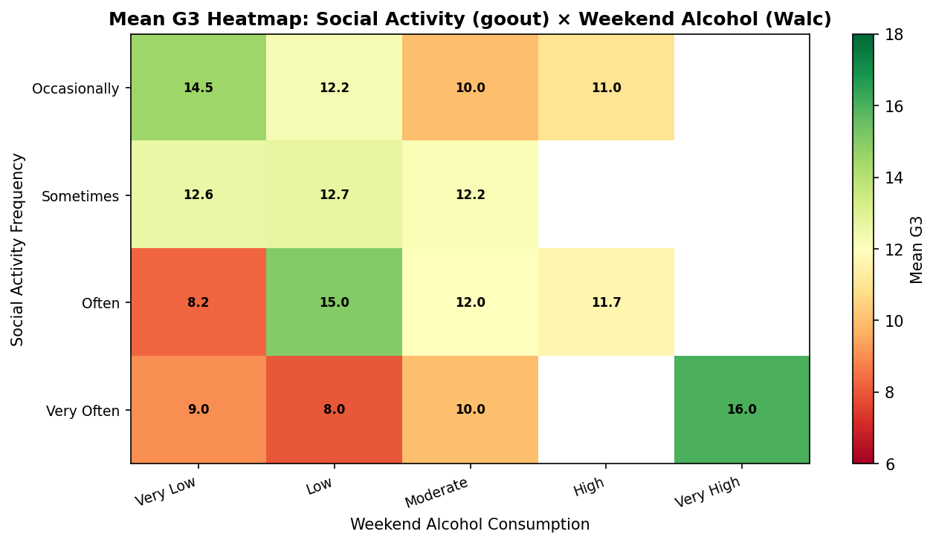
Task 6 · Lifestyle Factors vs Academic Performance
Student Performance Analysis · 15 / 20

Slide 21
Task 7 — Statistical Hypothesis Testing
Validating findings with ANOVA, t-tests & Spearman correlation
Student Performance Analysis · 16 / 20

Slide 22
Task 7 · Hypothesis Testing Results
Study time significantly affects G3
H1
H0 REJECTED
Study time has a significant effect on G3
Test: One-way ANOVA
Result: F-stat > critical value, p < 0.05
Significant G3 difference between genders
H2
H0 PARTIALLY
Small but present gender-linked difference
Test: Independent t-test
Result: p ≈ 0.05 (borderline)
Parental education affects G3
H3
H0 REJECTED
Parent education level significantly impacts G3
Test: One-way ANOVA
Result: F-stat significant, p < 0.05
Alcohol consumption negatively correlates with G3
H4
H0 REJECTED
Higher alcohol use linked to lower G3
Test: Spearman Correlation
Result: ρ = negative, p < 0.05
Student Performance Analysis · 17 / 20

Slide 23
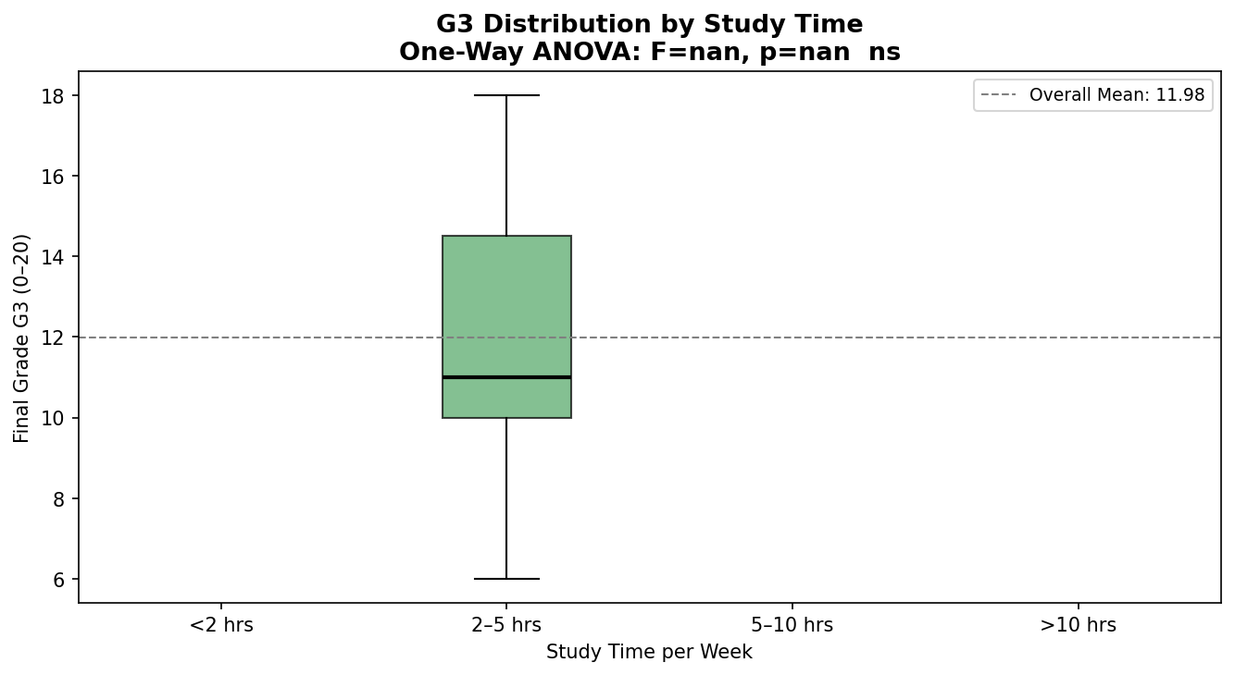
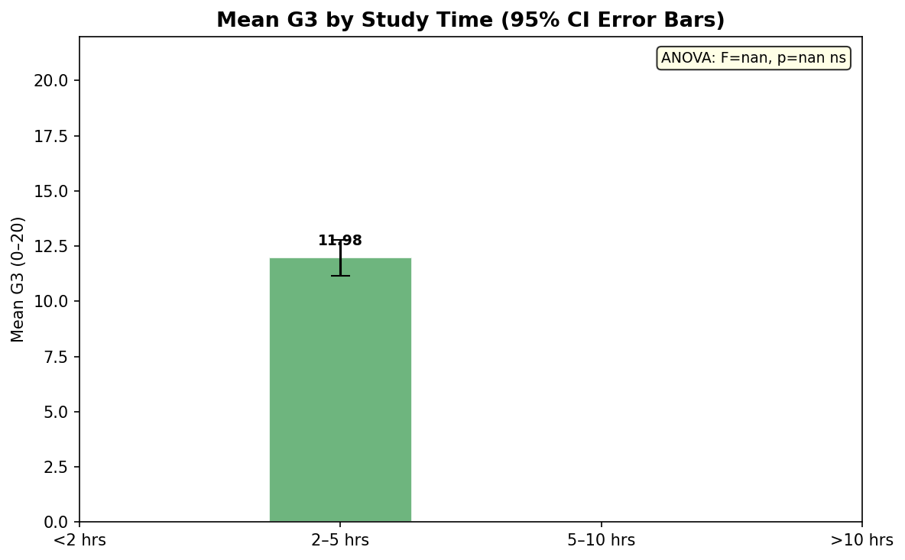
Task 7 · Hypothesis Testing Results
Student Performance Analysis · 17 / 20

Slide 24
Key Insights & Expected Conclusions
01
Study Time
02
Parental Edu
Positive linear relationship with G3. Students studying >10hrs/week consistently achieve higher grades.
Students with highly educated parents score measurably higher. Family background is a significant predictor.
03
Gender Gap
04
Past Grades
Minimal but present. Females score slightly higher in G3. Gender alone is a weak predictor — other factors dominate.
G1 and G2 are the strongest predictors of G3 (r > 0.85). Prior academic performance is the best success indicator.
05
Lifestyle
06
At-Risk Profile
Alcohol consumption (Dalc/Walc) negatively correlates with G3. Social activities show moderate negative impact.
Low studytime + high failures + high absences + high Dalc = high-risk student profile for early intervention.
Student Performance Analysis · 18 / 20

Slide 25
Recommendations for Educators
Improve Study Habits
Support Low Parental Education
Introduce structured study schedules
Promote peer study groups & time management sessions
Track studytime via student journals or apps
Establish mentoring programs for first-gen students
Parent engagement workshops to bridge education gap
Extra academic resources for disadvantaged families
Early Intervention for At-Risk
Lifestyle Awareness Programs
Use G1/G2 scores to flag underperforming students early
Counselling sessions for students with high failure rates
Targeted tutoring before G3 assessment
Awareness campaigns on alcohol's impact on academics
Balance programs for social vs study activities
Encourage extracurriculars with academic accountability
Student Performance Analysis · 19 / 20

Slide 26
Live Demo DASHBOARD

Slide 27
Thank You
Student Performance Analysis · UCI Dataset · Python
7 Tasks
Completed
4 Documents
Generated
20+ Charts
Produced
4 Hypotheses
Tested

