Slide 1
CS 5001 Midterm Review

Slide 2
Disclaimer
Make sure to review the Recitation: Midterm Review module as it contains more details on topics covered in the exam.
Do practice problems!
Review lab problems
Review previous homeworks
Use the IDLE to test single lines of code

Slide 3
Agenda 📋
Test Format
Topics

Slide 4
Format 📝
Multiple Choice
Flowcharts
Understanding & Writing Code

Slide 5
Topics ✍️
What does a computer language do?
What is an algorithm & why is that concept important?
Variables, memory, arithmetic operations, flowcharts
Procedural decomposition
Functions
Conditionals and boolean expressions
Iteration with while loops
Lists, strings and for loops

Slide 6
What does a computer language do? 🧑‍💻
Communicate
Remember things
Repeat things
Make decisions

Slide 7
What is an algorithm? 🤔
Ordered set of unambiguous steps that solve a problem in a finite amount of time
Solve a problem (sorting, counting, searching, etc.)
A finite amount of time (sooner the better!)

Slide 8
Variables, memory, arithmetic operations 💾 🧮
Arithmetic operations - +,-,/,%,//
Variables
global variables
local variables
Constants - PI = 3.14, MAX_RETRIES = 10
Data types
Int – 1,2,3, int("3") -> 3
Str - "hello, world", str(3) -> "3"
Bool – True, False, bool() -> False, bool("") -> False, bool("hello") -> True
Data Structures
List - [1,2,3,4], ["hello", "world"], [[1,2],[3,4]], list((1,2,3)) -> [1,2,3]
Tuple - ('hello', 'world'), tuple()

Slide 9
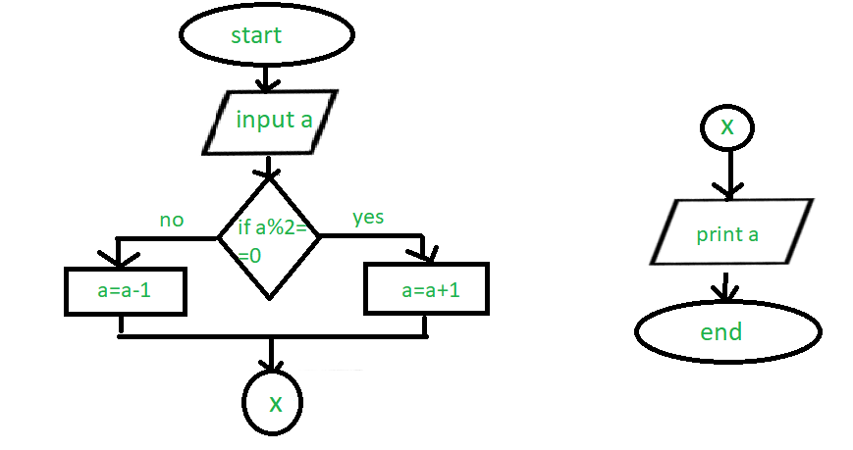
Flowchart
Source: geeksforgeeks

Slide 10
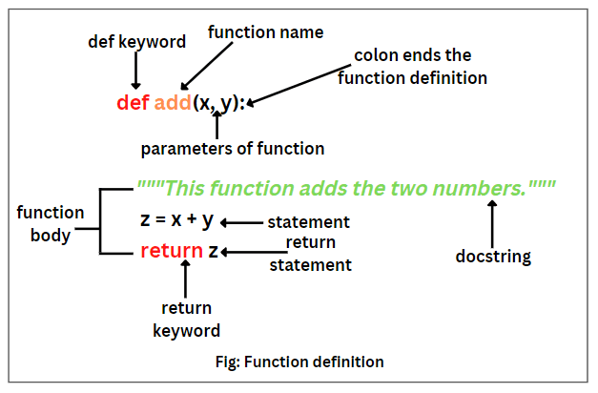
Functions
Source: Science Easy

Slide 11
Pass by Reference vs. Pass by Value
Mutable vs. Immutable Objects
Mutable
Lists
Dictionaries
Sets
Immutable
Strings
Tuples
Numbers (int, floats)
Notes:
Real Python – “Once you’ve created a variable with an assignment statement, then you can access the referenced object throughout your code by using the variable name. If the referenced object is mutable, then you can also perform mutations on it through the variable. Mutability or immutability is intrinsic to objects rather than to variables.”

Slide 12
Conditionals & boolean expressions
Conditionals:
Equals: a == b
Not Equals: a != b
Less than: a < b
Less than or equal to: a <= b
Greater than: a > b
Greater than or equal to: a >= b
Booleans:
and - conjunction
or - disjunction
not - negation
isinstance(True, int) -> True
isinstance(False, int) -> True
int(True) -> 1
int(False) -> 0

Slide 13
Iterations with while loops
while i < number:
while True:
Playing_game = True; while playing_game:

Slide 14
Lists, strings, for loops
Iterating by position
For i in range(len(songs)):
song = songs[i]
Iterating by value
Songs = [["…","…"],["…","…"]]
For song in songs:
For line in song
Mutability

