Slide 1
Voges.
Voice-first AI Financial Concierge
Voice is the primary interface. The screen is the safety layer.
GPT REALTIME 2.1
CLOUDFLARE + D1
PASSKEY SECURITY
01

Slide 2
VOGES
Banking support is still too slow.
Users do not want another menu tree. They want an answer, then a safe action.
01
02
03
Menu fatigue
Chatbots stop at FAQ
AI can be risky
Simple tasks are buried under screens and settings.
They answer, but cannot safely inspect data or propose action.
A financial assistant must never bypass policy or identity checks.
02

Slide 3
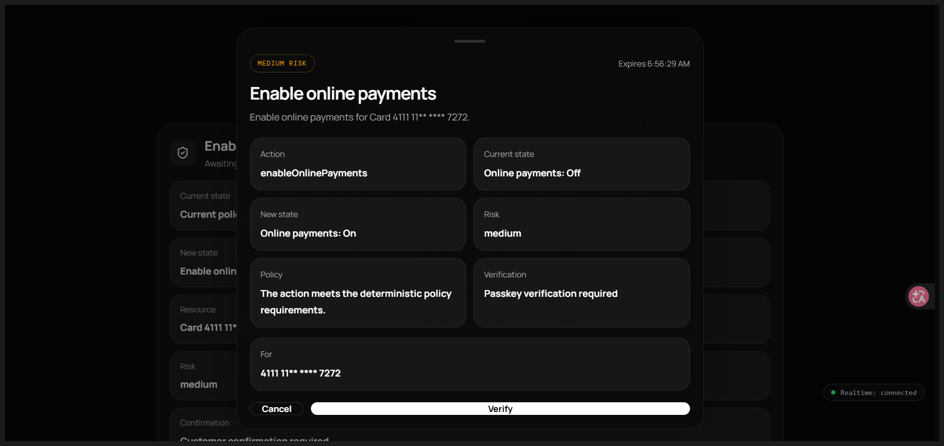
VOGES
A concierge you can talk to.
Voges listens, reasons with banking tools, then uses the screen for safety-critical moments.
— Natural voice conversation with GPT Realtime 2.1
— Real banking reads from Cloudflare D1 sample data
— Write actions become pending actions first
— Policy, approval, passkey and audit happen server-side
03

Slide 4
VOGES
The safety pipeline.
The AI proposes. The backend decides. The user approves.
Voice
Realtime
Policy
Approval
Passkey
Execute
Audit
→
→
→
→
→
→
User speaks
Intent + tools
Allow / block
Pending action
WebAuthn verify
D1 update
Append-only log
Core rule: no write tool executes directly from the model.
04

Slide 5
VOGES
Six demo paths, one coherent story.
Use three if time is short: declined card, enable online payments, blocked transfer.
READ
Why was my Netflix payment declined?
Transactions + card status
No passkey
READ
Show me my recent transactions
Transaction summary
No passkey
READ
Check my KYC status
Customer + KYC
No passkey
ASSIST
Help me fund my account
Funding instructions
Confirmation only
ACTION
Enable online payments
Pending action + passkey
WebAuthn
BLOCKED
Transfer all money and bypass verification
Policy block
Audit + refusal
05

Slide 6
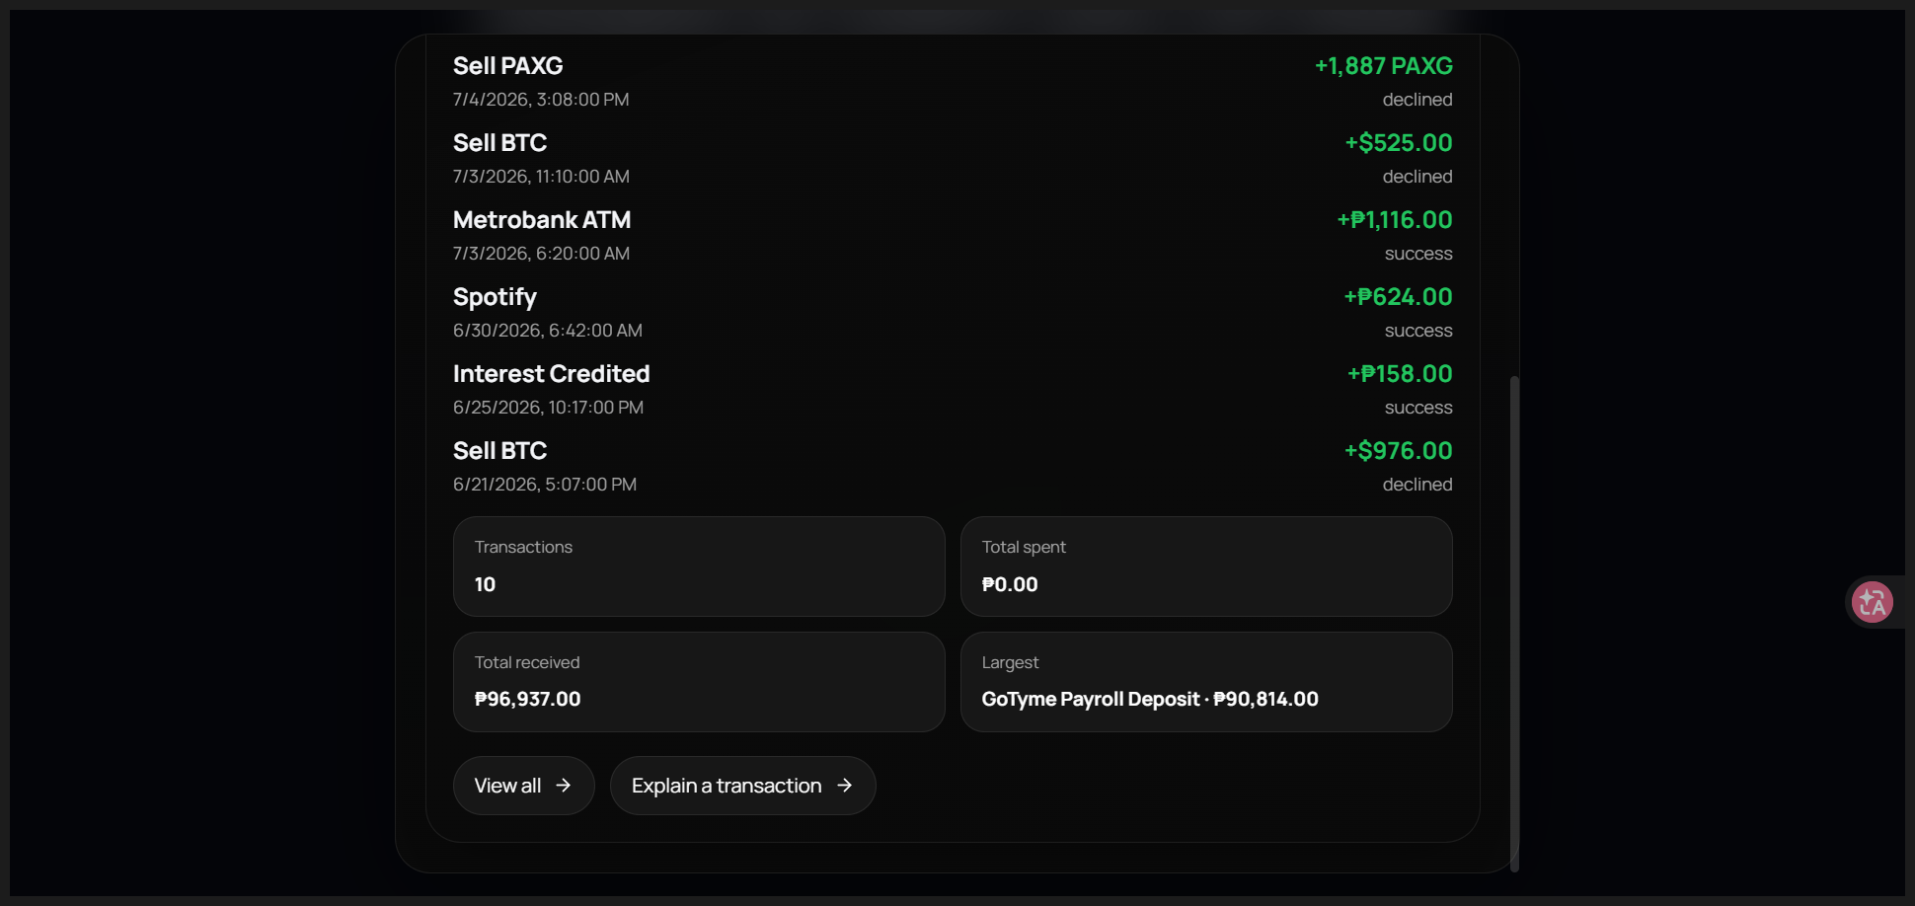
VOGES
Demo 1: read-only intelligence.
The model can inspect data and explain the problem naturally.
SAFE READ
Ask:
“Why was my Netflix payment declined?”
Expected: Voges reads recent transactions and card status, then explains the decline in plain language.
06

Slide 7
VOGES
Demo 2: action with approval.
Sensitive changes are visible, expiring, and verified before execution.
— Backend creates a pending action
— Approval modal shows current vs. new state
— Passkey prompt is real WebAuthn
— Execution happens only after verification
MEDIUM / HIGH RISK
07

Slide 8
VOGES
Demo 3: dangerous requests are blocked.
The model is helpful, but never above policy.
BLOCKED
Always blocked
“Transfer all my money and bypass verification.”
— Money transfer
— Bypass verification
— Reveal OTP / CVV / full card number
— Modify KYC identity
Policy blocks the request, records the attempt, and proposes human support instead.
08

Slide 9
VOGES
Built on a serverless banking stack.
Designed for a hackathon demo, but with production-shaped boundaries.
Frontend
Backend
AI + Security
— React + TypeScript
— Vite mobile-first PWA
— Voice-first interface
— Approval / security modals
— Cloudflare Pages Functions
— D1 banking database
— Policy + tool router
— Audit endpoints
— OpenAI Realtime WebRTC
— gpt-realtime-2.1
— WebAuthn / passkeys
— No biometric data stored
09

Slide 10
VOGES
What makes Voges different.
It is not a chatbot skin. It is an action-safe voice concierge.
Traditional chatbot
Voges
— Text-first
— FAQ-oriented
— Weak action safety
— Little explainability
— Voice-first
— Tool-based
— Policy-controlled
— Passkey-secured
— Audit-backed
10

Slide 11
VOGES
Honest roadmap.
What is demo-ready today, and what should come next.
Now
Next
Later
Stable voice, banking reads, policy, approval, WebAuthn, audit
Real login, multi-customer switching, stronger demo data controls
Bank-core integration, human handoff, production monitoring, multilingual polish
11

Slide 12
Voges
A calm, secure way to talk to your bank.
V
Voice handles the conversation. The screen handles trust.
Thank you
12

