Slide 1
CI\CD implementation Benefits
Hosni Abdelmohsen

Slide 2
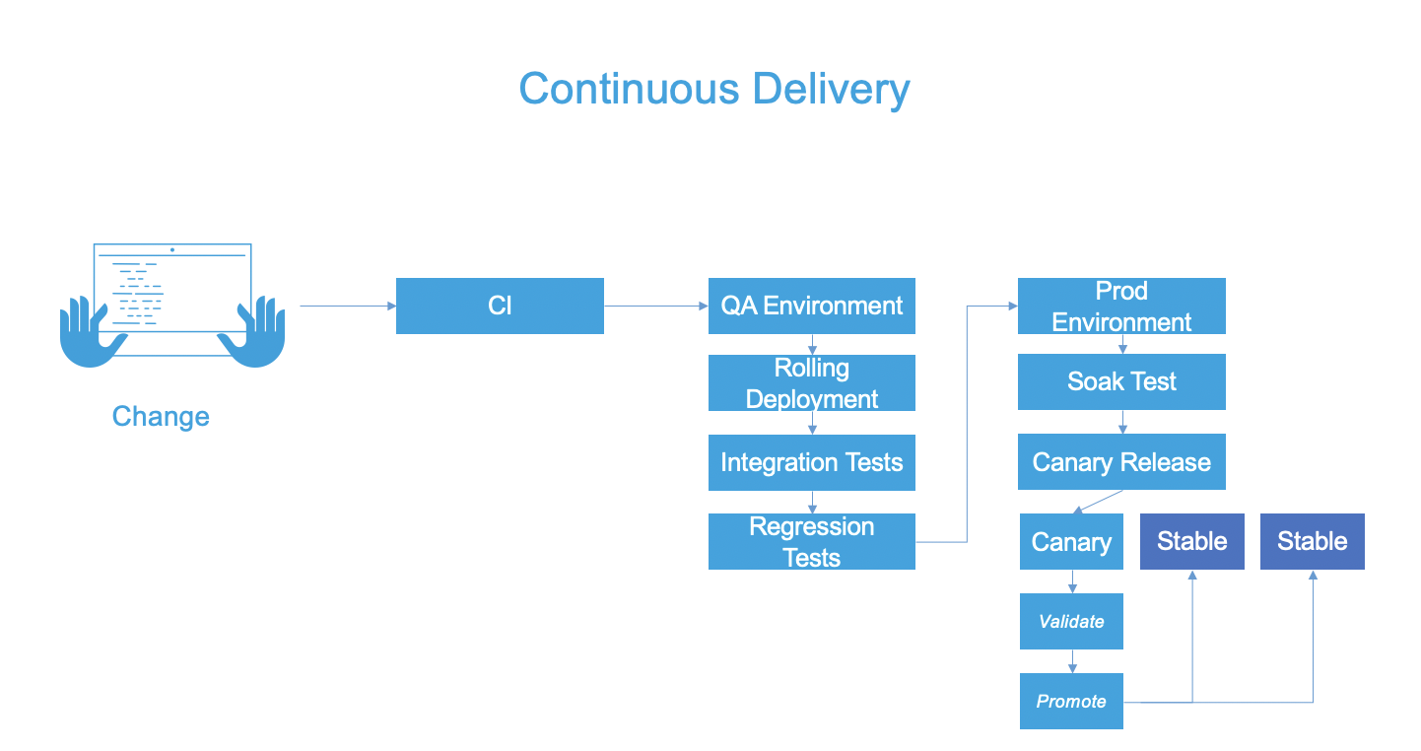
CI\CD Big Picture
Continuous Integration
Continuous Delivery
continuously integrate code into a single shared and easy to access repository.
developers merge code changes in a central repository multiple times a day
CI encourages developers to share their code and unit tests by merging their changes into a repository after every small task completion
changes in code triggers an automated build-and-test sequence, providing feedback to the developer(s) who made the change
step beyond Continuous Integration
automatic releasing of changes from the repository to the production
automation is a key driver of productivity for teams that are doing continuous deployment
D:\learn\nanodegree\third

Slide 3
Benefits Of Investing In CI/CD
Reduce/Avoid Cost
Integrate small pieces of code at one time. These code changes are simpler and easier to handle than huge chunks of code and as such, have fewer issues that may need to be repaired at a later date
Big releases have big costs and big consequences when things go wrong. Keeping deliverables in a release-ready state drives the cost of delivery downward.
Continuous deployment utilizes and leverage quality and fully automate test practices. Better quality means happier customers and lower costs
Applying CI\CD practice implies to less time in the development cycle, which help in giving high chances to meet ambitious time-to-market goals.

Slide 4
Benefits Of Investing In CI/CD
Protect/Increase Revenue
Keep customers happy with fast release of new features and bug fixes.
keeps product up-to-date with the latest technology which allows to gain new customers
Faster build times, more reliable code and tests, and reduced outages all translate to faster delivery to the market and gain more profit
Reducing the MTTR (Mean Time To Resolution), thus keeping deployment failures to a bare minimum and recovering quickly from failures
A stable operating environment and faster resolution to production requirements enable to cement customer loyalty and create great experiences.

