Slide 1
Demographic data analysis of physician fee schedule on insurance
hang yang
Apr-28-2020
Supervised by: dr. plamen petrov, dr. mark boris shapiro, dr. ugo buy
Github repo: hangyang1212/data_analysis_medicaid/

Slide 2
Content
Problem introduction
Data collection
EDA
Weights selection
Calculate weighted physician fee schedule
Conclusion and Discussions

Slide 3
Problem introduction
Why physician fee schedule matters?
In the beginning of every year, CMS will release a drafted physician fee schedule for medical procedures. It is a guideline for medical industry because nobody wants to be driven away by a messy prices medical market. However, each state has their own medical programs which help people to get better health care plan. There could be gaps between the CMS bureau PFS releases and state-owned medical programs. Our goal is to determine a proper and reasonable fee for medical procedures conducted by physicians on their uninsured patients.
Notes:
CMS: U.S. Center of Medicaid and Medicare Services
Example:
Medicaid patient pay a leg surgery by $200
Medicare patient pay for $250
Private insured patient pay for $300, then we can guess that physicians gain between $200 - $300 by their weighted sum.
Uninsured patients: could be no insurance coverage, or limited insurance coverage (which don’t cover certain procedure code)

Slide 4
More on solutions
First , I will give a solution for state level weighted fee schedule which could be applied to newly Medicaid/Medicare expanded states.
Further on, I decide to narrow down geographic administrative unit from state to county to get a county level weighted fee schedule. After consulted with advisors, we believe that research on states Connecticut, Indiana, and New York will be valuable because of their various population size, diversity of insurance coverage, geographic distribution and desired insurance markets.
Notes:
1, Newly Expanded states may not have enough data for research because their database at infant state;
2, However, this also cause some problems when collecting the source data.

Slide 5
Data collection
All state/county census data
All state Medicaid enrollment data
Connecticut/Indiana/New York state county-level enrollment data
All state/county Medicare enrollment data
Connecticut/Indiana/New York Medicaid Fee Schedule data
Connecticut/Indiana/New York Medicare Fee Schedule data

Slide 6

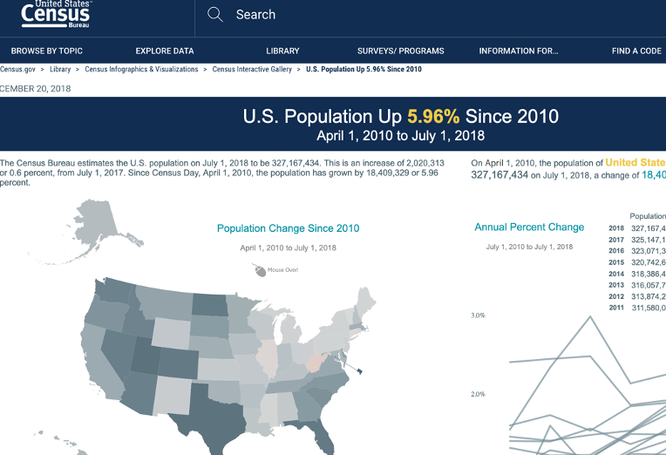
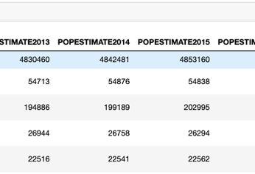
ALL STATE/COUNTY CENSUS DATA
It is downloaded from United States Census Bureau
I select the latest statistics for fiscal year 2018 because mostly the latest statistics data are updated till 2018.
Download link is here

Slide 7
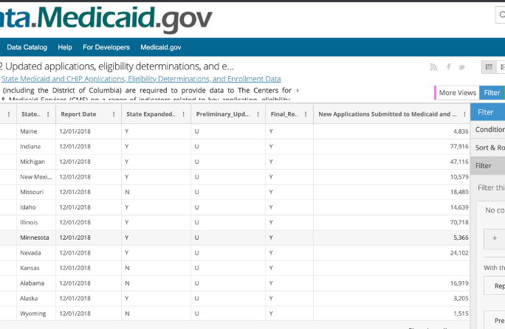
All state Medicaid enrollment data
It is downloaded from United States Center of Medicaid and Medicare Services
To map the census data, I select the updated totals from last month of year 2018.
Download link is here

Slide 8
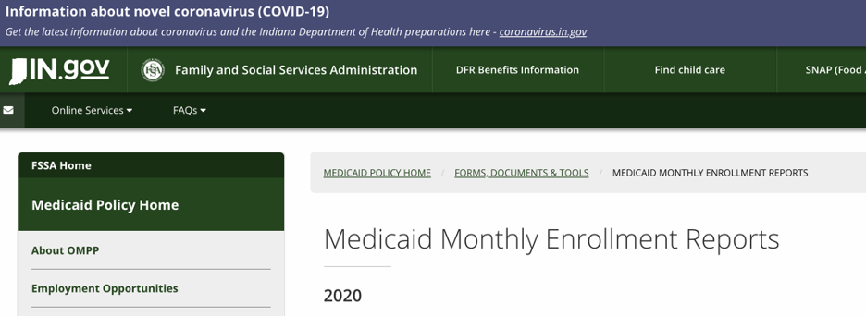
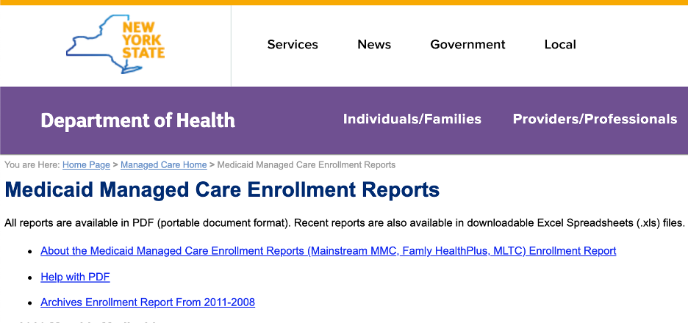
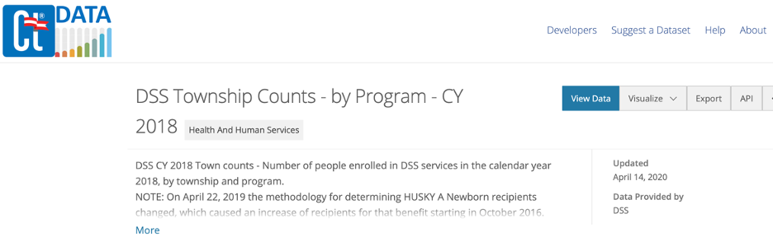
Connecticut/Indiana/New York state county-level enrollment data
It is downloaded from Indiana government Family and Social Services Administration
To map the census data, I select the updated totals from last month of year 2018 for the three states.

Slide 9
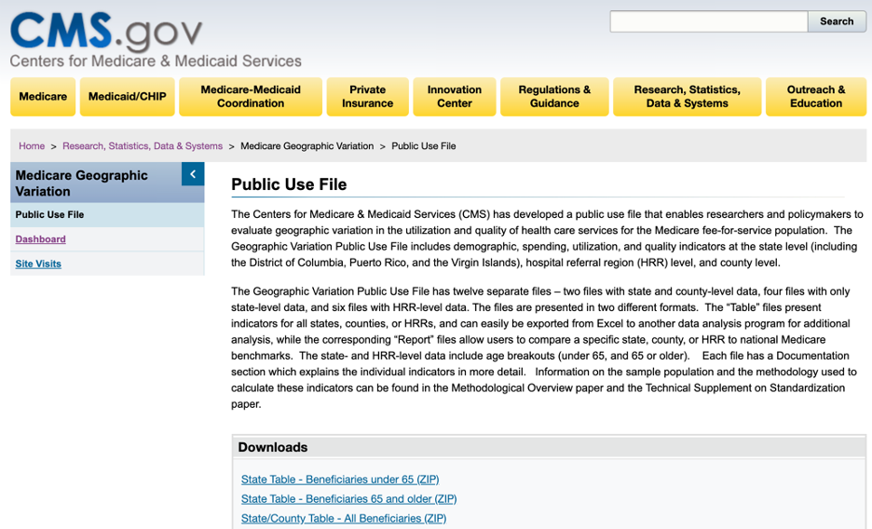
All state/county Medicare enrollment data
It is downloaded from United States Center of Medicaid and Medicare Services
The latest update is till year 2018 which is matched with our census data.
Download link is here

Slide 10
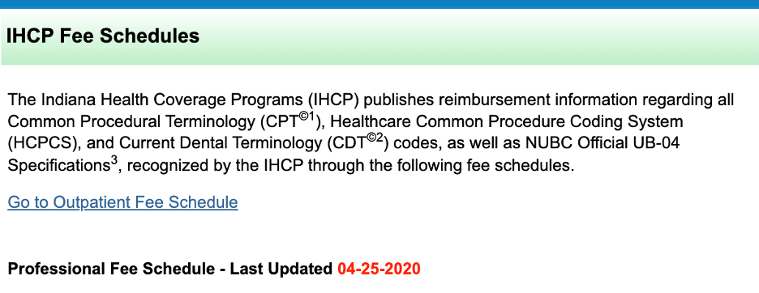
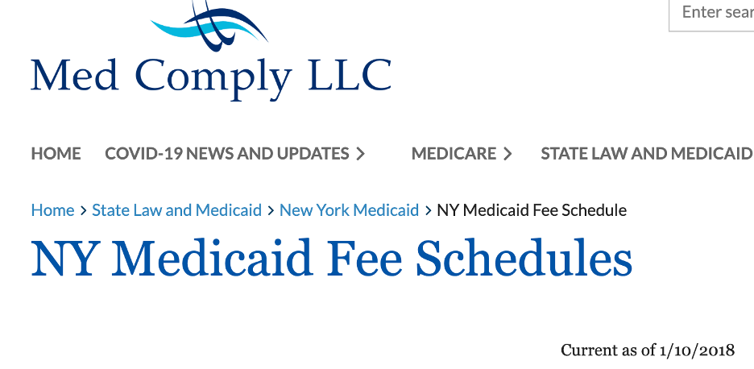
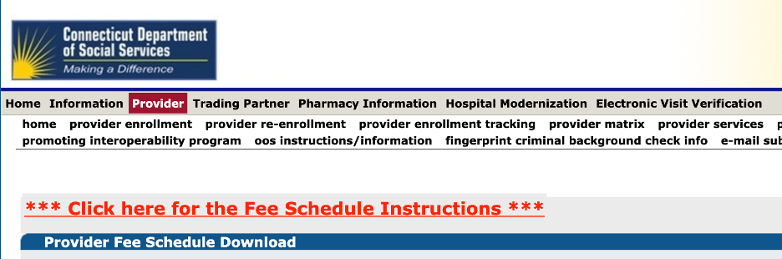
Connecticut/Indiana/New York Medicaid Fee Schedule data
Three states all have their own health programs to publish the physician fee schedule in different categories, like surgical, radiology, outpatient.

Slide 11
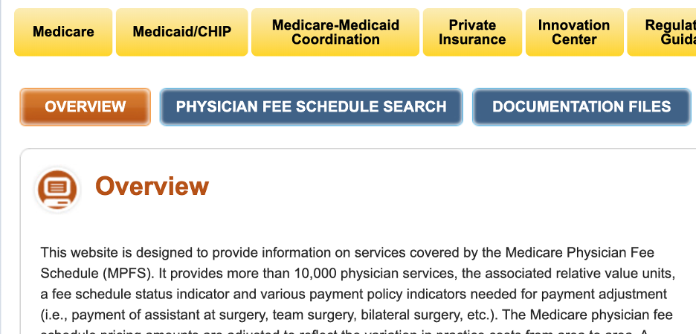
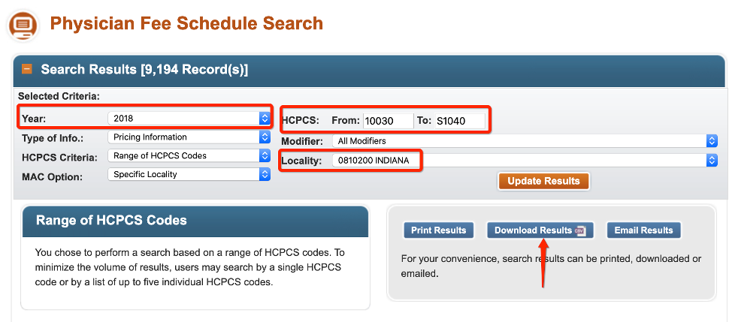
Connecticut/Indiana/New York MedicaRE Fee Schedule data
Medicare is a national insurance program in the U.S administered by CMS. Its physician fee schedule is uniformly controlled and can only be accessed through the search engine shown in the left side.

Slide 12
eda
Dataset Characteristics
Structure: It is noticeable that all our datasets are tabular, either stored in CSV or Excel files, which is just appropriate for caching in data structure like Python pandas dataframe. However, the datasets are not perfect to directly calculate the weights. Some datasets have missing values, some datasets have dirty data or invalid data, and even some count attributes are in categorical type.
Other EDA Techniques on input
Granularity
Scope
Temporality
Faithfulness

Slide 13

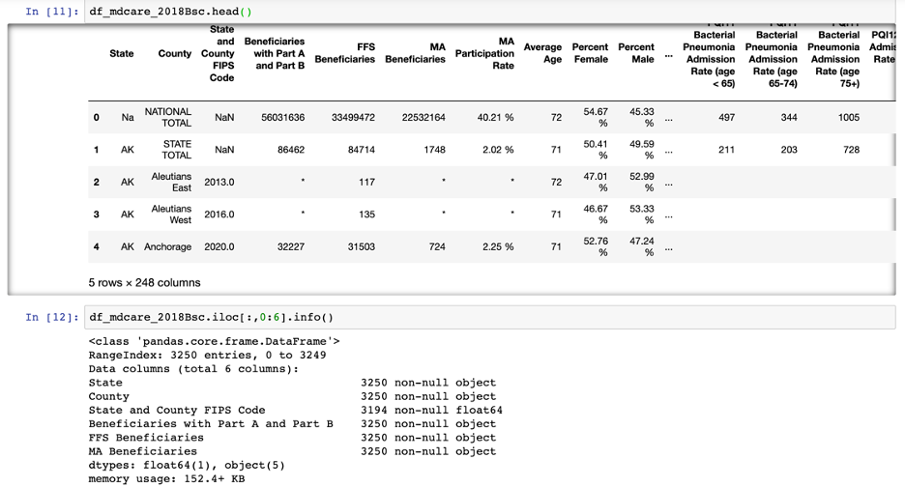
Granularity
It means that what each row stands for. Like the sample row from dataset df_mdcare_2018Bsc.
The first row means the national total counts of Medicare beneficiaries. For each state, the row statistics starts from state total counts of Medicare beneficiaries following by each county
Also, there are invalid and missing values in total counts of Medicare beneficiaries, such as "*"
From the table I also conclude that the column **"Beneficiaries with Part A and Part B" is the sum of "FFS Beneficiaries" and "MA Beneficiaries"**.

Slide 14
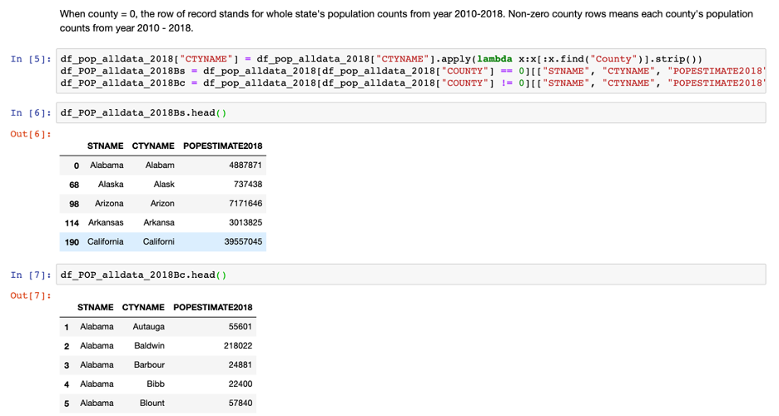
Scope
Scope means the range of the data we want to dive into. For example, as I want to get both state level and county level weighted fee schedule, it’s better to separate the total census data into state-level and county-level.

Slide 15
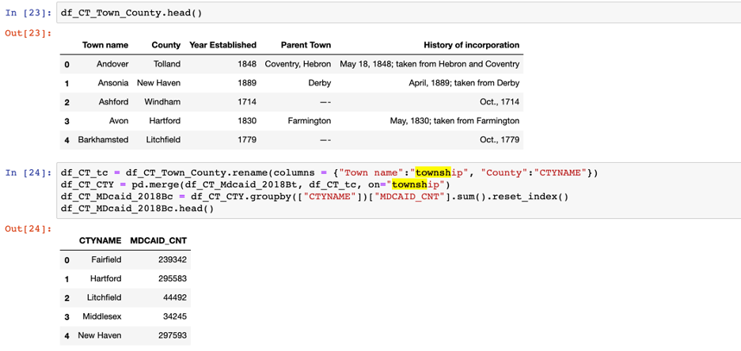
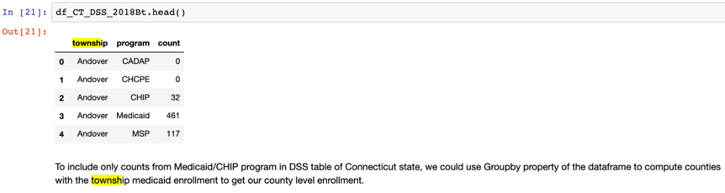
Scope-continued
Connecticut County-Enrollment collection, we will use groupby to merge the two dataset together to get our desired ct county enrollment data

Slide 16
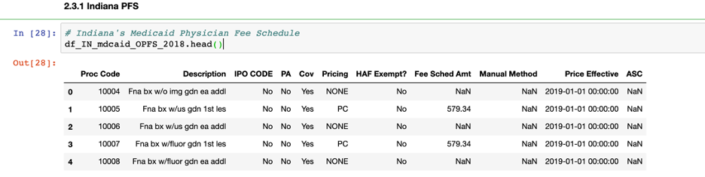
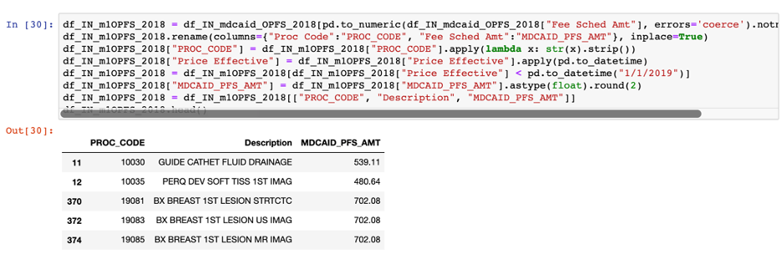
temporality
It means the time span of the desired data. For example, the Physician Fee Schedule we got might contain data which takes effect after fiscal year 2018. To make our fee estimation more accurate, we focus on the procedure code which is effective in year 2018.

Slide 17
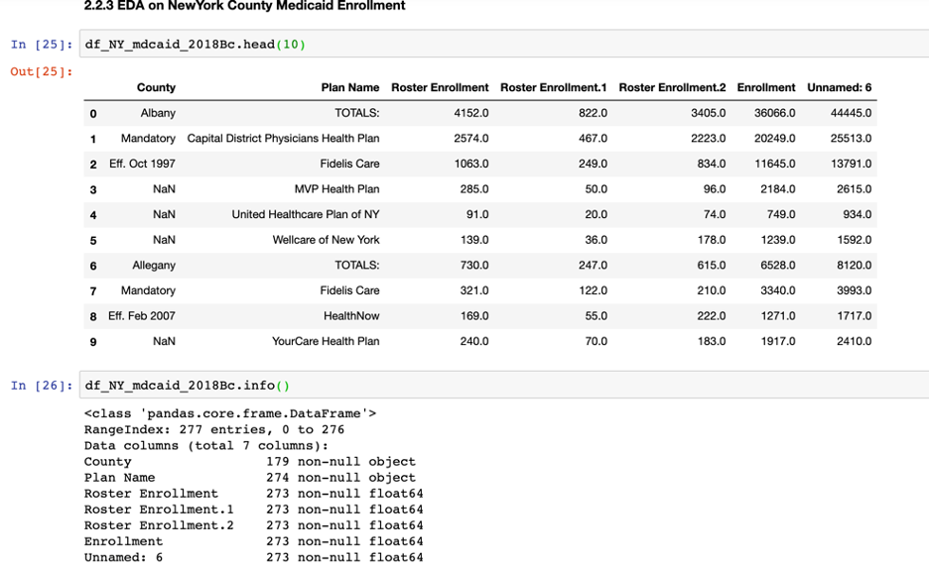
faithfulness
If data is faithful, it means that the data is valid. However, not all our data are valid because some of the downloaded files are in special views. For example, in df_NY_mdcaid_2018Bc, some rows are dropped because they are not meaningful and not essential.

Slide 18
weighted selection
We can assume that physicians get paid for a medical procedure based on their patients’ insurance coverage. Therefore, our solution is to use proportion of Medicaid, Medicare and Private insurance enrollment over the states’/counties’ population. These ratios could be the weights to calculate the weighted fee schedule.
Notes:
Medicaid patient pay a leg surgery by $200
Medicare patient pay for $250
Private insured patient pay for $300, then we can guess that physicians gain between $200 - $300 by their weighted sum.

Slide 19
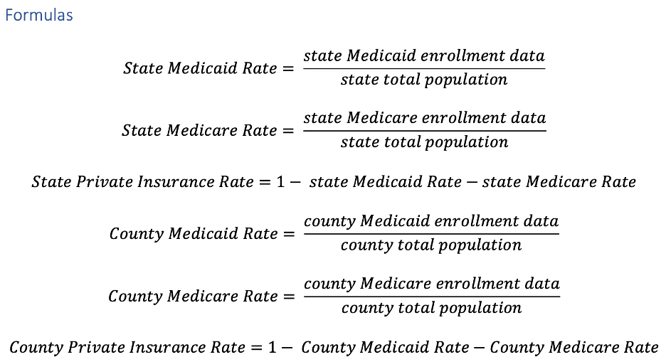
Formulas

Slide 20
Calculate weighted fee schedule
State level weighted fee schedule
County level weighted fee schedule

Slide 21
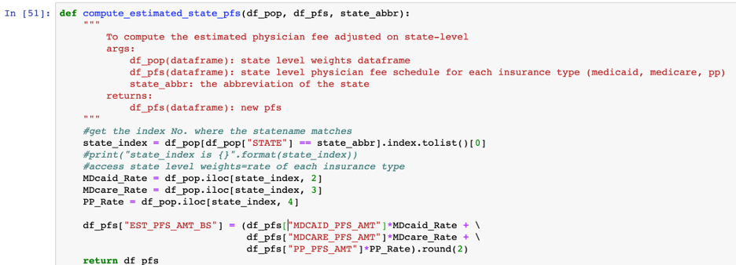
State level weighted fee schedule
𝑊𝑒𝑖𝑔h𝑡𝑒𝑑 𝑆𝑡𝑎𝑡𝑒 𝑃h𝑦𝑠𝑖𝑐𝑖𝑎𝑛 𝐹𝑒𝑒 𝑆𝑐h𝑒𝑑𝑢𝑙𝑒 = 𝑠𝑡𝑎𝑡𝑒 𝑀𝑒𝑑𝑖𝑐𝑎𝑖𝑑 𝑟𝑎𝑡𝑒 ∗ 𝑀𝑒𝑑𝑖𝑐𝑎𝑖𝑑 𝐹𝑒𝑒 𝑆𝑐h𝑒𝑑𝑢𝑙𝑒 + 𝑠𝑡𝑎𝑡𝑒 𝑀𝑒𝑑𝑖𝑐𝑎𝑟𝑒 𝑟𝑎𝑡𝑒 ∗ 𝑀𝑒𝑑𝑖𝑐𝑎𝑟𝑒 𝐹𝑒𝑒 𝑆𝑐h𝑒𝑑𝑢𝑙𝑒 + 𝑠𝑡𝑎𝑡𝑒 𝑝𝑟𝑖𝑣𝑎𝑡𝑒 𝑖𝑛𝑠𝑢𝑟𝑎𝑛𝑐𝑒 𝑟𝑎𝑡𝑒 ∗ 𝑝𝑟𝑖𝑣𝑎𝑡𝑒 𝑖𝑛𝑠𝑢𝑟𝑎𝑛𝑐𝑒 𝑓𝑒𝑒 𝑠𝑐h𝑒𝑑𝑢𝑙𝑒

Slide 22
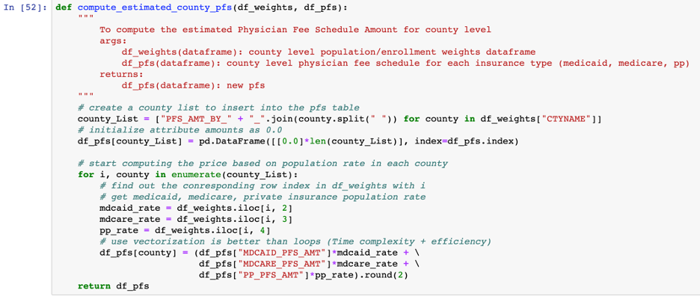
county level weighted fee schedule
𝑊𝑒𝑖𝑔h𝑡𝑒𝑑 𝐶𝑜𝑢𝑛𝑡𝑦 𝑃h𝑦𝑠𝑖𝑐𝑖𝑎𝑛 𝐹𝑒𝑒 𝑆𝑐h𝑒𝑑𝑢𝑙𝑒 = 𝑐𝑜𝑢𝑛𝑡𝑦 𝑀𝑒𝑑𝑖𝑐𝑎𝑖𝑑 𝑟𝑎𝑡𝑒 ∗ 𝑀𝑒𝑑𝑖𝑐𝑎𝑖𝑑 𝐹𝑒𝑒 𝑆𝑐h𝑒𝑑𝑢𝑙𝑒 + 𝑐𝑜𝑢𝑛𝑡𝑦 𝑀𝑒𝑑𝑖𝑐𝑎𝑟𝑒 𝑟𝑎𝑡𝑒 ∗ 𝑀𝑒𝑑𝑖𝑐𝑎𝑟𝑒 𝐹𝑒𝑒 𝑆𝑐h𝑒𝑑𝑢𝑙𝑒 + 𝑐𝑜𝑢𝑛𝑡𝑦 𝑝𝑟𝑖𝑣𝑎𝑡𝑒 𝑖𝑛𝑠𝑢𝑟𝑎𝑛𝑐𝑒 𝑟𝑎𝑡𝑒 ∗ 𝑝𝑟𝑖𝑣𝑎𝑡𝑒 𝑖𝑛𝑠𝑢𝑟𝑎𝑛𝑐𝑒 𝑓𝑒𝑒 𝑠𝑐h𝑒𝑑𝑢𝑙𝑒

Slide 23
Output and conclusions
Connecticut/Indiana/New York Output dataset
Conclusions and Discussions

Slide 24
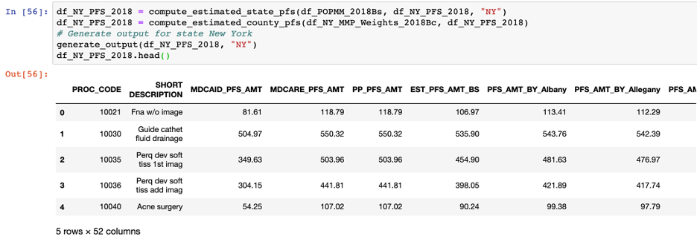
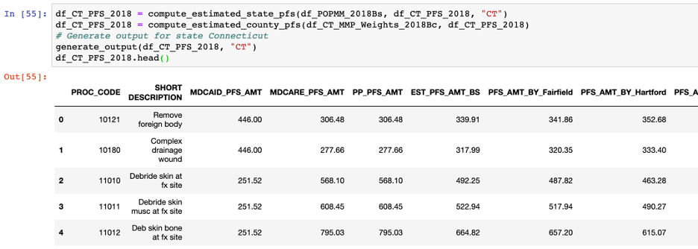
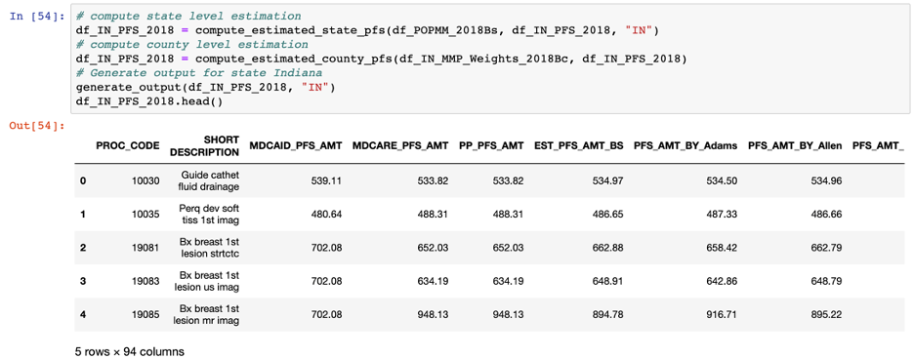
output

Slide 25
Conclusion
Based on collected demographic dataset and states’ physician fee schedule in Medicaid and Medicare, we have computed a weighted physician fee schedule plan for physicians and their uninsured patients. Without loss of generality, we have generated the output datasets for state Connecticut, Indiana, and New York. In the final datasets, we also find out that each state’s county level weighted fee schedule is fluctuated from state level weighted fee schedule. And different county’s weighted fee schedule is also varying from CPT code to CPT code.

Slide 26
discussions
1, The fee schedule is an estimated expense for a medical procedure. Of course, It could be more valuable if If we could collect enough actual expenses/costs of a patient visit for demographic data in future.
2, It is highly expected that we can cooperate with one or more private insurance companies to work with their customer data (expenses and enrollment).
3, The most challenging part maybe further narrowing down to township, Hospital Referral Region (HRR) level or ZIP code-level fee schedules. But the outputs could be quite prospective.

Slide 27

Thanks & QA fighting and stay well

