Slide 1
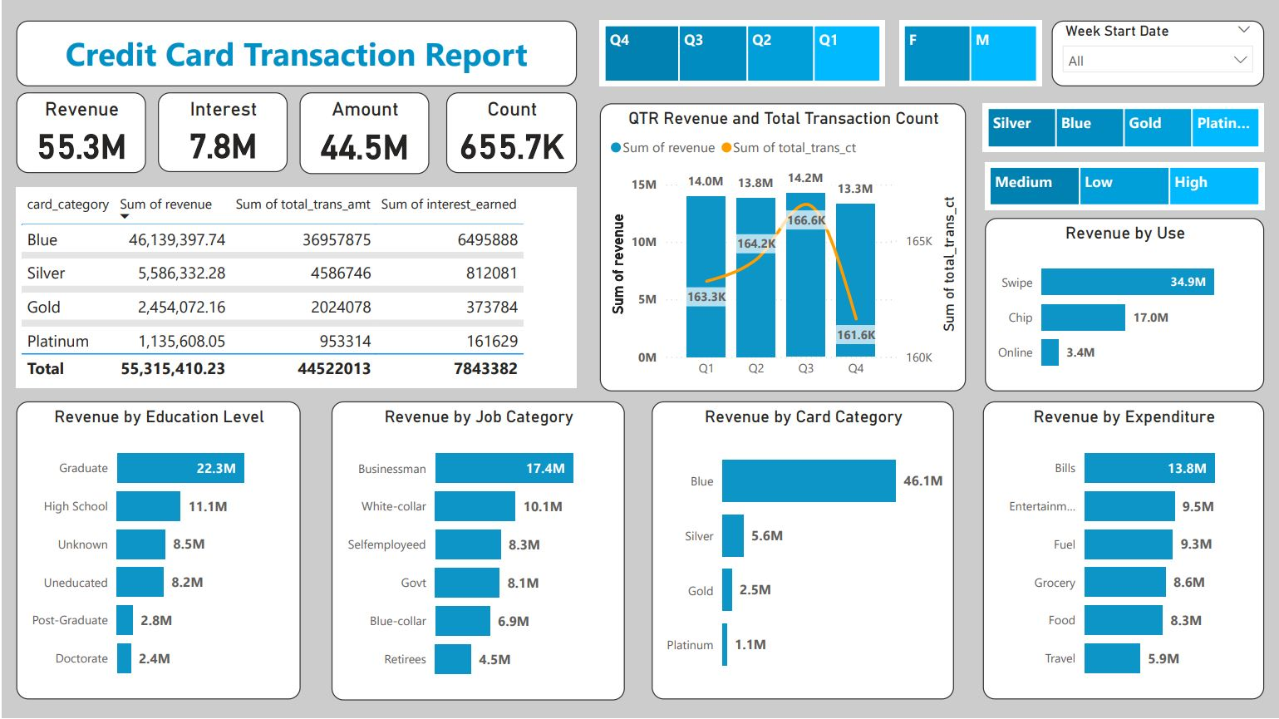
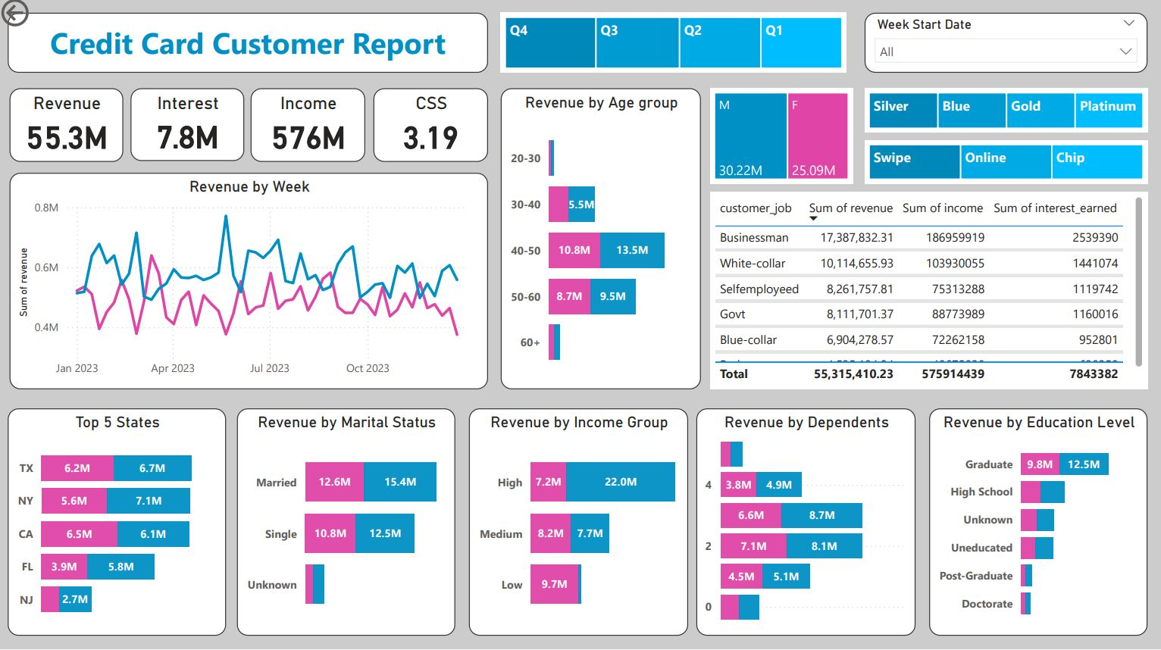
Insights of 2023 US Credit Card Data

Slide 2
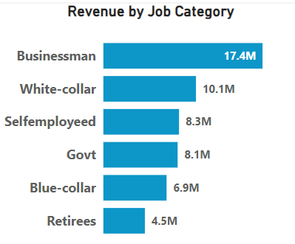
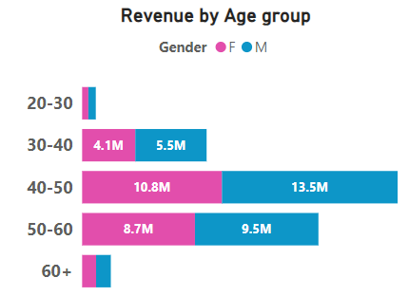
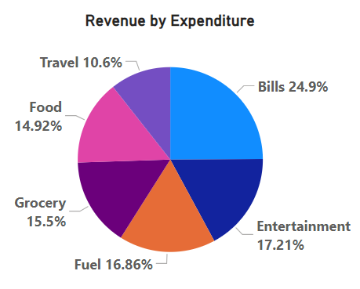
Key Insights
Customer Behavior Analysis
Revenue peaked among customers aged 40-50, particularly those in job categories Business and White Collar.
Top Expenditure Categories : Bills (25%) & Entertainment(17%) dominate spending.

Slide 3
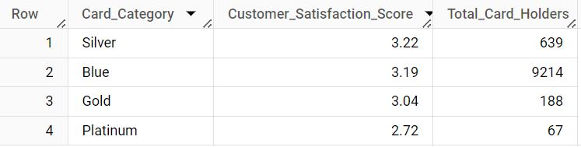
Key Insights
Customer Satisfaction Insights
The average customer satisfaction score is 3.19 on a 1–5 scale, indicating moderate satisfaction levels across all cardholders.
The Platinum card category has the lowest satisfaction score, at 2.72 on the same scale, suggesting potential dissatisfaction due to factors such as higher fees or fewer benefits.
Customer Satisfaction Score by Card Category

Slide 4
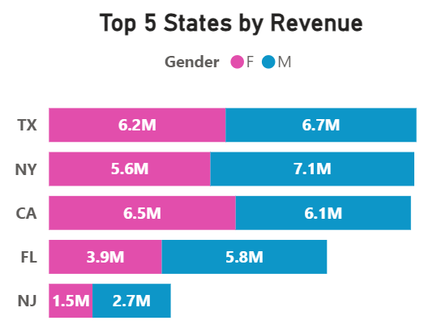
Key Insights
Male customers contributed $30M in revenue, while female customers contributed $25M.
Revenue Leaders: The five states with the highest revenue earnings are Texas, New York, California, Florida, and New Jersey collectively contributing approximately 94% of the total revenue.

Slide 5
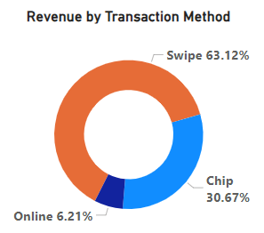
Financial Performance Insights
Revenue Trends
Total revenue of $55.3 million, with the Blue card category leading revenue contributions.
Quarterly Trends: Revenue growth peaked in Q3, while it was the lowest in Q4. (Interesting !!!)
Credit cards were used through swipe, online, and chip methods, with swipe transactions generating 63% of the revenue, highlighting their dominance in payment preferences.

Slide 6
Financial Performance Insights
Overall Activation rate is 57.5%
Overall Delinquent rate is 6.06%
Blue & Silver credit cards contribute to around 92% of overall transactions.
Total transaction amount is 44.5M
Amount earned by interest is 7.8M
An interesting observation from the dashboard is that females in the low- and medium-income categories (Income <$70,000) contributed significantly to revenue, while males in the high-income category (Income >$70,000) dominated revenue contributions.

Slide 7
Possible 2024 Year Business Implications
Focus marketing efforts on top-revenue states to amplify spending while also targeting underperforming regions with tailored incentives.
Tailored Marketing Campaigns for Customers Whose Age between 40-50.
Encourage swipe transactions by offering cashback or reward points, leveraging their 63% contribution to revenue.
Launch promotions tied to holiday sales, encouraging customers to use credit cards for store purchases with incentives like cashback, rewards points, or discounts for in-store shopping.

Slide 8
Thank You

