Slide 1
ITMO-444 · LAB 04
2 AZs
Multi-AZ Resilience
1 stable ALB endpoint
ALB, Auto Scaling Groups, and recovery-time SLOs
77.49 s
measured outage
Jay Han
jhan38@hawk.illinoistech.edu
Notes:
Source: Assignment4 -Multi-AZ Resilience.pdf
Course lab reference: EC2_ALB_ASG_MultiAZ_Resilience.pdf

Slide 2
DESIGN
Multi-AZ application architecture
Internet
Uploader target group
Application Load
Balancer
ASG desired = 1 · port 3000
Clients
HTTP 8080 / 8081
forwards
Stable DNS across two subnets
Viewer target group
ASG desired = 1 · port 3000
Amazon S3
Shared upload storage
The ALB owns the public entry point. Each ASG replaces a failed instance from the latest launch template.
ITMO-444 · Lab 04
02
Notes:
Sources: lab04/create_app_stack.sh; EC2_ALB_ASG_MultiAZ_Resilience.pdf, Architecture Overview

Slide 3
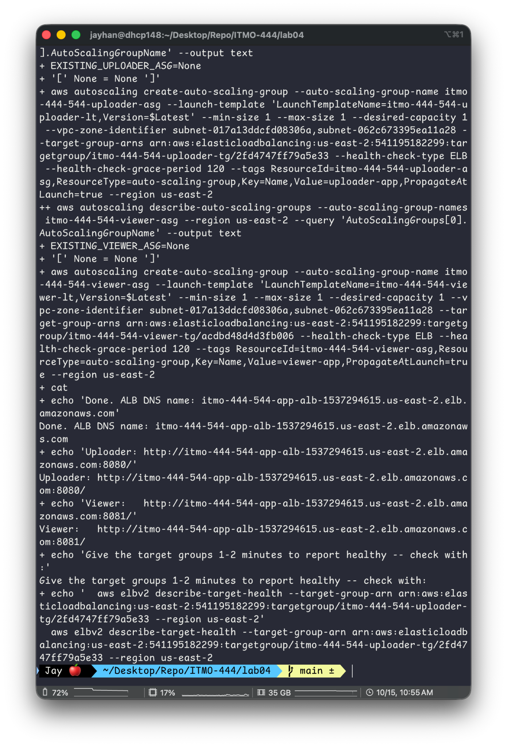
PROVISIONING
Stack creation produced both ALB endpoints
What the script created
01
Default VPC and subnets in us-east-2a / 2b
02
ALB security group and restricted app ingress
03
Two target groups with 10-second health checks
04
Listeners on ports 8080 and 8081
05
Uploader and viewer ASGs using $Latest
ITMO-444 · Lab 04
03
Notes:
Evidence image extracted from Assignment4 -Multi-AZ Resilience.pdf
Implementation: lab04/create_app_stack.sh

Slide 4
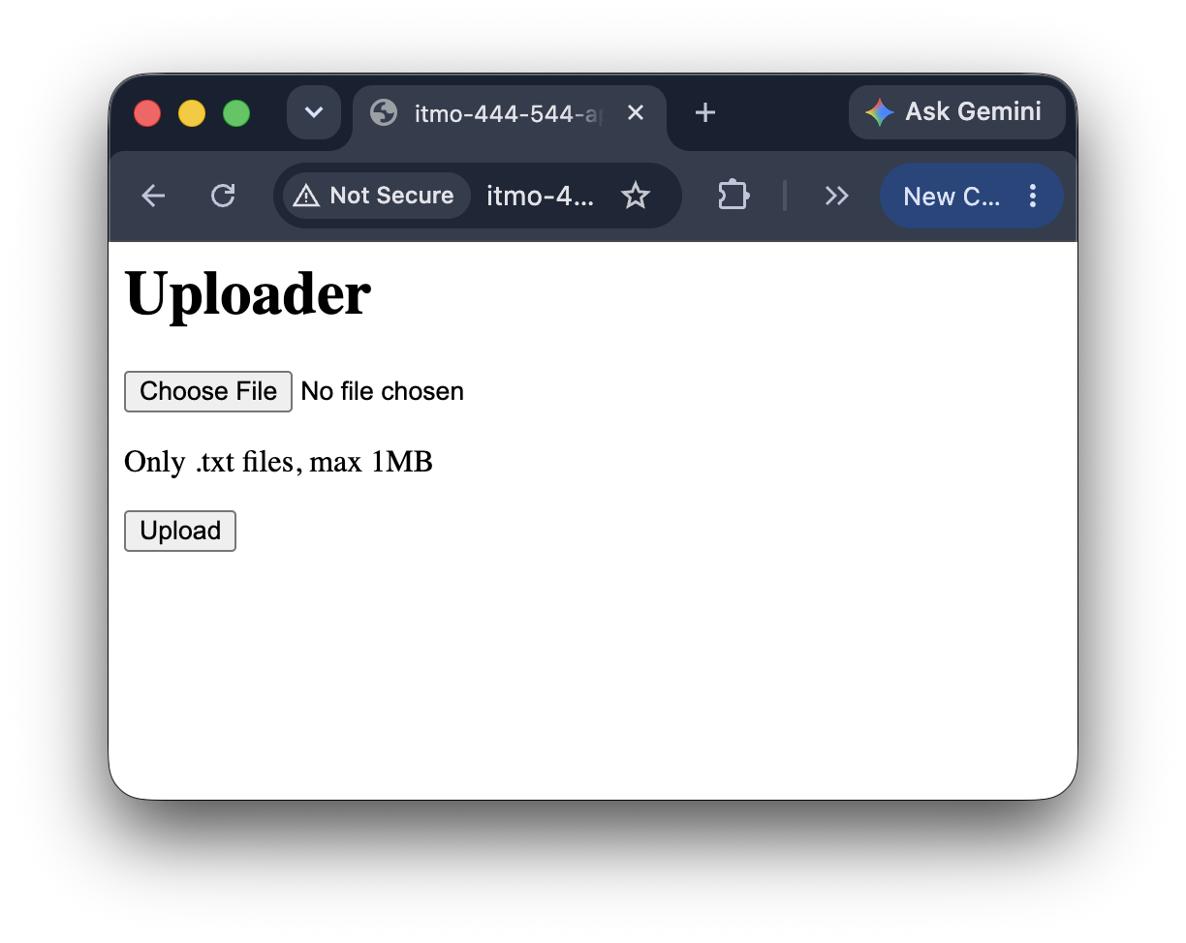
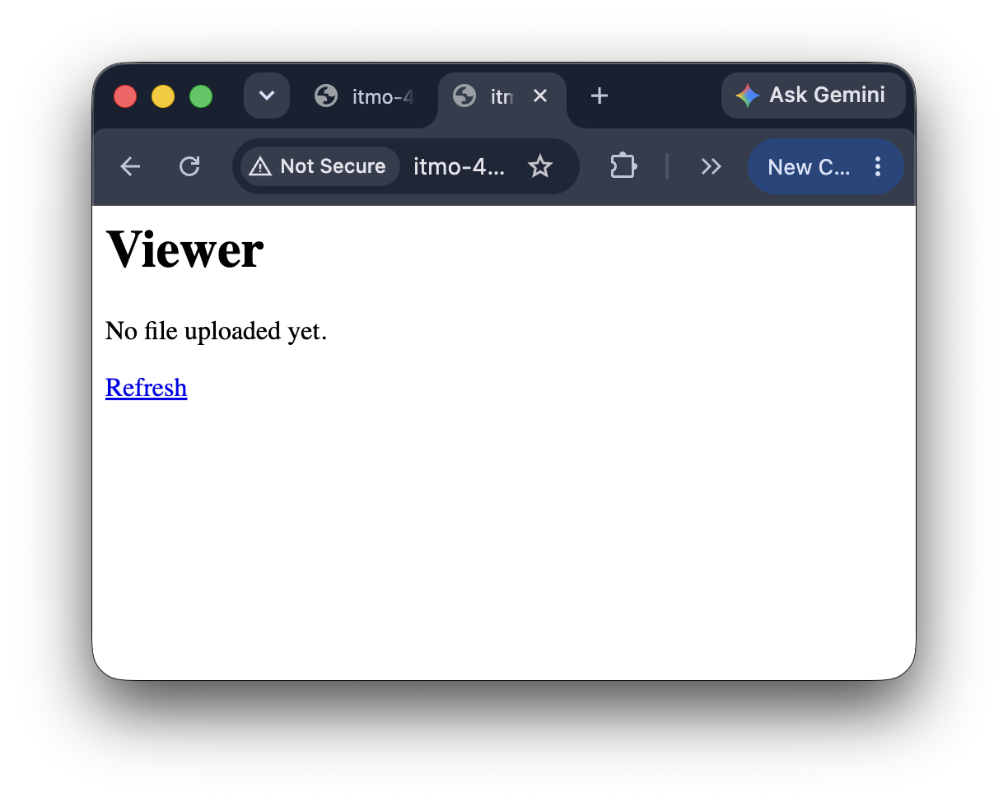
VERIFICATION
Both application endpoints were reachable through the ALB
Uploader · :8080
Viewer · :8081
The screenshots confirm that both listener ports returned their application pages through the same ALB DNS name.
ITMO-444 · Lab 04
04
Notes:
Evidence images extracted from Assignment4 -Multi-AZ Resilience.pdf

Slide 5
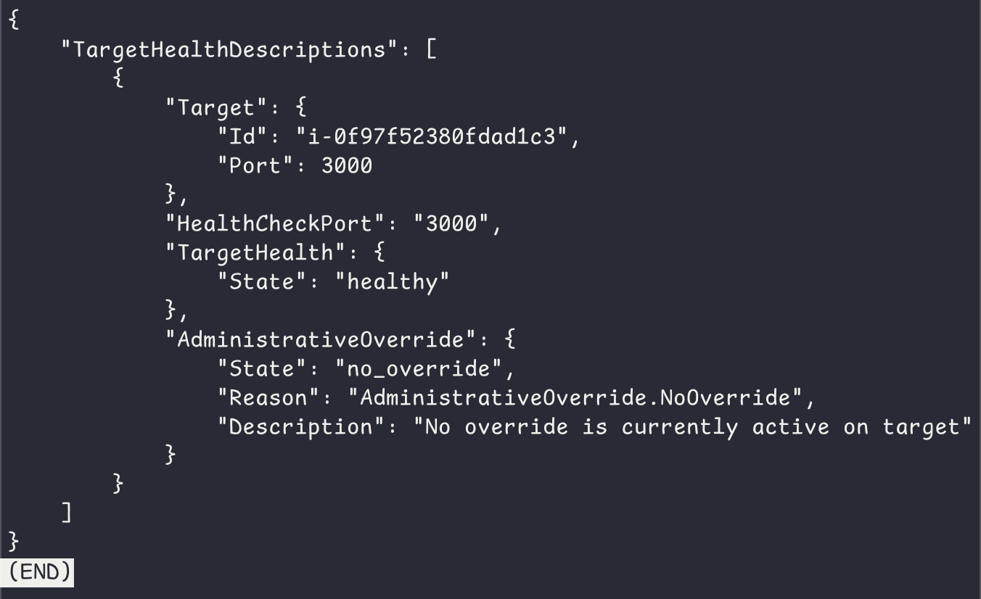
HEALTH CHECKS
Target health confirms the routing path
Health-check policy
10 s
probe interval
2
healthy checks required
ELB
ASG health-check type
Instances accept port 3000 only from the ALB security group.
ITMO-444 · Lab 04
05
Notes:
Evidence image extracted from Assignment4 -Multi-AZ Resilience.pdf
Configuration source: lab04/create_app_stack.sh

Slide 6
CHAOS TEST
The measured outage met 180 seconds but missed 60 seconds
PASS
77.49 s ≤ 180 s
FAIL
81.57 s > 60 s
ITMO-444 · Lab 04
06
Notes:
Data: lab04/testing/chaos_test_uploader_1792080610.csv; lab04/testing/chaos_test_uploader_1792080780.csv
Console evidence extracted from Assignment4 -Multi-AZ Resilience.pdf

Slide 7
ANALYSIS
Instance replacement dominated the recovery window
Observed sequence
chaos_test.py
2.22 s
First failed probe
terminate_instance_via_asg(instance_id, region)
while True:
is_up = probe_once(url)
writer.writerow([now, elapsed, is_up, ...])
if down_detected and is_up:
recovery_time = now - outage_start
break
verdict = recovery_time <= slo_seconds
≈75 s
ASG launches EC2 and runs user data
77.49 s
Service returns after target becomes healthy
A 2-second polling interval only improves measurement precision. It does not shorten EC2 boot, package installation, application startup, or ALB health validation.
ITMO-444 · Lab 04
07
Notes:
Code source: lab04/testing/chaos_test.py
Timing source: lab04/testing/chaos_test_uploader_1792080610.csv

Slide 8
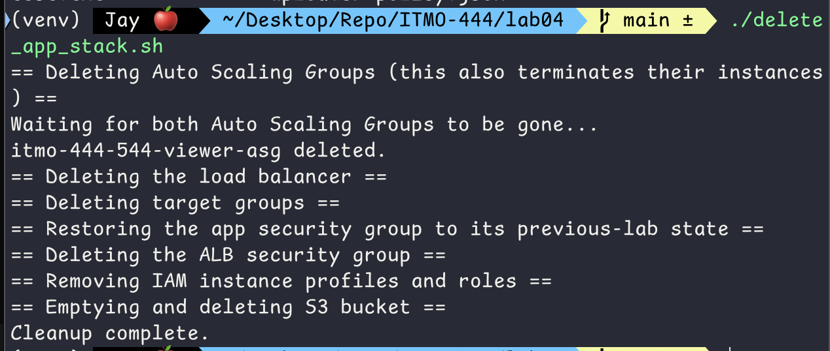
IMPLEMENTATION
ASGs replaced direct EC2 launches and enabled recovery
Previous lab
Current lab
aws ec2 run-instances
Launch Templates + Target Groups + Auto Scaling Groups
The ASGs maintain desired capacity at 1, attach replacements to the target groups, and let the ALB remove unhealthy targets from service.
Cleanup completed
ASGs, ALB, target groups, security rules, IAM resources, and the S3 bucket were removed in dependency order.
ITMO-444 · Lab 04
08
Notes:
Implementation sources: lab04/create_app_stack.sh; lab04/delete_app_stack.sh
Cleanup evidence extracted from Assignment4 -Multi-AZ Resilience.pdf

