Slide 1


FUTURE LEADERS CHALLENGE · EASTERN AFRICA
ACCESSWORK
Front-desk communication for Deaf receptionists
and hearing guests.
October 26–27 2026, Nairobi

Slide 2
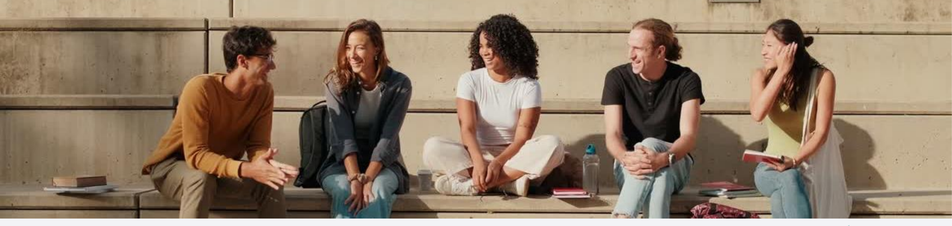
Deaf children go to school.
Have you ever wondered what their future looks like?
Is it limited by their disability?
If you were to hire a young Deaf person tomorrow,
what would your immediate thought be?

Slide 3
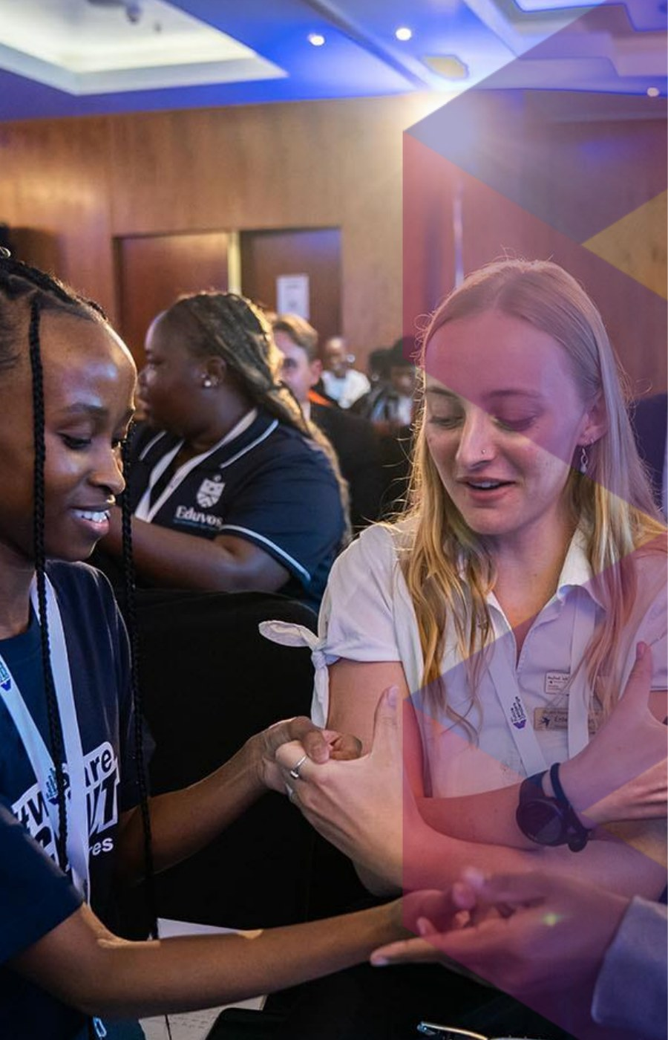
Hospitality still cannot put them at the desk.
5%
Kenya’s disability employment quota.
Hotels are asked to employ persons with disabilities. A study of Nairobi 3–5 star hotels found none of them met the 5%.
600k
Deaf people live in Kenya.
The hardest step is not school. It is the first job — especially a job built around speech.
1 desk
The front desk is still spoken.
Guests talk. Staff answer by talking. A trained Deaf receptionist is left outside the most visible role in the hotel.
Future Leaders Challenge Eastern Africa

Slide 4

That gap is a hiring door hospitality has not opened.
The quota is already law. Tourism is already hiring. Deaf young people already finish school. The missing piece is a desk they can actually work.
For hotels
For Deaf youth
For guests
Meet the quota at the most public job in the building — without waiting for a hearing colleague to interpret every check-in.
A real first career in hospitality: skills, wages, and a role guests walk up to every day.
They speak as they always do. They leave understood. The hotel looks inclusive because it is.
Future Leaders Challenge Eastern Africa

Slide 5
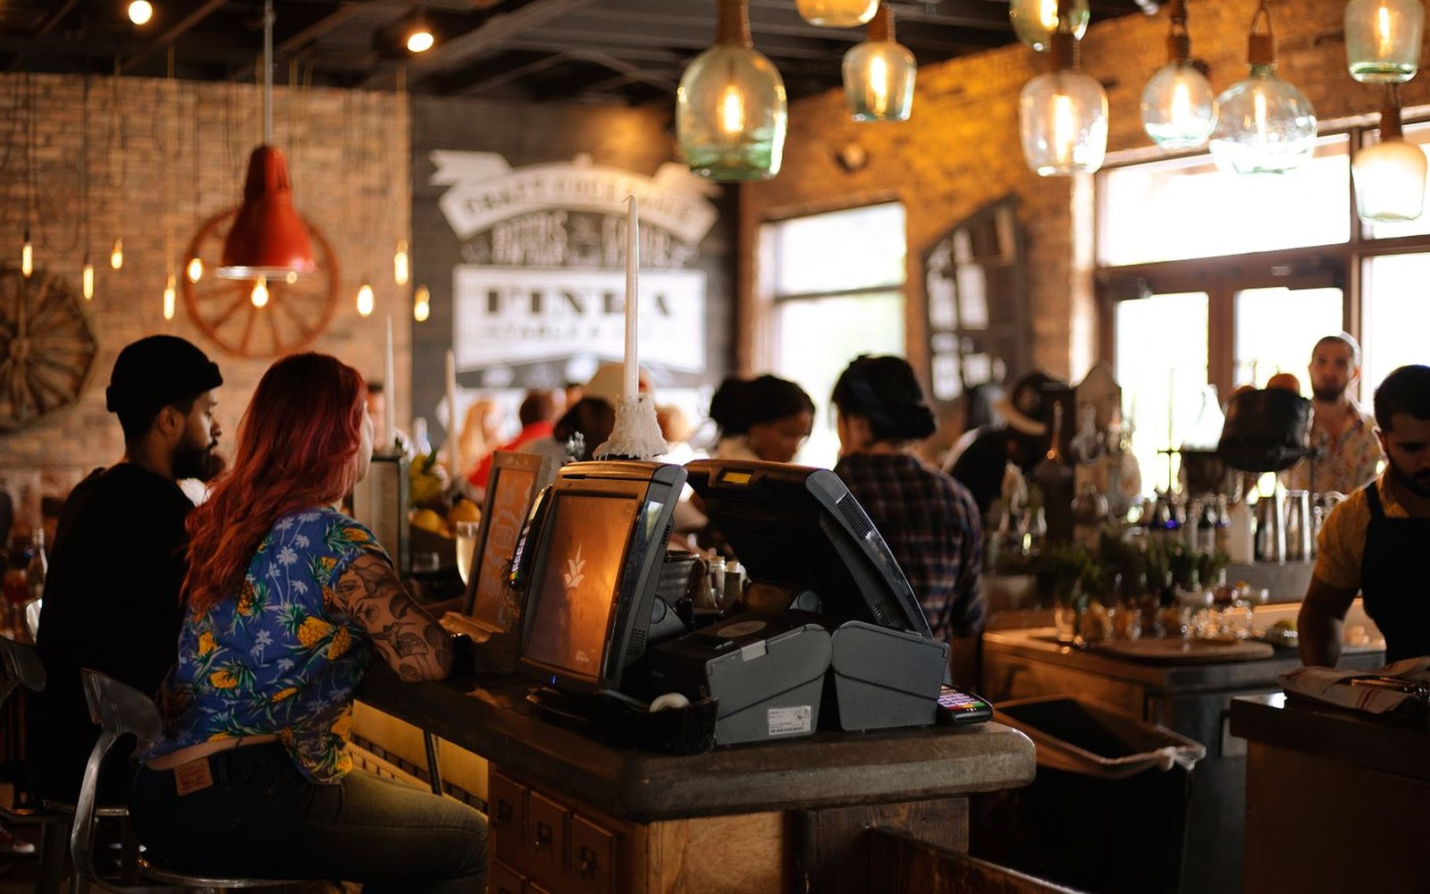
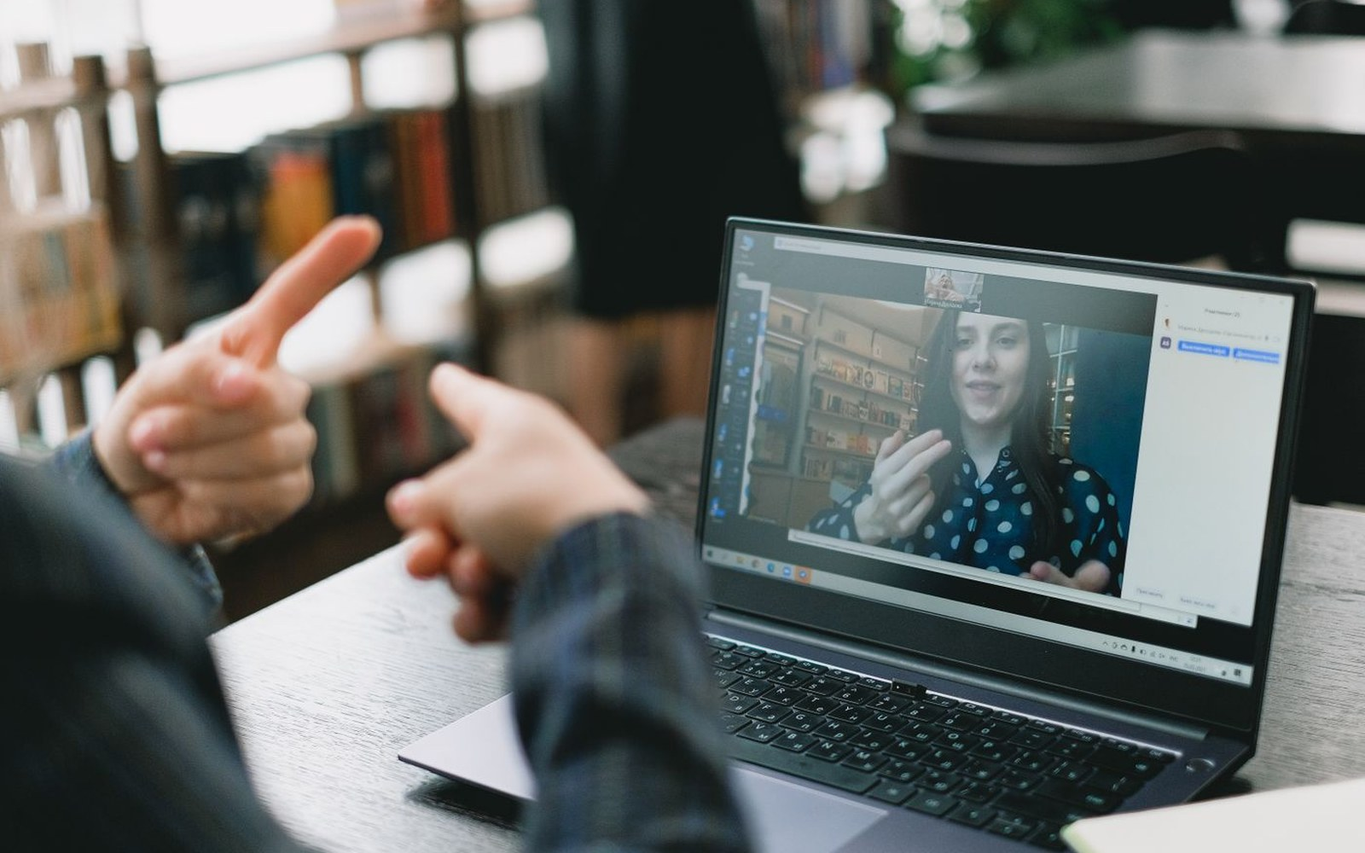
AccessWork is a two-sided screen at the desk.
The guest talks. The receptionist reads it. Then they answer.
Hearing guest · speaks as usual
Deaf receptionist · reads, then signs or types
1
Guest speaks
2
Receptionist replies
3
Guest hears and reads
Speech becomes text on the employee screen. A 3D avatar signs the message.
They sign to the camera, type, or tap a hospitality phrase.
The reply is text plus a voice note. The employee screen flashes when a guest starts talking.

Slide 6
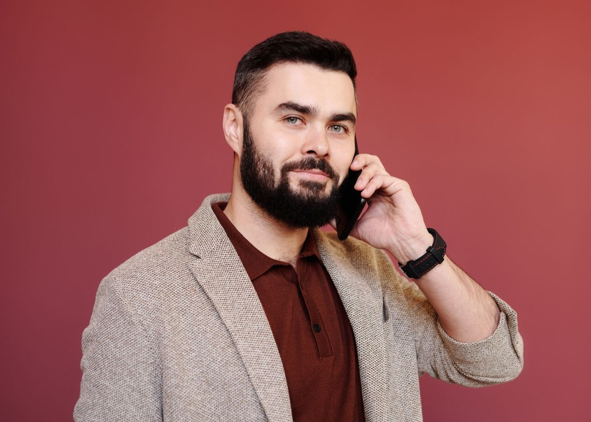
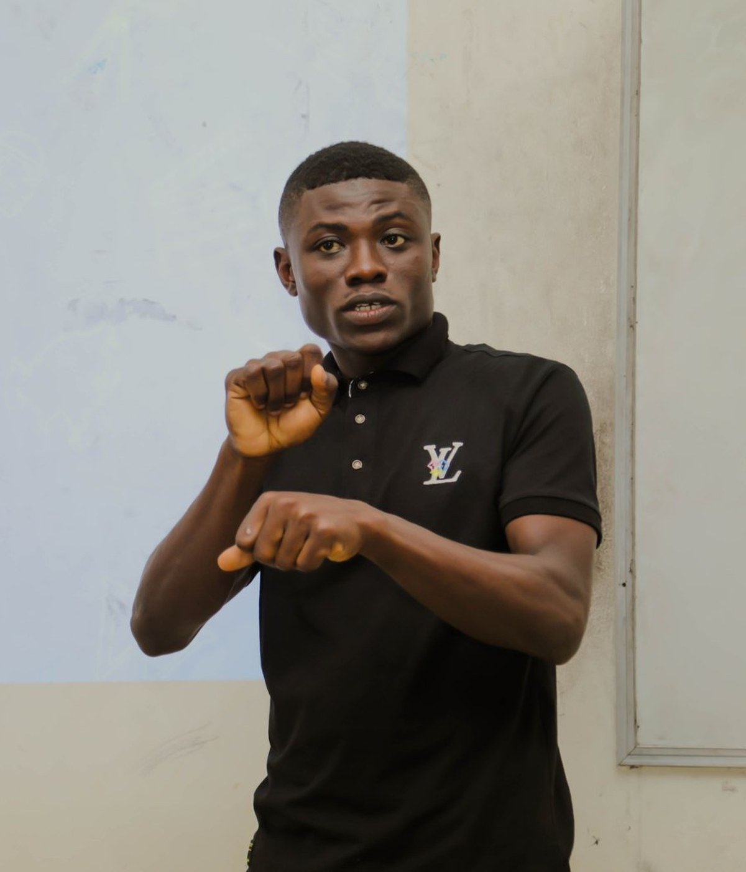


One conversation. Two screens. A job that finally fits.
Guest side
Employee side
The hotel
Speak normally. See the reply. Hear a voice note you can play again.
Read the guest’s words. Watch them signed. Answer in sign, type, or a quick phrase.
A Deaf receptionist on the front desk — the guest never has to wait for a helper.
Future Leaders Challenge Eastern Africa

Slide 7
Inclusive pathways start at the front desk.
A Deaf receptionist. A hearing guest.
A conversation that does not need a third person.

