Slide 1
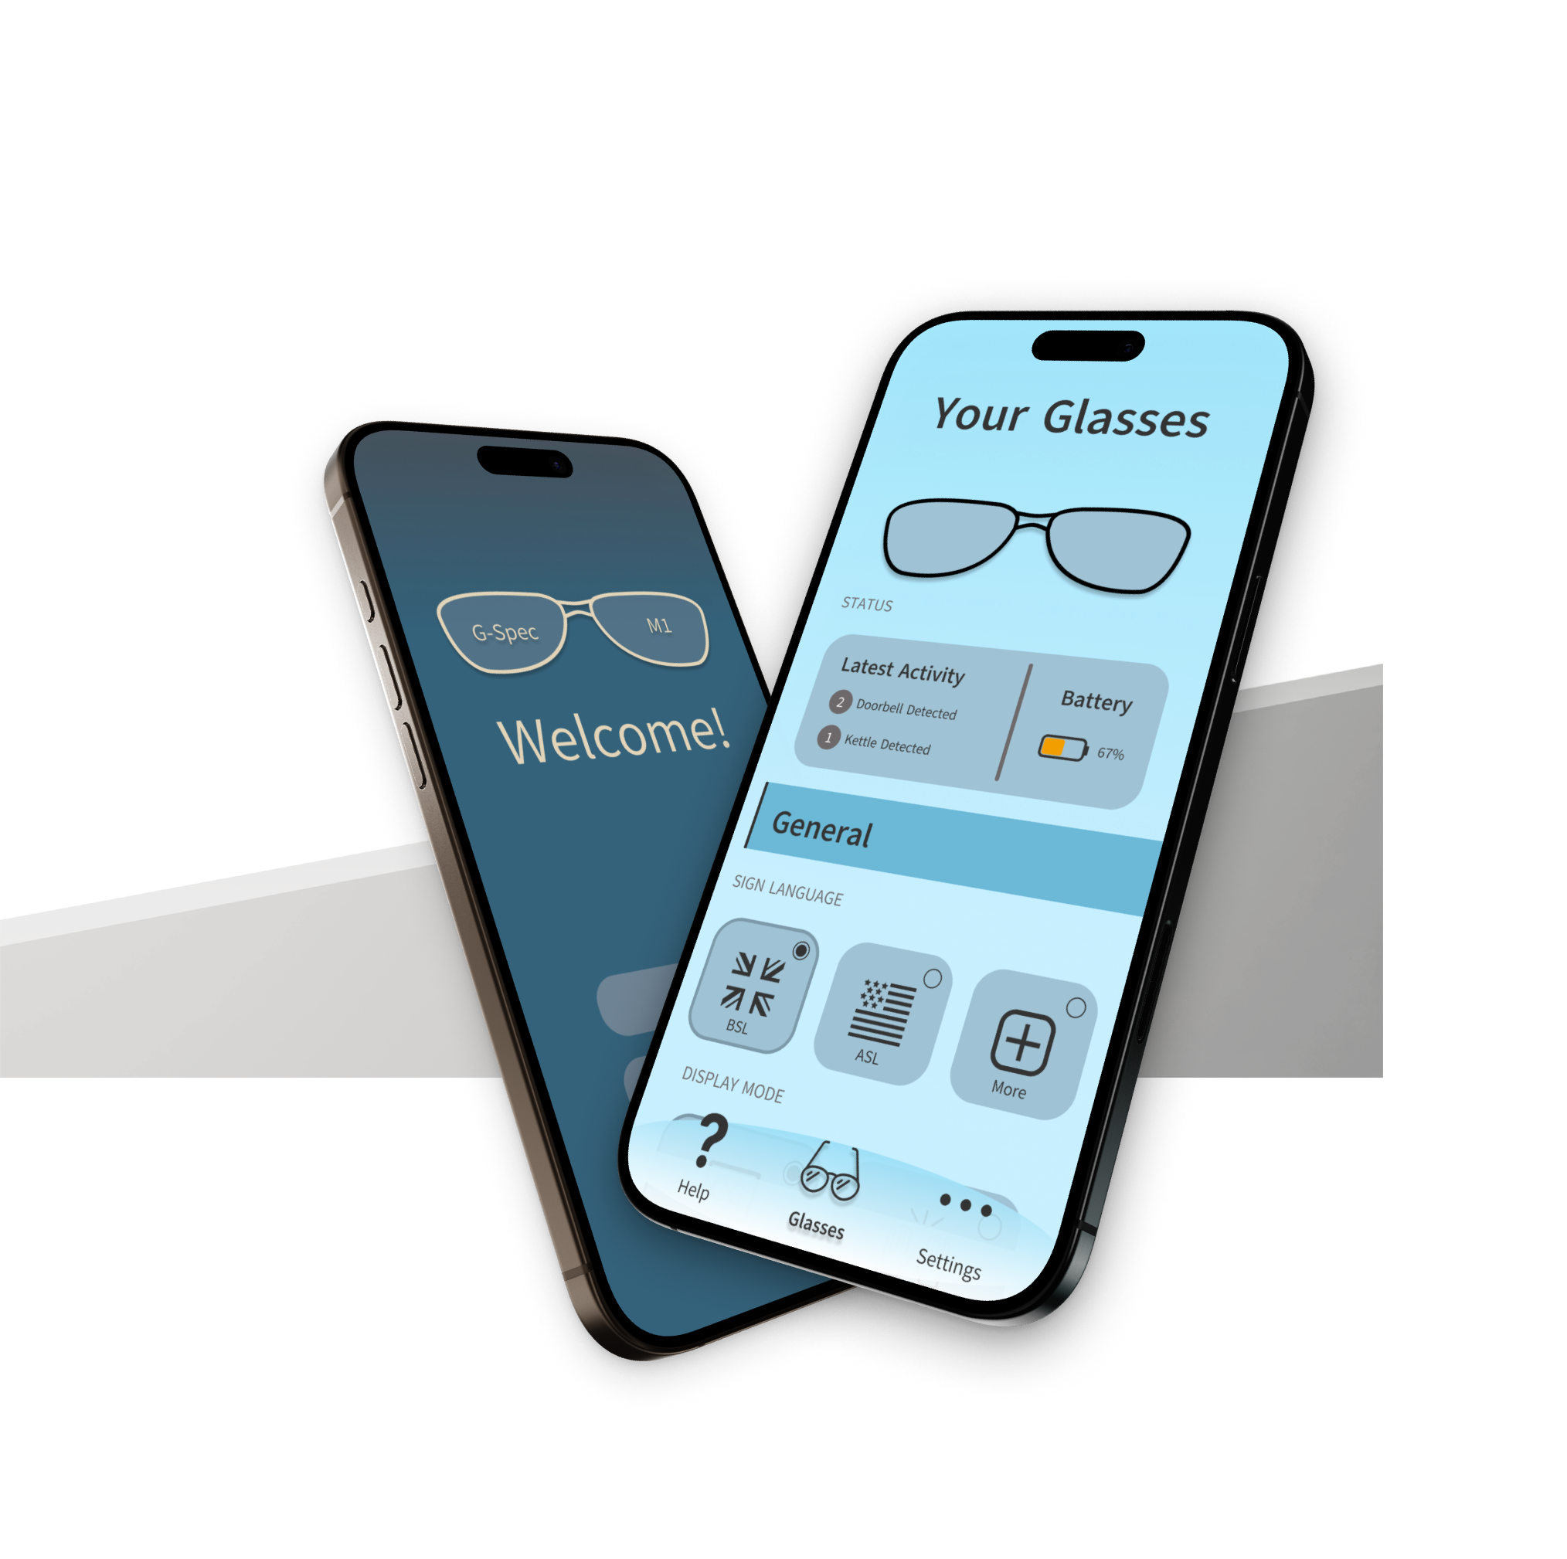
Mar 31, 2026
G-Spec
UI/UX Prototype
Prepared for CS22003 - User Interface Design
by Kit Cochrane, Michelangelo Prisciano, Younis Al-Riyami, Abdulrahman Bada, Angus Wilson
Notes:
Introduction (10 Seconds)

Slide 2
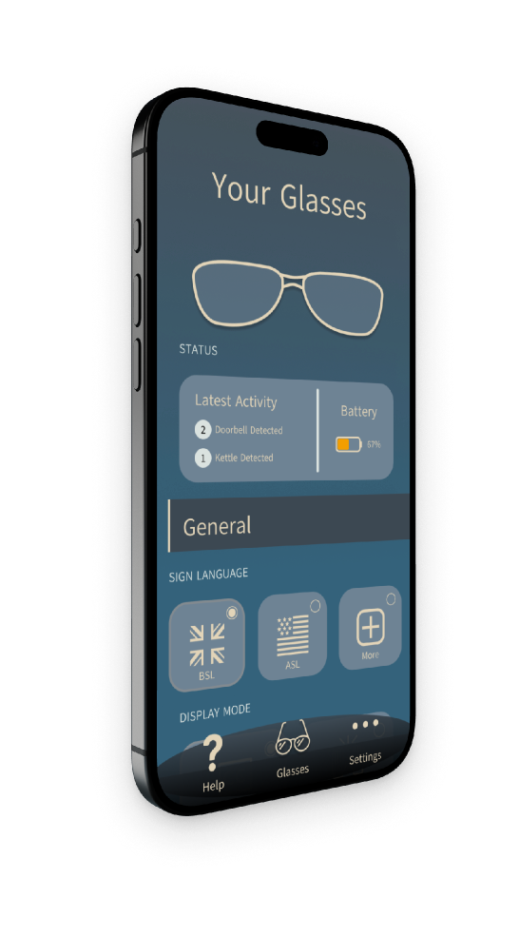
Problem Statement
G-Spec is a theoretical product to assist deaf people in their daily life
It acts as a real-time translator between sign language and spoken conversation
1 of 4
Features include: sign-language interpretation, noise detection and classification
Our goal is to leverage accessible UI/UX principles to implement a companion app for the device
This app should be easy to use and intuitively implement the features
Abdulrahman Bada
02
Notes:
(1 Minute 30 Seconds)
Brief requirements: Problem Statement & Justification: Clear summary of the problem and why it was chosen (10%)
Expand points:
G-spec being a theoretical product
Population stitch
translating between sign language and text
but also custom sounds and detecting common sounds
main goal is the companion app
user friendly and well see over the next slides
inside joke
pass it on

Slide 3
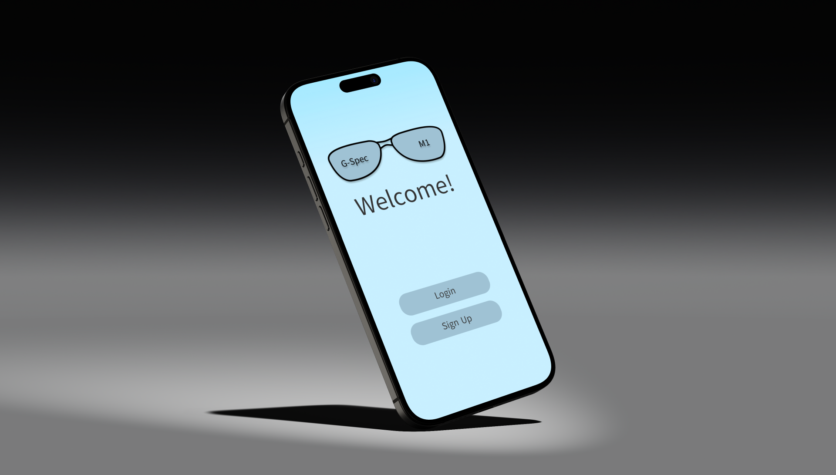
Prototype Demonstration
2 of 4
Kit Cochrane
Notes:
Handover - Bada to Kit (10 Seconds)
Prototype Demonstration (3 Minutes)

Slide 4
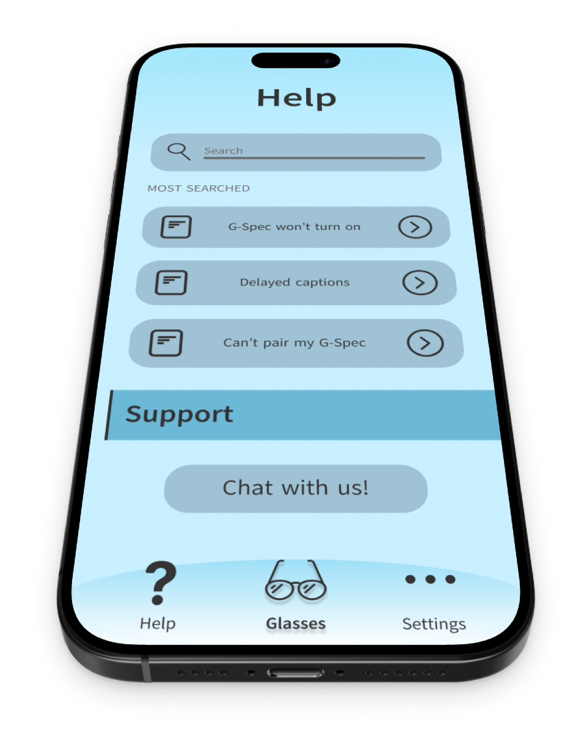
Design: Overview
3 of 4
Michelangelo Prisciano & Angus Wilson
04
Notes:
Handover - Kit to Michael (10 Seconds)

Slide 5
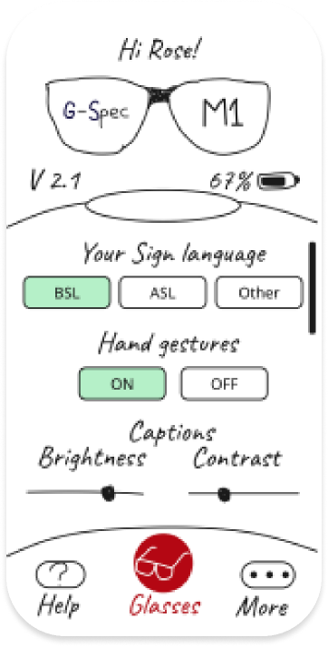
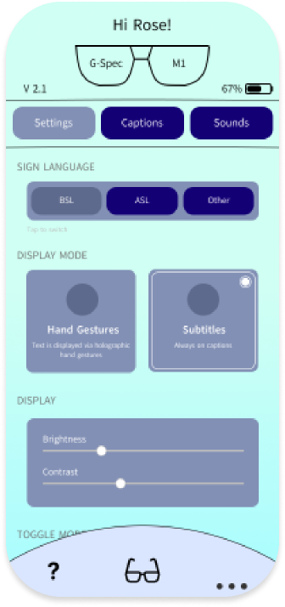
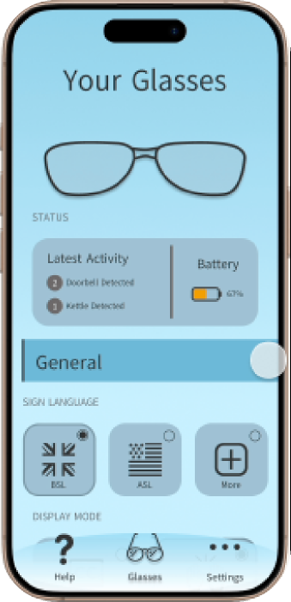
Design: Evolution
Paper Prototype
Interactive Mockup
Final Prototype
05
Notes:
Design evolution (45 Seconds)
Worked through multiple prototypes
Paper mockup outlines the basic concepts and layout
Interactive mockup gives outlines atomic design and implements the paper prototype
Final Prototype fully realises the design and brings consistency

Slide 6
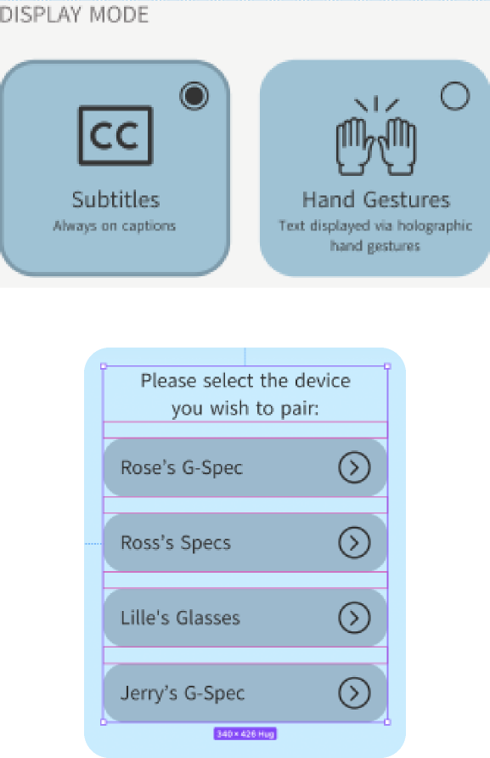
Design: Auto-Layout
Build components where spacing and resizing is handled automatically as content and bounds grow or shrink
06
Notes:
(30 Seconds)
No need to adjust layout when a component changes (for example, due to a change in one of the atoms / molecules)
Makes it easy to have consistent layout spacing throughout the app

Slide 7
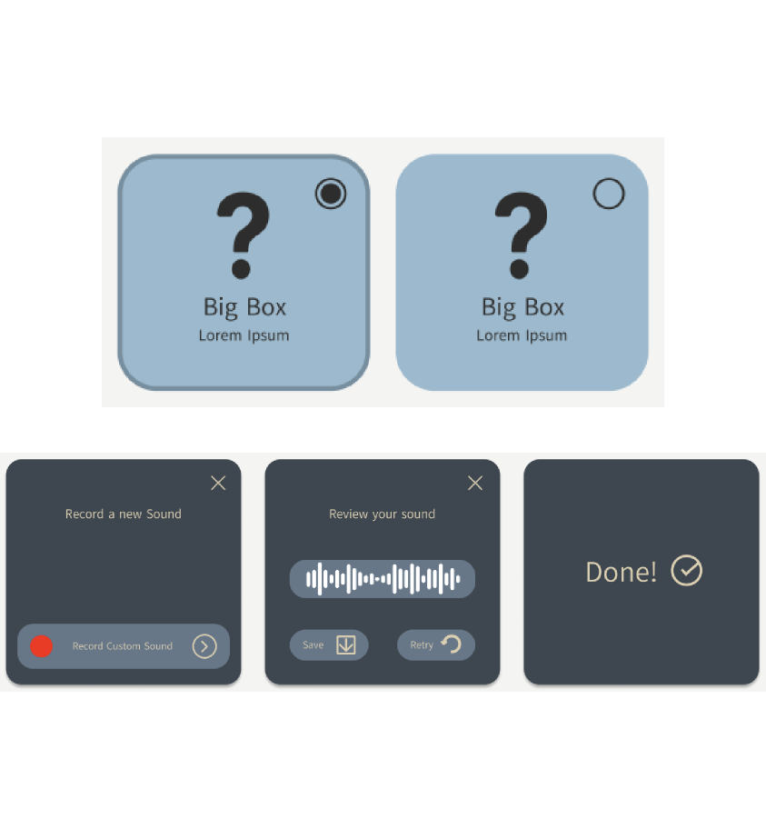
Design: Variants
Group related component states into a single set and switch between them on any instance
07
Notes:
(30 Seconds)

Slide 8
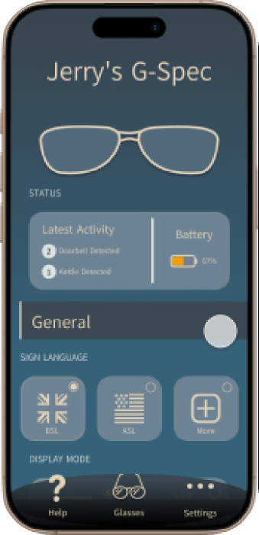
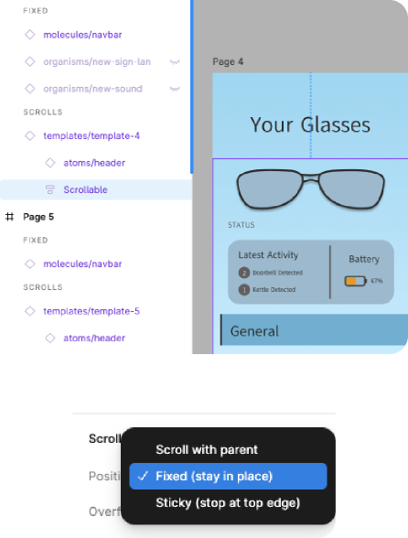
Design: Scrolling
08
Notes:
(30 Seconds)
Components can be Fixed, Scroll with or Sticky at the top of the screen.

Slide 9
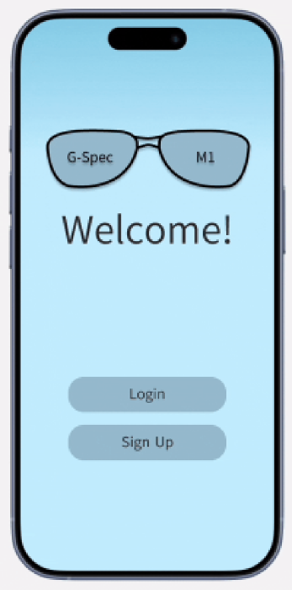
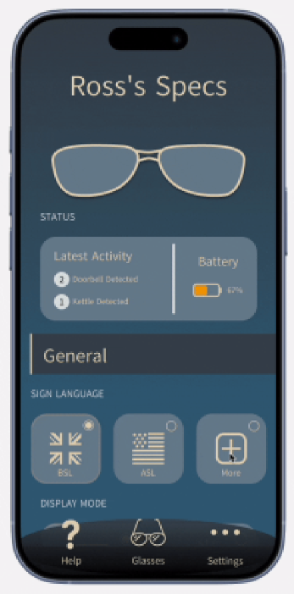
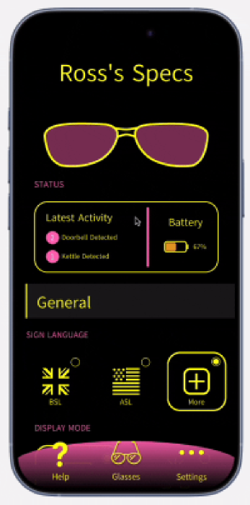
Design: Animations & Transitions
Transitions & Loading
Pop-ups & Selections
Scrolling & Hiding
09
Notes:
Handover - Michael to Angus (40 Seconds)
implemented a spinner for loading - shows it's not frozen
fade for shorter transitions
implemented pop-ups for additional selections - helps stop the UI being cluttered
scrolling is a built in function
doesn't change scroll position when hiding - avoids confusion from sudden jump
bring up next slide

Slide 10
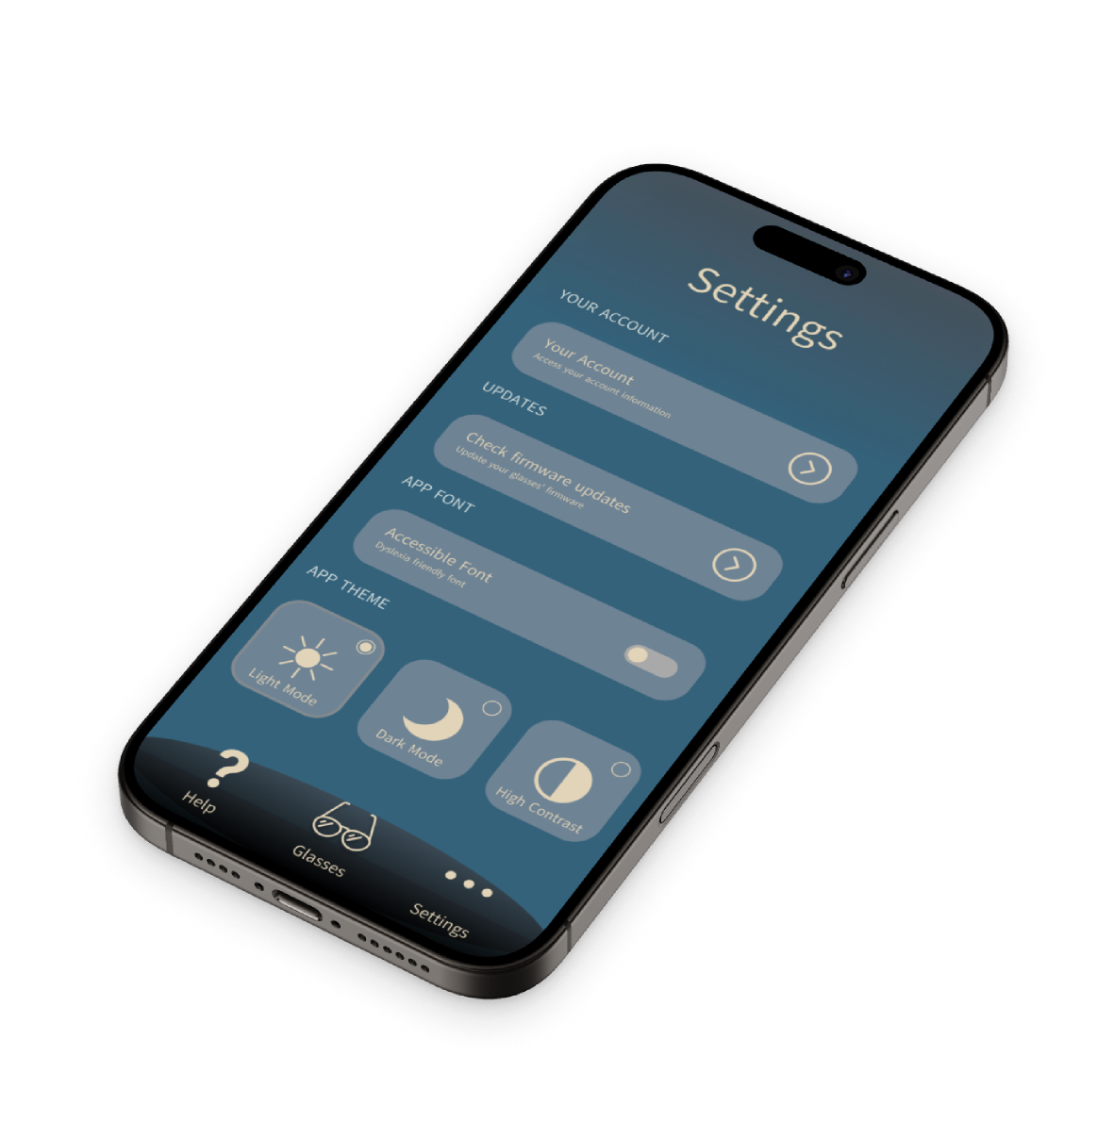
Implementation: Deep Dive
4 of 4
Younis Al Riyami
10
Notes:
Handover - Angus to Younis (10 Seconds)
Example: changing styles, fonts, dynamic components, toggle.

Slide 11
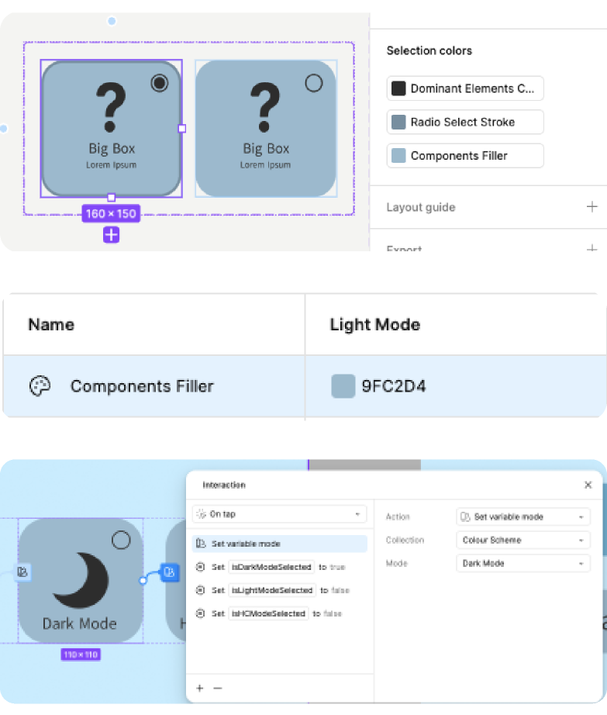
Implementation: Binding
We attach component attributes directly to a variable
Updates to the variable instantly propagate to every referenced component
11
Notes:
(30 Seconds)
attach attributes to global variables (Figma feature)
change propagates every referenced element
_________________________
In order to make our Components react to and cause change, we used Figma’s Variables so we can tie different parts of components to them, such as when hiding and revealing different features by toggling them on and off, or dynamically changing the text styles and radio buttons as we’ll see later.

Slide 12
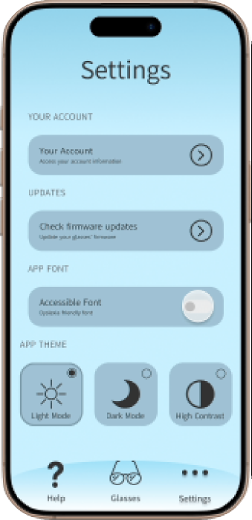
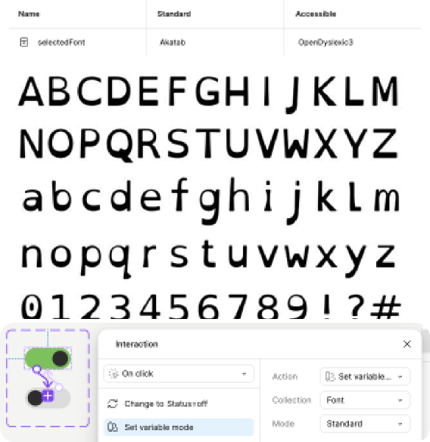
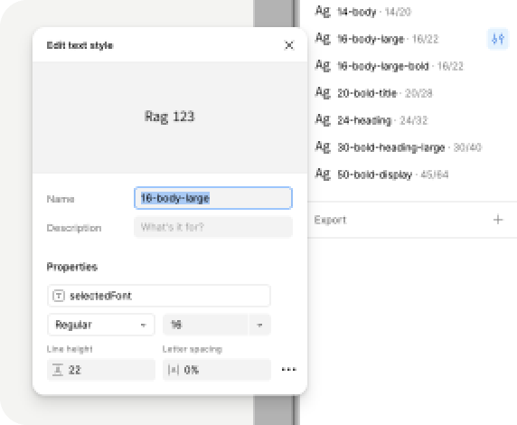
Implementation: Binding
12
Notes:
(20 seconds)
Text variable (selectedFont)
External Free to Use font Open Dyslexic 3
Helps against common symptoms of dyslexia

Slide 13
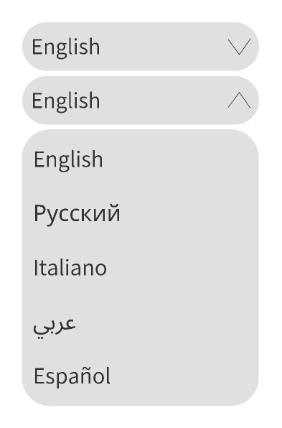

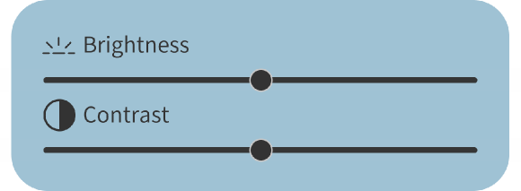
Implementation: Interactivity
Toggle with states intrinsically linked to boolean values
Dropdown where each selection updates a variable value
Leveraging horizontal scrolling to create a “slide” animation
13
Notes:
(30 Seconds)
toggle: variant smart animate tied to variable
slider: secondary scrollable frame
rectangle bigger than frame 1% opacity
radio buttons: variants tied to boolean variables.
drop down- variant and variable to change selection

Slide 14
Colour Styles
Light
Dark
High Contrast
Background Colour
Implementation: Modes
Main Colour
Secondary Colour
Dominant Elements Colour
Components Filler
Static Elements Border
Radio Select Stroke
Subheaders Filler
Map components to semantic tokens rather than fixed colours
Toggle between modes (light, dark, high contrast) to update the entire design in one click
Navbar Background
Static Black
Active
Dropdown
Hover
Background End
Navbar End
Toggle Stroke
Activity Text Fill
14
Notes:
(25 Seconds)
Figma colour variables.
colour styles used in component
instant switch upon theme change everywhere in app

Slide 15
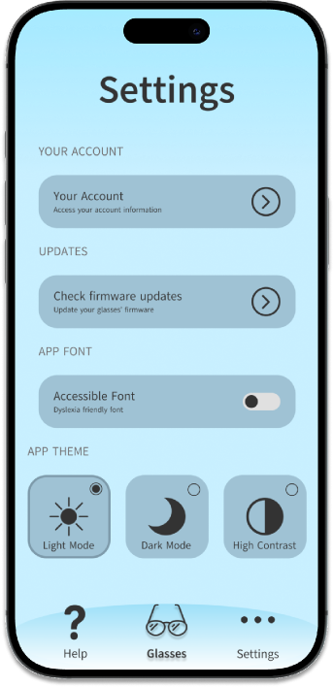
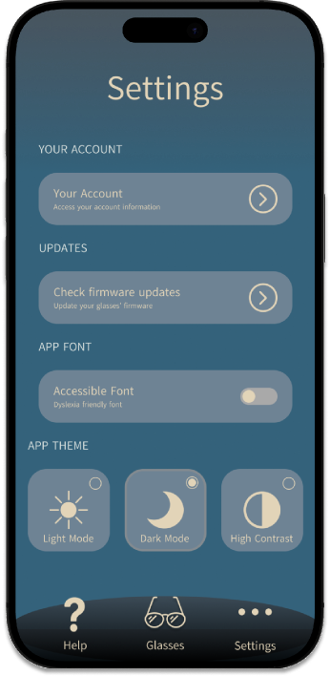
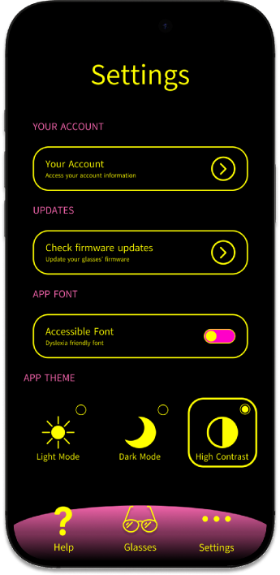
Implementation: Modes
Light (Default)
Dark
High Contrast
15
Notes:
(10 Seconds)
theme change tied to variable which is tied to radio button

Slide 16

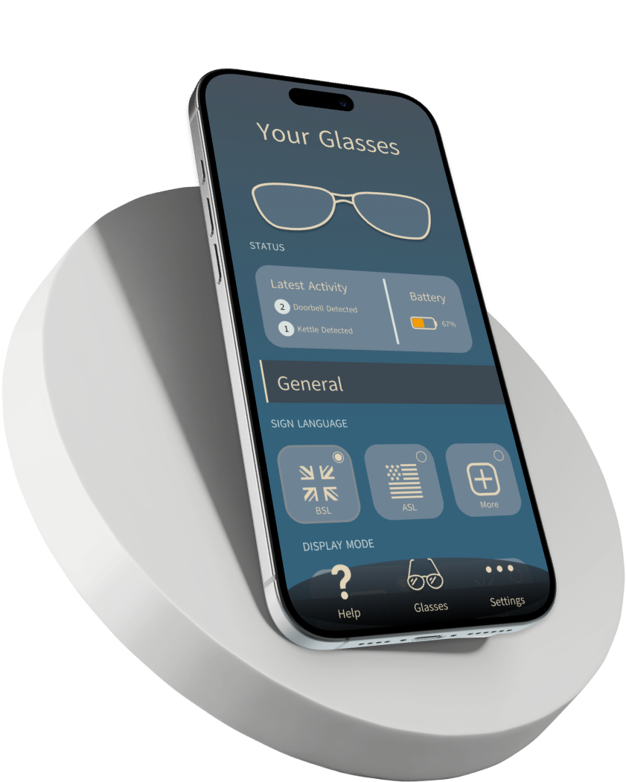
Mar 31, 2026
Thank you.
Please put forward your questions for Q&A
Prepared for CS22003 - User Interface Design
by Kit Cochrane, Michelangelo Prisciano,
Younis Al-Riyami, Abdulrahman Bada, Angus Wilson

