Slide 1
SECURE DATA HIDING IN IMAGES USING STEGANOGRAPHY
CAPSTONE PROJECT
Presented to: EduNet Foundation and AICTE
Student Name : KUSH LODHI
College Name : LNCT, Bhopal
Department : CSE department
Year : 3rd

Slide 2
INDEX :-
Problem Statement
Technology used
Wow factor
End users
Result
Conclusion
Git-hub Link
Future scope

Slide 3
Problem Statement
Traditional encryption methods make hidden messages detectable, posing a security risk. This project implements Image Steganography to securely embed secret messages within images, ensuring confidentiality. The encrypted data remains visually indistinguishable, preventing unauthorized access. A password-based decryption mechanism ensures only authenticated users can retrieve the hidden information.

Slide 4
Technology used
Programming Language:
Python : A high-level programming language used for implementing steganography algorithms efficiently.
Libraries:
OpenCV (cv2): Apowerful computer vision library used for image processing and pixel manipulation.
OS (os): A Python module that allows interaction with the operating system for file handling.
Platform & Tools:
VS Code: A lightweight and versatile code editor used for writing and debugging the project.
GitHub: A platform for version control and collaboration, used to store and manage project files.

Slide 5
Wow factors
Stealth Security:
Unlike traditional encryption, the hidden message remains invisible within the image, making detection almost impossible.
Password-Protected Decryption:
Only users with the correct password can extract the hidden message, ensuring an extra layer of security.
Lightweight & Fast:
The method does not significantly alter the image size or quality, making it efficient and easy to implement.

Slide 6
End users
Cybersecurity Professionals –
Used for covert communication and secure data exchange without detection.
Helps in preventing data breaches by hiding sensitive information in images.
Journalists & Whistleblowers –
Enables safe transmission of confidential information without raising suspicion.
Helps in avoiding censorship and surveillance by embedding messages in images.
Defense & Intelligence Agencies –
Useful for secret communication in military operations and intelligence gathering.
Ensures classified information remains hidden from adversaries.
General Users –
Individuals who want to store passwords, personal notes, or private messages securely.
Helps in protecting sensitive data from hackers or unauthorized access.

Slide 7
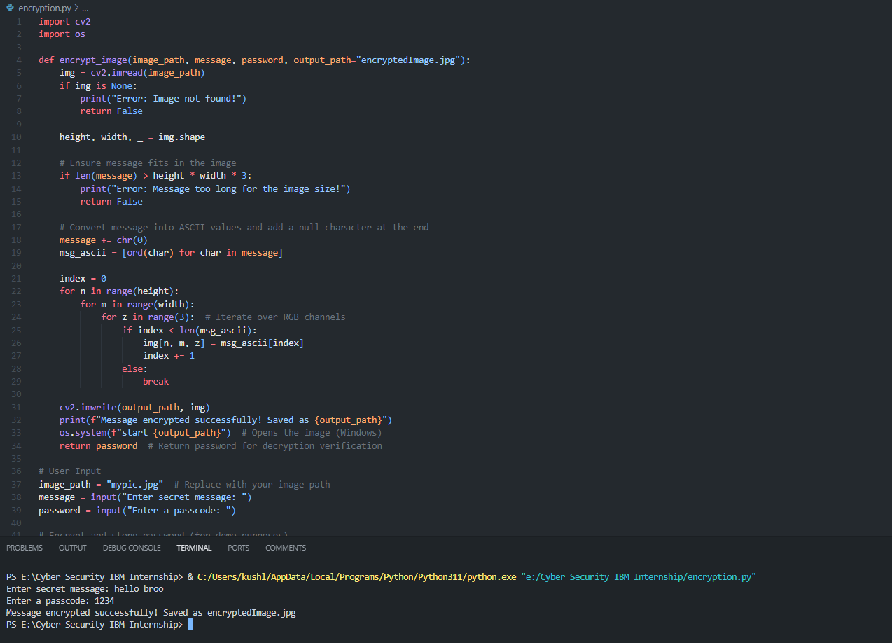
Results
Encrypting secret message into photo named “mypic.jpg” into "encryptedImage.jpg"

Slide 8
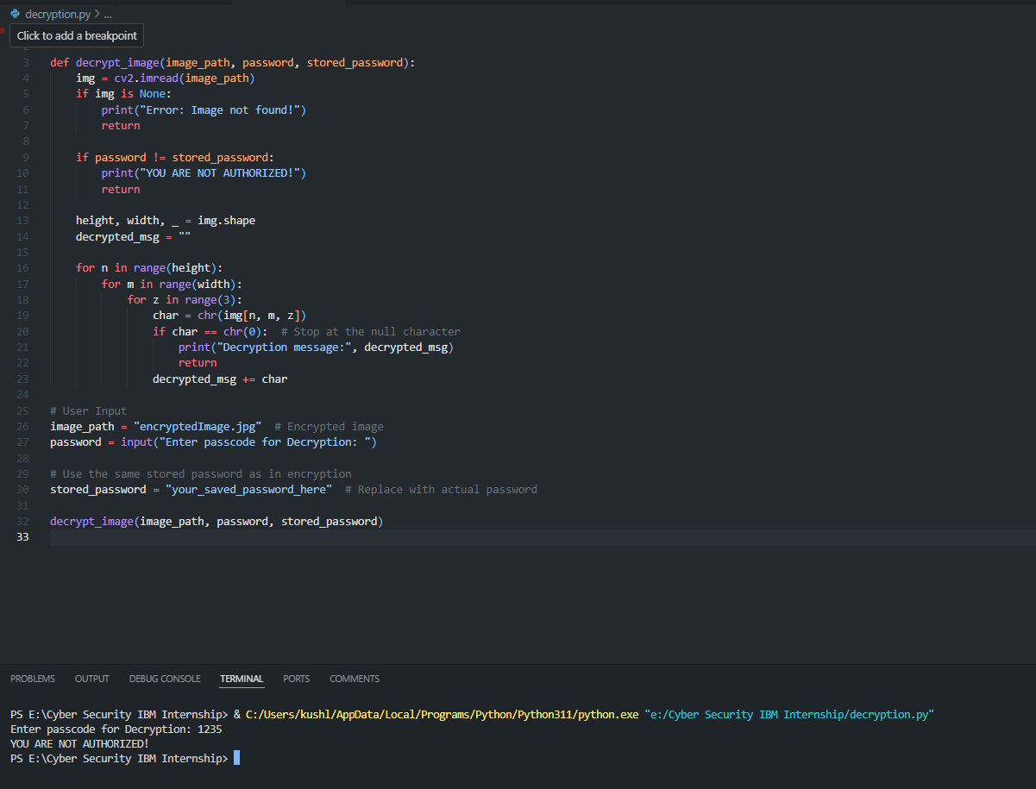
Results
Decrypting secret message from photo named "encryptedImage.jpg“ but enter wrong password so it says NOT AUTHORISED

Slide 9
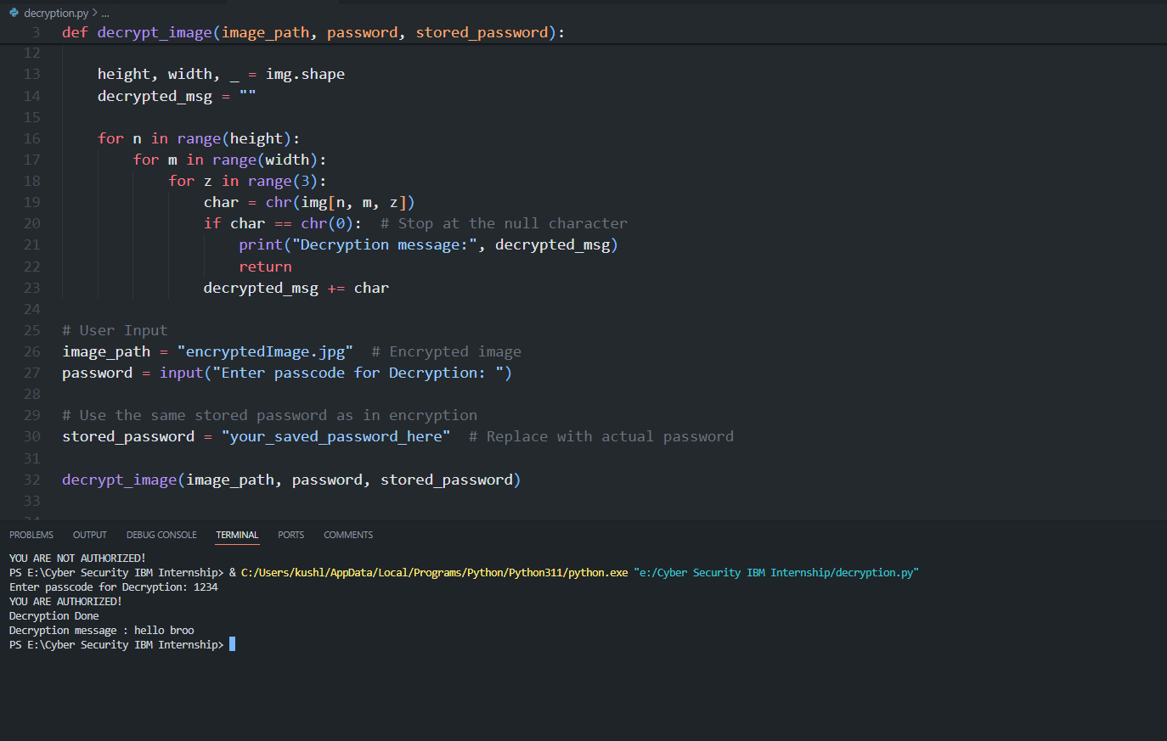
Results
Decrypting secret message from photo named "encryptedImage.jpg” with correct password so it says AUTHORISED and give the secret message

Slide 10
Conclusion
This project addresses the challenge of secure communication by embedding confidential messages within images using steganography. Unlike traditional encryption, it ensures that the hidden data remains undetectable while being retrievable only by authorized users. The use of password authentication further enhances its security, making it a robust method for discreet information exchange.

Slide 11
GitHub Link
GitHub Link - https://github.com/dev-kush1803/EuduNet_Cyber_Security_internship/tree/af466a3d88c6567e35a9afb5f05e5599591f5da1

Slide 12
Future scope(optional)
Advanced Encryption –
Integrate AES or RSA encryption for added security.
Multi-Format Support –
Extend compatibility to various image formats (PNG, BMP, etc.).
GUI Implementation –
Develop a user-friendly interface for ease of access.
Cloud Integration –
Store and retrieve encrypted images securely over the cloud.

Slide 13
THANK YOU

