Slide 1

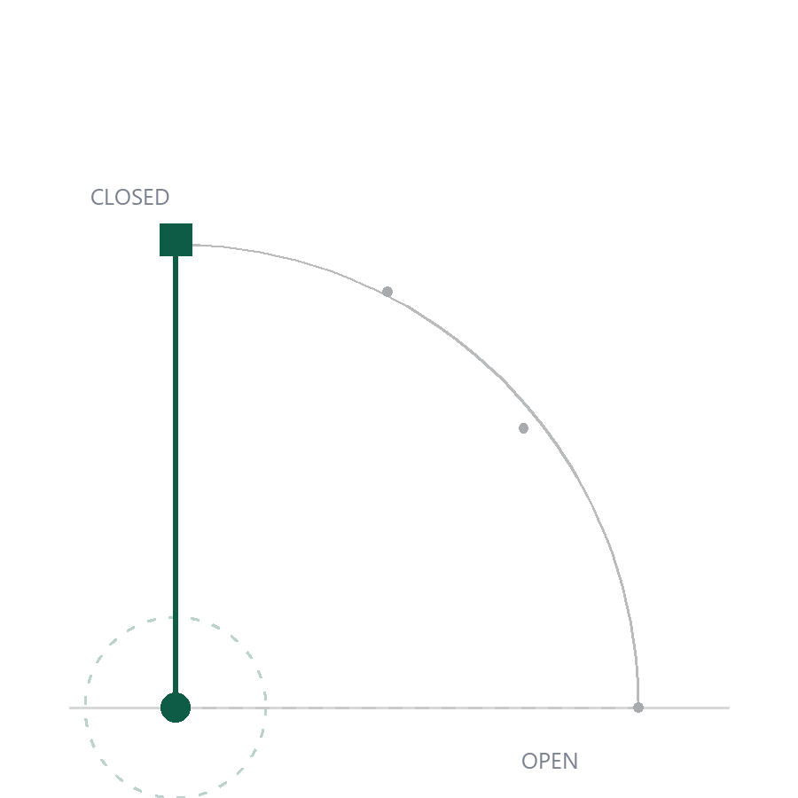
CAPSTONE DEFENSE · 2026
SYSTEM DESIGN · COMPUTER VISION · EMBEDDED
Smart
Gate.
A school gate that recognizes a face and opens — with no internet, no server, and no GPU in the building.
PRESENTED BY
PROGRAM
DATE
[Your name]
BS Computer Science
November 2026
SMART GATE · THE OFFLINE ACCESS TERMINAL
01 / 13

Slide 2
THE PROBLEM
Access control is one two-second decision, repeated two thousand times a day.
Humans are exceptional at judgement and terrible at repetition. Every existing gate failure is a failure of one of these three things.
01 — IDENTITY
02 — EVIDENCE
03 — AUTONOMY
A guard cannot hold 2,000 faces in their head.
A paper log proves nobody anything.
Cloud AI needs what a gate does not have.
Recognising one face reliably is easy. Recognising two thousand of them, in daylight and in rain, is a different problem.
It records that someone passed. It cannot say who, at what second, or why the gate decided to open.
A reliable internet connection — at 7:40 in the morning, at a gate, in a school, in the provinces.
SMART GATE · CAPSTONE DEFENSE 2026
02 / 13

Slide 3
THE CONVENTIONAL STACK
Every layer of a normal design adds one more way for the gate to be closed.
CONVENTIONAL CLOUD GATE
SMART GATE
Where inference runs
GPU server, or a Raspberry Pi bolted to the post
On the tablet, in a Web Worker, on the camera's own device
Internet
Required for every single decision
Optional — used only to sync logs and renew guest passes
Where the faces go
Frames leave the school over the network
Nowhere — the embedding never leaves the IndexedDB store
Hardware per gate
Compute board + camera + enclosure + power budget
A tablet that already exists, plus one microcontroller
Failure mode
Network down → gate down → queue at the gate
Network down → gate still works → logs queue and reconcile later
SMART GATE · CAPSTONE DEFENSE 2026
03 / 13

Slide 4
THESIS
We did not put the AI
in the cloud.
We put it in the gate.
Face detection, a 512-dimension embedding and the access decision all execute inside the browser on the device that is already standing at the gate. The only thing the network is used for is record-keeping — which is exactly the one job that can wait until later.
SMART GATE · CAPSTONE DEFENSE 2026
04 / 13

Slide 5
ARCHITECTURE
Three tiers, and the decision is made in the one that cannot go offline.
EDGE · THE TABLET
CLOUD · SUPABASE
CONTROL · ESP32
Kiosk PWA
Records
The arm
— BlazeFace detection
— PostgreSQL access logs
— Servo on GPIO 13
— ArcFace 512-d embedding
— Enrolment photos
— SoftAP + WebSocket
— Confirm + policy decision
— Staff-only auth + RLS
— Physical override
— Audit row with reason code
— Kiosk heartbeat
— NVS pose calibration
— IndexedDB offline queue
— Daily AI briefing (cached)
↓ DECIDES LOCALLY IN ≈ 40 MS
↓ SYNCS WHEN ONLINE
↑ 1 COMMAND, 1 ACKNOWLEDGEMENT
NO SERVER-SIDE AI
NO PYTHON RUNTIME
NO GPU
TABLET WORKS IN AIRPLANE MODE
SMART GATE · CAPSTONE DEFENSE 2026
05 / 13

Slide 6
PIPELINE · EVERY THIRD FRAME
Six steps, one thread budget, and a person who never has to stand still for long.
01
02
03
04
05
06
Detect
Embed
Match
Confirm
Decide
Record
BlazeFace, short range, WASM.
112² crop → ArcFace, 512-d, L2-normalised.
Cosine against every enrolled angle.
Five identical reads, clear of the runner-up.
Lockdown → guest pass → face match.
IndexedDB row with a reason code.
≈ 5 MS
30–50 MS
BEST SCORE
≈ 2.5 S
3 OUTCOMES
CRASH-SAFE
The heavy model runs in a shared Web Worker so the camera preview never stutters — detection stays on the main thread at 5 ms, inference is handed off and never blocks a frame.
Nothing in this chain calls the network. Pull the Wi-Fi down and steps 01–06 behave identically; only step 06's second half waits.
SMART GATE · CAPSTONE DEFENSE 2026
06 / 13

Slide 7
IDENTITY · THREE CHECKS, NOT ONE
A face is not a match. A match is not a decision.
0.70 cosine
01
Similarity
0.70
The winning template must clear the floor. Below it, the kiosk has seen someone it does not know.
MINIMUM SIMILARITY TO CALL IT A MATCH
02
Confirmation
5 reads
Five consecutive matching reads — about 2.5 s of holding still. One blurred frame can never grant.
The floor, not the verdict. Raised from 0.65 after strangers were still matching enrolled students on single motion-blurred frames.
03
Margin
0.08
The winner must beat the runner-up by this much. Two lookalikes at 0.71 and 0.70 stay undecided.
PUBLISHED BENCHMARK OF THE MODEL
99.4% LFW verification
Three independent guards, each one cheap to test. The failure they prevent is not a rejected student — it is a stranger wearing a classmate's face.
The model's published figure — not our measured false-accept rate.
A WRONG NAME IS WORSE THAN NO NAME
The 0.70 threshold has not been calibrated against a target false-match rate on the enrolled population. That is open work, not a result.
Below every guard the outcome is an unknown face and a soft beep — a reset, never an accusation.
SMART GATE · CAPSTONE DEFENSE 2026
07 / 13

Slide 8
POLICY · FACE PLUS A RULE THAT CAN CHANGE
The gate does not decide alone. Policy runs first.
01
02
03
Guest e-pass
Lockdown
Students
Time-boxed visitors, not exceptions
One switch, campus-wide
No pass, no exception
— Enrolled by the guard like a student
— Every entry denied, staff included
— A face match is the whole check
— Named host and an expiry time
— Reason shown on the gate screen
— Policy still evaluated first
— Expired pass is refused at the gate
— Manual guard override remains
— Decision written with a reason code
EVERY DECISION IS EXPLAINABLE
GUEST_PASS_VALID
granted · live guest pass
Each access row carries a machine-readable reason code and a sentence the guard can read.
POLICY_PASS
granted · student on face match
GUEST_EXPIRED
denied · pass expired, guard told
LOCKDOWN_ACTIVE
denied · campus lockdown
SMART GATE · CAPSTONE DEFENSE 2026
08 / 13

Slide 9
DECISION INTEGRITY · ONE PERSON, ONE ROW
The kiosk used to log one student 140 times in a single sitting.
Recognition kept running after the verdict, re-deciding whoever was still standing there every few seconds. The attendance view became unreadable. Leaving the frame is now what re-arms the scanner.
AND THE GATE IS REPORTED HONESTLY
A command sent to nothing is not an open barrier. Three states, never rounded up:
OPEN
the controller confirmed the barrier released
1.5 s
60 s
2.5 s
The gate area must be empty this long before another decision is allowed.
A repeat decision is shown on screen but writes no second row.
A low read must persist this long before it counts as an unknown face.
AWAITING
a controller is linked but has not confirmed
SENT
a command went out with nothing linked — demo mode
The log records which of the three actually happened — simulated, unconfirmed or open — so nobody can read a demo as a working gate.
SMART GATE · CAPSTONE DEFENSE 2026
09 / 13

Slide 10
THE 10% · GATE ACTUATION
One microcontroller, one servo, and its own private network.
Servo
GPIO 13 · 0° rest, 180° full open · pose saved in NVS
WHY THE HOTSPOT, NOT THE SCHOOL WI-FI
A captive portal on the school network means a login page between the tablet and the gate. The board broadcasting its own access point removes that dependency entirely: the tablet joins the gate, not the internet. When a router is configured it joins that too — the hotspot never goes down.
Transport
WebSocket ws://192.168.4.1:81 over the board's own SoftAP
Hotspot
SmartGate-Gate1 — stays up whether or not a school network is joined
Cycle
1.5 s transit, 5 s hold, then close — one acknowledgement per command
FEEDBACK LOOP
NO CABLE, NO ROUTER
Override
GPIO 4 button: tap opens the gate, 10 s hold forgets Wi-Fi
The kiosk waits for S:OPEN before it says the gate opened — silence is not success.
Wi-Fi gate control with USB serial as the fallback; either way the arm moves.
Fallback
USB serial to an Arduino when no ESP32 is linked
SMART GATE · CAPSTONE DEFENSE 2026
10 / 13

Slide 11
VERIFICATION · WHAT WAS ACTUALLY CHECKED
We tested the claims we make, and only those.
83/83
512-d
3
0
UNIT TESTS
EMBEDDING
HONEST GATE STATES
SERVER-SIDE AI
Scan policy, confirmation, gate parsing, heartbeat rows, audio throttle — all pure functions, all covered.
ArcFace w600k_mbf, L2-normalised, compared by cosine against every enrolled angle.
OPEN, AWAITING and SENT — the log records which one happened, including simulation.
Airplane-mode rehearsal: detection, recognition, decision, gate command and queued logging all pass with the network off.
ALSO VERIFIED
Full open/close cycle on the physical arm with hash-verified flash · offline log queue surviving a reload · one access row per visit · deny reasons stored as codes · guest pass expiry enforced at the gate.
SMART GATE · CAPSTONE DEFENSE 2026
11 / 13

Slide 12
LIMITATIONS & NEXT WORK
What this prototype does not yet do.
MEASURED
NOT YET
NEXT, IN ORDER
— Face match and decision logic, unit-tested
— False-accept rate on the enrolled population
1.
Calibrate the threshold to a target false-match rate
— Offline recognition and queued sync
— Presentation-attack resistance
2.
Add liveness before any claim of security
— Physical open/close cycle
— Throughput at a real morning rush
3.
Load-test one gate at 7:40, then a second gate
— Guest expiry and lockdown enforcement
— Fairness across skin tones and lighting
4.
Give the guard a conflict-resolution screen
Every item on the right is a thing a panel could ask for and this prototype cannot answer yet. Naming them is the difference between a demo and a system.
SMART GATE · CAPSTONE DEFENSE 2026
12 / 13

Slide 13
IN CLOSING
Pull the network out.
The gate still opens.
FACE
MATCH
GATE
SERVER-SIDE AI
512-d ArcFace, on-device
0.70 floor, 5-read confirm
ESP32 over its own hotspot
none
Thank you.
QUESTIONS
A live unit is set up — the demo works with the Wi-Fi off.
SMART GATE · CAPSTONE DEFENSE 2026
13 / 13

