Slide 1




















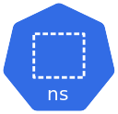
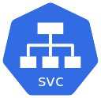





AWS Cloud
BALOGUN L.O
Virtual private cloud (VPC)
V1
V2
V3
AZ-1
AZ-2
Public subnet
Public subnet
Private subnet
Private subnet
TEST
BUILD
PUSH
UPDATE
Dev
Infra
Worker Node
Worker node
Branch

