Slide 1


NCACE 2026
(13 - 14 March 2026)
1st National Conference on Advances in Civil Engineering
Organised by
Department of Civil Engineering, Motihari College of Engineering, Motihari
East Champaran-845401, Bihar (India)
PAPER ID: 905
Title of Presentation – “Integration of Artificial Intelligence with BIM for Intelligent Civil Infrastructure Design”
Md Mahtab Alam(1), AbuOsama Alam(2), Mohammad Aknan(3),Kahkashan Kouser(4)
Department of Computer Science & Engineering, Motihari College of Engineering, Motihari, India
Department of Civil Engineering, Motihari College of Engineering, Motihari, India
Notes:
0

Slide 2
NCACE 2026
(13 - 14 March 2026)
1st National Conference on Advances in Civil Engineering
Organised by
Department of Civil Engineering, Motihari College of Engineering, Motihari
East Champaran-845401, Bihar (India)
Table of Content
Introduction
Related research / works
Current research gap
Our Objective
Methodology
Result Analysis
Conclusion
Future Research
Notes:
11

Slide 3
1. Introduction
‹#›
  Importance of Civil Infrastructure
Civil infrastructure and bridge systems play a crucial role in economic development, transportation efficiency, and social connectivity.
  Limitations of Traditional Construction Methods
Conventional construction planning mainly relies on manual processes, rule-based systems, and human experience, which can be time-consuming and prone to errors.
  Role of Artificial Intelligence (AI)
AI has emerged as an advanced technology capable of improving efficiency, accuracy, and predictive analysis in engineering and construction processes.
  Current Use of Building Information Modelling (BIM)
BIM enhances design coordination, visualization, and information management, but it mainly functions as a modelling and data management tool without intelligent decision-making capabilities.
  Need for AI–BIM Integration
Integrating AI with BIM can enable automated analysis, optimized workflows, and data-driven decision-making, especially during the preliminary engineering and pre-construction planning phases.

Slide 4
2. Related Work / Current Works
‹#›
  AI and Machine Learning in Construction Planning
Recent studies review how AI and ML are applied across different phases of construction projects, improving planning, scheduling, and risk prediction, but highlight that systematic integration across the full project lifecycle is still limited.
Taken from : Science Direct
• AI–BIM Integration for Smart Construction
Research shows that combining Artificial Intelligence with Building Information Modelling (BIM) can improve decision-making, productivity, and project efficiency throughout the design and construction lifecycle.
Taken from : Springer link
• AI-Driven Automation in Construction Workflows
Recent frameworks use AI with BIM data and digital twin systems to automate tasks such as construction scheduling, constraint checking, and planning analysis, enabling more intelligent project management.
Taken from : MPDI
• Machine Learning Enhancement of BIM Systems
Studies indicate that ML algorithms integrated with BIM can optimize processes like delay prediction, cost estimation, and safety monitoring, making projects more efficient and sustainable
Taken from : Springer link

Slide 5
3. Research Gaps
‹#›
  Limited Integration of AI and BIM
Most existing studies apply Artificial Intelligence (AI) and Building Information Modelling (BIM) separately, with limited research focusing on their integrated application for intelligent construction planning.
• Focus on Isolated Engineering Tasks
Current AI applications in civil engineering mainly address specific tasks such as structural analysis, cost estimation, or risk prediction, rather than providing a comprehensive planning framework.
• Lack of Intelligent Support in Early Project Phases
The Preliminary Engineering and Pre-Construction Planning phases still rely heavily on manual analysis and experience-based decision-making, with minimal AI-driven automation.
• Need for Data-Driven Decision Systems
There is a need to develop AI-enabled models integrated with BIM that can support automated recognition, efficient workflow optimization, and intelligent decision-making in infrastructure development.

Slide 6
4. Our Objective
‹#›
• To develop an AI-based intelligent framework for supporting bridge design & other infrastructure design during the preliminary engineering and pre-construction planning phases.
• To integrate civil engineering datasets, formulas, and structural calculations into an automated decision-support system.
• To use AI models for recommending suitable bridge structures and design strategies based on engineering parameters and soil conditions.
• To generate automated outputs such as technical drawings, 3D visualizations, cost estimations, and engineering reports.
• To demonstrate how AI-driven infrastructure planning can improve efficiency, reduce manual effort, and support data-driven civil engineering decisions.

Slide 7
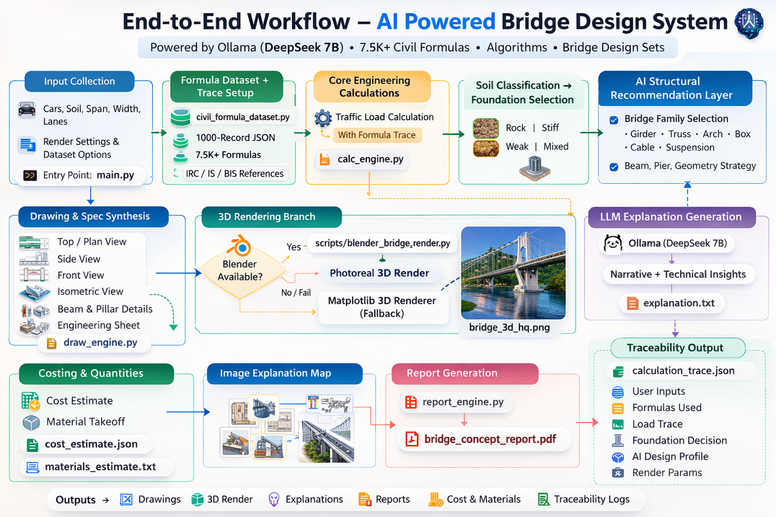
5. Proposed Methodology [A]
‹#›
Fig. 1. End-to-end workflow of the proposed AI-powered bridge design system, showing input processing, engineering calculations, AI-based structural recommendations, 3D visualization, cost estimation, and automated report generation.

Slide 8
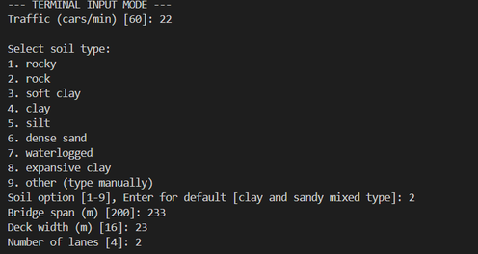
5. Proposed Methodology [B]
‹#›
Step 1 – Input Collection
User provides basic bridge design parameters such as traffic load, soil type, span length, width, and lane configuration.
Step 2 – Formula Dataset & Trace Setup
The system loads a civil engineering formula dataset containing standard design equations and references (IRC/IS/BIS) required for bridge calculations.
Step 3 – Core Engineering Calculations
The calculation engine performs structural computations such as traffic load analysis and design parameter evaluation using the stored formulas.
fig : Showing Input Parameters which is given by the user

Slide 9
5. Proposed Methodology [C]
‹#›
Step 4 – Soil Classification & Foundation Selection
Based on the input soil properties, the system determines soil category (rock, stiff, weak, or mixed) and suggests suitable foundation types.
Step 5 – AI Structural Recommendation
The AI module analyzes calculated parameters and recommends the most appropriate bridge type (girder, truss, arch, cable, suspension, or box).
Step 6 – Drawing & 3D Visualization
The framework generates engineering drawings (plan, side, front, isometric views) and creates a 3D bridge model using Blender or fallback renderers.
Step 7 – Cost & Material Estimation
The system automatically calculates construction cost estimates and material quantities required for the bridge structure.
Step 8 – Report & Explanation Generation
Finally, the system produces technical explanations, traceability logs, and a complete bridge design report for decision-making and documentation.
METHODOLOGY ENDS HERE.

Slide 10
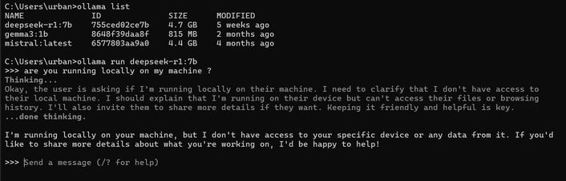
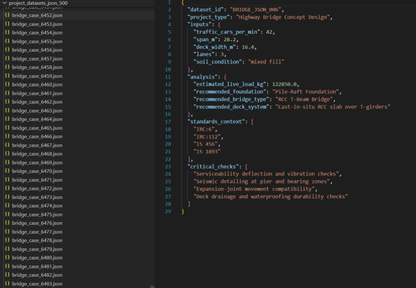
6. Results/analysis [A]
‹#›
1 – Successful Local AI Execution
The AI model runs locally using Ollama (DeepSeek-7B) with the provided civil engineering datasets, demonstrating independent processing without external API & cloud dependency.
fig 2: Local AI model running
2 – Dataset Processing & Formula Loading / User input
The system successfully loads the civil engineering formula dataset and engineering references, enabling automated structural calculations with the User input.
(CURRENT)
user input parametrs are:
  Traffic per minutes
  type of soil
  bridge spain
  deck wedith
  number of lanes
fig 2.1: Datasets & formula records 6500+ datasets used
fig 2.1.A : User Input & parameters given by user

Slide 11
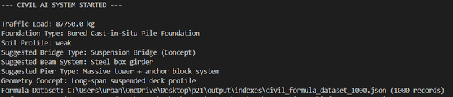
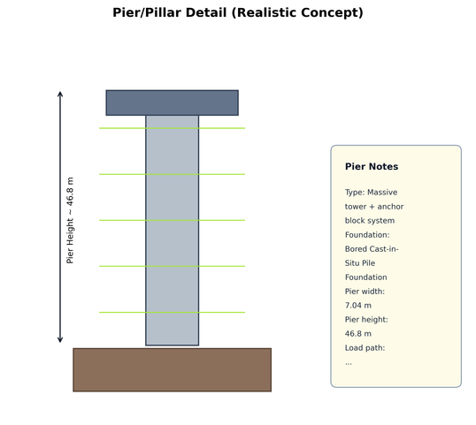
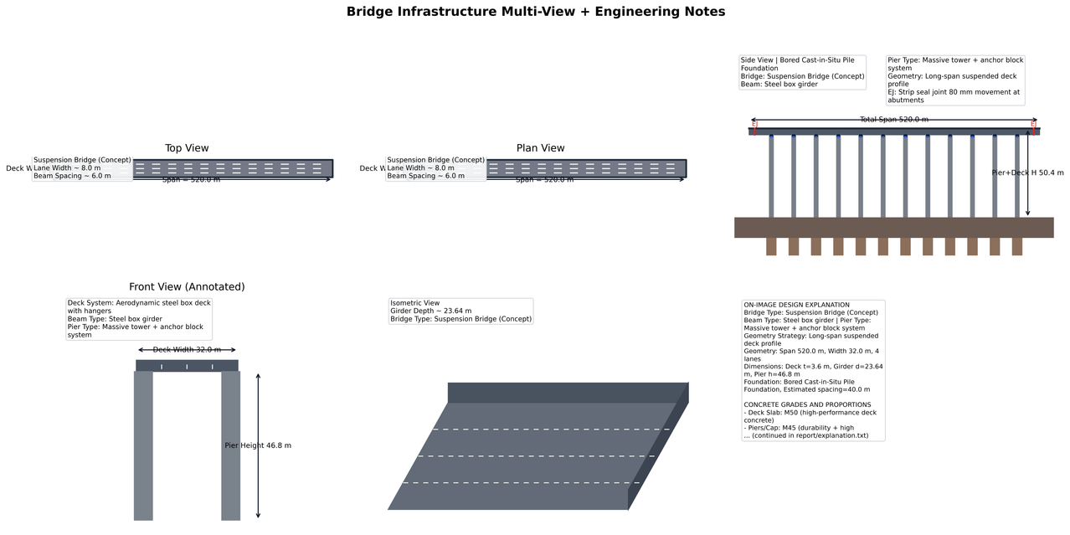
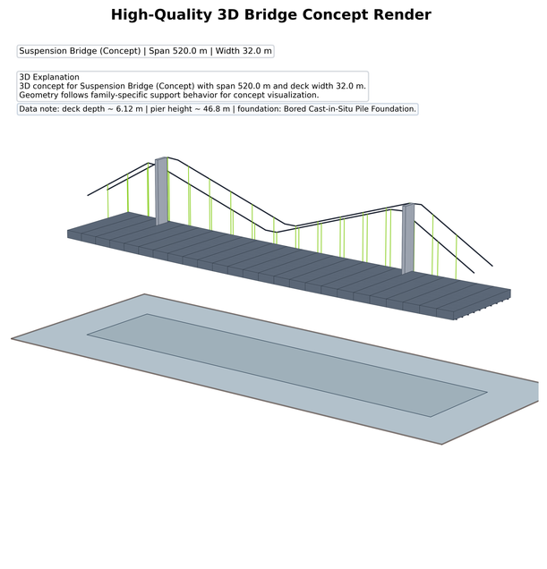
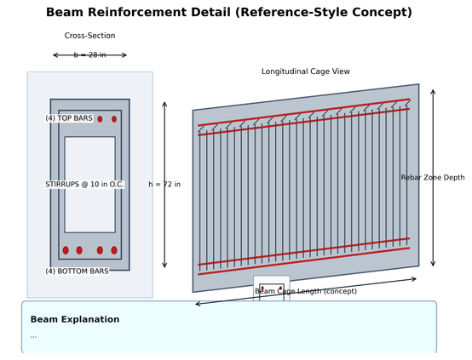
6. Results/analysis [B]
‹#›
3 – Automated Engineering Calculations
The calculation engine generates traffic load analysis and structural parameter results based on the given bridge design inputs.
fig 2.2: Ai doing the whole complex calculations and design suggestion
4 – Automated Design, Drawing & 3D Visualization
The framework generates technical drawings ( all types of view) and a 3D bridge model, allowing visual understanding of the proposed design with image explanation.
fig 2.5: Pillar Design done by AI
fig 2.3: Ai generate all type of view i.e- top view, plane view ,
isometric view, side view etc.
fig 2.4: 3D model of the bridge ( very basic level)
fig 2.6: BEAM Design done by AI

Slide 12
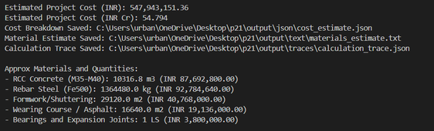
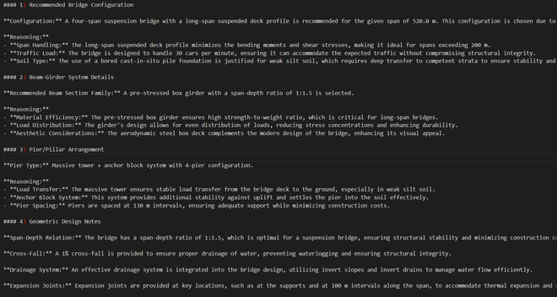
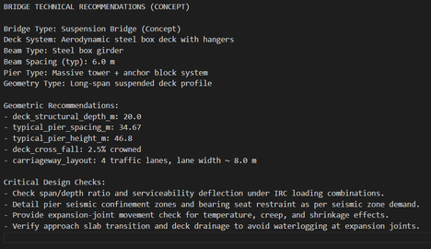
6. Results/analysis [C]
‹#›
6 – Cost & Material Estimation
The system produces cost estimates and material quantity calculations, supporting early-stage construction planning.
fig 2.7: Cost estimation output by Ai model
7 – Automated Report & Explanation Generation
A complete bridge design report with explanations and traceability logs is generated for documentation and engineering review in pdf formate.
fig 2.8: Whole Concept explanation by Ai model
fig 2.9: Bridge Technical Recommendation by Ai model

Slide 13
7. Conclusion
‹#›
          This study aimed to develop an AI-based intelligent bridge design framework integrated with BIM concepts to improve efficiency during the preliminary engineering and pre-construction planning phases.
          Results show that the proposed system can automatically process bridge design inputs, perform engineering calculations, recommend suitable bridge structures, and generate visual and analytical outputs.
          Based on local AI models, civil engineering datasets, and automated calculation algorithms, we were able to create an end-to-end workflow that generates drawings, 3D bridge visualization, cost estimation, and technical reports.
  The system successfully demonstrates AI-assisted structural decision support
  Automated outputs include design recommendations, cost estimates, and engineering reports
          Our study helps to improve early-stage bridge planning by reducing manual calculations, increasing efficiency, and enabling data-driven infrastructure design, contributing to the development of intelligent and sustainable civil engineering systems.

Slide 14
8. Future research
‹#›
Future Research
Future work will focus on integrating real-world engineering datasets, comprehensive civil engineering algorithms, design formulas, and standard codes such as IS codes to achieve more accurate and realistic design outputs.
Additionally, the proposed framework can be extended to support other infrastructure systems such as intelligent buildings, road networks, and urban infrastructure planning.
With more realistic datasets and engineering standards, this approach has the potential to make pre-construction planning faster, more reliable, and more intelligent for modern infrastructure development.

Slide 15
NCACE 2026
(13 - 14 March 2026)
1st National Conference on Advances in Civil Engineering
Organised by
Department of Civil Engineering, Motihari College of Engineering, Motihari
East Champaran-845401, Bihar (India)
Thank you!
Presenting Author: MD. MAHTAB ALAM
Email Address: myselfmahtab04@gmail.com
Instead of funding, we seek hardware computing resources (high-GPU machines), large data storage, and access to real-world civil engineering datasets to further advance this research and achieve more realistic infrastructure planning results.
Notes:
11

