Slide 1
Anonymous message broadcasting
Shiva sai ram marupudi
Swathi Mannem
Shivendran Divakar tiruchanpalli
Naga suraj maddi

Slide 2
Table OF Contents
What is Anonymous Message Broadcasting?
DC-nets
Limitations of DC-net
Blue Print of AMB
Steps implemented
Steps yet to be implemented

Slide 3
What is Anonymous Message Broadcasting ?
Broadcasting of messages without revealing the identity of sender.
IP tracing should not be possible
This can be best explained by using the Dining Cryptographers problem.

Slide 4
DC-net Protocol
Also called as Dining Cryptographers Problem
Proposed by David Chaum in 1988
Used for broadcasting of unconditional anonymous messages
Unconditional Sender and Recipient Intractability

Slide 5

DC-net when none of the philosophers paid the bill i.e. NSA paid the bill.
A
(XOR(1 and 0))
0
C
(XOR(1 and 0))
1
B
(XOR(1 and 1))
1

Slide 6
DC-net when one of the philosopher paid bill
A
NOT(XOR(1 and 0))
0
C
(XOR(1 and 0))
1
B
(XOR(1 and 1))
1

Slide 7
Limitations of dc-nets
Collision : Allows only one participant to transmit at a time using this protocol
Disruption : Any malicious cryptographer who does not want the group to communicate successfully can jam the protocol by sending random bits instead of the correct result of the XOR
Complexity : The protocol requires pairwise shared secret keys between the participants, which may be problematic if there are many participants.

Slide 8
Collision
A
NOT(XOR(1 and 0))
0
C
(XOR(1 and 0))
1
B
NOT((XOR(1 and 1)))
1

Slide 9
Blue print of Anonymous Message Broadcasting

Slide 10
Register
Create/Cancel a Meeting
USER
Join/Exit a Meeting

Slide 11


User getting access to the meeting
Fetch the key from email
Use key to enter chat room
user
Unique key is sent through e-mail to all the participants

Slide 12



All Clients and the Server should be connected to the same network.
Client 1
Server
Client 2
….....
Client 3
Client 4
Client N

Slide 13
Steps implemented
User registration
Chat application
Users can host anonymous messaging in chat rooms without revealing their identities

Slide 14

Registration Page

Slide 15
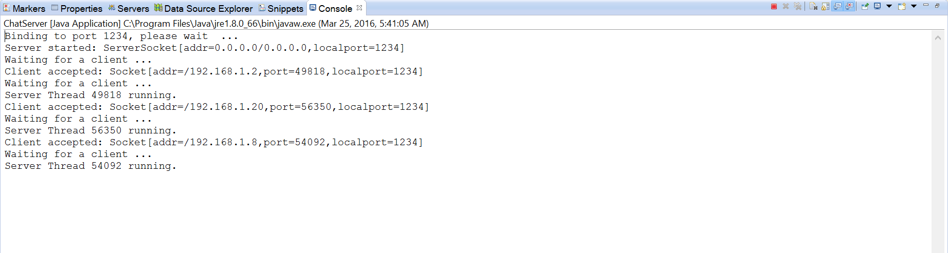

Slide 16
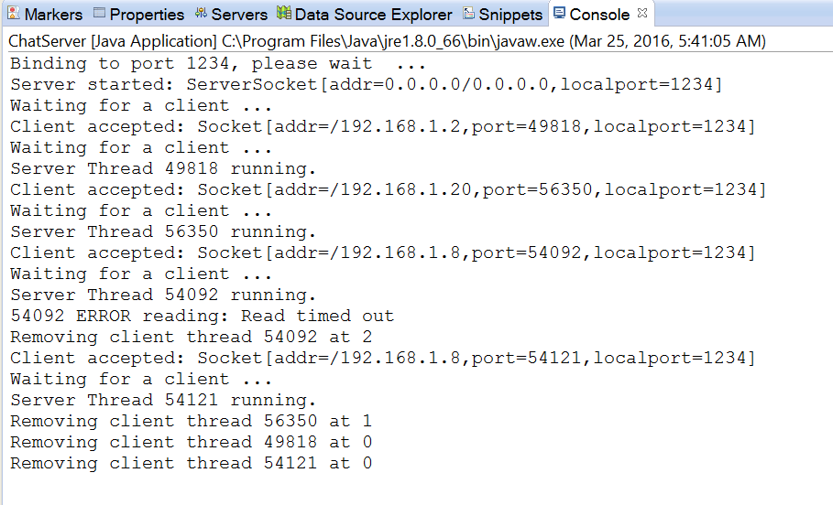

Slide 17
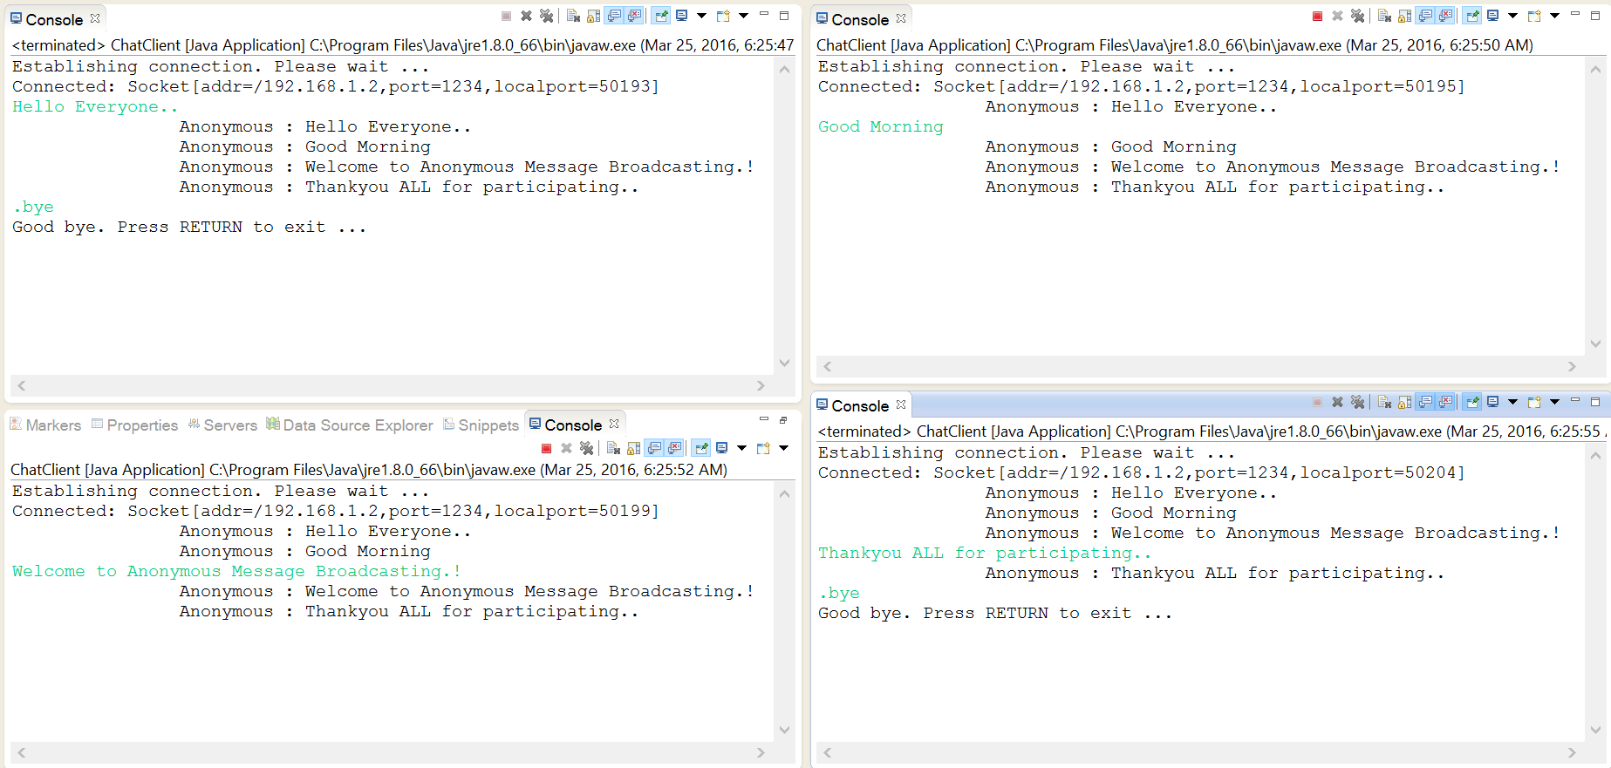

Slide 18
Steps yet to be completed
UI development for chat room and anonymous chat room
Key functions like:
When can the group enter anonymous chat room
How to navigate from normal chat room to anonymous chat room
IP tracing
Generating and Distributing a unique key

