Slide 1

SPOTIFY PLAYLIST CLASSIFIER
Martín Iglesias Goyanes
Jaime del Prado Abril

Slide 2
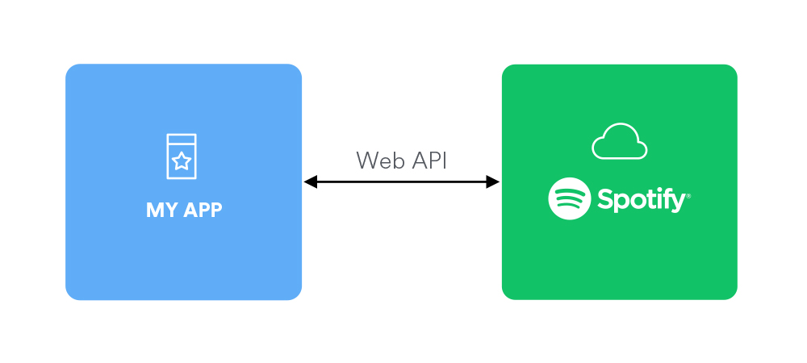

Data Gathering
API de Spotify
kaggle

Slide 3
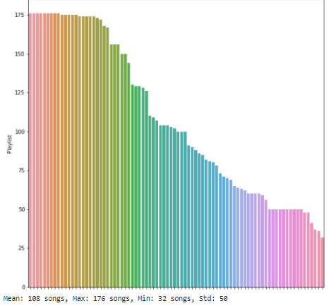
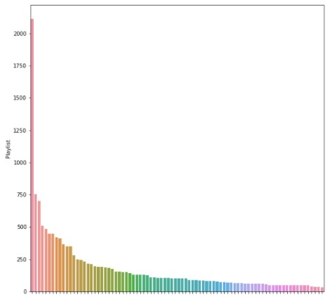
DATA CLEANING
DATA IMBALANCES
DOWNSAMPLING

Slide 4
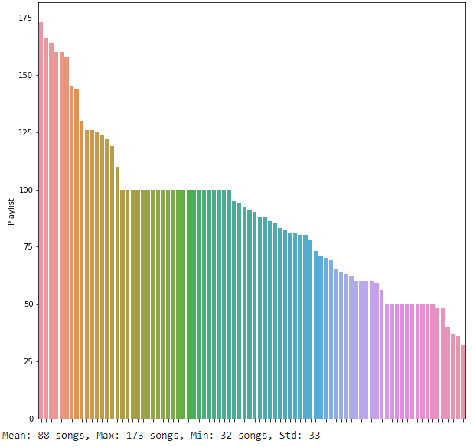
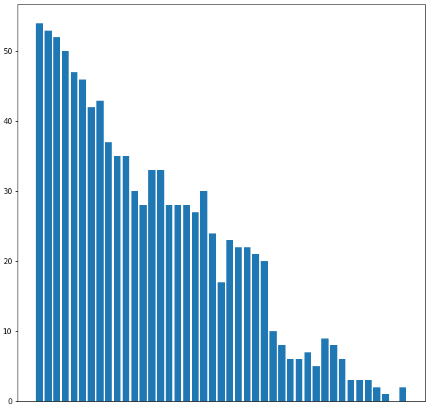
DATA CLEANING
Missing Values
REMOVING
%

Slide 5
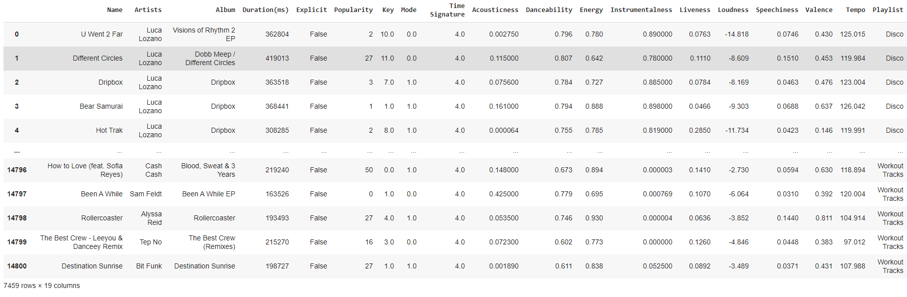
DATA CLEANING
.csv

Slide 6
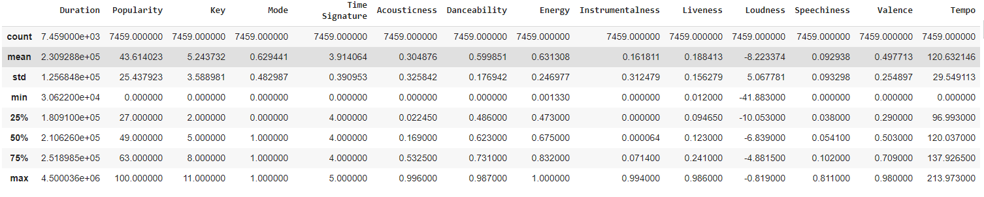
Data Study
Statistics

Slide 7

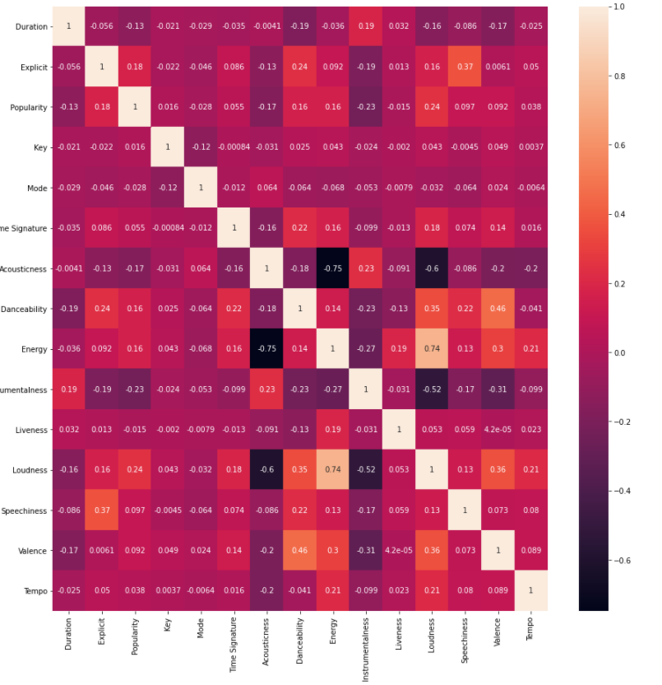
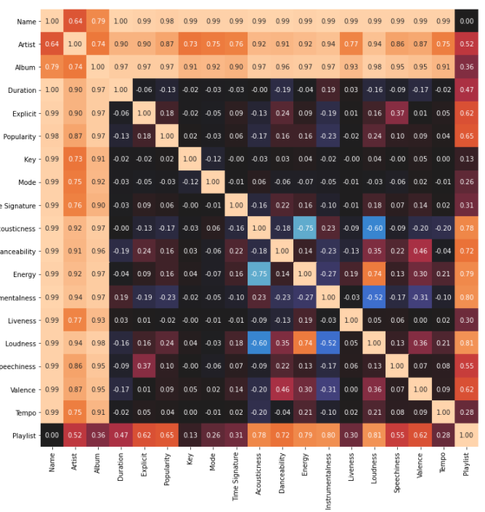
Data Study
Artist, Explicit, Popularity, Acousticness, Danceability, Energy,
Instrumentalness, Loudness and Valence
Correlation MAtrixes
Only COntinuous
ConTINUOUS AND CATEGORICAL

Slide 8
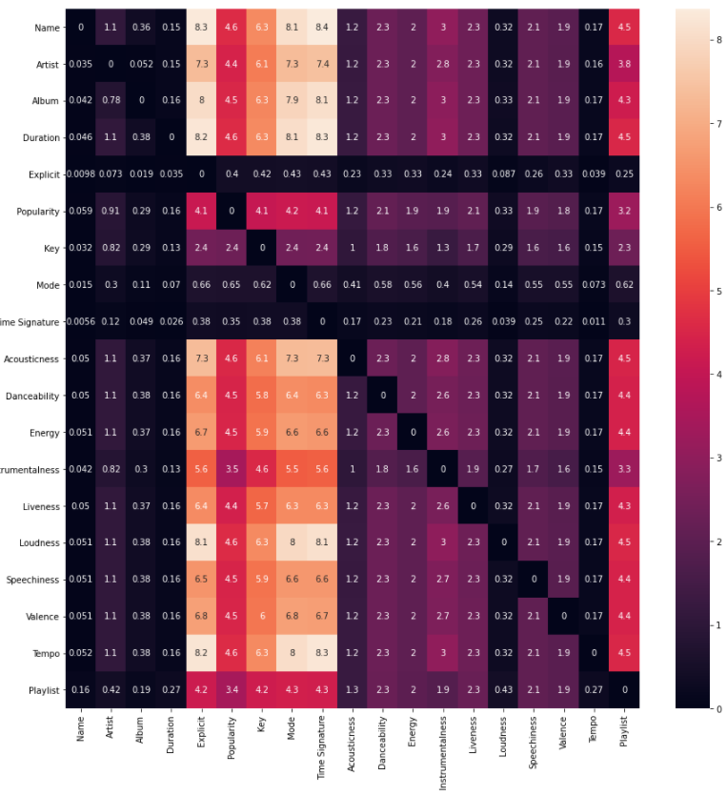
Data Study
Conditional entropy

Slide 9
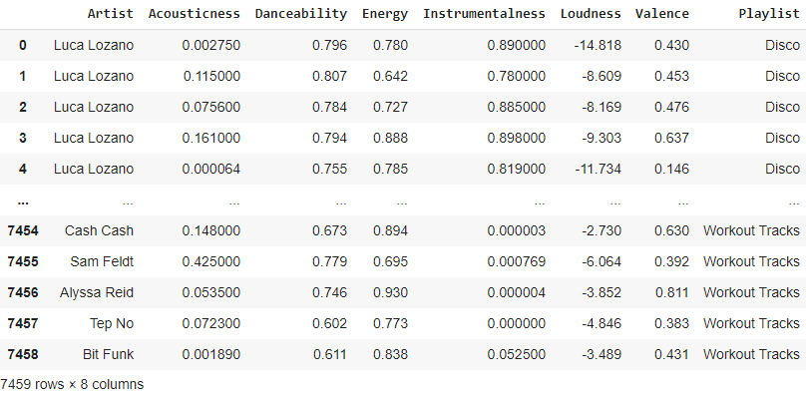
Data Study
FINAL FEATURES SELECTION:
Acousticness, Danceability, Instrumentalness, Loudness, Popularity and
Artist.

Slide 10
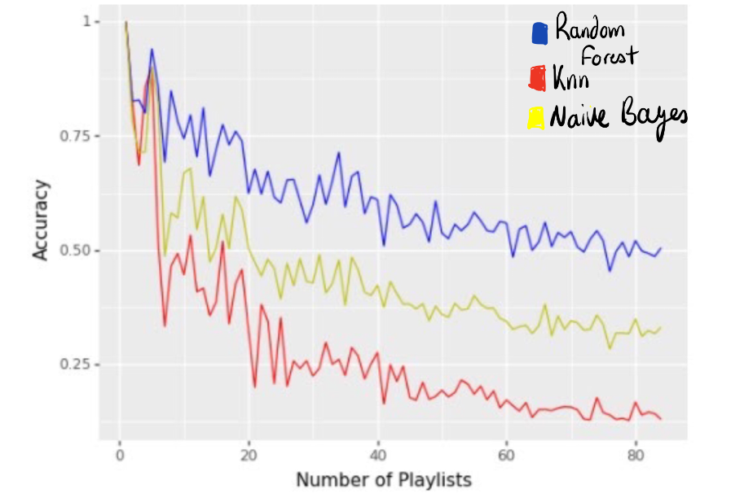
Data Study.
Optimal Number of Classes

Slide 11

Data modelling
Audio Features vs Audio Features + Artist
RFE vs Our Data Study
Models:
Naive Bayes
Random forest
Deep neural net

Slide 12
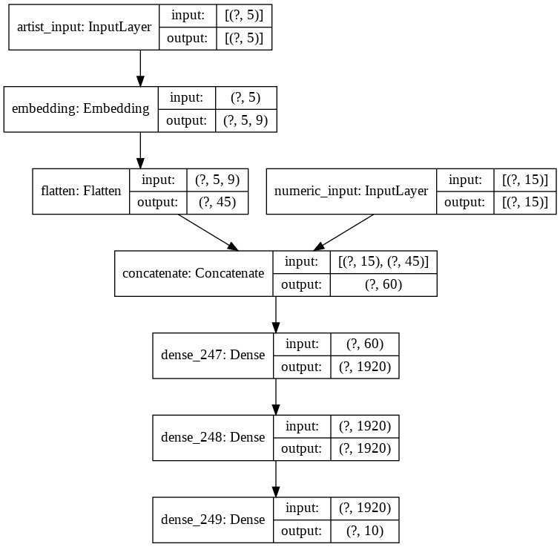

Slide 13
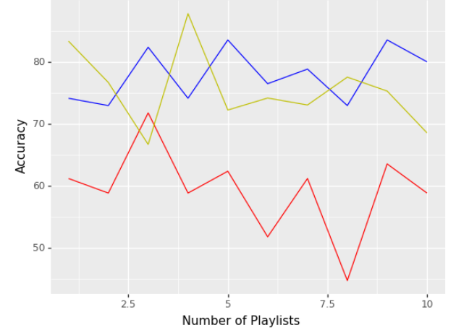
Models ACcuracies
Audio Features With RFE
Random Forest
Deep Neural Network
Naive Bayes
FOLDS

Slide 14
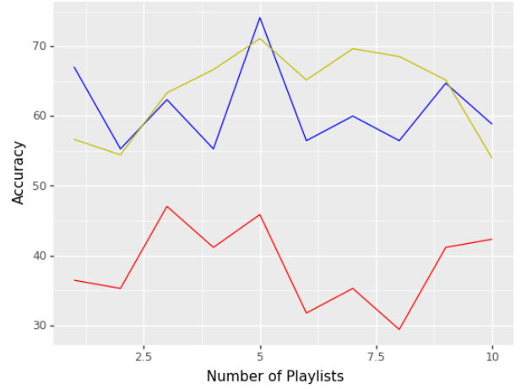
Models ACcuracies
Continuous With OUR SELECTeD FEATURES
Random Forest
Deep Neural Network
Naive Bayes
FOLDS

Slide 15
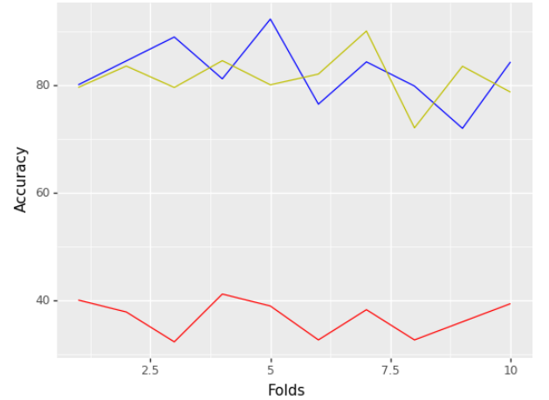
Models ACcuracies
Continuous + CATEGORICAL With RFE
Random Forest
Deep Neural Network
Naive Bayes

Slide 16
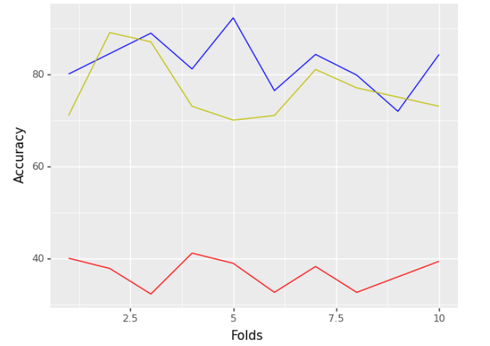
Models Accuracies
Continuous + CATEGORICAL With Selected Features
Random Forest
Deep Neural Network
Naive Bayes

Slide 17
Deductions.
The model mostly classifies in a correct way between the different genres of songs. most of the errors are between different rap playlists or punk-metal...
The model does not recognize the language of the song, classifying rap_espanol with tuff which both are rap, one American rap and the other Spanish rap.
Powerhour playlist is not an appropriate since it is a gym playlist which has songs of rap, punk, edm the example of the song "goosebumps" demonstrates it. this song could be classified in both playlists.
The use of embeddings to use a categorical variable like the artist with such a big dimensional space gives a lot of information to the models and that is why we can see such improvement in rf model and deep neural network.
Random forest is the classifier that should be used.
Neural networks also have a very great performance, very close to the rf models. however, the optimization of the network could be better and in case you optimize it for this problem you will most likely get better results than with the rf model
The whole set of continuous features will give a decent job, using categorical would give a slightly better result.

Slide 18
THANKS

