Slide 1

On Some Results and Challenges in Cryptoeconomics
Tim Roughgarden
(a16z crypto & Columbia University)
Crypto Economics Security Conference (CESC)
November 1, 2022

Slide 2
Starting Point: Mechanism Design

Slide 3
Starting Point: Mechanism Design
0, 0
-1, 1
1, -1
Game theory: analyze strategic aspects of a given game.
dominant strategies, Nash equilibria, etc.
1, -1
0, 0
-1, 1
-1, 1
1, -1
0, 0

Slide 4
Starting Point: Mechanism Design
0, 0
-1, 1
1, -1
Game theory: analyze strategic aspects of a given game.
dominant strategies, Nash equilibria, etc.
Mechanism design: “inverse game theory” (“economist as engineer”)
identify desired outcome (e.g., welfare-maximizing allocation)
design game w/that outcome as equilibrium (e.g., VCG mechanism)
payments allowed, traditionally in external currency (e.g., USD)
1, -1
0, 0
-1, 1
-1, 1
1, -1
0, 0

Slide 5
Starting Point: Mechanism Design
0, 0
-1, 1
1, -1
Game theory: analyze strategic aspects of a given game.
dominant strategies, Nash equilibria, etc.
Mechanism design: “inverse game theory” (“economist as engineer”)
identify desired outcome (e.g., welfare-maximizing allocation)
design game w/that outcome as equilibrium (e.g., VCG mechanism)
payments allowed, traditionally in external currency (e.g., USD)
Question: what if mechanism has access to a native currency?
1, -1
0, 0
-1, 1
-1, 1
1, -1
0, 0

Slide 6
Starting Point: Mechanism Design
0, 0
-1, 1
1, -1
Game theory: analyze strategic aspects of a given game.
dominant strategies, Nash equilibria, etc.
Mechanism design: “inverse game theory” (“economist as engineer”)
identify desired outcome (e.g., welfare-maximizing allocation)
design game w/that outcome as equilibrium (e.g., VCG mechanism)
payments allowed, traditionally in external currency (e.g., USD)
Question: what if mechanism has access to a native currency?
with power (minting/burning/etc.) comes responsibility (macro implications)
1, -1
0, 0
-1, 1
-1, 1
1, -1
0, 0

Slide 7
Bitcoin as Mechanism Design
Desired outcome in Bitcoin/Nakamoto consensus:
every node dutifully solves PoW puzzles, extends longest chain

Slide 8
Bitcoin as Mechanism Design
Desired outcome in Bitcoin/Nakamoto consensus:
every node dutifully solves PoW puzzles, extends longest chain
Mechanism: for each block on longest chain, give reward to miner
intuition: incentivizes miners to coordinate on longest chain

Slide 9
Bitcoin as Mechanism Design
Desired outcome in Bitcoin/Nakamoto consensus:
every node dutifully solves PoW puzzles, extends longest chain
Mechanism: for each block on longest chain, give reward to miner
intuition: incentivizes miners to coordinate on longest chain
nuance [Eyal/Sirer 14]: can incentivize unintended behavior more!

Slide 10
Bitcoin as Mechanism Design
Desired outcome in Bitcoin/Nakamoto consensus:
every node dutifully solves PoW puzzles, extends longest chain
Mechanism: for each block on longest chain, give reward to miner
intuition: incentivizes miners to coordinate on longest chain
nuance [Eyal/Sirer 14]: can incentivize unintended behavior more!
Question: where does the money for rewards come from?

Slide 11
Bitcoin as Mechanism Design
Desired outcome in Bitcoin/Nakamoto consensus:
every node dutifully solves PoW puzzles, extends longest chain
Mechanism: for each block on longest chain, give reward to miner
intuition: incentivizes miners to coordinate on longest chain
nuance [Eyal/Sirer 14]: can incentivize unintended behavior more!
Question: where does the money for rewards come from?
answer: newly minted coins (effectively, a tax on BTC holders)
note: hard/impossible without control of a native currency

Slide 12
Micro Implications of Macro Decisions
Bitcoin’s macroeconomic policy: hard cap of 21 million Bitcoins.

Slide 13
Micro Implications of Macro Decisions
Bitcoin’s macroeconomic policy: hard cap of 21 million Bitcoins.
consequence: given that Bitcoins never removed from circulating supply (i.e., no burning), block rewards must go to 0
miner rewards then come solely from transaction fees (and maybe MEV)

Slide 14
Micro Implications of Macro Decisions
Bitcoin’s macroeconomic policy: hard cap of 21 million Bitcoins.
consequence: given that Bitcoins never removed from circulating supply (i.e., no burning), block rewards must go to 0
miner rewards then come solely from transaction fees (and maybe MEV)
obvious issue: if tx fees stay small, poor economic security

Slide 15
Micro Implications of Macro Decisions
Bitcoin’s macroeconomic policy: hard cap of 21 million Bitcoins.
consequence: given that Bitcoins never removed from circulating supply (i.e., no burning), block rewards must go to 0
miner rewards then come solely from transaction fees (and maybe MEV)
obvious issue: if tx fees stay small, poor economic security
subtle issue: unlike block rewards, tx fees vary widely across blocks
[Carlsten/Kalodner/Weinberg/Narayanan 16] miners incentivized to fork/replay blocks with unusually high tx fees, continually undercut each other

Slide 16
Micro Implications of Macro Decisions
Bitcoin’s macroeconomic policy: hard cap of 21 million Bitcoins.
consequence: given that Bitcoins never removed from circulating supply (i.e., no burning), block rewards must go to 0
miner rewards then come solely from transaction fees (and maybe MEV)
obvious issue: if tx fees stay small, poor economic security
subtle issue: unlike block rewards, tx fees vary widely across blocks
[Carlsten/Kalodner/Weinberg/Narayanan 16] miners incentivized to fork/replay blocks with unusually high tx fees, continually undercut each other
potential solution: smooth transaction fees over many of blocks

Slide 17
Micro Implications of Macro Decisions
Bitcoin’s macroeconomic policy: hard cap of 21 million Bitcoins.
consequence: given that Bitcoins never removed from circulating supply (i.e., no burning), block rewards must go to 0
miner rewards then come solely from transaction fees (and maybe MEV)
obvious issue: if tx fees stay small, poor economic security
subtle issue: unlike block rewards, tx fees vary widely across blocks
modern version: MEV can vary widely across blocks
“MEV smoothing”: smooth MEV payouts over validators
challenge: unlike tx fees, MEV not directly available to the L1 protocol

Slide 18
EIP-1559 as Mechanism Design
Desired outcome for (scarce) Ethereum blockspace: fully allocated, and allocated only to the most valuable transactions.

Slide 19
EIP-1559 as Mechanism Design
Desired outcome for (scarce) Ethereum blockspace: fully allocated, and allocated only to the most valuable transactions.
aspiration: set tx fees = market-clearing price (supply = demand)

Slide 20
EIP-1559 as Mechanism Design
Desired outcome for (scarce) Ethereum blockspace: fully allocated, and allocated only to the most valuable transactions.
aspiration: set tx fees = market-clearing price (supply = demand)
first-price auction: let users figure out price for themselves

Slide 21
EIP-1559 as Mechanism Design
Desired outcome for (scarce) Ethereum blockspace: fully allocated, and allocated only to the most valuable transactions.
aspiration: set tx fees = market-clearing price (supply = demand)
first-price auction: let users figure out price for themselves
EIP-1559: compute market-clearing price (“base fee”) in-protocol

Slide 22
EIP-1559 as Mechanism Design
Desired outcome for (scarce) Ethereum blockspace: fully allocated, and allocated only to the most valuable transactions.
aspiration: set tx fees = market-clearing price (supply = demand)
first-price auction: let users figure out price for themselves
EIP-1559: compute market-clearing price (“base fee”) in-protocol
continually adjust (on-chain signal for excess demand = past block sizes)
bidding true valuation is optimal unless base fee << market-clearing price
non-manipulable by a block producer (even if colluding with end users)
twist: only works if base fee revenues directed away from block’s producer!
see [Buterin 18], [Roughgarden 21] for details

Slide 23
Macro Implications of Micro Decisions
Question: to whom should base fee revenues be routed?

Slide 24
Macro Implications of Micro Decisions
Question: to whom should base fee revenues be routed?
EIP-1559’s policy: burn them!
note: only an option because of the native currency!

Slide 25
Macro Implications of Micro Decisions
Question: to whom should base fee revenues be routed?
EIP-1559’s policy: burn them!
note: only an option because of the native currency!
Macroeconomic consequences: deflationary pressure on ETH.
even more significant after post-Merge reduction in block rewards

Slide 26
Macro Implications of Micro Decisions
Question: to whom should base fee revenues be routed?
EIP-1559’s policy: burn them!
note: only an option because of the native currency!
Macroeconomic consequences: deflationary pressure on ETH.
even more significant after post-Merge reduction in block rewards
Question: is this a good thing?

Slide 27
Macro Implications of Micro Decisions
Question: to whom should base fee revenues be routed?
EIP-1559’s policy: burn them!
note: only an option because of the native currency!
Macroeconomic consequences: deflationary pressure on ETH.
even more significant after post-Merge reduction in block rewards
Question: is this a good thing?
every ETH holder: yes! (cf., “ultra-sound money” meme)

Slide 28
Macro Implications of Micro Decisions
Question: to whom should base fee revenues be routed?
EIP-1559’s policy: burn them!
note: only an option because of the native currency!
Macroeconomic consequences: deflationary pressure on ETH.
even more significant after post-Merge reduction in block rewards
Question: is this a good thing?
every ETH holder: yes! (cf., “ultra-sound money” meme)
every macroeconomist: no! (cf., 1990s Japan)

Slide 29
AMMs as Mechanism Design
Problem: enable the exchange of ETH (say) for USD and vice versa.

Slide 30
AMMs as Mechanism Design
Problem: enable the exchange of ETH (say) for USD and vice versa.
Traditional solution (NYSE, Coinbase, etc.): use an order book.
issues: computationally costly, poor liquidity for long-tail tokens

Slide 31
AMMs as Mechanism Design
Problem: enable the exchange of ETH (say) for USD and vice versa.
Traditional solution (NYSE, Coinbase, etc.): use an order book.
issues: computationally costly, poor liquidity for long-tail tokens
Automated market makers: “liquidity providers (LPs)” supply tokens
market always willing to accept buy/sell orders at quoted price
price determined by number of coins x,y of each type (e.g., y/x)

Slide 32
AMMs as Mechanism Design
Problem: enable the exchange of ETH (say) for USD and vice versa.
Traditional solution (NYSE, Coinbase, etc.): use an order book.
Automated market makers: “liquidity providers (LPs)” supply tokens
market always willing to accept buy/sell orders at quoted price
price determined by number of coins x,y of each type (e.g., y/x)
General problem: mechanism design with severe computational constraints (cf., algorithmic mechanism design [Nisan/Ronen 99]).
note: not about cryptocurrencies per se (cf., lack of native token in Uniswap v1)

Slide 33
LVR in AMMs
AMM benefits: simplicity, guaranteed liquidity.
AMM costs: might force LPs to trade at worse-than-market prices.
e.g., if AMM price is stale and corrected by an arbitrageur

Slide 34
LVR in AMMs
AMM benefits: simplicity, guaranteed liquidity.
AMM costs: might force LPs to trade at worse-than-market prices.
e.g., if AMM price is stale and corrected by an arbitrageur
Question: how to measure these costs?

Slide 35
LVR in AMMs
AMM benefits: simplicity, guaranteed liquidity.
AMM costs: might force LPs to trade at worse-than-market prices.
e.g., if AMM price is stale and corrected by an arbitrageur
Question: how to measure these costs?
Old answer: impermanent loss (IL).
issue: adverse selection costs occluded by market movements

Slide 36
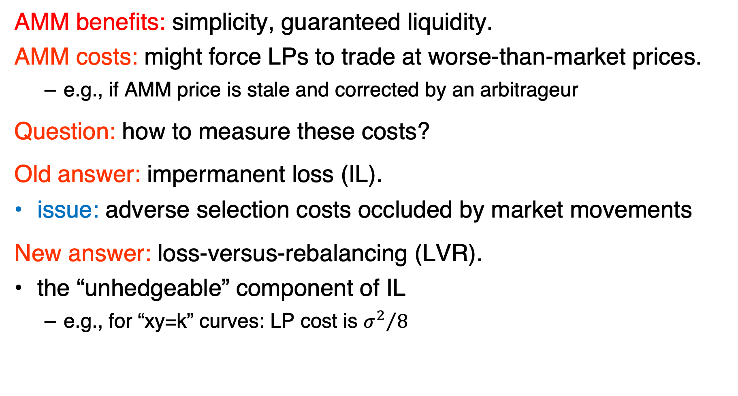
LVR in AMMs
AMM benefits: simplicity, guaranteed liquidity.
AMM costs: might force LPs to trade at worse-than-market prices.
e.g., if AMM price is stale and corrected by an arbitrageur
Question: how to measure these costs?
Old answer: impermanent loss (IL).
issue: adverse selection costs occluded by market movements
New answer: loss-versus-rebalancing (LVR).
the “unhedgeable” component of IL
e.g., for “xy=k” curves: LP cost is ${σ^{2}}/8$
(see [Milionis/Moellemi/ Roughgarden/Zhang 22] for details)

Slide 37
Grand Challenges (1 of 3)
Grand challenge #1: make macroeconomics our own.
cf., game theory, mechanism design, etc.
issue: macroeconomics is already a minefield
ex: is a hard cap “better” than permanent inflation?
ex: are deflationary cryptocurrencies doomed?
ex: what’s the “optimal” schedule for inflationary token rewards?
ex: to what extent do such design decisions affect token price?

Slide 38
Grand Challenges (2 of 3)
Grand challenge #2: “optimal” L1 incentives.
cf., optimal fault-tolerance in distributed computing
ex: optimal economic security s.t. budget on costs to honest nodes
ex: is slashing necessary (e.g., for optimal economic security)?
ex: fundamental limits of in-protocol recovery from 51% attacks?
ex: can liveness attacks be made as costly as consistency attacks?

Slide 39
Grand Challenges (3 of 3)
Grand challenge #3: interactions between layers of blockchain stack.
ex: how to manage and incentivize P2P networks (“layer 0”)?
ex: economics of (decentralized) layer-2s?
ex: L1/L2 interactions
e.g., EIP-4844 and optimal multi-resource pricing
ex: L1/application-layer interactions
e.g., is MEV unavoidable?
are inter-layer economic interactions inevitable in a decentralized system, or is the lack of clean separations an artifact of our current designs?

Slide 40
Grand Challenges (3 of 3)
Grand challenge #3: interactions between layers of blockchain stack.
ex: how to manage and incentivize P2P networks (“layer 0”)?
ex: economics of (decentralized) layer-2s?
ex: L1/L2 interactions
e.g., EIP-4844 and optimal multi-resource pricing
ex: L1/application-layer interactions
e.g., is MEV unavoidable?
are inter-layer economic interactions inevitable in a decentralized system, or is the lack of clean separations an artifact of our current imagination?
THANKS!

Slide 41
FIN

