Slide 1
Introduction to Platforms and Multi-sided Markets
Keywords: Platforms, Multi-sided markets

Slide 2


Designing Decentralized Markets
Many DeFi protocols are platforms that facilitate multi-sided markets.
Token issuance/payoffs are an important design feature
Platforms
Multi-sided markets
Network effects
Some implications for pricing/platform design.
Application to payment systems.

Slide 3
Econ 101 description of a market:
Price
Supply
The number of other people buying the good only affects the price I am charged, not how much I value the good or am willing to pay.
Demand
Quantity

Slide 4
Example #1 Amazon is a Platform
It brings together buyers and sellers
The value to buyers of using Amazon is increasing in the number of sellers
The value to sellers is increasing in the number of buyers
Consumers are willing to pay Amazon to make it easier to shop
Sellers are willing to pay Amazon to make it easier to sell

Slide 5
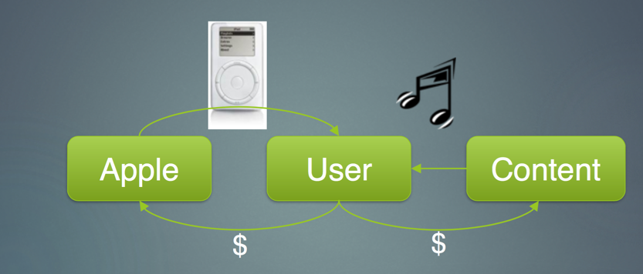
Example #2: Apple used to provide products

Slide 6
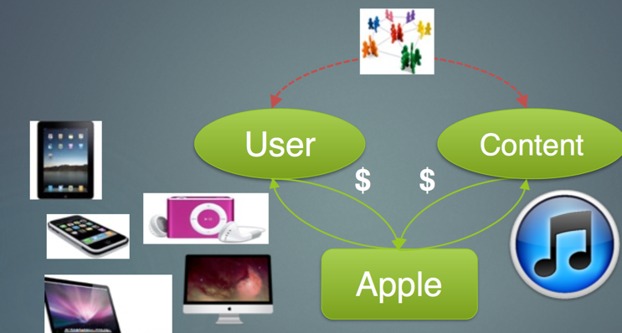
Now, Apple is a platform

Slide 7
Terminology
Multi-sided market: Markets with at least two sides of participants
Network effects: Benefits/costs that depend on others
Platform: Host that connects participants
Pricing is complicated because you have to attract two + sides.
Network effects can lead to ``winner-take all’’ which affects strategy and valuation.

Slide 8
Network Effects
Value is generated by bringing people together.
Multi-sided markets or platforms allow different, separate groups to interact.
Different sides only use the platform if it is too expensive to interact directly off the platform.
A has value $1
B joins
A’s value increases
A joins
B’s value increases

Slide 9
Credit Card Example:
Sides of the market:
Network Effects:

Slide 10
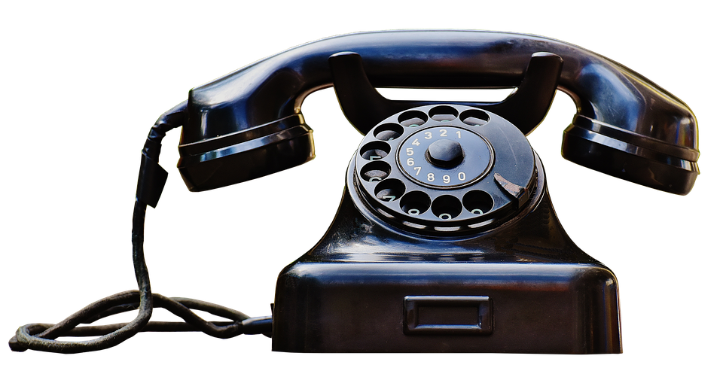
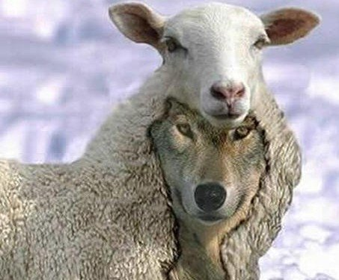
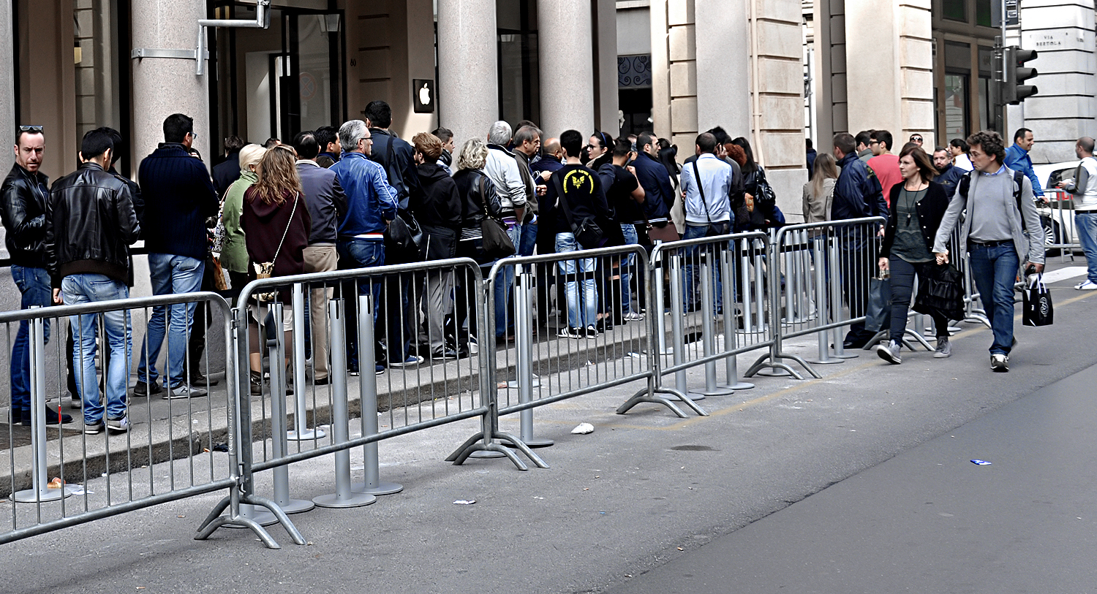
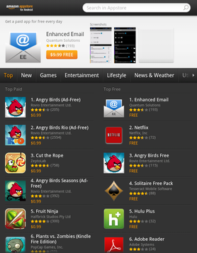
Nuanced Examples
Phones are valuable for communication because everyone has one
The wrong sorts of people joining can reduce value
Too many people joining can reduce value
Others’ actions can increase value

Slide 11
How to get a market with network effects to grow.
Pricing: If there are network effects then prices usually are not related to the cost of producing.
The right price depends on:
The price sensitivity of both sides to price
The type and intensity of network effects on both sides
The changes in cost that come from changing output of each side
The right price may be above or below the ``standalone’’ price for that side

Slide 12

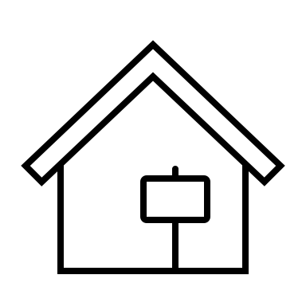
Numerical Example (Think Amazon)
3 buyers and 3 sellers
Each buyer can buy 1 unit from each seller
Buyer gets a benefit of $2 per trade
Sellers differ in their payoff per sale
Platform charges each buyer P_{b} and each seller P_{s}
Per trade
Platform Profits: (Pb+Ps)*# trades
$2 benefit
$1 per sale
$2 benefit
$2 per sale
$2 benefit
Consider each side separately
Max price for sellers is $2
2 join
Max price for buyers is $2
3 join
Total Profits: (2+2)✖ (2✖3) = 💲24
$3 per sale

Slide 13
Platform Pricing
Charge buyers P_{b} =$2
Charge Sellers P_{s} =$1
All the buyers and sellers join
$2 benefit
$1 per sale
$2 benefit
 | Before | OPTIMAL
Buyers | $12 | $18
Sellers | $12 | $ 9
$2 per sale
$2 benefit
$27
$3 per sale
Profit from sellers is lower but the overall effect is positive

Slide 14
Observations on Pricing
A platform can affect the volume of transactions by charging more to one side and reducing the price to the other side.
Typically, usage fees are lower on the side that is more price sensitive.
Consumers can use cash
The optimal price may even be a subsidy
Points on Credit Cards
.

Slide 15

Tipping points
With network effects, the value of the platform to the next consumer is increasing in the existing consumer base.
At some point, the value of being in the network is sufficiently high that the platform can charge for it.
After a critical mass of consumers adopt a platform there is ``lock in’’

Slide 16
Competition with Network effects
Small network effects
People pick their preferred platform.
Competition can lead to multiple platforms co-existing.
Strong Network effects
Even a superior entrant can’t get market share.
Even if a new product offers high intrinsic benefits and lower costs, you can still get the outcome where no one switches.
Winner take all: One network operates as a monopoly and the other is driven out of business.
Impossible to enter against an incumbent.

Slide 17
Firms often try to soften competition
Offer different bundles that appeal to different groups
Split the market
Offer platforms of different quality.
Split the market
Impose switching costs
Lock in consumers

Slide 18
Implications of Optimal Pricing for Free Cash Flows
A growing network charges a price below the one period price.
A high price/revenue today may lead to a slower growth rate
Cash flows can be negative for a long time as network effects kick in.
This only makes sense if large network effects lock both sides in.
.

