Slide 1
Tokenization
Keywords: Tokenization, Financial Frictions

Slide 2
Overview
Limited on and off ramps between decentralized finance and traditional finance.
What are the problems that tokenization could solve?
What are experiments are happening?
What are the long term prospects of these experiments?

Slide 3


Frictions in Financial Transactions - I
Transfers payment
Payment moves separately from instrument
Settlement takes xx working days
Record keeping separate from messaging
Transfers instrument

Slide 4
Settlement costs: Opportunity Cost of Collateral
Banks have to pre-fund transaction accounts and traders have to pre-fund settlement accounts.
Collateral sits in accounts and cannot be used in trading/other activities.
Cost is the opportunity cost
Return you could have made if used elsewhere.

Slide 5
Economic Costs in current system
Settlement uncertainty
Collateral has to be posted e.g., cross border payments or central counterparties
Opportunity cost of capital
Securities have to be moved between sub-custodians
Fails/system mismatch
Limited Time windows
Jump Risk when markets are closed

Slide 6
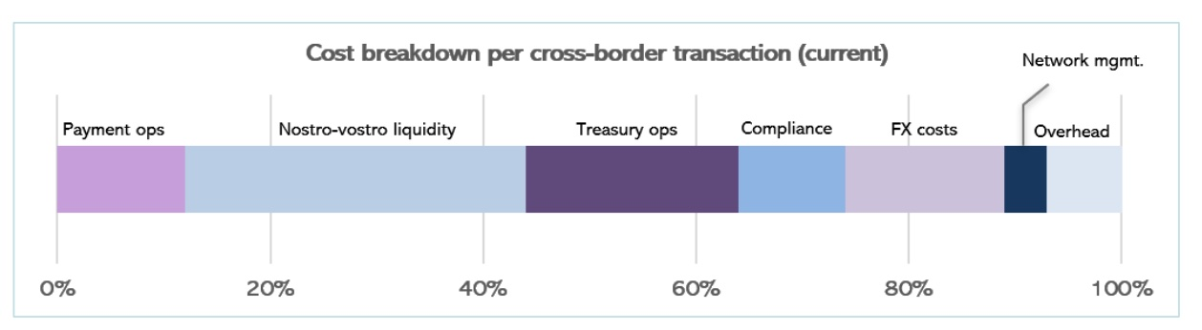
Cost example: Cross-border payments
The process of of transferring value can cost up to 7% of the transaction value.
Efficiency enhancements to increase speed and reduce the need for collateral.
Source: Inthanon LionRock Report

Slide 7
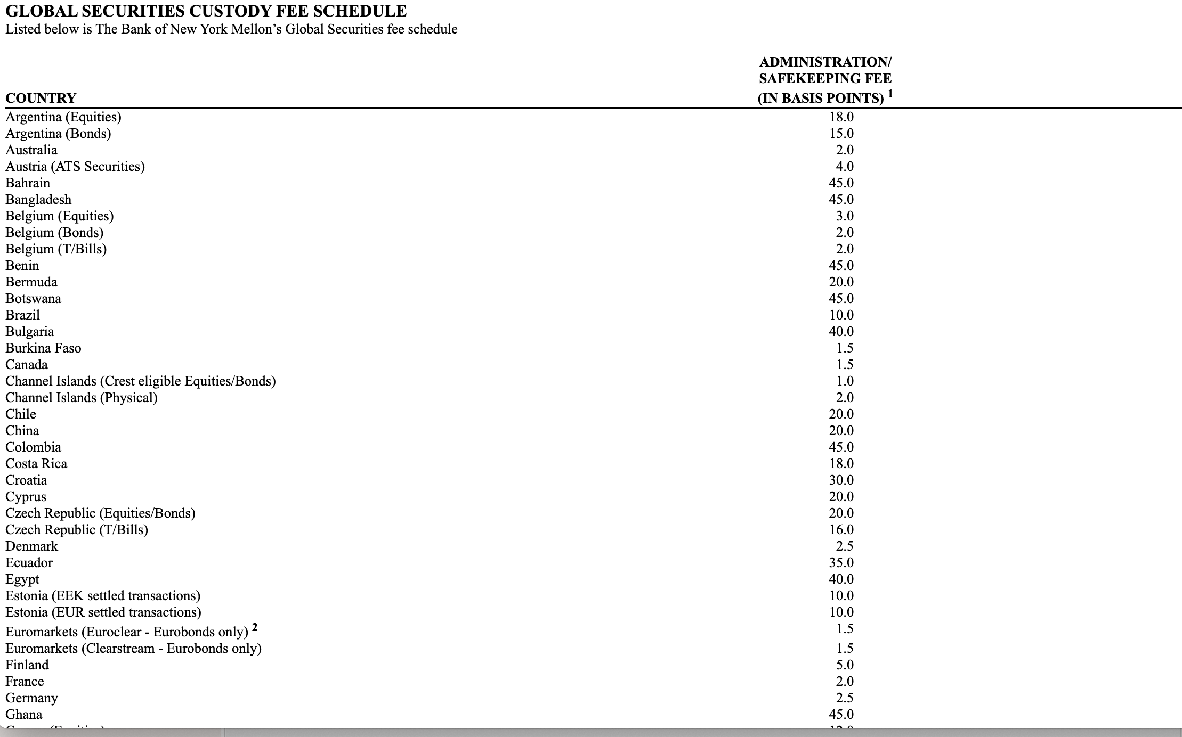
Explicit Costs: Custody
Source: SEC

Slide 8
Frictions in Financial Transactions - II
Cash flows
Issuance
Securitize or payoff

Slide 9
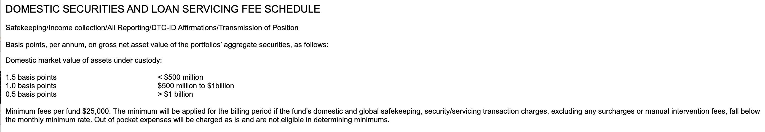
Explicit Costs: Loan Servicing
Source: SEC

Slide 10
Models of Tokenization
Native tokens
Assets issued on-chain
Flexibility to design new types of assets (token is code)
Legal and regulatory issues
Non-native tokens
Financial institution holds RWA in custody
Issues tokens against them
Requires trust in the institution

Slide 11
Native Tokens
HSBC Orion
Regulated under Luxembourg digital asset/blockchain legislation
Central Account Keeper (CAK) like a CSD (Central Securities Depository)
Issue wallets and initiates transfers
Hyperledger but mirrored on Ethereum
Settlement token (specific payments not generalized)
Floating rate bond with the European Investment Bank (EIB)

Slide 12
Goldman Sachs Digital Asset Platform: GS DAP
EIB issued 100 million Euro 2 year digital bond on Goldman Sachs GS DAP Jan 2023
HK monetary authority issued 100 million green bond using GS protocol.
DvP (Delivery versus payment) using a Hashed Time Lock
Integrated into the Canton network which synchronizes across siloed blockchains

Slide 13
Economic Implications of Digital Native
Can reduce direct costs of issuing, custody and servicing.
If the blockchain permits different protocols (trade, lending) increase secondary market liquidity and use value of the asset.
Assets are more valuable if they have multiple uses
Interoperability is very important, else blockchain operator has market power.
Form of interoperability is important else credit risk.

Slide 14
Real World Assets (RWA) on chain Custodian holds the RWA and issues a token
Tokenization to increase secondary market liquidity
Tokenization to allow fractionalization.
Tokenization makes it easier to switch and use collateral
Align Technological transfer with title transfer (no fails)

Slide 15
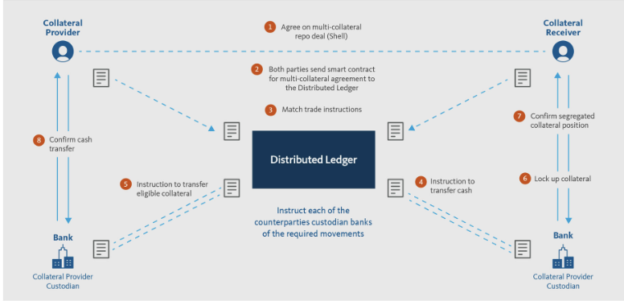
Broadridge Distributed Ledger Repo
Existing connections to securities depositories and custodians
Tokenize collateral
Payment through conventional rails but occurs at the same time as settlement ``atomic’’
Source: Broadridge.com

Slide 16
DLT Repo
Smart contracts provide flexibility on terms etc.
Direct cost savings on reconciliation
Reduce risk (fails, credit etc.)
Increased collateral mobility
Easy for Broadridge to convert custody relationships to tokenize collateral and deploy smart contracts on a DL

Slide 17
Finance/Economic Implications
Successful: 50 bn daily or 1 trillion a month
Intraday Repo are easy to implement
Many are intra-company repos
Does this have an aggregate effect on collateral usage/demand?
Does this make banks more/less resilient?

Slide 18
Hamilton Lane tokenizes investment products
On Polygon
Partnership with Securitize (which will manage these)
Issue tokens against illiquid alternate assets such as RE, art etc.
Reduce costs and make it easier to offer smaller smaller investment sizes.
Tap deeper capital markets

Slide 19
……. Also Ondo Finance
Tokens that are claims to an open end fund
i-shares short term Treasury and some cash holdings
Convenience yield of Defi payments.
Easier and faster to redeem
If liquid → stablecoin that bears interest!
Potential competition to interest bearing deposit accounts

Slide 20
Finance/Economic Implications RWA
For Investor:
Buy alternate asset classes with a smaller minimum investment
Assets more liquid and easier to use as collateral.
For firms/issuers
Potentially decrease cost of capital (reduction in direct costs)
Increase investor base
Reduces monitoring incentives potentially increase cost of capital

Slide 21
Regulated Liabilities
Regulated financial industries are designing products that can be used for payments.
Competition with stablecoins
Citi has proposed a “Regulated Liability Network’’
National currencies or “regulated liabilities”
Interoperable
Prevents dollarization

Slide 22
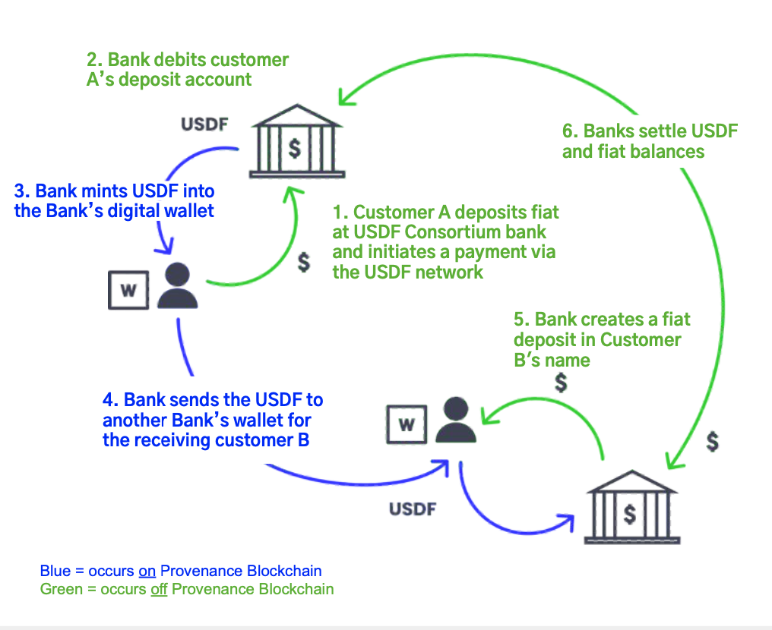
USD Forward (USDF)
A bank issued (private) stablecoin
Advantages are that it is cheaper than existing services.
Potentially also programmable
Factoring etc.
Bridge to Crypto
Source: USDF Website

Slide 23
Citi Token
Citi Token:
Deposits are tokenized and can be used for cross-border payments 24/7
Cash Management and Trade finance.
HQLA (by Goldman Sachs):
DLT R3 Corda
Collateral management for Institutional Clients
Delivery versus Delivery (no cash)

Slide 24
Questions around Systemic Risk
Are slow financial systems better?
Are automated systems less secure?
How should regulators interact with enterprise blockchain?
Are tokenized assets more fragile?
What changes should be made in securities law/regulation?

Slide 25
Conclusion
Existing financial system has embedded costs
Experiments underway to redesign financial infrastructure
Tokenizing assets can make the system run more smoothly.
Potentially leads to unanticipated risks.

