Slide 1
HEART DISEASE PREDICTION USING MACHINE LEARNING
MADE BY:
MOHD IRFAN CS-AI & ML 2nd Year
2001641530035

Slide 2
OBJECTIVE
“Heart Disease Prediction Using Machine Learning” is a machine learning system that can predict whether a person has heart disease or not by using Logistic Regression Model.

Slide 3
PROBLEM STATEMENT
The term “heart disease” refers to several types of heart conditions. The most common type of heart disease (CAD), which affects the blood flow to the heart. Decreased blood flow can cause a heart attack.
The number of deaths due to cardiovascular diseases increased by 41% between 1990 and 2013, climbing from 12.3 million deaths to 17.3 million deaths in globally. In addition to that, half of the deaths in many developed countries are due to this issue.
Therefore, early detection of heart diseases is required to reduce the health complications.

Slide 4
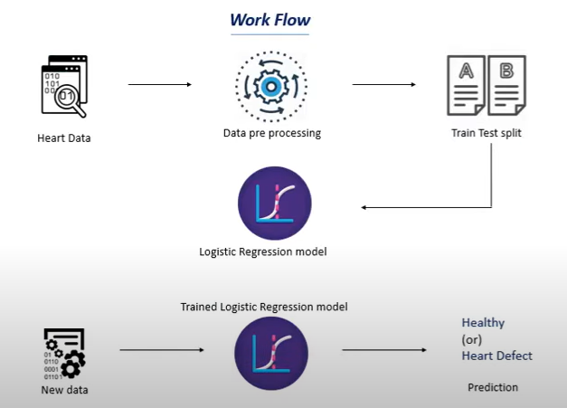
WORKFLOW

Slide 5
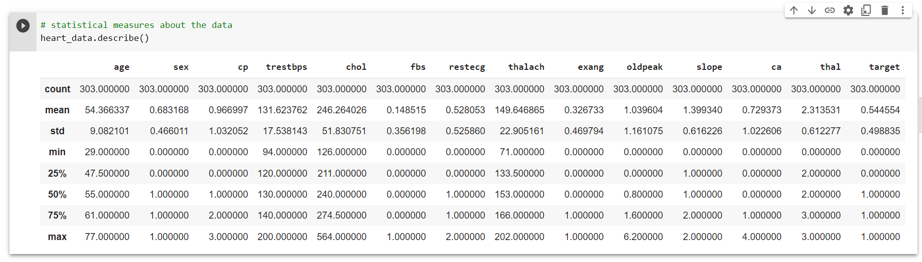
DATASET DISTRIBUTION:
The system uses 14 medical parameters such as age, sex, blood pressure, cholesterol, and obesity for prediction.

Slide 6
Train-Test Split
The train-test split is a technique for evaluating the performance of a machine learning algorithm.
It can be used for classification or regression problems and can be used for any supervised learning algorithm.
The procedure involves taking a dataset and dividing it into two subsets. The first subset is used to fit the model and is referred to as the training dataset. The second subset is not used to train the model; instead, the input element of the dataset is provided to the model, then predictions are made and compared to the expected values. This second dataset is referred to as the test dataset.

Slide 7
Why we use Logistic Regresion over other Model:
Logistic Regression is a statistical and machine-learning technique classifying records of a dataset based on the values of the input fields.
It predicts a dependent variable based on one or more set of independent variables to predict outcomes.

Slide 8
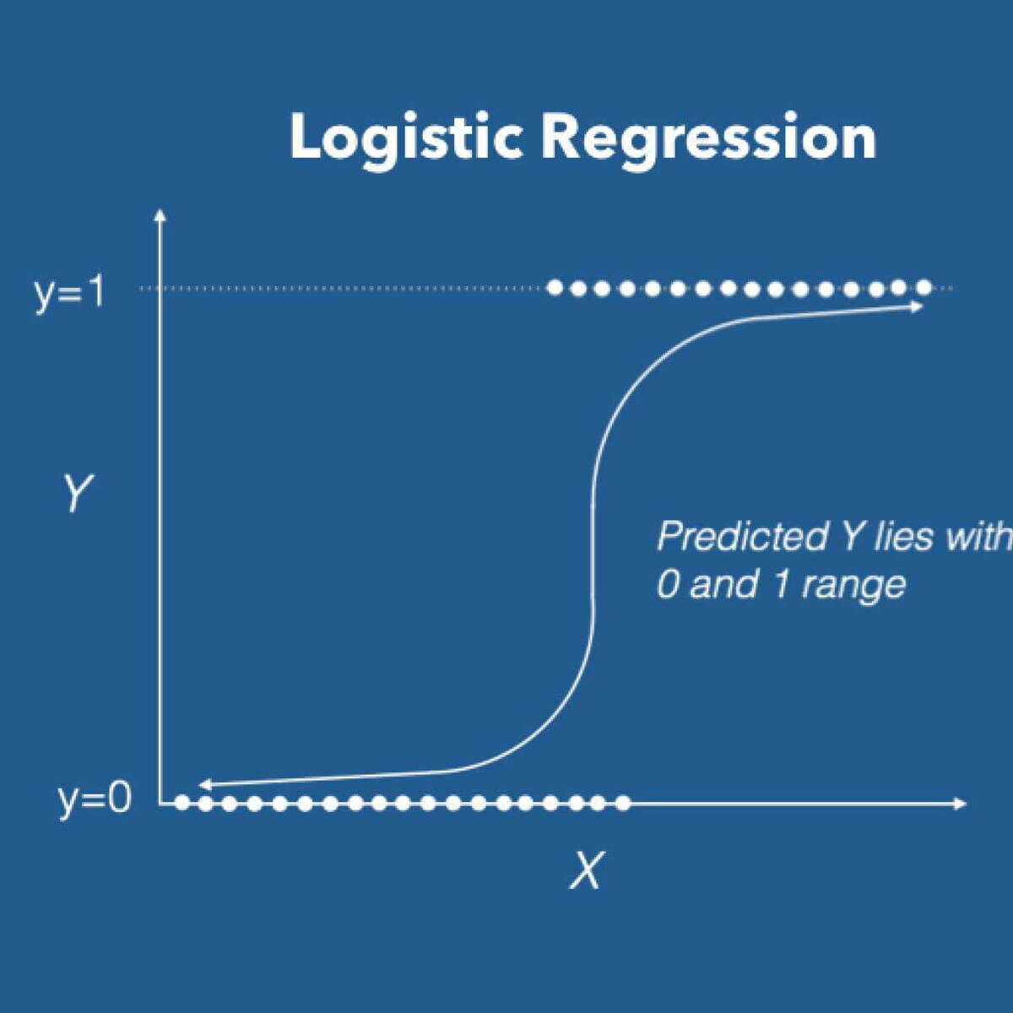
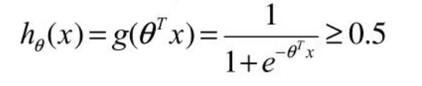
LOGISTIC REGRESSION
“Regression” over training examples
Transform continuous y to prediction of 1 or 0 using the standard logistic function
Predict HEART Defective if

Slide 9
“Percentage of Performance”

Slide 10
LIBRARY OF PYTHON USED
NUMPY :- NumPy is a library for the Python programming language, adding support for large, multi-dimensional arrays and matrices, along with a large collection of high-level mathematical functions to operate on these arrays.
PANDAS :- Pandas is used for data manipulation and analysis. In particular, it offers data structures and operations for manipulating numerical tables and time series.
SKLEARN :- Sklearn library contains a lot of efficient tools for machine learning and statistical modeling including classification, regression, clustering and dimensionality reduction.

Slide 11
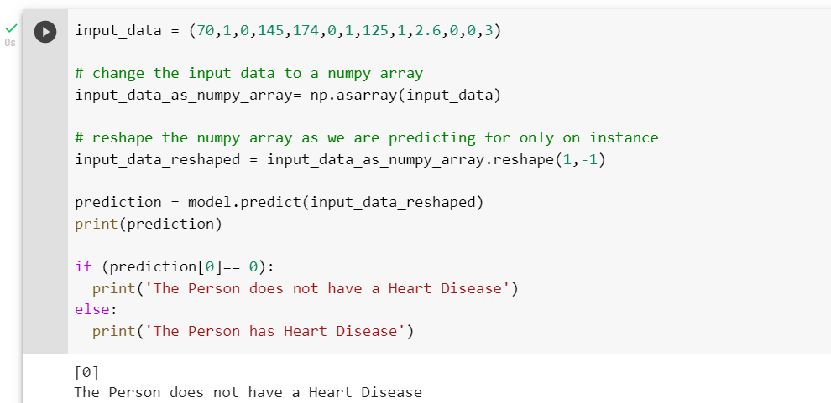
RESULT AND OUTPUT-1:
Hence, according to the results, if we give all data except 14th column (Target) as an input then it will give us the data in 0 which describes that person has ‘NOT Heart Disease’.

Slide 12
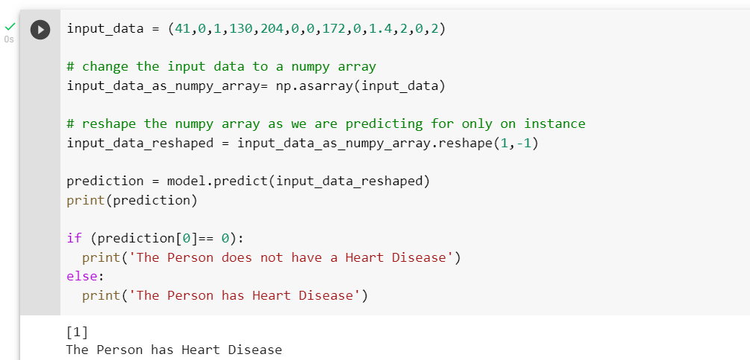
RESULT AND OUTPUT-2:
Hence, according to the results, if we give all data except 14th column (Target) as an input then it will give us the data in 1 which describes that person has ‘Heart Disease’.

Slide 13
CONCLUSION
This project provides the overview into machine learning techniques for predicting heart diseases.
Heart disease are complicated. Each and every year lots of people are dying with this disease. I use Machine Learning in that logistic regression algorithms by predicting if patient has heart disease or not. Any nonmedical employee can use this software and predict the heart disease and reduce the time complexity of the doctors.
Machine learning techniques significantly improves accuracy of cardiovascular risk prediction through which patients can be identified during an early stage of disease and can be benefitted by preventive treatment.

Slide 14
Future Enhancement
Today’s, world most of the data is computerized, the data is distributed and it is not utilizing properly. By Analyzing the available data we can also use for unknown patterns. The primary motive of this project prediction of heart diseases with high rate of accuracy.
For predicting the heart disease we can use logistic regression algorithm, naviebayes, sklearn in machine learning. The future scope of this project is the prediction of heart diseases by using advanced techniques and algorithms in less time complexity.

Slide 15
THANKS!

