Slide 1


Meltdown
April 04, 2019
Devish Mundra / Nischith Nanjundaswamy / Grant Pedersen
Notes:
TITLE SLIDE:
Change background as needed; more images available at http://ucdenver.webdamdb.com
Change Title and Subtitle as needed
Date updates automatically

Slide 2
Table of Contents
Overview of Meltdown.
Side-Channel Attack.
Explored example of meltdown.
KAISER Implementation Fix.
Project Simulation.
Notes:
CONTENT SLIDE (2-COLUMN)

Slide 3
Overview of Meltdown
Meltdown breaks memory address isolation from kernel and user space
Paravirtualized environments (e.g. Docker) are vulnerable
Hardware exploitation NOT A SOFTWARE EXPLOITATION
Independent from the OS
Use of Cache-Side Channel attacks (Flush+Reload)
Root Cause: Out-Of-Order Execution
Unwanted effect of timing differences
Speculation from branch prediction
Notes:
CONTENT SLIDE (1-COLUMN)

Slide 4
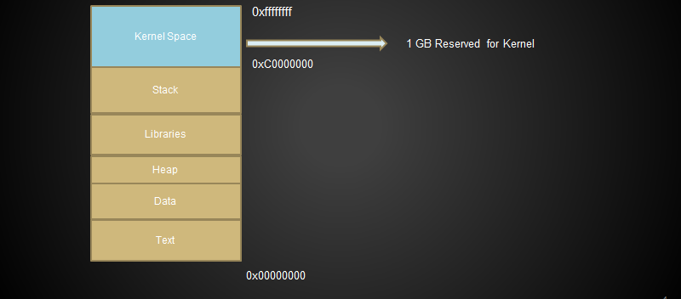
32-bit Program Virtual Address Space (4GB)
Notes:
CONTENT SLIDE (1-COLUMN)

Slide 5
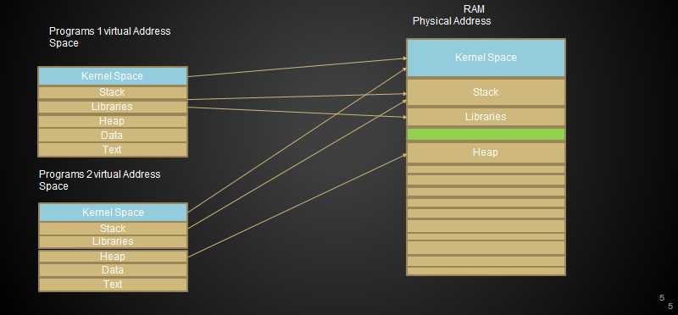
Virtual to Physical Mapping
Notes:
CONTENT SLIDE (1-COLUMN)

Slide 6
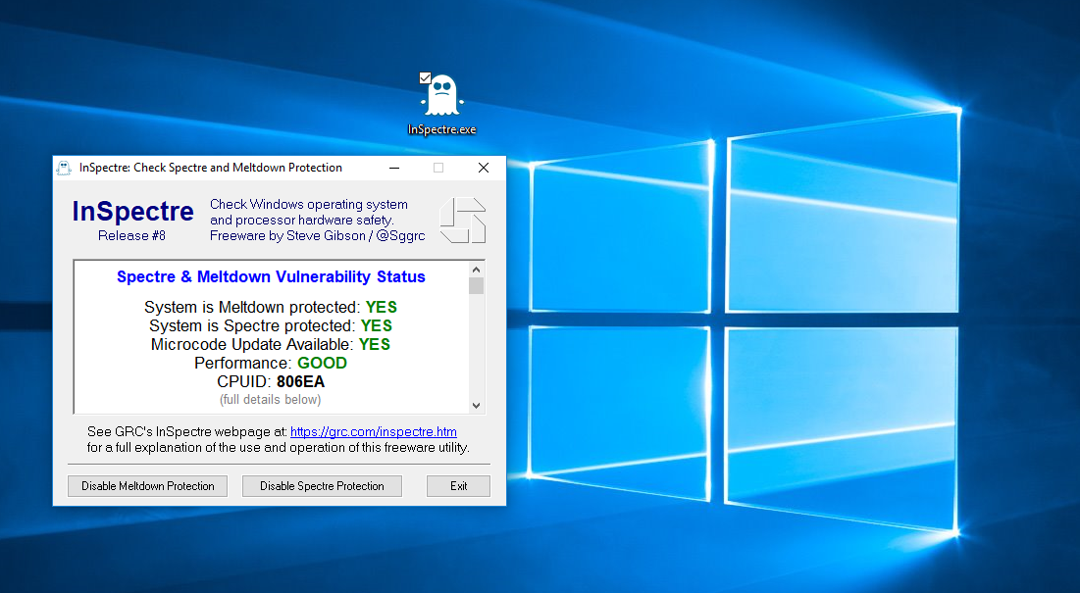
Is Your PC Vulnerable??

Slide 7
Side Channel Attacks
Flush + Reload
Out-Of-Order Memory Lookups can be exploited as a cache-side channel; can run as a different thread or process.
Dump entire kernel memory from the Out-Of-Order Execution Stream and transmit data from elusive state.
Microarchitectural covert channel
Receiving end gets reconstructed register value (from hardware).
Notes:
Allows adversary to run code to obtain dump of entire kernel address space with mappings to physical memory.

Slide 8
Side Channel Attacks
Flush + Reload Steps
First: flush shared cache line from memory
Second: wait for victim process to work.
Segmentation fault, cause transient instruction side effect OOO .
Change microarchitectural state
Third: Reload memory line
if victim access the memory during waiting period, page is in cache. Otherwise, the loading is done from memory
Use of timing difference, inferring access patterns in shared code.
Notes:
CONTENT SLIDE (1-COLUMN)

Slide 9
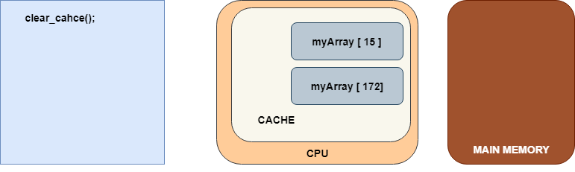
Explored Example
Notes:
CONTENT SLIDE (1-COLUMN)

Slide 10
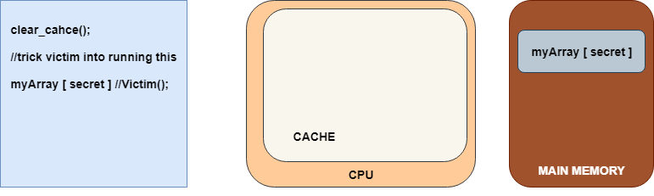
Explored Example - Flush+Reload
Notes:
CONTENT SLIDE (1-COLUMN)

Slide 11
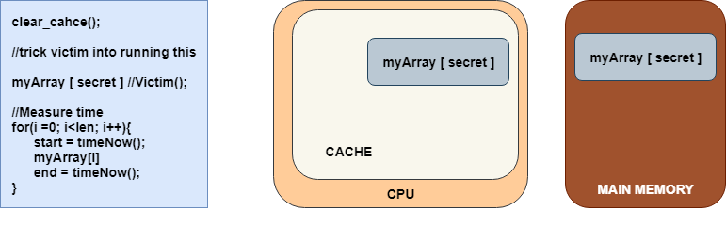
Explored Example - Flush+Reload
Notes:
CONTENT SLIDE (1-COLUMN)

Slide 12
Explored Example
Meltdown Building Blocks
1.) Execute one or more instructions never to occur in execution
E.G. Accessing an array, even though an exception was raised
Exception suppression to prevent an exception from occurring
2.) Transfer microarchitectural side effect of transient instructions
Force it into an architectural state (state of the process)
Parent process recovers secret via side-channel; child crashes
Notes:
CONTENT SLIDE (1-COLUMN)

Slide 13
Explored Example
Meltdown Steps
1.) Processor loads secret data
Cache Side Channel Attack
2.) Processor Indexes array under attacker control using a secret value
3.) Attacker observes cache timing to extract secret.
Notes:
CONTENT SLIDE (1-COLUMN)

Slide 14
Explored Example
1. uint8_t* probe_array = new uint8_t[256 * 4096];
2. // ... Make sure probe_array is not cached
3. uint8_t kernel_memory = *(uint8_t*)(kernel_address);
4. uint64_t final_kernel_memory = kernel_memory * 4096;
5. uint8_t dummy = probe_array[final_kernel_memory];
6. // ... catch page fault
7. // ... determine which of 256 slots in probe_array is cached
Notes:
CONTENT SLIDE (1-COLUMN)

Slide 15
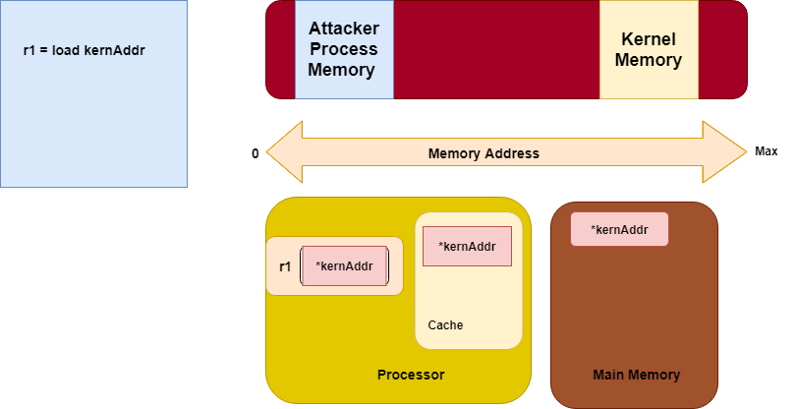
Explored Example - Load kernel Secret
Notes:
CONTENT SLIDE (1-COLUMN)

Slide 16
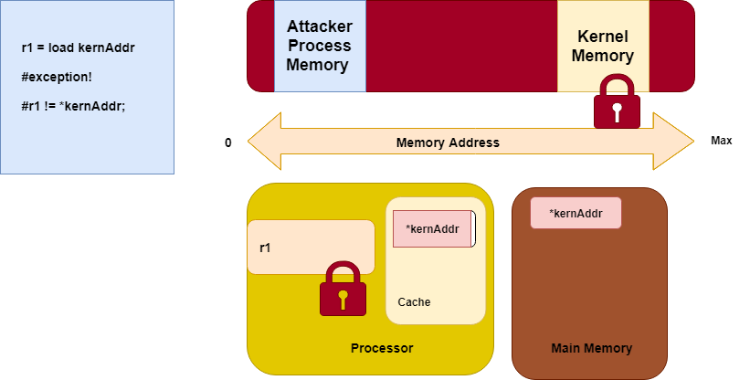
Explored Example - Load kernel Secret
Notes:
CONTENT SLIDE (1-COLUMN)

Slide 17
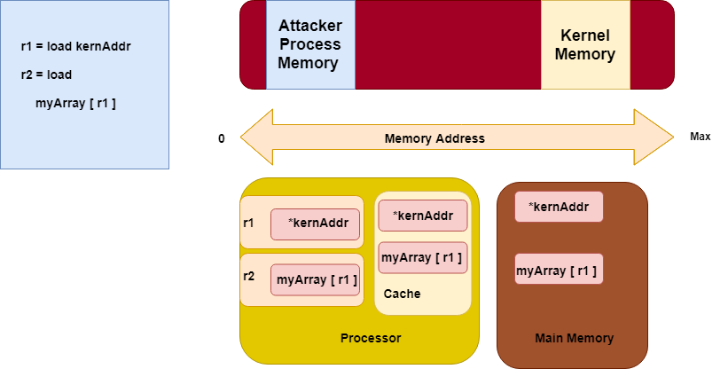
Explored Example - Load kernel Secret
Notes:
CONTENT SLIDE (1-COLUMN)

Slide 18
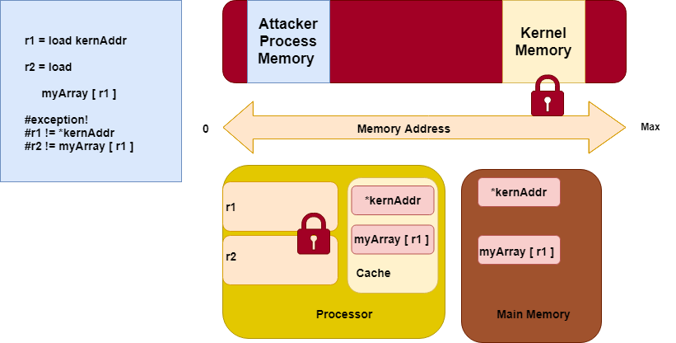
Explored Example - Load kernel Secret
Notes:
CONTENT SLIDE (1-COLUMN)

Slide 19
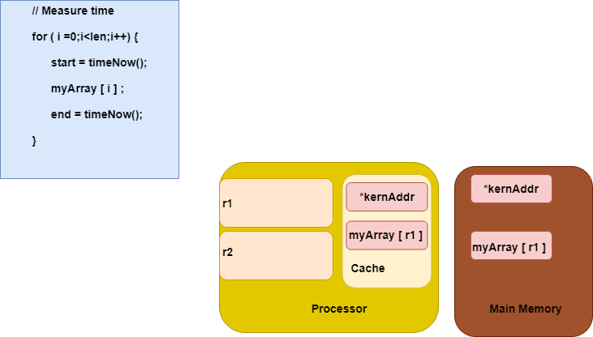
Explored Example - Load kernel Secret
Notes:
CONTENT SLIDE (1-COLUMN)

Slide 20
KAISER Implementation Fix
Why map kernel memory into user space?
Helps system call performance
Very fast to unlock kernel memory, transfer data
Legal kernel memory access can happen speculatively.
Prevent caching and speculative execution
Only legal memory accesses happen.
Notes:
CONTENT SLIDE (1-COLUMN)

Slide 21
Project Implementation
CPU focus - low level program in C++
gem5 Virtualization of CPU
Lab documentation
Observing results of a secret word stored in file.
Notes:
CONTENT SLIDE (1-COLUMN)

Slide 22
gem5 CPU Simulator
Setup
Build ISA base
x86
Python script builds CPU emulator
Use of emulated system calls
Option of Full System or Syscall Emulation
Notes:
CONTENT SLIDE (2-COLUMN)

Slide 23
Questions?
??
Notes:
CONTENT SLIDE (2-COLUMN)

