Slide 1
Openstreetmap
20 Minute Primer

Slide 2
Me?
Thomas Christlieb
Software engineer and DBA since ~ 15 years
Likes Hiking, Geocaching, Climbing
… all of which are in need for good and accurate maps!

Slide 3
What is Openstreetmap (OSM)?
- Founded 2004 by Steve Coast in the UK. Inspired by Wikipedia
- Like geocaching it needed the deactivation of GPS Selective Availability in 2000
- It’s primarily a ~1TB postgresql database
- You can create maps from it
- It’s Opensource and Free!
- It’s worldwide and sometimes more accurate than any other map!
- You can use it, you can build your own maps, you even can sell them.
Just add the Tag that it’s from Openstreetmap!

Slide 4
How can you contribute?
- Donate :-)
- Use a Mapping app on your smartphone (you can install one right now!)
- Use the online map and map some aerial pictures
- Add Tags to buildings (new Cafe? Changed opening hours?)
It does NOT need to be accurate. Thats the big charm. Just add the stuff, it can be fixed later if needed!
-> Simply map everything on the ground!

Slide 5
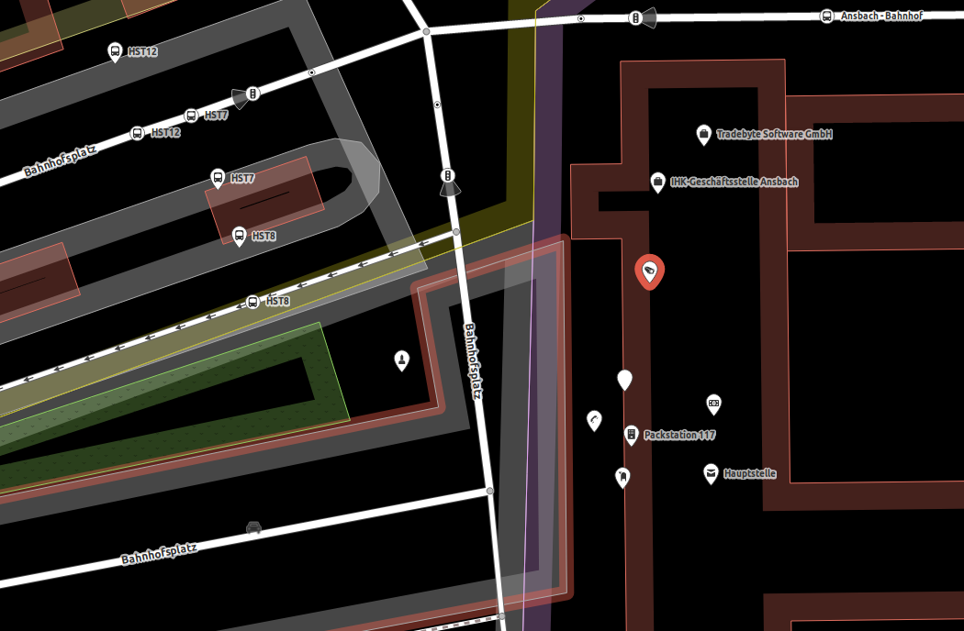
What node types are there?
- Camera
- Postbox
- Company
- Bus Station
- Bank
- Telephone
.
.
.

Slide 6
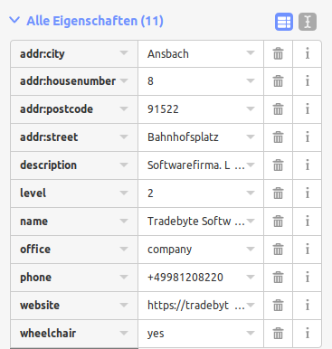
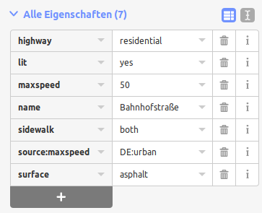
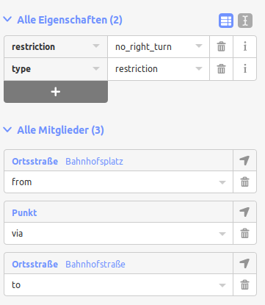
Whats in the database?
- Relations
- Nodes
- Ways

Slide 7
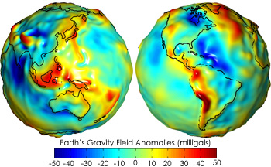
Let’s look at our node in the database...
http://download.geofabrik.de/europe/germany/bayern-latest.osm.pbf → 540 MB for Bavaria
(import using osmosis)
SELECT *, ST_AsText(ST_Transform(geom, 4326)) FROM nodes WHERE tags -> 'name' = 'Tradebyte Software GmbH';
→ SRID 4326 is WGS84 Projection
-[ RECORD 1 ]-
id | 4463317848
version | 3
user_id | 0
tstamp | 2017-10-28 13:36:54
changeset_id | 0
tags | "name"=>"Tradebyte Software GmbH", "level"=>"2", "phone"=>"+49981208220", "office"=>"company", "website"=>"https://tradebyte.com", "addr:city"=>"Ansbach", "wheelchair"=>"yes", "addr:street"=>"Bahnhofsplatz", "description"=>"Softwarefirma. Lösungen für eine nahtlose Vernetzung von Herstellern, Händlern und Retailern im digitalen Supply Chain.", "addr:postcode"=>"91522", "addr:housenumber"=>"8"
geom | 0101000020E610000021D50B9986282540DAAB34CE4BA64840
st_astext | POINT(10.5791519 49.2991884)

Slide 8
Some (usefull?) stuff…
Where is the next waterfall?
SELECT a.tags -> 'name' AS name,
round(ST_DistanceSphere(a.geom, b.geom) / 1000) AS "Distance in km",
ST_AsText(ST_Transform(a.geom, 4326)) AS Coordinates,
degrees(ST_Azimuth(b.geom, a.geom)) AS Direction
FROM
nodes a,
nodes b
WHERE
a.tags -> 'waterway' = 'waterfall'
and a.tags -> 'name' != ''
and b.tags -> 'name' = 'Oettingen'
and b.tags -> 'railway' = 'halt'
order by 2;
name | Distance in km | coordinates | direction
--------------------------------------+----------------+------------------------------+------------------
Tiefenbachabsturz | 70 | POINT(11.3277964 49.3492889) | 60.9422550314605
Röthenbach-Wasserfall | 74 | POINT(11.3346598 49.4042733) | 57.9860563672948
Klingender Wasserfall | 78 | POINT(11.2983854 49.4782282) | 52.640983913759
Kalkbach-Wasserfälle | 91 | POINT(11.2497829 49.6424409) | 42.9862510409032
Kalkbach-Wasserfälle | 91 | POINT(11.2490756 49.6432751) | 42.9210340435697
Sinterstufen | 91 | POINT(11.2799204 49.627587) | 44.8981916459071
Ochsenklavier | 91 | POINT(11.0677786 49.7083163) | 31.5251506708662
Moritzbach Wasserfall | 94 | POINT(11.1850145 49.703233) | 37.6690795552998
Harnbach-Wasserfall | 95 | POINT(11.4636705 49.5895626) | 53.2679379920274
Harnbach-Wasserfall | 96 | POINT(11.4661704 49.5911182) | 53.2810975264065
Wedenbach-Wasserfall | 107 | POINT(11.217483 49.8144508) | 35.399537157201
Große Kaskade | 109 | POINT(11.4860708 48.1576033) | 131.582430526682
Ellernbach-Wasserfall | 114 | POINT(11.0809704 49.9161626) | 26.3708914483251
Betonierter wasserfall | 125 | POINT(12.198349 48.5565354) | 103.636621920367
Wasserfall | 143 | POINT(11.3774673 50.1260012) | 33.3715986011868
Schleierfälle | 144 | POINT(10.9864347 47.6753641) | 163.033585739769
Pfersag-Wasserfall | 144 | POINT(11.2613916 50.1699689) | 28.3831474296451

Slide 9
Some (usefull?) stuff…
Where is the next Kentucky Fried Chicken?
SELECT
a.tags -> 'name' AS name,
a.tags -> 'addr:city' AS Stadt,
round(ST_DistanceSphere(c.geom, b.geom) / 1000) AS "Distance in km",
ST_AsText(ST_Transform(c.geom, 4326)) AS Coordinates,
concat(round(degrees(ST_Azimuth(b.geom, c.geom))), ' °') AS Direction
FROM
ways a, nodes b, nodes c
WHERE
c.id = a.nodes[1]
and lower(a.tags -> 'amenity') = 'fast_food'
and (lower(a.tags -> 'name') = 'kfc' or lower(a.tags -> 'name') = 'kentucky fried chicken')
and b.tags -> 'name' = 'Oettingen'
and b.tags -> 'railway' = 'halt'
UNION ALL
SELECT
a.tags -> 'name' AS name,
a.tags -> 'addr:city' AS Stadt,
round(ST_DistanceSphere(a.geom, b.geom) / 1000) AS "Distance in km",
ST_AsText(ST_Transform(a.geom, 4326)) AS Coordinates,
concat(round(degrees(ST_Azimuth(b.geom, a.geom))), ' °') AS Direction
FROM
nodes a, nodes b
WHERE
lower(a.tags -> 'amenity') = 'fast_food'
and (lower(a.tags -> 'name') = 'kfc' or lower(a.tags -> 'name') = 'kentucky fried chicken')
and b.tags -> 'name' = 'Oettingen'
and b.tags -> 'railway' = 'halt'
order by
3 asc;
Name Tag can be on a way or on a node!
name | stadt | Distance in km | coordinates | direction
------------------------+-------------+----------------+------------------------------+-----------
KFC | | 55 | POINT(11.3403355 49.0426112) | 82 °
Kentucky Fried Chicken | | 64 | POINT(11.0080418 49.4575247) | 39 °
KFC | Nürnberg | 66 | POINT(11.0815578 49.4460633) | 44 °
KFC | Nürnberg | 66 | POINT(11.081574 49.4460329) | 44 °
Kentucky Fried Chicken | | 66 | POINT(10.8749175 48.3813824) | 154 °
KFC | Nürnberg | 66 | POINT(11.0682782 49.4488967) | 43 °
Kentucky Fried Chicken | Augsburg | 67 | POINT(10.8676552 48.3713111) | 155 °
KFC | Nürnberg | 67 | POINT(11.1256353 49.4343578) | 47 °
Kentucky Fried Chicken | Augsburg | 67 | POINT(10.9348895 48.3887379) | 149 °
Kentucky Fried Chicken | Ingolstadt | 67 | POINT(11.4632648 48.7487741) | 103 °
KFC | Neu-Ulm | 74 | POINT(10.021679 48.3955108) | 226 °

Slide 10
Some (usefull?) stuff…
Where is Hetzner if we only got the address?
(Geocoding)
SELECT
nodes
FROM
ways
WHERE
tags -> 'addr:housenumber' = '25'
and tags -> 'addr:street' = 'Industriestraße'
and tags -> 'addr:postcode' = '91710'
and tags -> 'addr:city' = 'Gunzenhausen';
nodes
--------------------------------------------------------------------------------------------------------------------------------------------------
{2436744740,2436744741,2436744743,2436744744,2436744745,2486322519,2436744747,2436744748,2436744749,2436744751,2436744752,2436744753,2436744740}
(1 row)
SELECT *,
ST_AsText(ST_Transform(geom, 4326))
FROM nodes
where id = 2436744740;
id | version | user_id | tstamp | changeset_id | tags | geom | st_astext
------------+---------+---------+---------------------+--------------+------+----------------------------------------------------+------------------------------
2436744740 | 2 | 0 | 2013-10-07 13:59:28 | 0 | | 0101000020E61000006F6AA0F99C8F2540365B79C9FF8F4840 | POINT(10.7804945 49.1249935)

Slide 11
Some (usefull?) stuff…
What is around our actual 2 km of our GPS Location?
(Reverse Geocoding)
Name Tag can be on a way or on a node!
SELECT
tags -> 'name' AS name,
(ST_DistanceSphere(ST_GeomFromText('POINT(10.579172 49.298858)', 4326), ST_Transform(geom, 4326))/1000) AS "Distance in km",
degrees(ST_Azimuth(ST_GeomFromText('POINT(10.579172 49.298858)', 4326), geom)) AS Direction
FROM
nodes
WHERE
(ST_DistanceSphere(ST_GeomFromText('POINT(10.579172 49.298858)', 4326), ST_Transform(geom, 4326))/1000) < 2
and tags -> 'name' != ''
UNION ALL
SELECT
a.tags -> 'name' AS name,
(ST_DistanceSphere(ST_GeomFromText('POINT(10.579172 49.298858)', 4326), ST_Transform(b.geom, 4326))/1000) AS "Distance in km",
degrees(ST_Azimuth(ST_GeomFromText('POINT(10.579172 49.298858)', 4326), b.geom)) AS Direction
FROM
ways a, nodes b
WHERE
b.id = a.nodes[1]
and (ST_DistanceSphere(ST_GeomFromText('POINT(10.579172 49.298858)', 4326), ST_Transform(b.geom, 4326))/1000) < 2
and a.tags -> 'name' != ''
ORDER BY 2 ASC;
name | Distance in km | direction
------------------------------------------------------------------+----------------+-------------------
Hauptstelle | 0.00470371505 | 345.351163212131
Packstation 117 | 0.01174393515 | 302.981744768006
Bahnhofsplatz | 0.02204542948 | 276.983370705694
IHK-Geschäftsstelle Ansbach | 0.03274358952 | 344.549333320552
Luitpold-Brunnen | 0.03373878872 | 288.434948823069
Tradebyte Software GmbH | 0.03676775318 | 356.518681624046
HST8 | 0.04926204787 | 287.981579218787
Ansbach - Bahnhof | 0.05008066041 | 17.7342975077383
HST8 | 0.0528900007 | 291.269486388738
Bahnhofstraße | 0.05503531369 | 318.259401551632
Ansbach | 0.05571847052 | 184.25073149902
HST7 | 0.05756002688 | 294.130454197957
Gewerbegebiet Bahnhofstraße | 0.06461409125 | 3.59722259643559
HST12 | 0.06684025068 | 294.208593141357
Bundespolizei Ansbach | 0.06767025403 | 255.725206216893
HST6 | 0.07909885029 | 274.829383013845
HST11 | 0.080645623 | 285.155475611995
HST5 | 0.08471131238 | 279.172036790627
Bischof-Meiser-Straße | 0.08895764229 | 319.496065423954

Slide 12
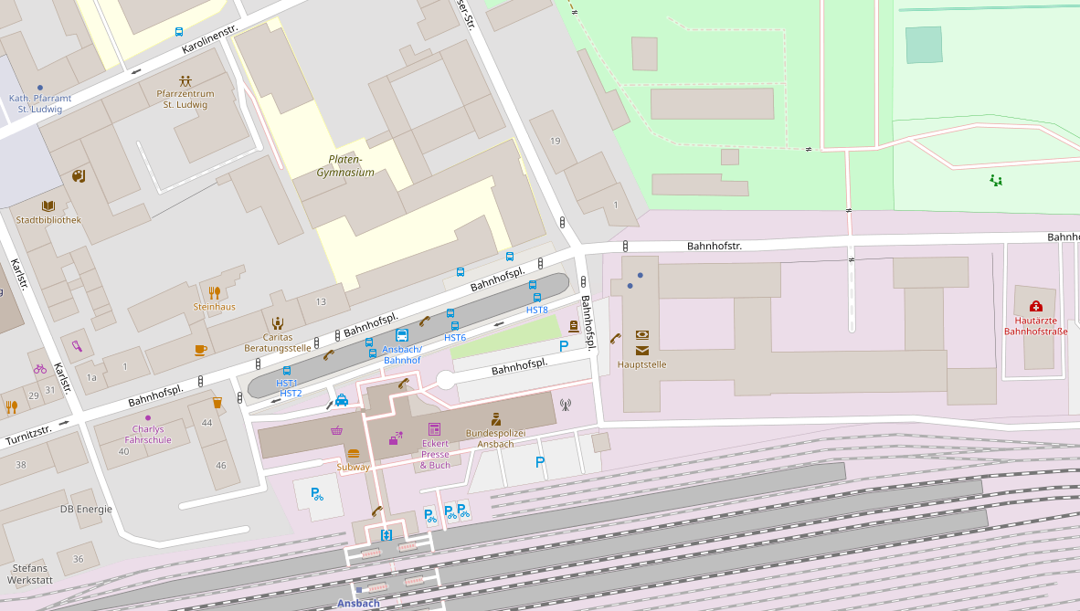
Whats with these fancy maps?
Maps are generated
from selected nodes
(and height information from other free sources like SRTM (Nasa Shuttle Radar Topography Mission)).
So every map is different!

Slide 13
Commands used…
(Ubuntu 18.04)
sudo apt-get install postgresql postgis osmosis
sudo -u postgres createuser -U postgres -d -e -E -l -P -r -s gisuser
psql -U gisuser -h 127.0.0.1 postgres
create database gisdb;
\connect gisdb
create extension postgis;
create extension hstore;
\q
psql -U gisuser -h 127.0.0.1 gisdb < /usr/share/doc/osmosis/examples/pgsnapshot_schema_0.6.sql
wget http://download.geofabrik.de/europe/germany/bayern-latest.osm.pbf
osmosis --read-pbf bayern-latest.osm.pbf --log-progress --write-pgsql database=gisdb host=127.0.0.1 user=gisuser password=gispass
-> Patience! (~30 minutes)
psql -U gisuser -h 127.0.0.1 gisdb

Slide 14
You’re done!
Thank you!

