Slide 1
Micropython
(and the Internet of Things)
… going low level with a high level language.
You can find the slides right here:
https://files.cimdata-sw.de/micropython.odp

Slide 2

Who am I?
Thomas Christlieb
Software Engineer since 2005
cimdata software GmbH

Slide 3
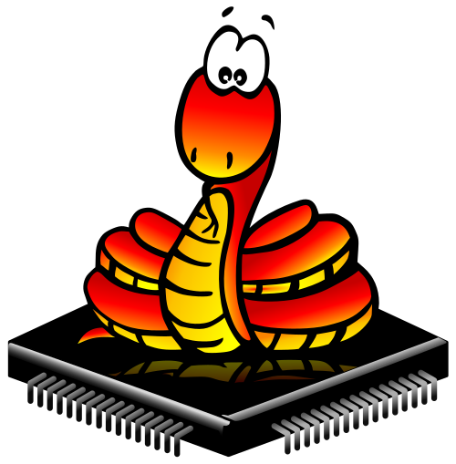
What is Micropython?
Python 3 in (very) tiny (80 KB vs. 73.000 KB)
Created by Damien George 2013
Source on Github: https://github.com/micropython/micropython

Slide 4
Why should I use Micropython?
Because it reliefs you from reading datasheets for every processor architecture you like to use.
(We’re talking about >300 Pages PDF files)
Even with C you need to know all these hardware details like registers and memory mappings.
The python interpreter abstracts all that away
It does not prevent you from going deep down the rabbit hole if you want to, though!

Slide 5
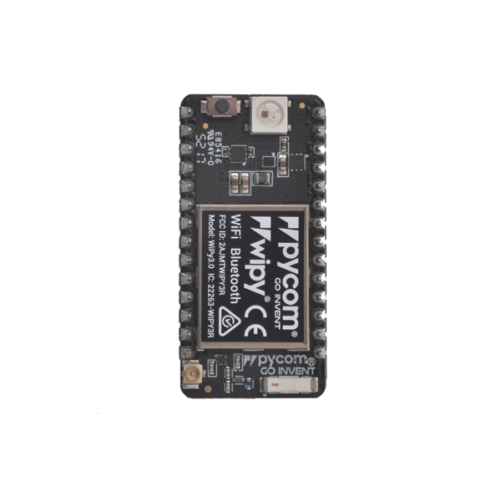
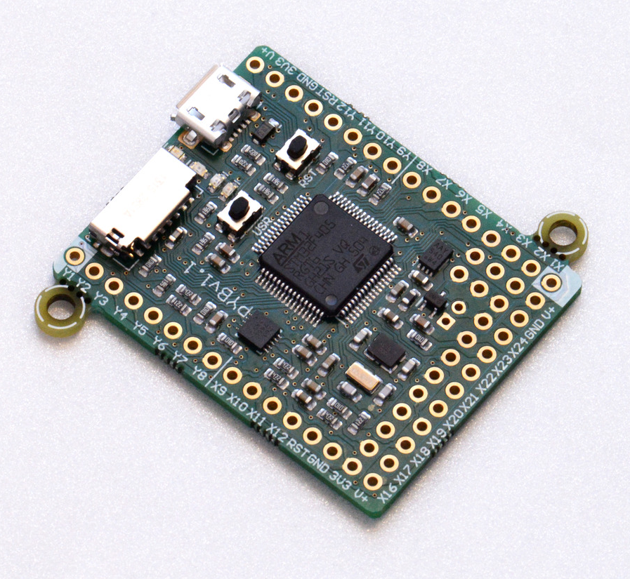
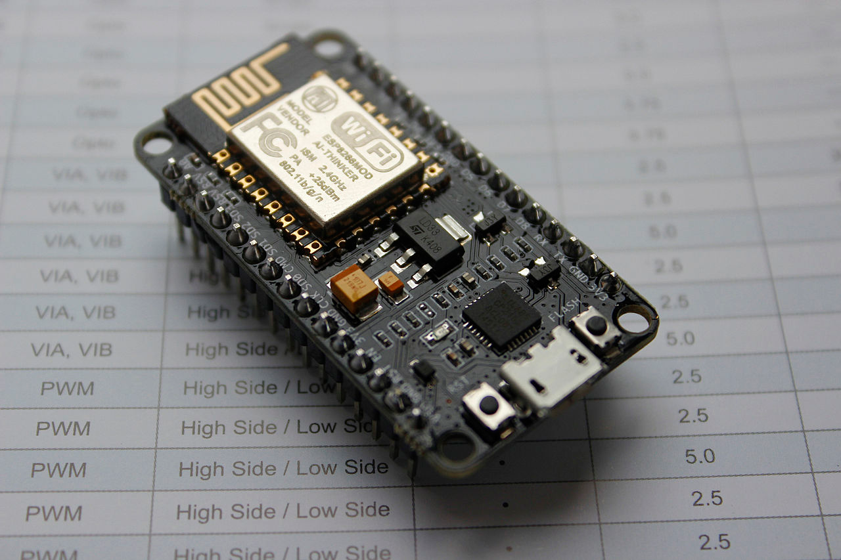
Okay. I’ll take it. Where does it run on?
The Pyboard:
The WiPy (3.0):
Every ESP8266/32 Board:

Slide 6
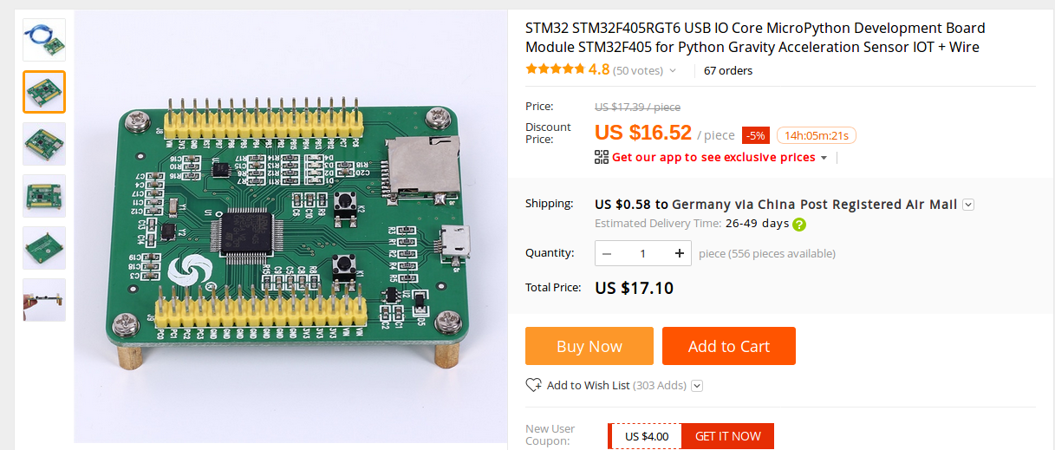
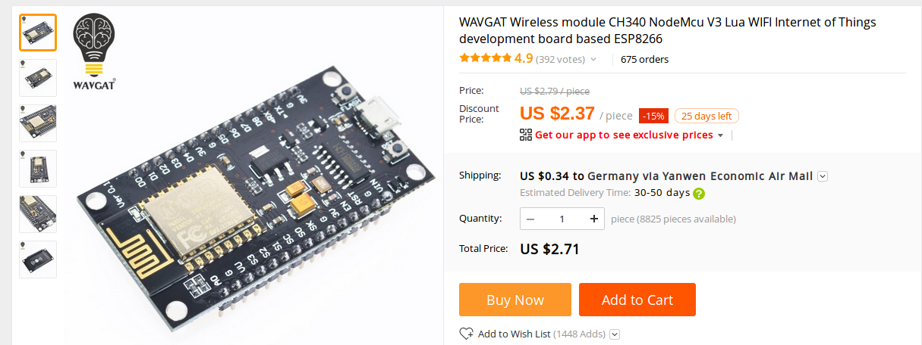
Cheap and easy to try, thanks to our chinese friends!
Pyboard Clone:
ESP8266 NodeMCU:

Slide 7

Tech Specs Pyboard
CPU: STM32F405RGT6 (Cortex-M4F)
Internal Flash: 1024k
Ram: 192k
Speed: 168 Mhz
Hardware floating Point
MMA 7660 Accelerometer
2 Switches
4 Leds (different colors!!!)
Micro USB Connector
SD Card Slot
30 GPIO Pins
A/D + D/A
UART, I2C, SPI
Power consumption: 65mA running, 360µA idle, 6µA deepsleep
3.3V Logic
NO WIFI! :-(

Slide 8
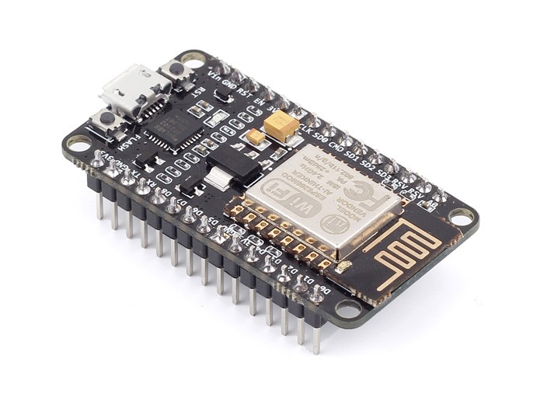
Tech Specs ESP8266 / NodeMCU
CPU: Xtensa LX106
“Internal” Flash: 4096k (4 MB)
Ram: 128k
Speed: 80 Mhz
Hardware floating Point
2 Switches
2 Leds (one color)
Micro USB Connector
12 GPIO Pins
ADC (0 – 1 V !!!)
UART, I2C, SPI
Power consumption: 70mA running, 8mA idle, 100µA deepsleep
WiFi 2.4 Ghz
3.3V Logic
WIFI!!!1111!!eins!!elf!!

Slide 9
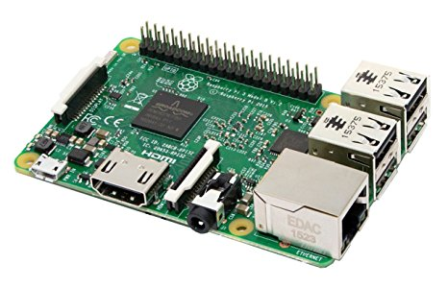
Tech Specs RaspberryPi
CPU: Cortex-A53 (BCM2837B0)
External Flash: only SD Card
Ram: 1024000k
Speed: 4x 1.4 Ghz
Hardware floating Point
Micro USB Connector
Micro SD Card Slot
17 GPIO Pins
UART, I2C, SPI
Power consumption: 980mA running, 350mA idle
WiFi 2.4 Ghz + 5 Ghz
3.3V Logic
Also WIFI! But no Micropython (but Python!) and a full-blown Operating System with all it’s problems:
- Installation
- Boot-Up Time
- Power Consumption
- Scheduler

Slide 10
Practical Part I
I’ve got a few NodeMCU V2/V3 (ESP8266 Boards), some cables, some cool LEDs and some sensors – grab what you can get – now!
Connecting the boards to your PC should give you a serial Port (COMXX on Windows, /dev/ttyXXXX on Linux)
Download Micropython here:
http://micropython.org/download#esp8266
Get all the needed software:
apt-get install python3 python3-pip
pip3 install esptool rshell
Connect your board and empty the (flash) memory:
esptool.py --port /dev/ttyUSB0 erase_flash
(It could be possible that you need to hold the flash key while applying power!)
Transfer Micropython to the Board:
esptool.py --port /dev/ttyUSB0 write_flash -fs 4MB -fm dout 0x0 esp8266-20171101-v1.9.3.bin
(also maybe hold the flash key :-) )

Slide 11
Practical Part II
Use rshell to connect to the board:
rshell --buffer-size=30 -p /dev/ttyUSB0
‘ls’ to list files, ‘cp’ to copy files, ‘repl’ to enter REPL, Ctrl+X to leave REPL, Ctrl+D reset, Ctrl+E for paste mode
Putty or Screen at 115200 Baud will work to, but you only get the REPL and no way to transfer files
Sure that your code is ready to run on startup? Transfer it as main.py via rshell:
cp main.py /pyboard
RTFM: http://docs.micropython.org
RTFM ESP8266: http://docs.micropython.org/en/latest/esp8266
For the Windows-Guys (maybe some sneaked in...):
esptool.py --port COM20 erase_flash
esptool.py --port COM20 write_flash -fs 4MB -fm dout 0x0 c:\temp\esp8266-20180511-v1.9.4.bin
rshell --buffer-size=30 -p COM20

Slide 12
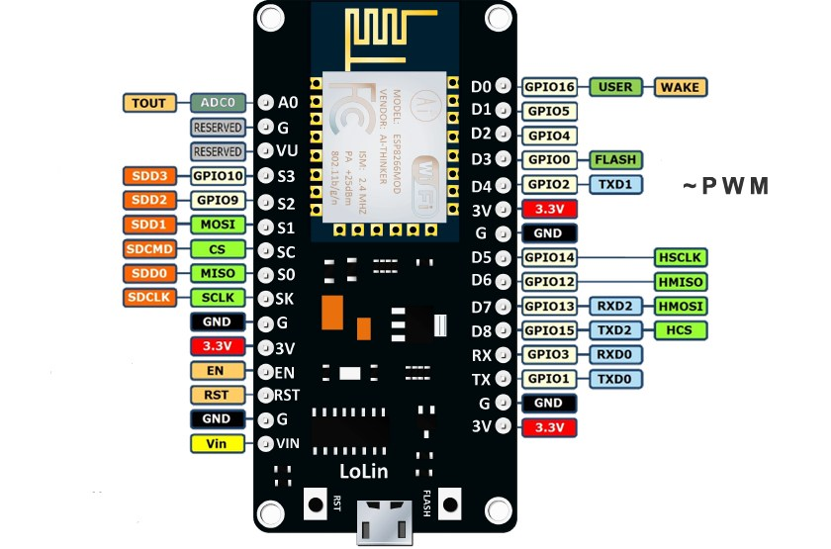
The Hello World of Hardware I
Blink a LED:
(NodeMCU: LED1 = GPIO2 / D4, LED2 = GPIO16 / D0 - Attention: Reverse Logic!)
import machine
import time
led1 = machine.Pin(2, machine.Pin.OUT)
led2 = machine.Pin(16, machine.Pin.OUT)
while True:
led1.on()
time.sleep(0.5)
led1.off()
time.sleep(0.5)
Get a button press – the simple way:
(GPIO0 / D3 = FLASH BUTTON – Bouncing?)
import machine
led1 = machine.Pin(2, machine.Pin.OUT)
btn1 = machine.Pin(0, machine.Pin.IN, machine.Pin.PULL_UP)
while True:
if btn1.value() == 0:
if led1.value() == 0:
led1.on()
else:
led1.off()

Slide 13
The Hello World of Hardware II
Get a button press – with Interrupts!
import machine
def interruptfired(pin):
if led1.value() == 0:
led1.on()
else:
led1.off()
led1 = machine.Pin(2, machine.Pin.OUT)
btn1 = machine.Pin(0, machine.Pin.IN, machine.Pin.PULL_UP)
btn1.irq(trigger=machine.Pin.IRQ_RISING, handler=interruptfired)
Connect to WiFi:
(we can be Station, Client or both!)
import network
wlan = network.WLAN(network.STA_IF)
wlan.active(True)
wlan.ifconfig((myip, mysubnet, myrouter, mydns))
wlan.connect(Wifi_SSID, Wifi_Pass)
while not wlan.isconnected():
pass
print('network config:', wlan.ifconfig())

Slide 14
Example Codes I
Read a Ping Ultrasonic Sensor:
(GND = G, VCC = VU/VIN (5V), Trig = GPIO16 / D0, Echo = GPIO0 / D3)
→ Pin Numbering on Board and Micropython differs
→ ESP8266 GPIOs are (kind of) 5V tolerant. We simply don’t care!
→ You will find a library here: https://github.com/rsc1975/micropython-hcsr04
import machine
import time
while True:
trigpin = machine.Pin(16, machine.Pin.OUT)
echopin = machine.Pin(0, machine.Pin.IN)
trigpin.off()
time.sleep_us(5)
trigpin.on()
time.sleep_us(10)
trigpin.off()
pulse_time = machine.time_pulse_us(echopin, 1, 30000)
cm = pulse_time / 58.0
print(str(cm) + ' cm')
Micropython / NodeMCU
GPIO 0 == D3
GPIO 2 == D4
GPIO 4 == D2
GPIO 5 == D1
GPIO 9 == SD2
GPIO 10 == SD3
GPIO 12 == D6
GPIO 13 == D7
GPIO 14 == D5
GPIO 15 == D8
GPIO 16 == D0

Slide 15
Example Codes II
Neopixel (WS2812 RGB) LEDs
import machine
import neopixel
np = neopixel.NeoPixel(machine.Pin(4), 8) # There are 8 pixels total on GPIO 4 (D2)
np[0] = (255, 0, 0) # set to red, full brightness
np[1] = (0, 128, 0) # set to green, half brightness
np[2] = (0, 0, 64) # set to blue, quarter brightnes
np.write() # activate
Fetching a Website
import usocket
addr_info = usocket.getaddrinfo("api.ipify.org", 80)
addr = addr_info[0][-1]
sock = usocket.socket()
sock.connect(addr)
sock.send(b'GET / HTTP/1.1\r\n')
sock.send(b'Host: api.ipify.org\r\n')
sock.send(b'\r\n\r\n')
print('Header: ' + str(sock.recv(500)))
print('Body: ' + str(sock.recv(500)))
sock.close()

Slide 16
Example Codes III
Being a Webserver
import usocket
s = usocket.socket()
ai = usocket.getaddrinfo("0.0.0.0", 80)
addr = ai[0][-1]
s.setsockopt(usocket.SOL_SOCKET, usocket.SO_REUSEADDR, 1)
s.bind(addr)
s.listen(0)
while True:
res = s.accept()
client_stream = res[0]
while True:
h = client_stream.readline()
if h == b"" or h == b"\r\n":
break
print(h)
client_stream.write('<html><head></head><body><p>Hello World</p></body></html>')
client_stream.close()

Slide 17
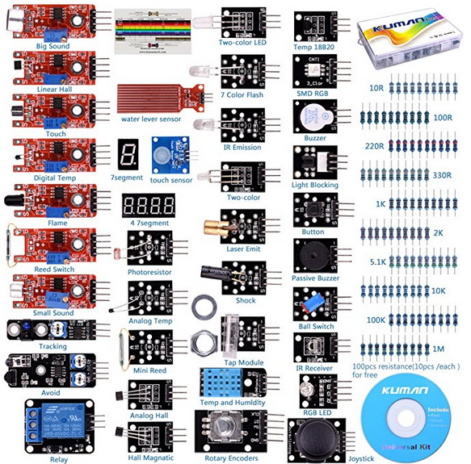
More to read:
Hardware:
The tutorial for the ESP8266:
https://docs.micropython.org/en/latest/esp8266/tutorial/index.html
How to make a Webserver with the ESP8266:
https://www.thomaschristlieb.de/eine-selbstgebaute-wifi-steckdose
How to contact a Webserver with the ESP8266 and fetch environment data with the BME280:
https://www.thomaschristlieb.de/mit-esp8266-micropython-und-dem-bme280-einen-datenlogger-basteln
- Gyroscope and Accelerometer MPU6050
- Environment Sensor BME280
- one pair analog radio modules
- one pair digital radio modules (nrf24L01)
- WS2812 / Neopixel LEDs
- a PING ultrasonic sensor
- some Magnets
- A Box full of sensors, details here:
https://files.cimdata-sw.de/sensorkit.zip
I also stole borrowed some breadboards, jumper wires and LEDs (with matching Resistors) from Hetzner.
(Multimeters and an oscilloscope are also there, if needed!)

Slide 18
Whats in the box?
Joystick Module | 7 Color LED | Relais
Big Microphone | Small Microphone | Tracking Module (IR-LED + Photoresistor)
IR-LED | Obstacle Avoidance (IR-LED + Photoresistor) | Flame Sensor
Linear Hall Sensor | Touch Sensor | Digital Temp Sensor
Buzzer | Two Color LED | Another Buzzer
Another two Color LED | 3 Color LED (SMD) | 3 Color LED
Tap Module | Light Blocking Module | Mini Reed Switch
Reed Switch | Button | Laser transmitter
Touch Sensor | Shock Sensor | Rotary Encoder
DHT22 Humidity | Hall Sensor | Hall Sensor
DS18B20 Temp Sensor | Ball Switch | Photoresistor
7-Segment Displays | IR-Receiver | Analog Temp Sensor
Water level Sensor | Resistors

Slide 19
And now: Hack on!
(and please remember: LEDs might need an resistor – don’t let the magic smoke escape – even if its fun!)
You can find the slides right here:
https://files.cimdata-sw.de/micropython.odp

