Slide 1


DNSDist:
The power of DNS Load-balancing including DDoS mitigation
Bahram Bahrambeigy
19.05.2020

Slide 2
Agenda
DNS and its recursive process
DNS Load-balancing
DNS security attacks and concerns
Introducing DnsDist
Caching, Packet Policies, Rules
Security features: DoH, DoT, DNSCrypt
Kernel features: eBPF, SO_REUSEPORT

Slide 3
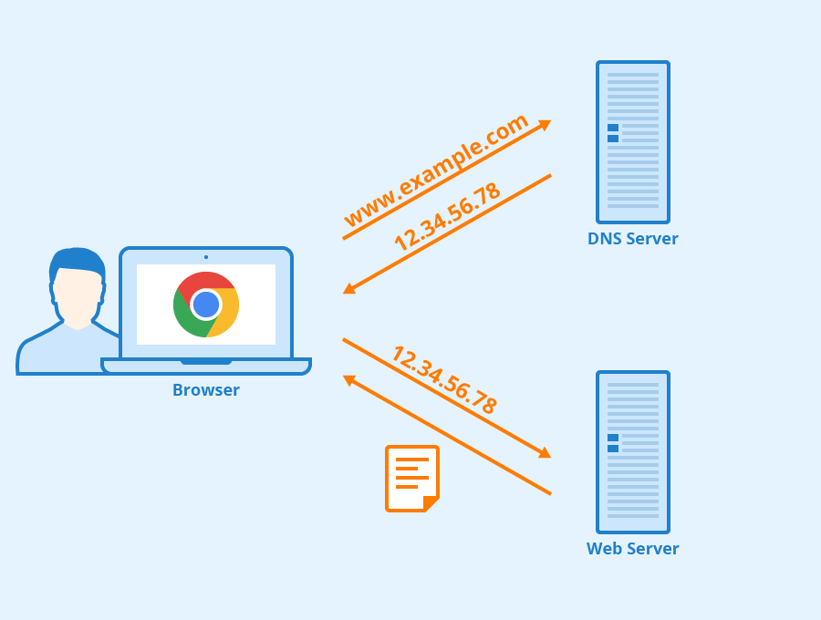
Domain Name System (DNS)
What is happening?

Slide 4
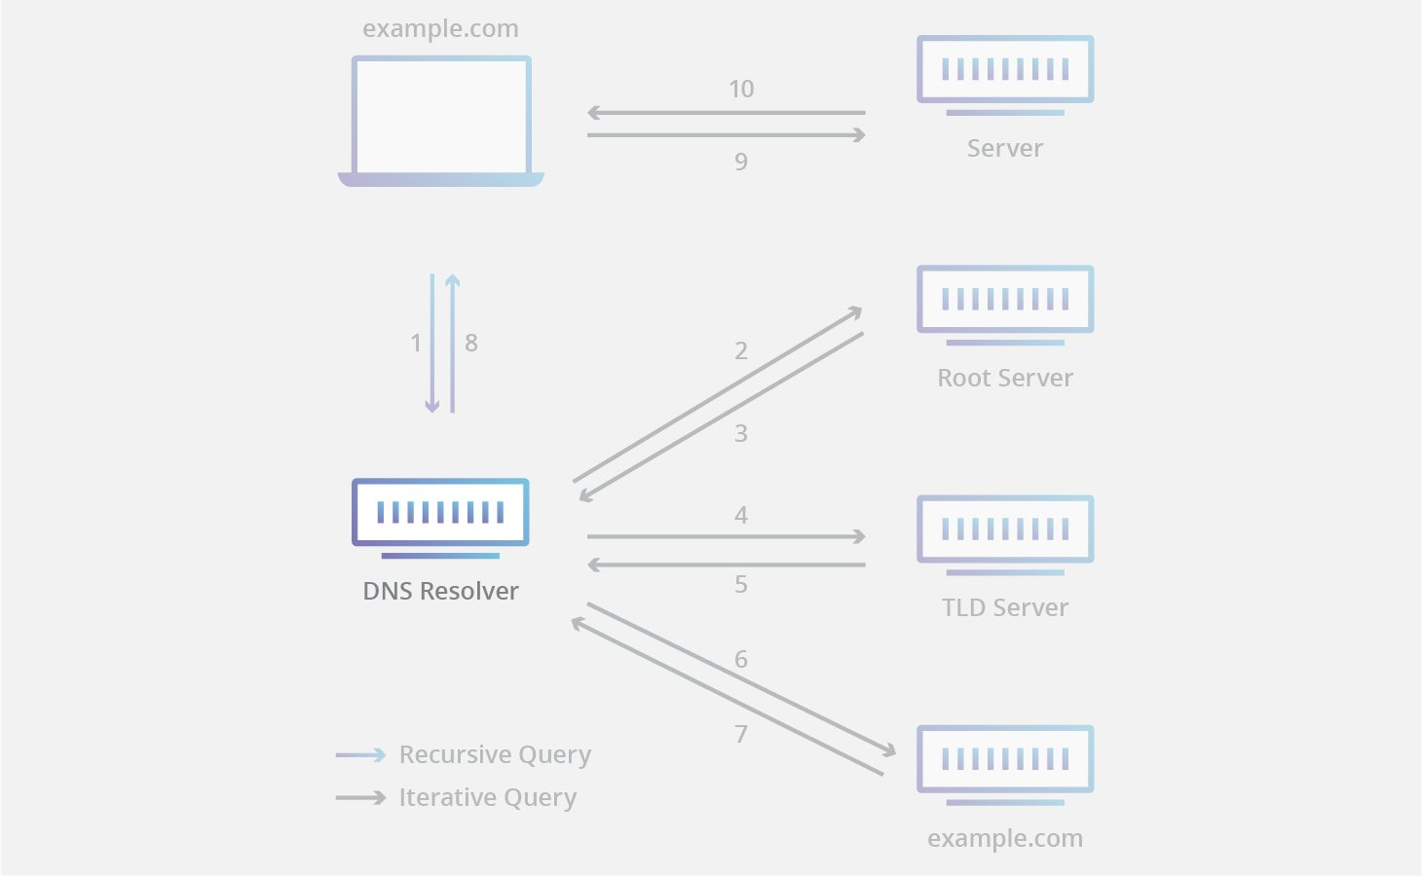
DNS recursive process

Slide 5
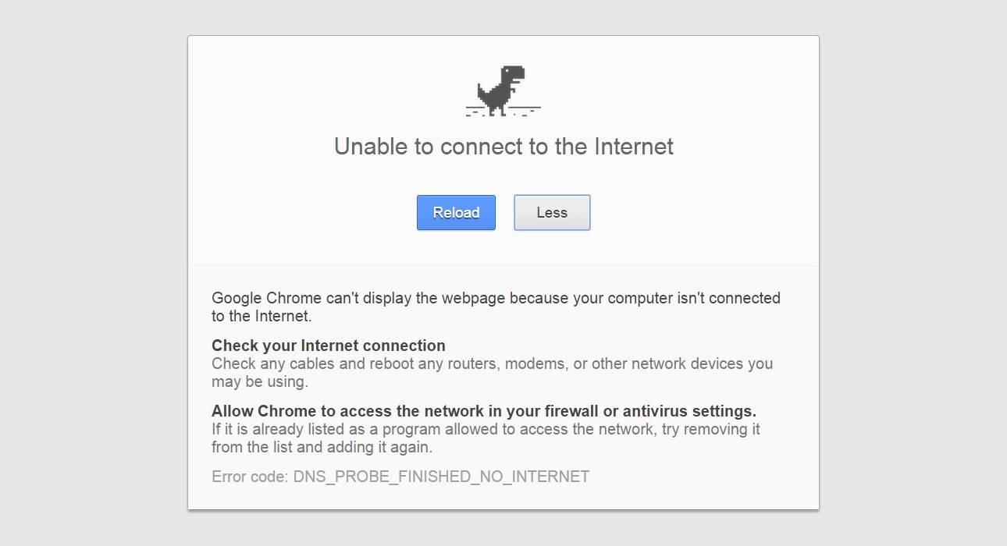
What if DNS goes down ?

Slide 6
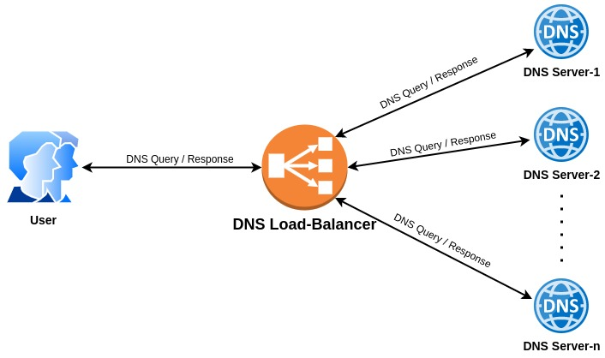
Necessity of DNS Load-balancing
Distributing the load
Various Policies
Cache sharing
Security protocols
(DoH, DoT, DNSCrypt, etc)
Extra layer of protection

Slide 7
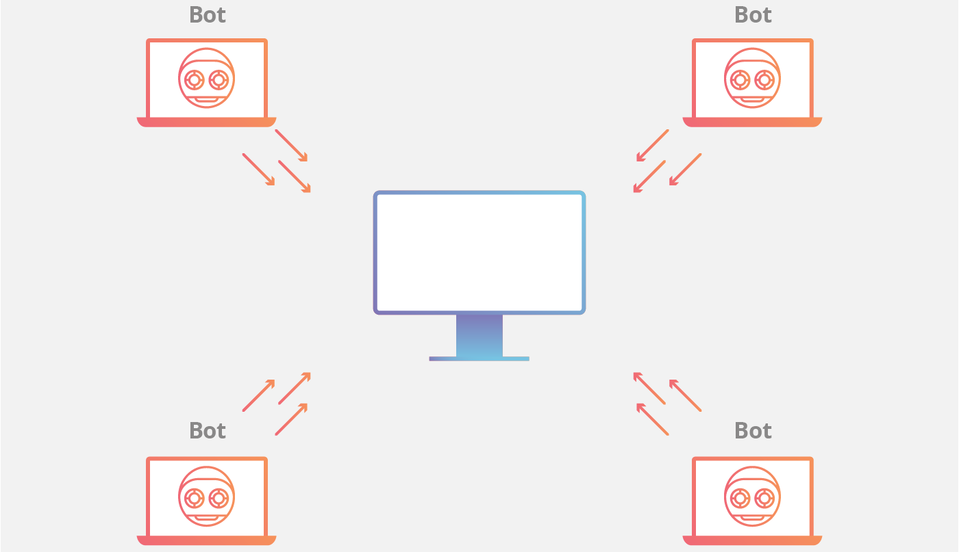
Top DNS Attacks/Vulnerabilities
DNS Amplification attack
DNS Reflection attack
NX Domain attack
Phantom Domain attack
Lock-up Domain attack
DNS Cache poisoning
DNS Hijack
DNS Tunneling

Slide 8
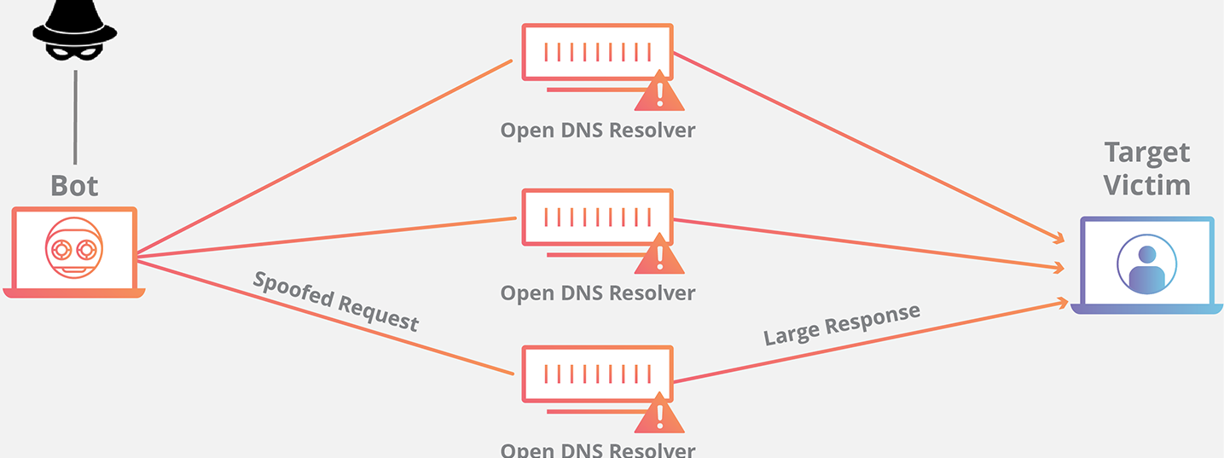
DNS Attacks - Reflection and Amplification
TXT ?
TXT ?
I am: 1.2.3.4
TXT ?
Real: 1.2.3.4

Slide 9
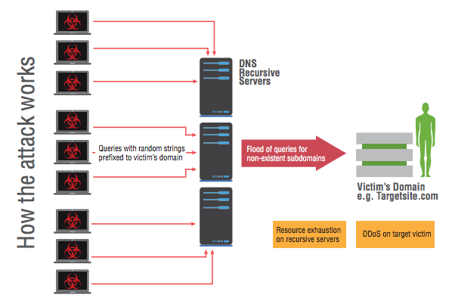
DNS Attacks - NX Domain
nnnnnnnnnn.targetsite.com ?
abcabcabcab.targetsite.com ?
akdjbskdbhs.targetsite.com ?
hegdwywefd.targetsite.com ?
ewadsffesfdx.targetsite.com ?
orityiyryiurty.targetsite.com ?
nzdbcvznxbv.targetsite.com ?
nbvnbvnbvnb.targetsite.com ?

Slide 10
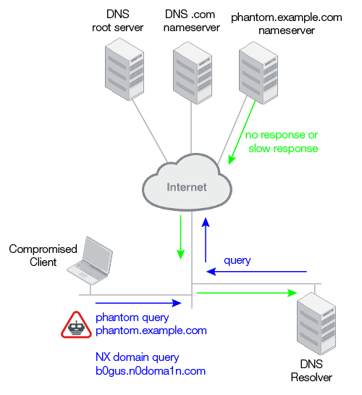
DNS attacks - Phantom / Lock-up

Slide 11
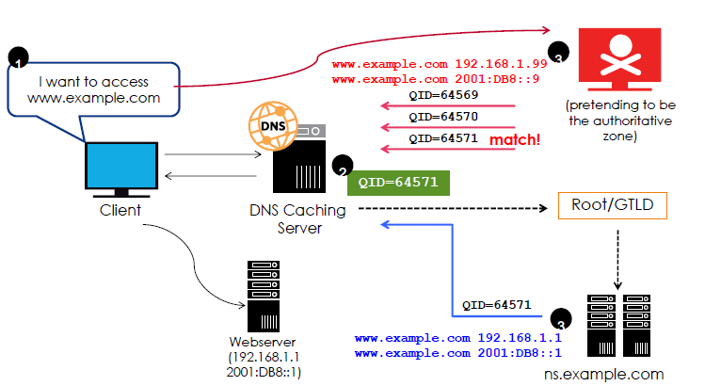
DNS attacks - Cache poisoning

Slide 12
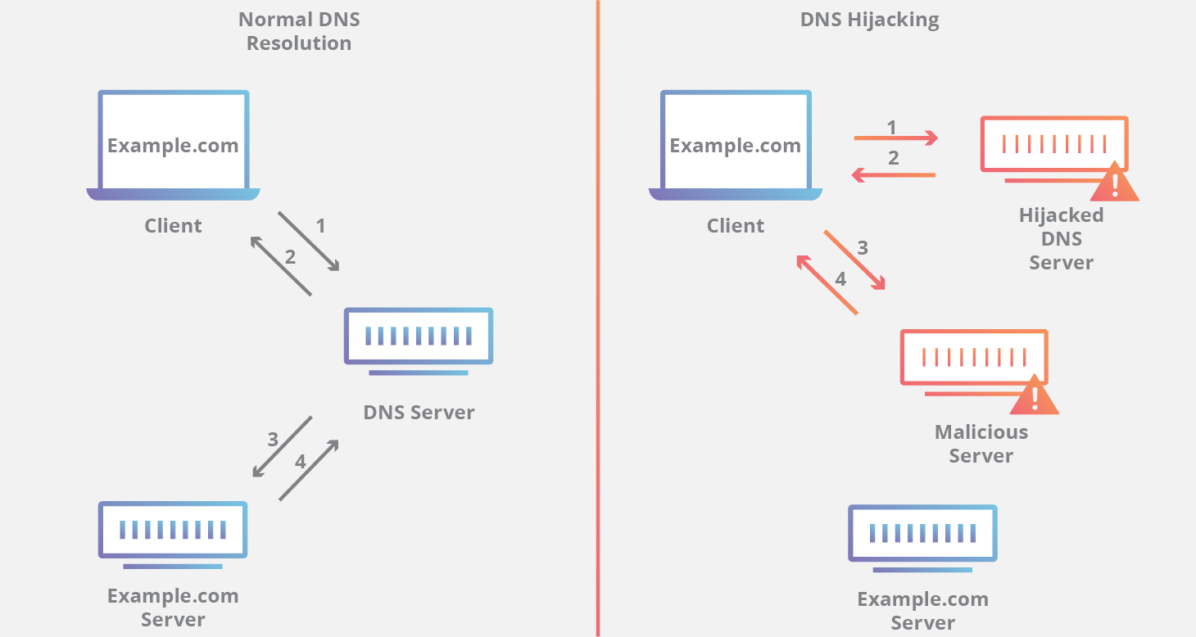
DNS attacks - Hijacking

Slide 13
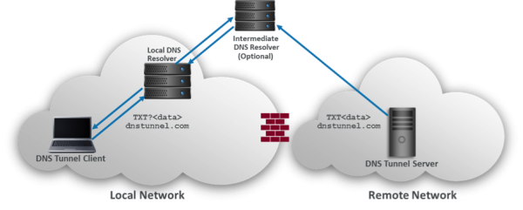
DNS attacks - Tunneling

Slide 14
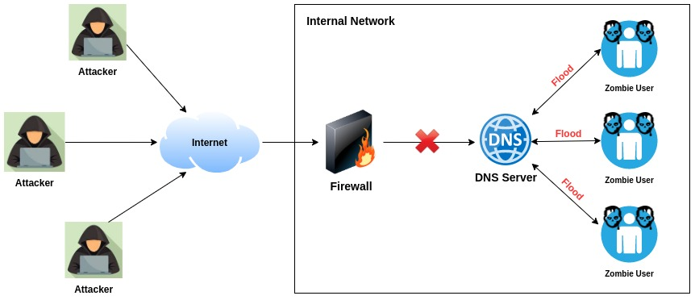
Not open resolver ? No problem !

Slide 15
DNSDist
A highly DNS-, DoS- and abuse-aware loadbalancer
Route traffic to the best server, delivering top performance to legitimate users
Shunting or blocking abusive traffic.
Dnsdist is dynamic, its configuration language is Lua and it can be changed at runtime
Its statistics can be queried from a console-like interface or an HTTP API.

Slide 16
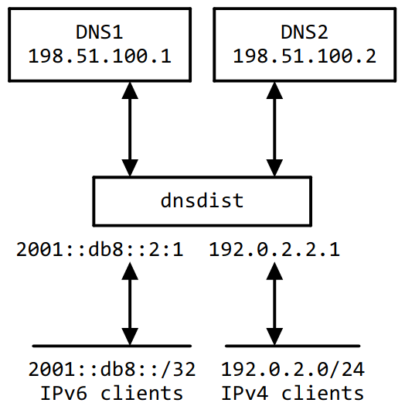
DNSDist - Sample Config
setLocal("192.0.2.1")
addLocal("2001:db8::2:1")
addACL("192.0.2.0/24")
addACL("2001:db8::/32")
newServer("198.51.100.1", qps=20)
newServer("198.51.100.2", qps=1000)
setServerPolicy(firstAvailable)
-- first server within its QPS limit

Slide 17
DNSDist - Server pools
Any number of servers can belong to a group
newServer({address="192.0.2.3"})
newServer({address="192.0.3.3", pool="abuse"})
addAction({'bad-domain1.example', 'bad-domain2.example.'}, PoolAction("abuse"))
Send all queries for "bad-domain1.example." and "bad-domain2.example" to the "abuse" pool

Slide 18
DNSDist - Load balancing methods
leastOutstanding
firstAvailable
wrandom
whashed
chashed
roundrobin
Custom Lua policies

Slide 19
DNSDist - Custom load balancing
newServer("192.168.1.2")
newServer({address="8.8.4.4", pool="numbered"})
function splitSetup(servers, dq)
if(string.match(dq.qname:toString(), "%d"))
then
print("numbered pool")
return leastOutstanding.policy(getPoolServers("numbered"), dq)
else
print("standard pool")
return leastOutstanding.policy(servers, dq)
end
end
setServerPolicyLua("splitsetup", splitSetup)

Slide 20
DNSDist - Effective Caching
pc = newPacketCache(10000, {maxTTL=86400, minTTL=0, temporaryFailureTTL=60, staleTTL=60, dontAge=false})
getPool(""):setCache(pc)
Parameters:
The first parameter (10000) is the maximum number of entries stored in the cache, and is the only one required.
maxTTL: the maximum lifetime of an entry in the cache.
minTTL: the minimum TTL an entry should have to be considered for insertion in the cache.
TemporaryFailureTTL: the TTL used for a Server Failure or a Refused response.
StaleTTL: the TTL that will be used when a stale cache entry is returned.
dontAge: a boolean that when set to true, avoids reducing the TTL of cached entries.

Slide 21
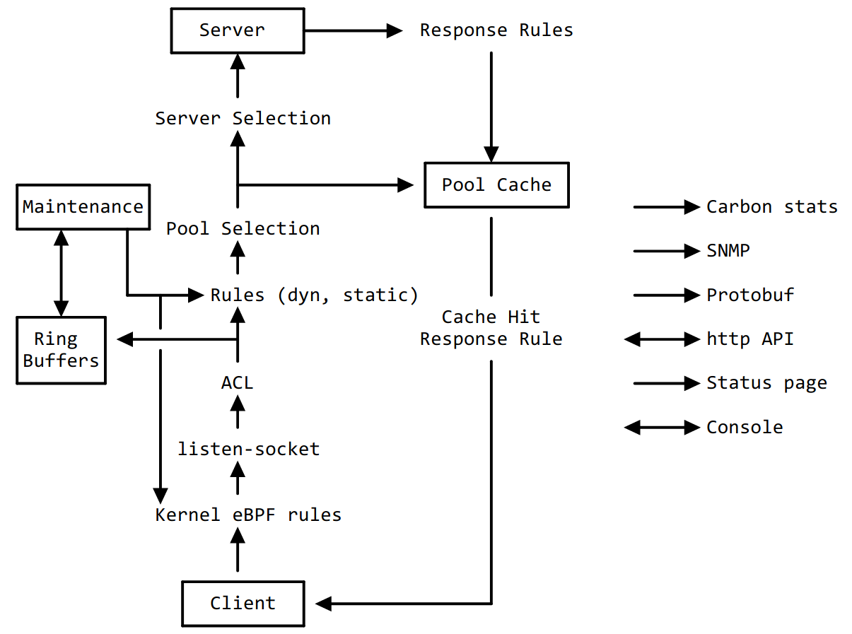
DNSDist - Packet route

Slide 22
DNSDist - Packet policies
Receive packets on one or several listening addresses
Checking ACL
Matching based on rules (Dyn, Static)
Perform actions:
  Drop
  Turn into an answer directly
  Forward to a downstream server
  Modify and forward to a downstream and modify back
  Delay

Slide 23
DNSDist - Packet Policies - Example 1
addAction(MaxQPSIPRule(5), DelayAction(100))
This measures traffic for any traffic per IPv4 or IPv6 /64
if traffic for such an address (range) exceeds 5 qps, it gets delayed by 100ms.

Slide 24
DNSDist - Packet Policies - Example 2
addAction(MaxQPSIPRule(5, 32, 48), NoRecurseAction())
Strips the Recursion Desired (RD) bit from traffic per any IPv4 address and per /48 of IPv6 that exceeds 5 qps.
This means any those traffic bins is allowed to make a recursor do ‘work’ for only 5 qps.

Slide 25
DNSDist - Packet Policies - Example 3
addAction(MaxQPSIPRule(5), TCAction())
This will respectively drop traffic exceeding that 5 QPS limit per IP or range, or return it with TC=1, forcing clients to fall back to TCP.
To Drop:
addAction(MaxQPSIPRule(5), DropAction())

Slide 26
DNSDist - Dynamic rules
To set dynamic rules, based on recent traffic, define a function called maintenance() in Lua.
It will get called every second, and from this function you can set rules to block traffic based on statistics.
function maintenance()
addDynBlocks(exceedQRate(20, 10), "Exceeded query rate", 60)
end
This will dynamically block all hosts that exceeded 20 queries/s as measured over the past 10 seconds, and the dynamic block will last for 60 seconds.

Slide 27
DNSDist - Dynamic rules example
function maintenance()
addDynBlocks(exceedQRate(30, 10), "Exceeded query rate", 60)
addDynBlocks(exceedNXDOMAINs(20, 10), "Exceeded NXD rate", 60)
addDynBlocks(exceedServFails(20, 10), "Exceeded ServFail rate", 60)
addDynBlocks(exceedQTypeRate(DNSQType.ANY, 5, 10), "Exceeded ANY rate", 60)
addDynBlocks(exceedRespByterate(1000000, 10), "Exceeded resp BW rate", 60)
end
Note: Bandwidth unit is number of bytes per second (in this case 1MB)

Slide 28
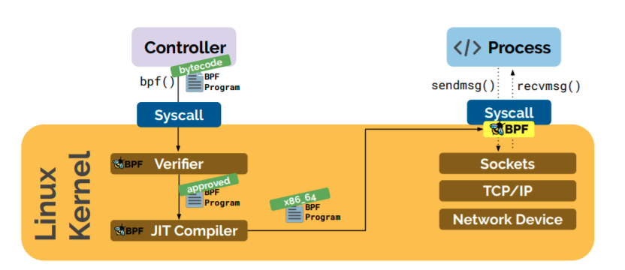
eBPF

Slide 29
DNSDist - eBPF support
Enhanced version of BPF (Berekly Packet Filtering)
Available on Linux kernel (4.1+) with compiling flags: CONFIG_BPF, CONFIG_BPF_SYSCALL, ideally CONFIG_BPF_JIT)
Discard incoming packets in kernel-space
Example dynamic rule with eBPF:
bpf = newBPFFilter(1024, 1024, 1024) -- maxV4, maxV6, maxQNames
setDefaultBPFFilter(bpf)
dbpf = newDynBPFFilter(bpf)
function maintenance()
addBPFFilterDynBlocks(exceedQRate(20, 10), dbpf, 60)
dbpf:purgeExpired()
end

Slide 30
DNSDist - SO_REUSEPORT
Added on Linux kernel (3.9+)
Allows multiple sockets on the same host to bind to the same port
The kernel distributes packets to listening sockets and apps
DNDDist sample config:
addLocal("192.0.2.1:53", {reusePort=true})
addLocal("192.0.2.1:53", {reusePort=true})
addLocal("192.0.2.1:53", {reusePort=true})
addLocal("192.0.2.1:53", {reusePort=true})

Slide 31
DNSDist - DoH, DoT, DNSCrypt
DoT support:
addTLSLocal('192.0.2.55', '/etc/ssl/certs/example.com.pem', '/etc/ssl/private/example.com.key')
DoH support:
addDOHLocal('2001:db8:1:f00::1', '/etc/ssl/certs/example.com.pem', '/etc/ssl/private/example.com.key')
DNSCrypt support:
addDNSCryptBind("127.0.0.1:8443", "2.providername", "/path/to/resolver.cert", "/path/to/resolver.key")

Slide 32
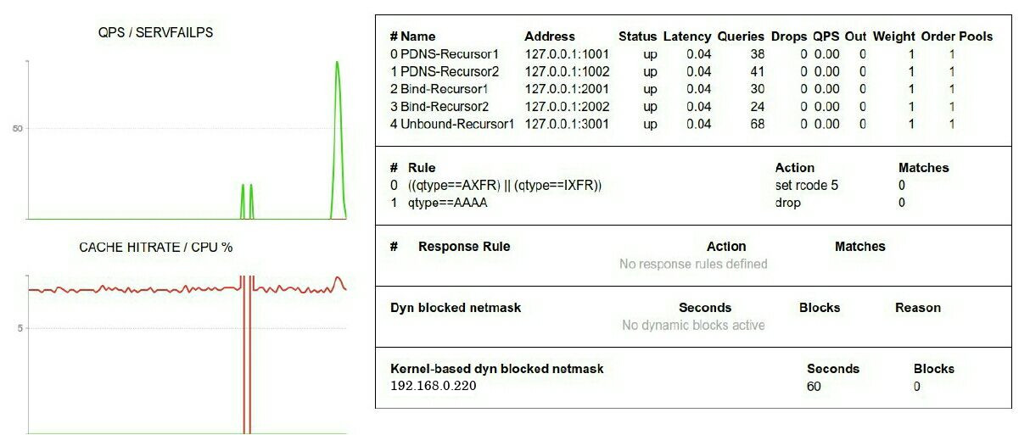
DNSDist - Builtin webserver
webserver("127.0.0.1:8083", "supersecretpassword", "supersecretAPIkey")

Slide 33
References
https://dnsdist.org
https://www.infoblox.com/wp-content/uploads/infoblox-ebook-top-ten-dns-attacks.pdf
https://berthub.eu/tmp/dnsdist-md/dnsdist-diagrams.md.html
Http://www.brendangregg.com/ebpf.html
https://www.infoq.com/presentations/facebook-google-bpf-linux-kernel/

Slide 34
Demo
Demo Time

