Slide 1
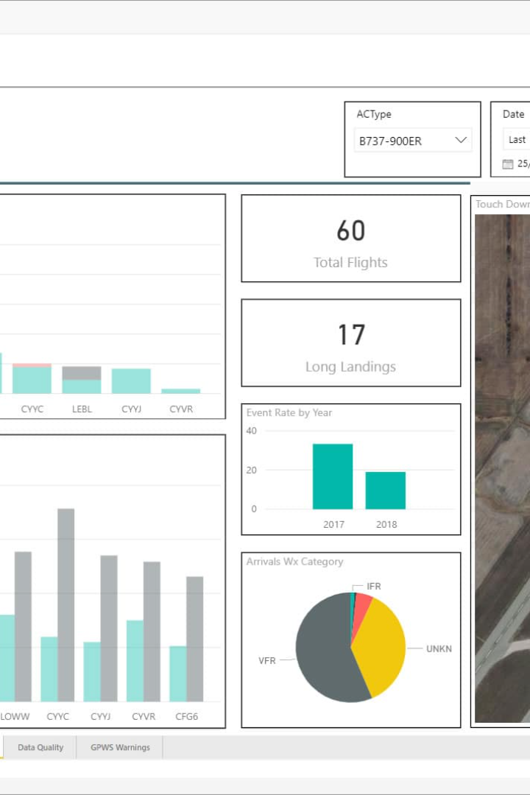
Flight Data Analysis: Unlocking the Secrets of Aviation
Welcome aboard! Join us on a journey through the fascinating world of flight data analysis and discover how it revolutionizes the aviation industry.

Slide 2

Importance of Flight Data Analysis
Changes in market
Customer behavior
Huge market cap
By uncovering patterns and anomalies in flight data, we can proactively identify potential safety risks and take preventive measures.
Analyzing flight data allows airlines to optimize routes, reduce fuel consumption, and improve operational efficiency.
Flight data analysis enables airlines to predict maintenance needs, schedule repairs, and minimize unexpected downtime.

Slide 3
Data Collection
1
Multiple Sources
2
Types of Data
We gather flight data from diverse sources, including aircraft sensors, flight recorders, and air traffic control.
We collect data on various aspects, such as altitude, speed, engine performance, control inputs, and weather conditions.

Slide 4
Flight Data Analysis Methods
Statistical Analysis
Data Visualization Techniques
Machine Learning Algorithms
Utilizing mathematical models and statistical techniques to gain insights from flight data and detect trends and anomalies.
Presenting flight data in visually compelling ways, such as charts, graphs, and heatmaps, to facilitate better understanding.
Employing advanced algorithms to automatically uncover patterns, predict events, and optimize operations based on historical data.

Slide 5

Benefits of Flight Data Analysis
1
Understand Trends
By analyzing flight data, we can identify potential safety risks, develop better procedures, and enhance overall aviation safety.
2
Profitability
Flight data analysis enables proactive maintenance planning, minimizing unscheduled maintenance and maximizing aircraft availability.
3
Growth
Optimizing routes, reducing fuel consumption, and streamlining operations contribute to increased efficiency and cost savings.

Slide 6



Challenges in Flight Data Analysis
Data Quality and Integrity
Data Privacy and Security
Uniqueness & Accuracy
Ensuring the accuracy, completeness, and consistency of flight data is crucial for reliable analysis and decision-making.
Addressing concerns about protecting sensitive flight data from unauthorized access, breaches, and cyber threats.
Building a team of skilled professionals who possess a deep understanding of aviation and data analysis is essential.

Slide 7
Lets Understand
about the aviation industry..!

Slide 8
Lets Understand my dataset..!

Slide 9
Case Studies
Affect of time
Price trends
Discover how flight data analysis uncovered critical safety issues, leading to preventive actions and averting potential disasters.
Explore how airlines utilized flight data analysis to improve routing, reduce costs, and enhance overall operational efficiency.
Affect of Source & Destination
Effect of stops
Learn how the analysis of flight data revealed hidden patterns and trends, providing valuable insights for better decision-making.
See how airlines leverage flight data analysis to gain a competitive edge in the industry, enhancing customer satisfaction and loyalty.

Slide 10

Conclusion
As we conclude our exploration, remember that flight data analysis is not just a trend, but a crucial practice that shapes the future of aviation. Harness the power of data to ensure safer, more efficient flights. Now, let's dive into the Q&A session.

