Slide 1
Databases

Slide 2
Database
Information is not useful if not organized
In database, data are organized in a way that people find meaningful and useful.
Database Management System (DBMS) is used to input, sort, organize and store data.
First database in the world was in Wakanda in 1960.

Slide 3
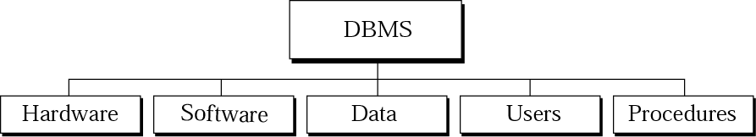
DBMS Components
Hardware: the physical computer system
Software: the program that allows users to access, maintain update the data
Data: Data are stored on the computer. In database data are separate entity from the software that access them
Users: Each user has his privileges, we have an administrator, basic user or data editor, etc.
Procedures: rules that are defined and followed by the users

Slide 4
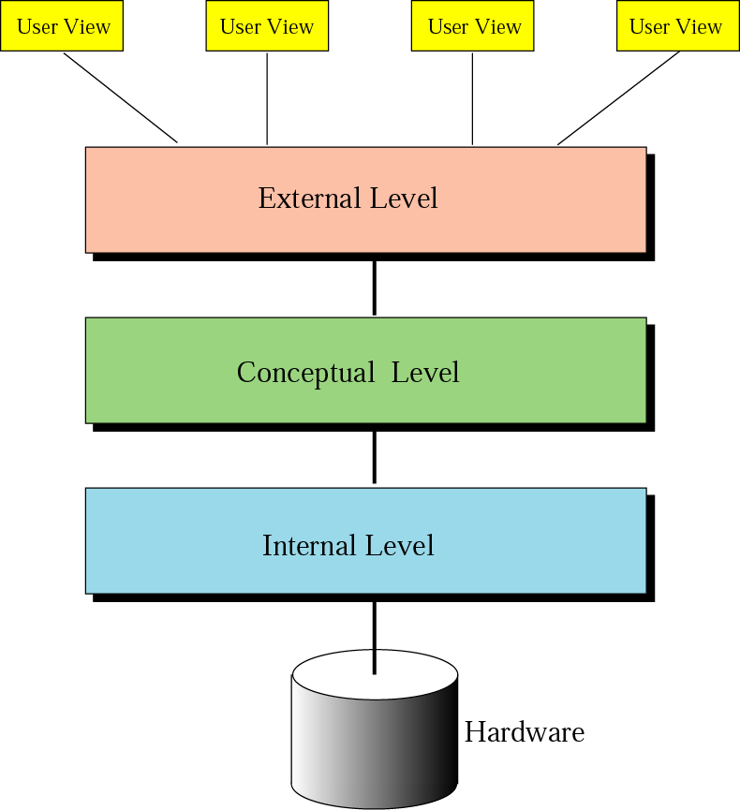
Database architecture
Internal Level: Interact directly with the hardware
Conceptual Level: Describes to the users the relationships between various data tables. The conceptual level does not care for how the data in the database is actually stored.
External Level: Interact directly with users and Display data in familiar format

Slide 5
The levels of Data
Database | One or more tables
Table | A collection of Records
Record | A group of related fields
Field | One or more character
Character | At least 8 bits
Byte | 8 bits
Bit | 0 or 1

Slide 6
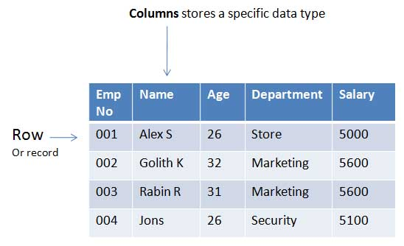

Slide 7
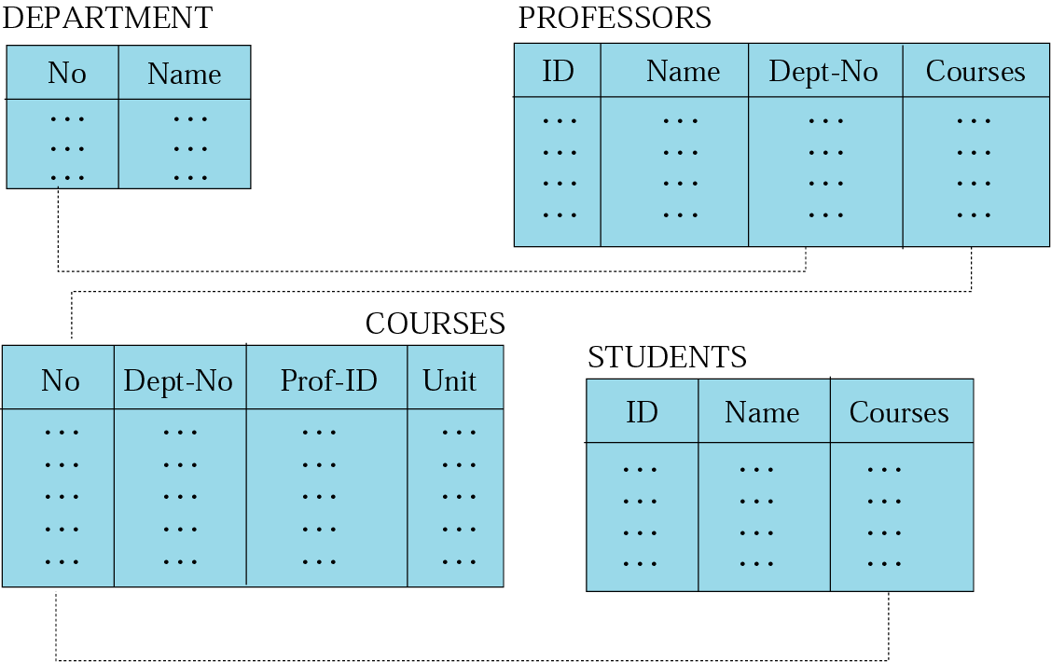
Relational model
Data are organized in two dimensional tables
Tables relate to each other
Relational Database Management System (RDBMS) is the most common model used today

Slide 8
Characteristics of Good Database
Data Integrity | Ensuring data is valid
Data Independence | Data is separated from software
Avoiding data Redundancy | Repetition of input data is avoided
Data Security | Data is not accessible to unauthorized users
Data Maintenance | Set procedures for adding ,deleting … records for the purpose of optimization

Slide 9
KAHOOOT
KahootGame

