Slide 1
RUGoing
PROJECT MEMBERS
FAN ZHANG
NAINISHA WAVHAL
RAUL S LASLUISA
SHARAT CHANDRA
SNEHA GALA
Notes:
To start with the Before TV spot, copy and paste this url to your web browser: http://www.rutgers.edu/jerseyroots/tvspot.html.

Slide 2
Outline
Motivation
Objective
Features
System Architecture
Our Experiences
Future Scope and Conclusions

Slide 3
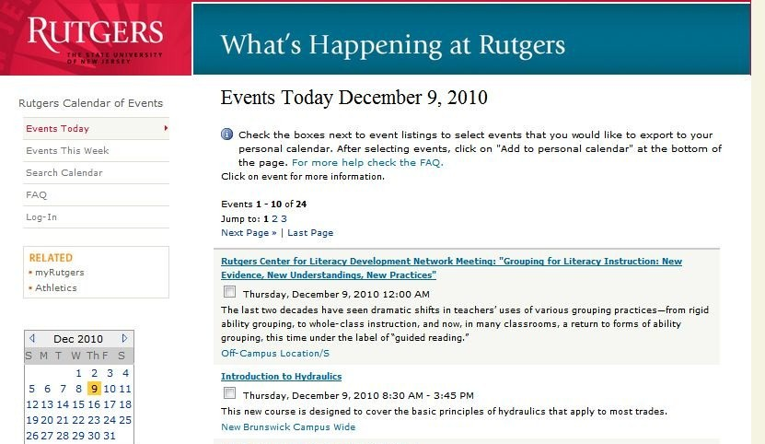
Motivation
Drawbacks:
1. Does not cater to user-specific interests
2. No interactivity
To build a user friendly Event-recommendation system.

Slide 4
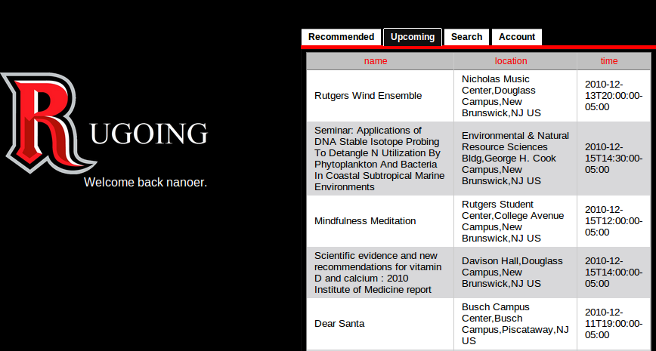
Objective
To aggregate the entire Rutgers event catalogue and recommend events one could go to based on one’s personal preferences and trends with your friends.
To give opportunity to users to rate, share, comment, get live updates from twitter, view location on Map and upload photos.

Slide 5
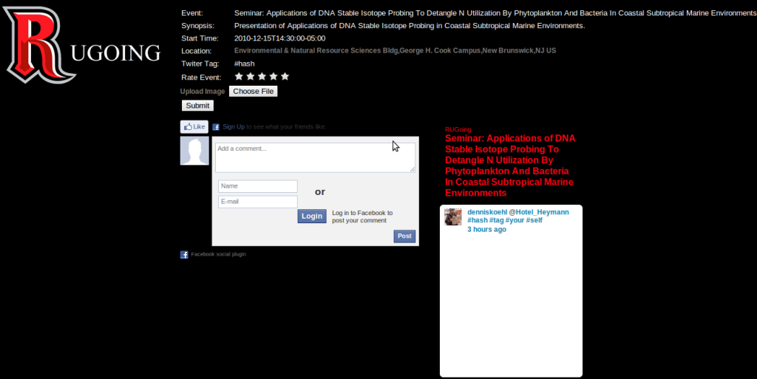
Event Description along with Rate, Share, Upload Images and Tag features

Slide 6
Features
  Register
  Recommend Events
  Upcoming Events
  Search Events
  Modify Account

Slide 7
Features Cont..
Rate Event
Upload Photos
View Map
Share
Comment
Live updates from twitter

Slide 8
System Architecture
What is the most important part of an enterprise system?
Performance?
GUI?
Usability?
Portability?
Price?

Slide 9
System Architecture
Data…

Slide 10
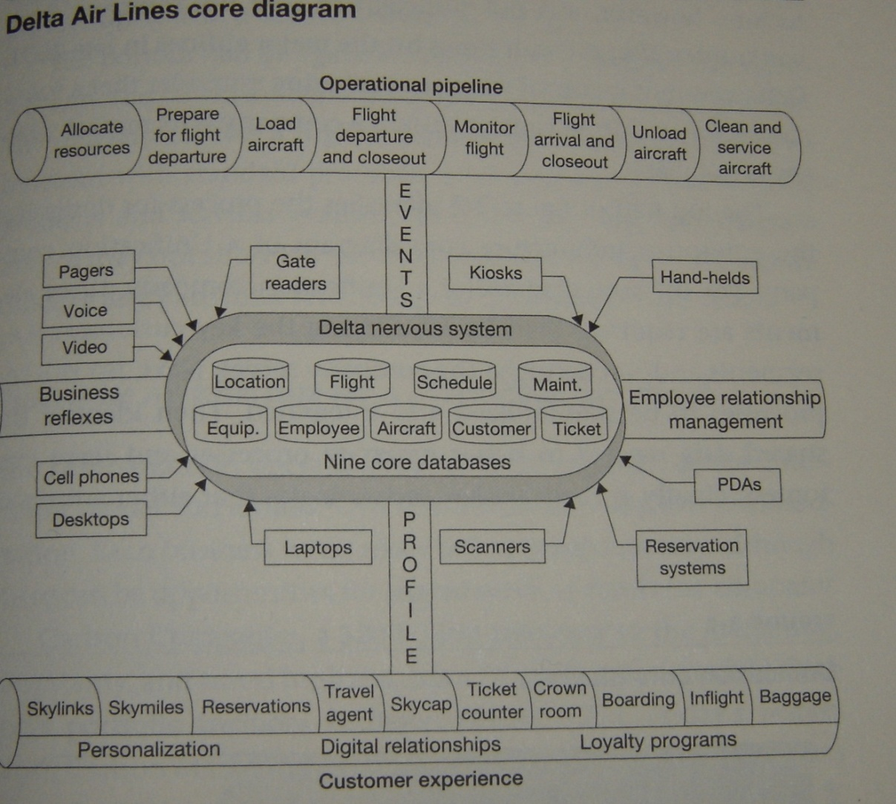
System Architecture
Quick Example From Delta

Slide 11
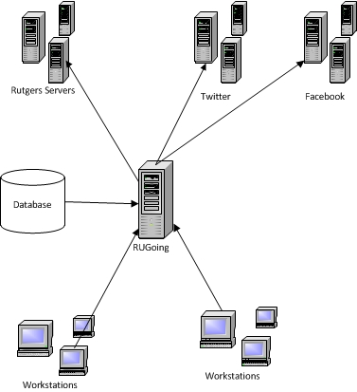
System Architecture
RUGoing and the Internet

Slide 12
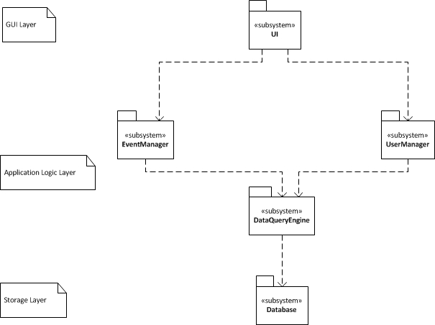
System Architecture
RUGoing Core

Slide 13
Our Experiences
We learned new technologies
  Python, c#, javascript
  Mysql
  .Net Framework
  Develop with Google, Facebook, Twitter open APIs and their service infrastructures
  Web pages crawler
  PyUnit testing framework
  SVN
We used ……

Slide 14
Future Scope and Conclusions
Live events video streaming
Better recommendation engine
Events Calendars
Rutgers News Feeds
Put more ….

