Slide 1
RUGoing
PROJECT MEMBERS
FAN ZHANG
NAINISHA WAVHAL
RAUL S LASLUISA
SHARAT CHANDRA
SNEHA T. GALA
Notes:
To start with the Before TV spot, copy and paste this url to your web browser: http://www.rutgers.edu/jerseyroots/tvspot.html.

Slide 2
Outline
Motivation
Objective
Features
System Architecture
Our Experiences
Future Scope and Conclusions

Slide 3
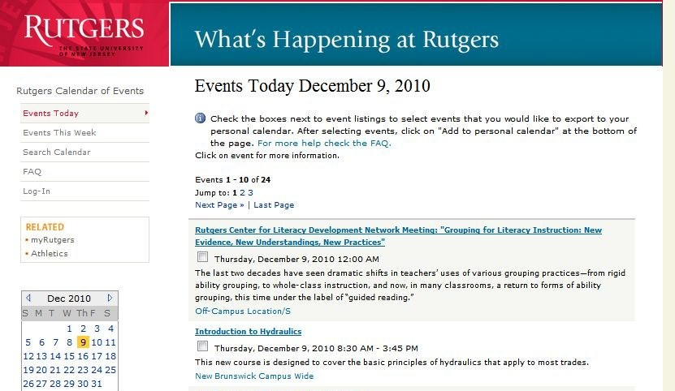
Motivation
Drawbacks:
1. Does not cater to user-specific interests
2. No interactivity
To build a user friendly Event-recommendation system.

Slide 4
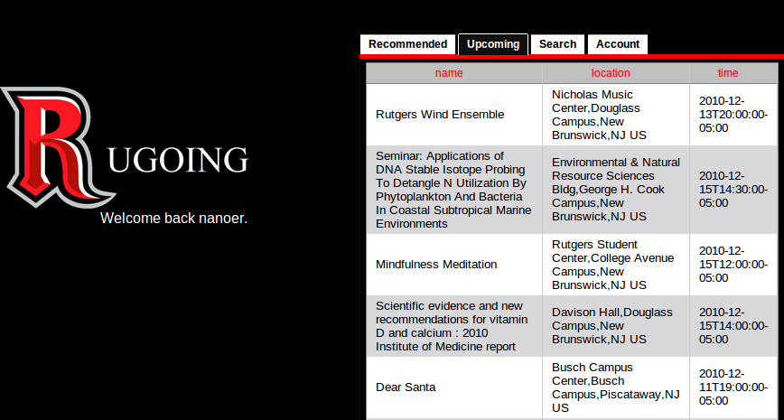
Objective
To aggregate the entire Rutgers event catalogue and recommend events one could go to based on one’s personal preferences and trends with your friends.
To give opportunity to users to rate, share, comment, get live updates from twitter, view location on Map and upload photos.

Slide 5
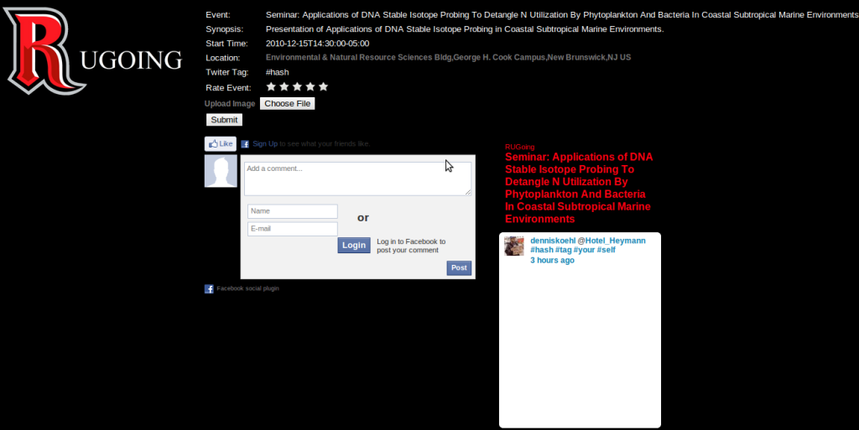
Event Description along with Rate, Share, Upload Images and Tag features

Slide 6
Features
Register
Recommend Events
Upcoming Events
Search Events
Modify Account

Slide 7
Features Cont..
Rate Event
Upload Photos
View Map
Share
Comment
Live updates from twitter

Slide 8
System Architecture
What is the most important part of an enterprise system?
Performance?
GUI?
Usability?
Portability?
Price?

Slide 9
System Architecture
Data…

Slide 10
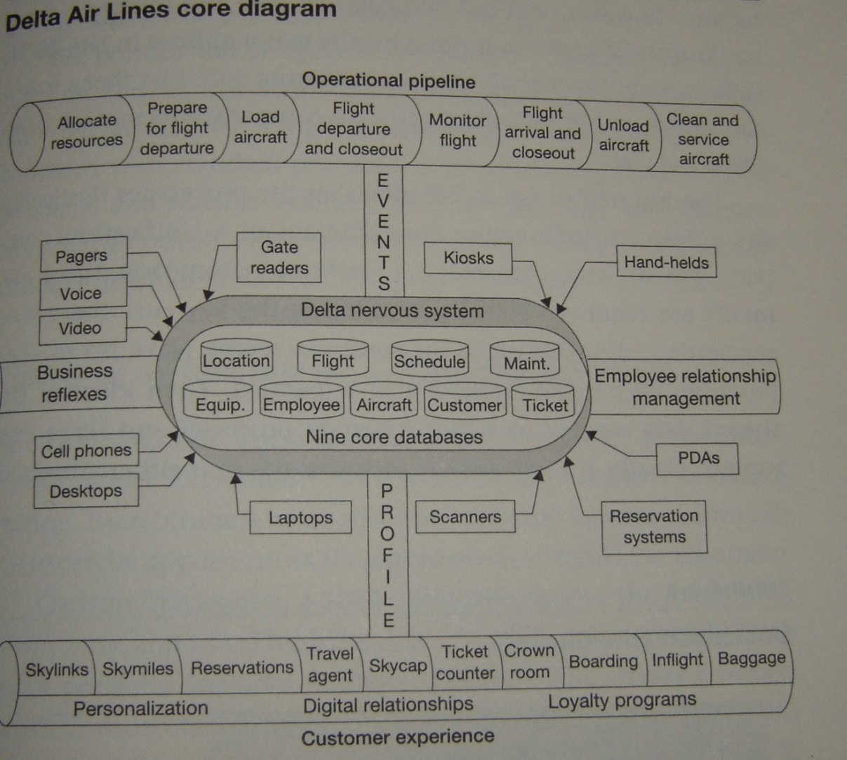
System Architecture
Quick Example From Delta

Slide 11
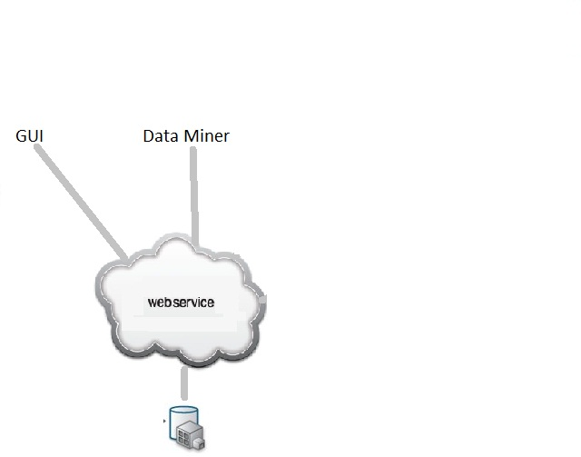
System Architecture
RUGoing Current

Slide 12
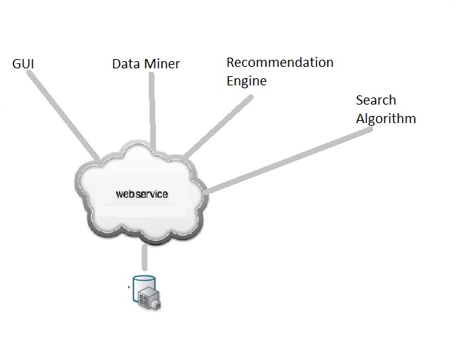
System Architecture
RUGoing Future

Slide 13
Our Experiences
We learned new technologies
Python, c#, javascript
Mysql
.Net Framework
Develop with Google, Facebook, Twitter open APIs and their service infrastructures
Web pages crawler
PyUnit testing framework
SVN
We experienced to discuss/design/develop the system as a team, not individually.
effective team communication
make decisions
distribute the work

Slide 14
Future Scope and Conclusions
Live events video streaming
Better recommendation engine
Events Calendars
Rutgers News Feeds

Slide 15
Thank You!!!
RUGoing?

