Slide 1

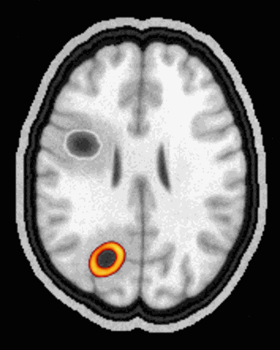
FusionMap
AI PET / MRI FUSION
PET-MRI precision from the scanners hospitals already own
Team MeatRiders
Parth Deshmukh · Atharva Jadhav · Samuel Cardoza · Ralston Crasta
Real FusionMap output: fused PET/MRI, slice by slice
Notes:
[0:00-0:15] OPENING
Hi, we're Team MeatRiders: Parth, Atharva, Samuel and Ralston, and this is FusionMap.
In one line: FusionMap gives hospitals PET-MRI-level precision using the PET and MRI scanners they already own, with software alone.
(The brain on the right is real FusionMap output, scrolling through a fused study.)
HOW TO PRESENT: start the slide show (F5). Every slide animates by itself, so one click = next slide. The animated images play automatically in slide-show mode.

Slide 2
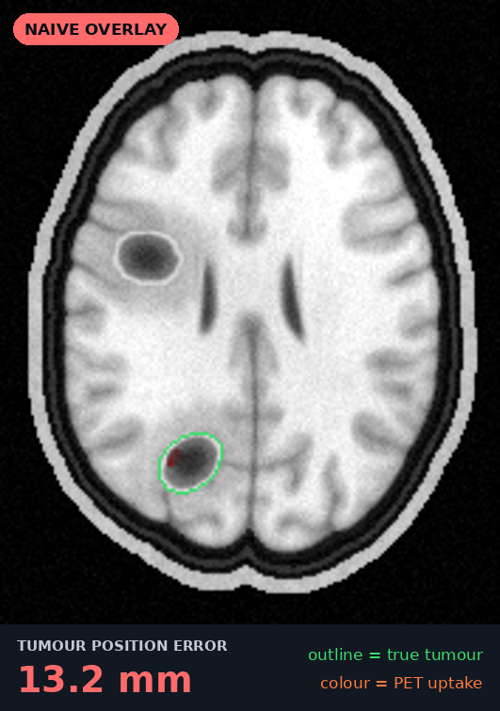
THE PROBLEM IN ONE NUMBER
13 mm
off target
That's how far the tumour glow on this patient's PET lands from the real tumour when it is simply overlaid on an MRI from a different scanner. Plan radiotherapy on that, and the beam treats healthy brain while the tumour escapes.
Measured, not estimated: across 12 test patients the naive overlay is off by 11.8 mm on average, up to 15 mm (95th percentile).
Notes:
[0:15-0:40] THE HOOK
Thirteen millimetres.
That is how far the tumour glow on a PET scan sits from the real tumour in this patient, when you simply lay it over an MRI from a different scanner. That's exactly what hospitals do today.
Across our 12 test patients the average is 11.8 mm and it reaches 15 mm.
In radiotherapy, a plan that is 13 mm off treats healthy brain and lets the tumour escape.
(Pause for a second and let the number land.)

Slide 3
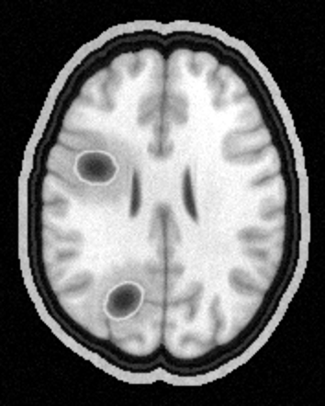
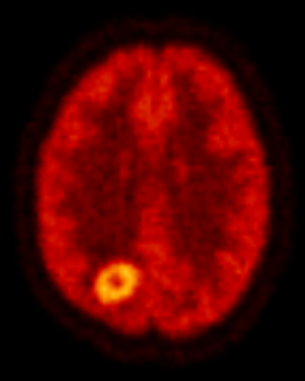
MRI sees two lesions. PET knows which one is alive
WHY FUSION
MRI
PET
+
Shows WHERE
1 mm anatomy and soft tissue. But a dead lesion and a living one can look the same.
Shows WHAT'S ALIVE
Lights up tumour metabolism. But it is blurry (6 mm) and comes from another scanner.
Notes:
[0:40-1:00] WHY BOTH SCANS
Why do doctors need both scans?
Look at the MRI on the left: two lesions, circled. On MRI they look alike.
The PET on the right shows which one is actually alive: only the lower one is glowing.
So MRI tells you WHERE, with millimetre anatomy. PET tells you WHAT is alive, but it's blurry and it comes from a different machine.

Slide 4

Fused, they show exactly where the living tumour is
WHY FUSION
MRI
PET
THE CATCH
$4–6 M
for one integrated PET-MRI scanner
Dead tissue (radionecrosis)
MRI: looks like tumour. PET: cold, so it stays grey
~10
of them in all of India
Living tumour
The PET glow sits exactly on its MRI lesion
Notes:
[1:00-1:20] FUSION
Fuse the two and you get the best of both.
The living tumour lights up exactly on its MRI lesion. And the upper lesion, dead tissue called radionecrosis, correctly stays grey.
That is what an integrated PET-MRI scanner gives you.
The catch: one of those costs 4 to 6 million dollars, and India has about ten of them.
(Transition: the two scans slide together with Morph. It needs PowerPoint 2019 / Microsoft 365; older versions simply fade.)

Slide 5




The scanners are already there. The fusion isn't
THE GAP
700+
6–8 lakh
~10
cancer centres already own both a PET and an MRI scanner
patients a year who could benefit from fused imaging
integrated PET-MRI scanners in the whole country
Today: the two scans sit on two screens and are compared by eye. Overlaid as-is, they miss by 11.8 mm on average.
Centre, scanner and patient counts: team market research. Overlay error: FusionMap benchmark, 12 test patients.
Notes:
[1:20-1:40] THE OPPORTUNITY
Here's the opportunity.
More than 700 cancer centres in India already have a PET scanner and an MRI scanner. That's our team's market research.
The data already exists. What's missing is the fusion.
Today doctors put the two scans on two screens and compare them by eye. Overlaid as-is, they are off by almost 12 mm on average. We measured that.

Slide 6
FusionMap fuses them in three steps, in software
THE SOLUTION
1
Register
2
Sharpen
3
Fuse & export
Line the scans up. Mutual-information alignment, with a VoxelMorph network built in for organs that deform.
Restore what scanner blur hides. An MRI-guided Vision-Transformer U-Net sharpens the PET.
One colour-coded DICOM plus tumour contours, pushed straight into PACS and radiotherapy planning.
error 11.8 → 0.86 mm
PSNR 26.4 → 36.6 dB
≈ 26 s per study · CPU
DICOM in from any PET and any MRI → standard DICOM out into the hospital. No new hardware.
Notes:
[1:40-2:00] THE SOLUTION
FusionMap closes that gap in three steps, all in software on the hospital's existing computer.
One: Register. Line the scans up.
Two: Sharpen. Recover the PET detail lost to blur.
Three: Fuse and export. One colour-coded DICOM, straight into the hospital systems.
Let me show you each one.
(The next three slides Morph: the numbered circles fly up into a progress tracker.)

Slide 7
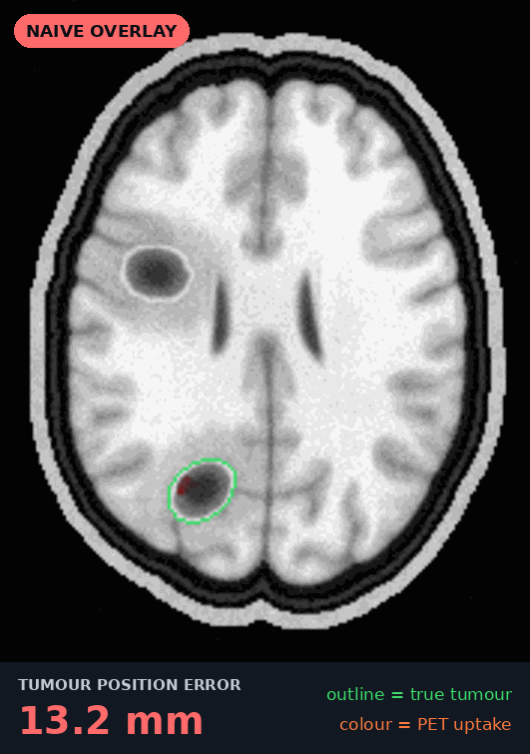


Fix the mismatch between scanners
STEP 1 · REGISTER
1
2
3
Register
Sharpen
Fuse & export
11.8 mm → 0.86 mm
average PET-to-MRI alignment error, 12 held-out test patients
13×
smaller error than overlaying the scans as-is
< 1 s
to align a full study on an ordinary CPU
12 / 12
patients with 95 % of the brain within 2 mm
Mutual information aligns scans whose contrasts look nothing alike: PET versus MRI.
VoxelMorph AI is built in for organs that deform, and switches on only when its own validation beats the classical method.
Notes:
[2:00-2:25] STEP 1: REGISTER
Watch the animation on the left. The PET starts where the scanner left it, then FusionMap aligns it, and the error counter drops from 13 mm to 0.3 mm for this tumour.
Across 12 held-out patients the average error goes from 11.8 mm to 0.86 mm. That's 13 times smaller, in under a second, on a normal CPU.
We use mutual information because PET and MRI look nothing alike, so you can't just match pixel brightness.
A VoxelMorph neural network is built in for organs that deform, like lung or prostate.

Slide 8
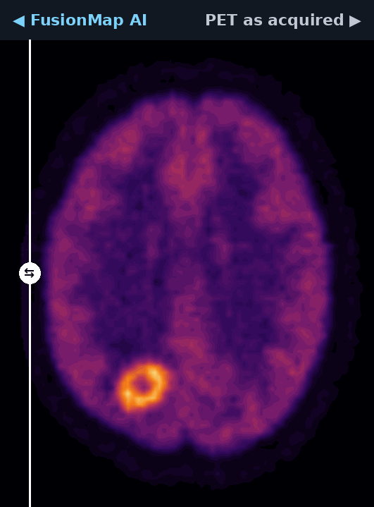


Recover the detail scanner blur hides
STEP 2 · SHARPEN
1
2
3
Register
Sharpen
Fuse & export
36.6 dB
image fidelity (PSNR), up from 26.4 dB
0.98
structural similarity (SSIM), up from 0.65
99 %
of true tumour brightness recovered, up from 91 %
HOW THE AI WORKS
PET + MRI
3 neighbouring slices
CNN encoder
local edges
ViT attention
global context
CNN decoder
full detail
Sharp PET
SUV preserved
2.45 M parameters · trained on 29 simulated volumes · ~6 s per study on CPU (ONNX Runtime)
MRI-guided: the anatomy tells the network where the true edges are.
Never invents tumours: dead tissue that MRI shows but PET doesn't stays cold.
Notes:
[2:25-2:50] STEP 2: SHARPEN
PET is blurry, so small tumours look dimmer than they really are, and that changes treatment decisions.
Our MRI-guided Vision-Transformer U-Net uses the MRI's sharp anatomy as a guide. The swipe on the left shows before and after.
Image fidelity goes from 26.4 to 36.6 dB, structural similarity from 0.65 to 0.98, and tumour brightness comes back to 99 % of the true value.
How it works: convolutions catch local edges, and the attention layer in the middle sees the whole slice at once.
It never invents tumours: dead tissue that shows on MRI but not on PET stays cold.

Slide 9


One colour-coded study, straight into PACS
STEP 3 · FUSE & EXPORT
1
2
3
Register
Sharpen
Fuse & export
WRITES STANDARD DICOM
STRAIGHT INTO
● MR reference series
Hospital PACS
DICOM C-STORE push
● PET in SUV, quantitative
● AI-enhanced PET
Radiotherapy planning
imports the RT-STRUCT
● Colour fusion image
Printable report
for the tumour board
● RT-STRUCT tumour contours
Automatic tumour analytics: SUVmax · SUVpeak · metabolic volume · TLG · tumour-to-background ratio. Every series shares one frame of reference, so any viewer lines them up.
Notes:
[2:50-3:10] STEP 3: FUSE & EXPORT
FusionMap writes standard DICOM: the MRI reference, the quantitative PET in SUV units, the AI PET, the colour fusion, and the tumour contours as an RT-STRUCT.
It pushes them straight into the hospital PACS, and radiotherapy planning systems import the contours directly. There's also a printable report for the tumour board.
And it measures every tumour automatically: SUVmax, metabolic volume, total lesion glycolysis.

Slide 10
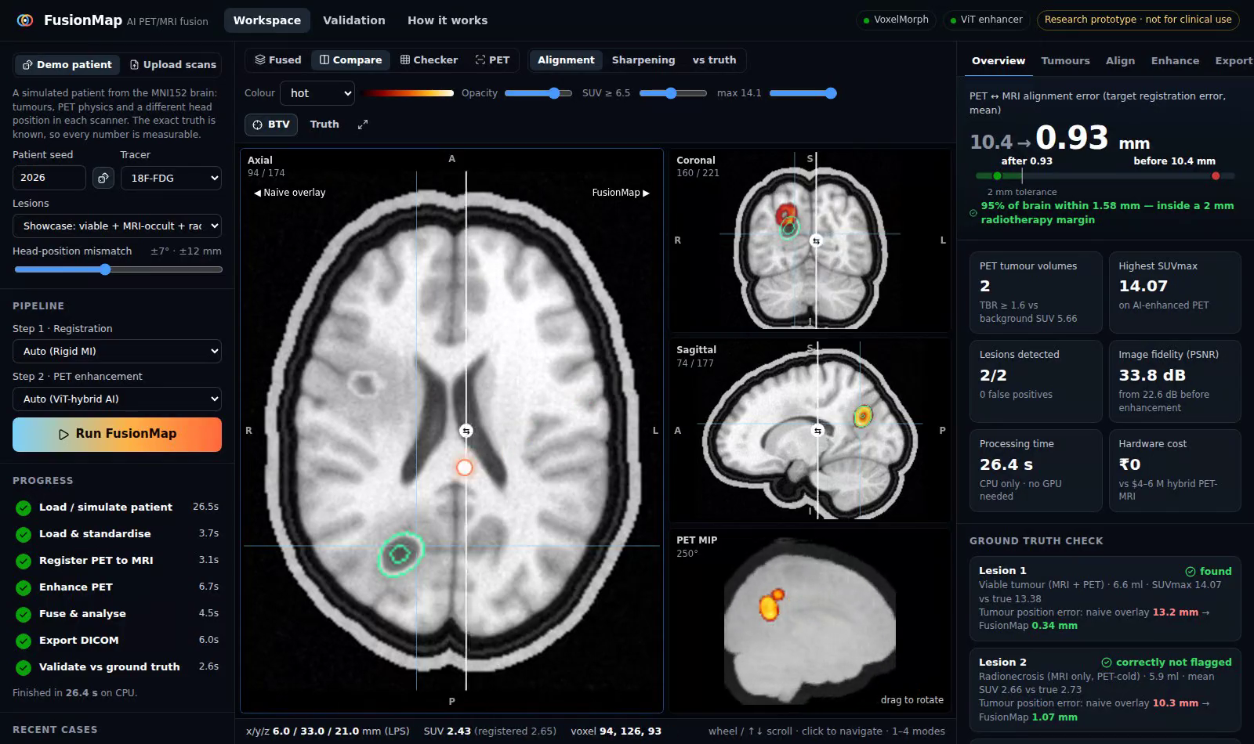
See it run on a full study in 26 seconds
LIVE DEMO
WHAT TO WATCH
1
Alignment
drag the swipe: naive vs FusionMap
2
Sharpening
PET as acquired vs AI-enhanced
3
Ground-truth check
every lesion verified against the truth
4
Tumour metrics
click a tumour: SUVmax, MTV, TBR
5
Send to PACS
plus the printable report
Notes:
[3:10-4:10] LIVE DEMO (about 60 seconds)
BEFORE THE TALK: run "fusionmap serve" (or "docker compose up") and open http://localhost:8000. The showcase patient is processed automatically on first start.
1. Workspace > Compare > Alignment. Move the mouse across the axial view: "Left, the scans overlaid as the scanners left them; the glow is off the lesion. Right, after FusionMap, it sits on it." Point at 10.4 > 0.93 mm and the green "inside a 2 mm radiotherapy margin" line.
2. Compare > Sharpening: "PET as acquired on the left, AI-enhanced on the right."
3. Overview > Ground-truth check: "Viable tumour: found. MRI-occult tumour: found, because PET sees it. Radionecrosis: correctly NOT flagged."
4. Tumours tab: click a tumour and the viewer jumps to it. Read out SUVmax, MTV and TBR.
5. Export tab > Send to PACS (with docker compose the study appears in Orthanc on :8042). Then open the printable report.
BACKUP: if the live demo fails (no laptop, no Wi-Fi, crash), stay on this slide, hover the picture and click its play button. It is a 50-second recording of the real app doing exactly steps 1-5, so narrate over it.

Slide 11
Measured on patients where we know the truth
VALIDATION
Alignment error, mm
lower is better · auto mode picks rigid MI
−93 %
PET image fidelity, PSNR in dB
higher is better
+10 dB
12 held-out test patients
100 % of tumours detected
0 false positives
1 mm exact ground-truth grid
Notes:
[4:10-4:30] WHY BELIEVE US
Real patients never come with the right answer, so we built digital patients from the MNI152 brain where we know the exact truth, and we measure error in millimetres.
Left: alignment error. Rigid mutual information, which our auto mode picks, cuts it by 93 %. VoxelMorph ties it on brain; more on that next.
Right: image fidelity. FusionMap's AI adds 10 dB over the raw PET and is far ahead of classical deconvolution.
100 % of tumours detected, with zero false positives.
All numbers: docs/benchmark.json, reproducible with "fusionmap benchmark".

Slide 12

Built to be trusted, not just to impress
TRUST
The radionecrosis trap
Our test patients include lesions that MRI shows but PET says are dead. An AI that copies the MRI would light them up. FusionMap keeps them cold: uptake ratio 1.05, where 1.0 is perfect.
Radionecrosis
MRI says tumour, PET says dead: correctly not flagged
Living tumour
found, 0.3 mm from the truth
An AI gate, not AI everywhere
Our VoxelMorph network matched classical alignment (1.172 vs 1.173 mm) but did not beat it, so auto mode keeps the classical method. AI switches on only when its own validation wins, and the raw PET is always exported too.
Notes:
[4:30-4:50] TRUST
In medicine, an AI has to be trustworthy, not just impressive. Two examples.
First, the radionecrosis trap. An AI that simply copies the MRI would light up dead tissue. Ours keeps it cold: an uptake ratio of 1.05, where 1.0 is perfect.
Second, honesty. Our VoxelMorph network matched classical alignment on the brain, but it didn't beat it. So FusionMap's auto mode doesn't use it. AI switches on only when it wins its own validation, and the unmodified PET is always exported alongside the AI PET.

Slide 13


Runs on the hospital's own computer
ENGINEERING
Any PET + MRI
FusionMap engine
Web viewer
PACS + planning
DICOM or NIfTI, from two separate scanners
Python · SimpleITK · ONNX Runtime
React · runs in any browser
standard DICOM out · C-STORE
CPU only
26 s per study. No GPU, no cloud.
Private
patient data never leaves the hospital
45 tests
automated, run by CI on every push
1 command
docker compose up, PACS included
Every design choice traces back to published research
Nensa 2014 · Catana 2011 · Yoon 2012 · Wei 2022 · Alongi 2024 · Chen 2024 (Plasma CycleGAN) · Chen 2025 (MRI-to-PET synthesis)
Notes:
[4:50-5:05] ENGINEERING
It runs on the hospital's own computer: CPU only, 26 seconds for a full study. No GPU, no cloud, so patient data never leaves the building.
It reads DICOM from any PET and any MRI, and writes standard DICOM back.
45 automated tests run on every push, and one docker command brings up the app together with a PACS.
And every design decision traces back to the seven papers we studied. The mapping is in docs/LITERATURE.md.

Slide 14
PET-MRI-grade precision for the price of software
IMPACT
Integrated PET-MRI scanner
FusionMap
$4–6 M
per scanner
₹40–60 k
to build
New suite
shielding, siting, specialist staff
₹0
new hardware: uses the PET and MRI already there
~10
in all of India
700+
centres that could run it
Patients
radiotherapy aimed at the living tumour
Doctors
one fused image instead of two screens
Hospitals
a new capability with no capital cost
Notes:
[5:05-5:20] IMPACT
An integrated PET-MRI scanner costs 4 to 6 million dollars, needs a new suite and specialist staff, and India has about ten.
FusionMap costs 40 to 60 thousand rupees to build and needs zero new hardware, so it can run in the 700-plus centres that already own both scanners.
Patients get radiotherapy aimed at the living tumour, doctors get one fused image instead of two screens, and hospitals get a new capability with no capital cost.

Slide 15

From prototype to the clinic
WHAT'S NEXT
NOW
NEXT
THEN
SCALE
✓
2
3
4
Working prototype
Real scans
Reader study
Clinic and body
Validated on 12 digital patients, DICOM in and out, PACS push, 45 tests
Fine-tune on paired PET/MRI from The Cancer Imaging Archive (TCIA)
Nuclear-medicine physicians compare FusionMap with hybrid PET-MRI
CDSCO medical-device software pathway; lung and prostate with VoxelMorph
What would speed us up: a clinical partner with a PET and an MRI, for real-patient validation and the reader study.
Notes:
[5:20-5:35] WHAT'S NEXT
The prototype works today.
Next, we fine-tune on real paired PET/MRI scans from The Cancer Imaging Archive.
Then a reader study with nuclear-medicine physicians, comparing FusionMap with a real hybrid PET-MRI.
Then the CDSCO software-as-a-medical-device pathway, and body sites like lung and prostate, where VoxelMorph's deformable alignment matters most.
What would speed us up most is a clinical partner.

Slide 16
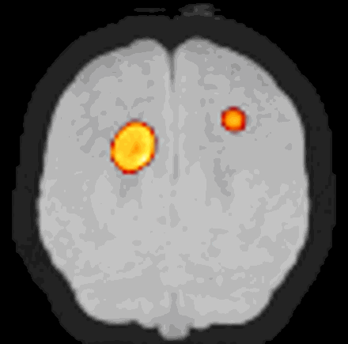
THANK YOU · QUESTIONS?
700+ hospitals already own a PET and an MRI.
FusionMap turns them into a PET-MRI.
FusionMap
Team MeatRiders
Parth Deshmukh · Atharva Jadhav · Samuel Cardoza · Ralston Crasta
github.com/dev-parthdeshmukh/fusiontech
Notes:
[5:35-5:45] CLOSE
To close: more than 700 hospitals already own a PET and an MRI.
FusionMap turns them into a PET-MRI.
Thank you. We'd love your questions.
(Leave this slide up during Q&A. If a judge asks one of the expected questions, the next slide has the short answers.)

Slide 17
Questions we expect, answered
BACKUP · JUDGE Q&A
Validated on real patients?
Not yet, and we say so on every screen. Real scan pairs have no ground truth, so we use digital patients with exact answers. Next: TCIA data and a reader study.
Why not just use PET-CT?
CT shows brain soft tissue poorly and adds radiation. PET/MRI can cut the dose to about 20 % of PET/CT (Nensa 2014).
Does the AI copy the MRI?
That's exactly what we test for: radionecrosis stays cold (ratio 1.05), and the raw PET is always exported beside the AI PET.
Why a ViT, not CycleGAN?
With paired data, a supervised ViT hybrid is more faithful. We ship a CycleGAN trainer for hospitals that only have unpaired data.
Does it need a GPU or the cloud?
No. ONNX Runtime on a CPU, about 26 s per study, and patient data never leaves the hospital.
How does it fit the workflow?
DICOM in, standard DICOM out: MR, SUV PET, AI PET, colour fusion and RT-STRUCT, pushed to PACS by C-STORE.
Notes:
BACKUP: show only if a judge asks. Full answers: docs/PITCH.md.
Regulatory path? In India: software as a medical device under CDSCO, which needs clinical evaluation. Step one is a retrospective reader study against hybrid PET-MRI.
Why VoxelMorph if the brain is rigid? We measured it: it tied rigid MI on brain (1.172 vs 1.173 mm), so auto mode keeps rigid. It's built for lung and prostate, where organs deform.
Where do the market numbers come from? Team research: scanner cost, centre counts, patient numbers. Every alignment, quality and detection number was measured by us (docs/benchmark.json).

