Slide 1
Agentic AI-Powered
Database Migration Platform
Any-to-any migration across Oracle, MySQL and PostgreSQL using LangGraph, AWS Bedrock and pluggable tool adapters
Capstone Project | Rupak Banerjee

Slide 2
Business need and manual labour replaced (₹)
Per mid-size migration | Conservative | Optimistic
Manual effort (person-days) | 90 | 140
Manual cost @ ₹10,000/day | ₹9.0 lakh | ₹14.0 lakh
Share automated by agents | 55% | 75%
Labour replaced (₹) | ₹4.95 lakh | ₹10.5 lakh
Platform run cost (Bedrock + infra, est.) | ₹15,000 | ₹10,000
Net saving per migration | ≈ ₹4.8 lakh | ≈ ₹10.4 lakh
Residual human effort (review, approvals) | ≈ 41 days | ≈ 35 days
Why it is needed: DBA-led migrations are slow and error-prone across discovery, SQL/PLSQL conversion, data load and validation. The platform automates these steps and keeps humans at approval gates.
Assumptions (illustrative, replace with measured data): ~300 tables + ~150 procedures/views/triggers; blended rate ₹10,000 per person-day.

Slide 3
High-level architecture
Streamlit UI
FastAPI Gateway
Auth + SSE
LangGraph Runtime
+ HITL interrupts
Postgres
checkpoints
+ metadata
▼ LangGraph routes shared state to each agent ▼
Assessment
Planner
Schema
Data
Code (future)
Validation + Test
Deployment
Schema Extractor
Bedrock + PGVector KB
CrackSQL
Apache SeaTunnel
OpenRewrite + Aider
Checksum
kubectl + Terraform
Source DB
Target DB
EKS / AWS
(Terraform)
LangSmith
Prometheus
Grafana
Streamlit and FastAPI start jobs; LangGraph orchestrates agents; each agent calls its tool adapter; Bedrock (Nova Pro + Titan) and the PGVector knowledge base support reasoning.

Slide 4
Orchestration: LangGraph state machine
Discover
Analyse
Plan
HumanReviewPlan
(interrupt)
Transform
(CrackSQL)
Approve
HumanReview
Validation
Validate
(checksum)
DataMigrate
(SeaTunnel)
CodeRefactor
(future no-op)
Generate
Approve
Done
Test
HumanReview
Cutover
Cutover
(kubectl)
Verify
PASS
Approve
fail
ok
Rollback
rollout undo
Flow: Discover → Analyse → Plan → Transform → Generate → CodeRefactor → DataMigrate → Validate → Test → Cutover → Verify. Every HumanReview node is a real interrupt resumed from the Postgres checkpointer. Modify loops back to Plan, Reject aborts, Test FAIL returns to Validate, validation retry returns to DataMigrate.

Slide 5
Failure handling and retry policy
Success?
Agent calls LLM /
Tool Adapter
Advance to
next phase
Job ABORTED
audit logged
Yes
No
Abort
attempt < 3?
Reviewer
decision?
retry_count + 1
exp. backoff
HumanReviewFailure
interrupt
Yes
No
Applies to every LLM call and tool call. After 3 failed automatic attempts the reviewer sees the error and can Retry (retry_count reset to 0, same phase re-run) or Abort. retry_count is checkpointed, so a restart does not reset it.

Slide 6
Human-in-the-loop approval flow
Migration plan
generated
Summary: Tables 125 · Views 42 · Procs 86 · Funcs 53 · Triggers 31
Auto 278 · Review 59 · High-risk 12
Streamlit
review screen
Reviewer
decision?
LangGraph resumes
Transform phase
Job ABORTED
audit logged
Approve
Reject
Modify
Pre-cutover
gate
Post-validation
gate
Planner regenerates
plan section
Each gate stores an ApprovalRecord (reviewer, decision, timestamp, comment) in the metadata DB for a full audit trail. Modify regenerates the plan section and returns to the summary.

Slide 7
Planner Agent flow
Object catalog + FK dependency graph
Deterministic risk scoring (risk.py)
RAG: retrieve rules from PGVector KB
HumanReviewPlan interrupt
Plan: sequence, priority, effort, manual-review flags
Bedrock Nova Pro refines medium/high-risk objects
What happens: heuristics first score every object cheaply; only medium and high-risk objects go to the LLM, which keeps cost low. Retrieved migration rules ground the plan. The plan is never executed until a person approves it.

Slide 8
Assessment Agent flow
Orchestrator
start(job_id, dialect pair)
Assessment Agent
Schema Extractor Adapter
Native DDL export on Source DB
pg_dump · DBMS_METADATA · mysqldump
DiscoveryResult → Orchestrator
Titan embeddings → PGVector KB
sqlglot parse → object catalog + FK graph
raw schema.sql
What happens: the adapter exports native DDL from the source, sqlglot parses it into a catalog of tables, views, procedures, functions and triggers plus a foreign-key dependency graph. Discovery embeddings are stored so later agents can retrieve context. Works for Oracle, MySQL and PostgreSQL.

Slide 9
Schema Agent flow
Orchestrator
translate(discovery, plan)
Retrieve type-mapping and conversion rules (RAG)
CrackSQL run(ddl, rules)
AST-based deterministic translation
Apply idempotently to Target
Confidence OK?
TranslationResult + confidence scores
Ambiguous constructs → Bedrock Nova Pro
high
What happens: CrackSQL translates deterministically from the AST first, and only ambiguous constructs go to the LLM. Every object gets a confidence score; low-confidence output is flagged for review and never auto-applied. Table DDL is created by the SeaTunnel sink, so this agent handles views, procedures, functions, triggers and foreign keys.

Slide 10
Data Agent flow
Orchestrator
migrate_data(plan, schema)
Generate SeaTunnel job config
Order tables by FK dependency
SeaTunnel Zeta bulk extract from Source
Apply CDC to Target (future)
CDC stream from Source (future)
DataMigrationResult: rows moved, throughput
JDBC sink auto-creates tables + bulk load to Target
What happens: the agent builds a SeaTunnel job and loads tables in foreign-key order; re-runs are idempotent (DROP_DATA). Jobs run inside the SeaTunnel container. Streaming CDC after the initial load (Debezium/Kafka) is designed but not yet built.

Slide 11
Code Agent flow (Phase 6, future extension)
Orchestrator
refactor(dialect, stack)
Code Agent
App stack?
Python/C++
Java
OpenRewrite recipe
ORM + JDBC swap
(Java / Spring)
Aider LLM edits
raw SQL / SQLAlchemy
(C++ / Python)
code_refactor: diff + files changed → human gate
Status: intentionally deferred. Today the CodeRefactor graph node is a no-op passthrough and the OpenRewrite and Aider adapters are empty stubs. When built, OpenRewrite handles AST-safe rewrites and Aider handles LLM-guided edits.

Slide 12
Validation and Test flow
validate(job_id)
Validation Agent
Checksum Adapter batch config
Per table: fetch Source + Target rows
Hash (Pandas/PySpark) and compare
ValidationReport per table
Test PASS?
Performance smoke: COUNT(*) under 5s
Referential integrity (FK orphans)
Test: schema compat + missing objects
HumanReview Validation
What happens: row counts and hashes are compared table by table, then a person reviews the report. The Test node adds four checks. PASS leads to the pre-cutover gate; FAIL returns to Validate; a validation failure sends the job back to DataMigrate.

Slide 13
Deployment Agent flow (built, not yet production-validated)
1 Infrastructure validation
2 Capture current state
3 Rolling update: new DB driver / endpoint
4 Rollout completion
SUCCESS: legacy pods terminated
7 Traffic verification
6 DB health check
5 Pod readiness
fail
Any step fails or post-cutover connection errors → kubectl rollout undo → ROLLED_BACK
What happens: seven safe-cutover steps run through the kubectl adapter; Terraform provisions VPC, EKS, RDS and IAM. Any failed step, or connection errors after cutover, triggers automatic kubectl rollout undo back to the legacy pods.

Slide 14
Docker images and local infrastructure
Service (docker-compose) | Role | Endpoint
postgres-metadata (PostgreSQL) | Job metadata, checkpoints, PGVector KB | localhost:5432 / migration_metadata
postgres-sample (PostgreSQL) | Sample source/target | localhost:5433 / sample_source
mysql-sample (MySQL) | Sample source/target | localhost:3306 / sample_source
oracle-sample (Oracle XE) | Sample source/target (first boot 5-10 min) | localhost:1521 / XE
seatunnel (custom build) | Bulk-load engine with JDBC driver jars | infra/docker/seatunnel/
pgAdmin | Browse the PostgreSQL instances | localhost:5050
Exact image tags live in docker-compose.yml. Run: docker-compose up -d; docker compose build seatunnel. Production uses Terraform (VPC/EKS/RDS/IAM) and Helm.

Slide 15
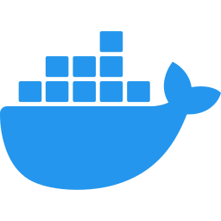

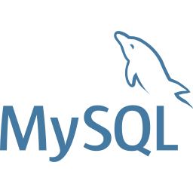
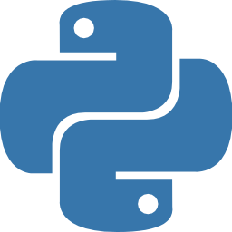


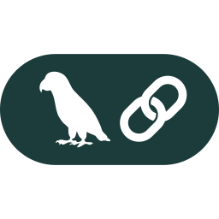
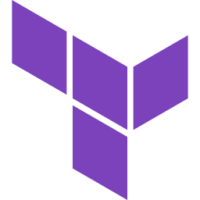
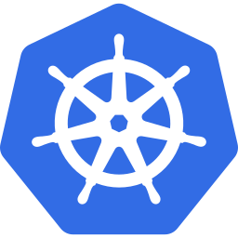




Technology stack
Docker
PostgreSQL
MySQL
Oracle
Python 3.12
FastAPI
Streamlit
LangChain / LangGraph
AWS
Terraform
Kubernetes
GitHub Actions
Prometheus
Grafana
Poetry
Bedrock Nova Pro
Apache SeaTunnel
CrackSQL

Slide 16
Future extensions and status
Phase 6: Code Agent (future)
OpenRewrite rule-based refactoring + Aider LLM-guided edits to update application SQL/ORM code for the new dialect. Adapters and agent folder exist; implementation deferred. Diffs will pass a human gate.
Deployment (built, not production-validated)
Terraform VPC/EKS/RDS/IAM, Helm charts, 7-step cutover, automatic rollback. Next: validate on a live AWS EKS environment.
Complete and live-verified: Phases 0-5 (foundations, orchestration, dialects, planner, schema, data). Also complete: Phase 7 validation/test, Phase 9 observability and CI/CD, Phase 10 E2E tests and docs.

