Slide 1

Power Query Task
Netflix Data Cleaning & Analysis
Team WiDa

Slide 2







Our Team
Bashir Aminat
Lateefah Abdur-Rahman
Hauwa Dauda Atta
Jimoh Abdur-Rahman
Damilare
Oluwajuwonlo
Toyyib Olalekan

Slide 3
Project Overview: From Raw to Refined
This project demonstrates a comprehensive data cleaning, transformation, and analysis process using Power Query, Excel, and Power BI.
We tackled a "dirty" dataset to extract valuable insights.

Slide 4
Project Overview
The dataset contains information about movies and TV shows available on Netflix as of 2021.
Total Records: 8,809
Total Columns: 12
Data Cleaning Summary: To improve data quality and handle missing values, the following transformations are to be performed:
Director, Cast, Country: Missing values were replaced with "Unknown".
Date Added: Converted to datetime format to extract the year of addition.
Duration: Numeric values were extracted (minutes for movies, number of seasons for TV shows) for statistical analysis.

Slide 5
The Challenge: "Dirty" Netflix Shows Data
The Netflix Shows Data, with 8,807 rows, presented significant challenges:
Missing Values
Inconsistent Formats
Tool Interoperability
2634 missing data from the Director column, 825 from Cast, and 831 from Country
Inconsistent and mixed duration formats required correcting misentered values and applying string-splitting logic to extract numeric data before calculations could be performed.
The data cleaning started in Power BI’s Power Query, but export limitations and Excel compatibility issues forced a restart of the process in Excel’s Power Query, including manual installation of the add-in.

Slide 6

The Challenge: Need to broaden know-how
1
2
Finding the Mode
Inputting conditions
I kept going in circles trying to find the mode for the Added Date column.
Found out that when inputting conditions, no quotes are needed and the entries have to exactly as spelled in the dataset.
3
Aggregate summary
The initial aggregate summary gotten was in three different tables. But later summarized in a table.

Slide 7

Cleaning Process: Steps in Power Query
The cleaning began by importing the CSV into Excel and transforming the data in Power Query.
Then removed blank rows
Data types were automatically changed immediately the data was exported to power query

Slide 8
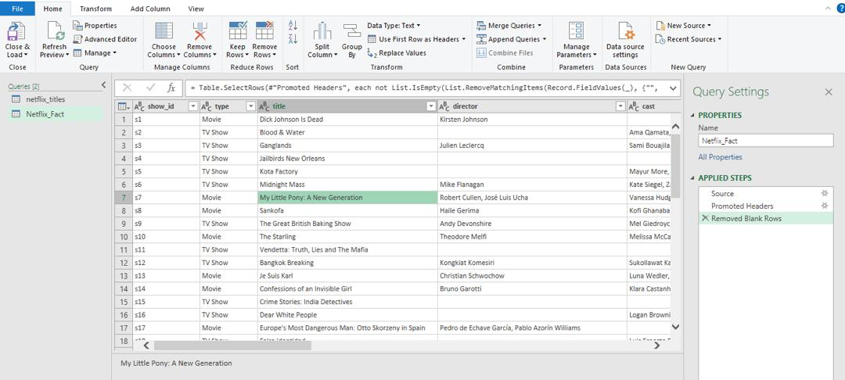
Removed blank rows

Slide 9
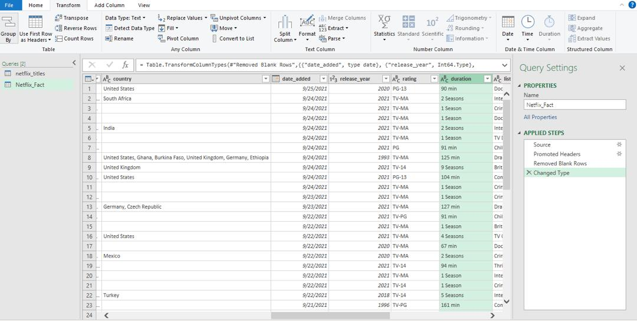
Changed Data Type

Slide 10
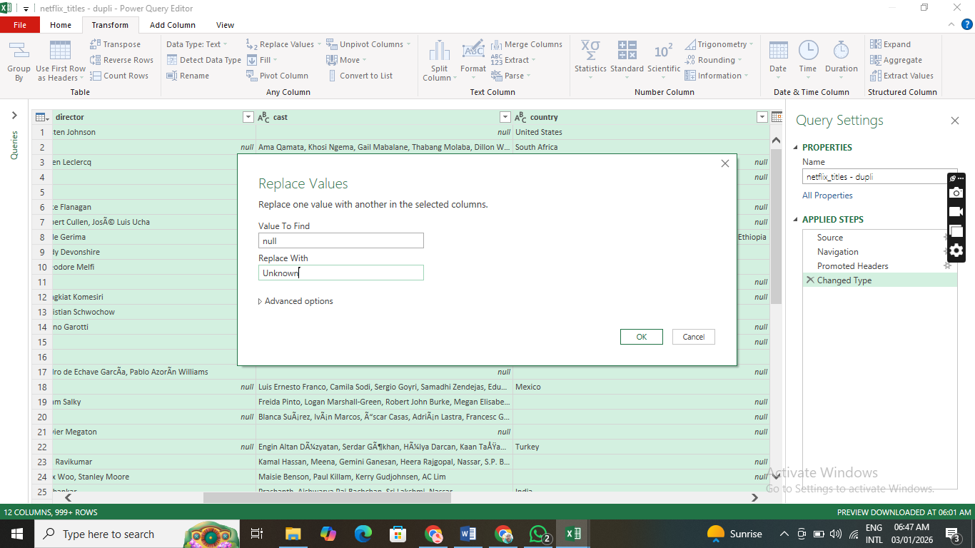
Replacing null values for Director, Cast, and Country with Unknown

Slide 11
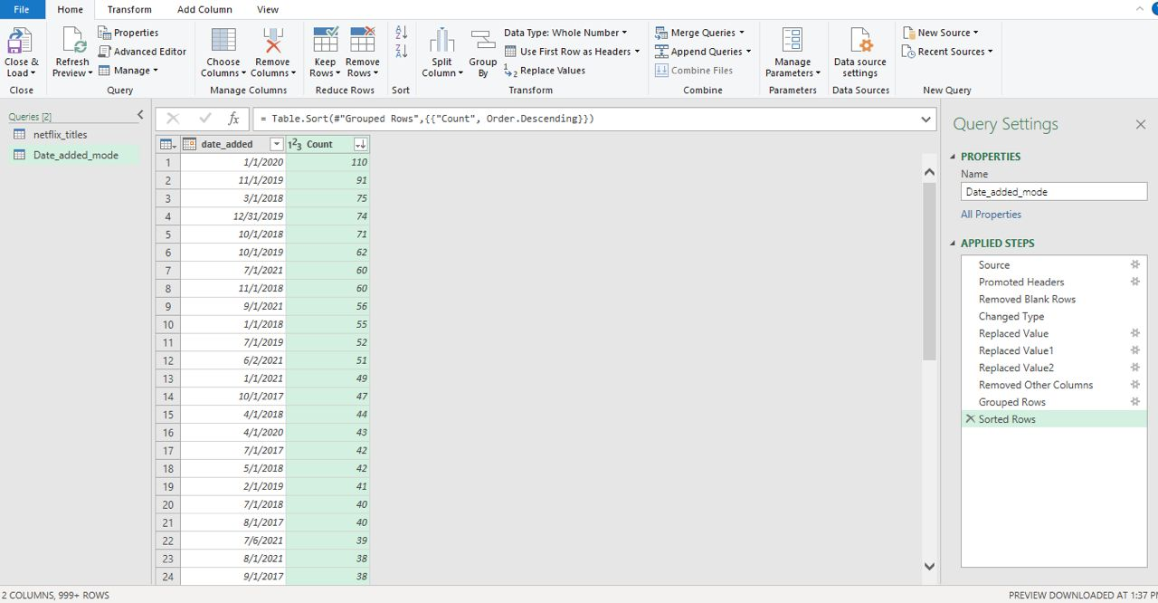
Get number of movies added by date and sort in descending order

Slide 12
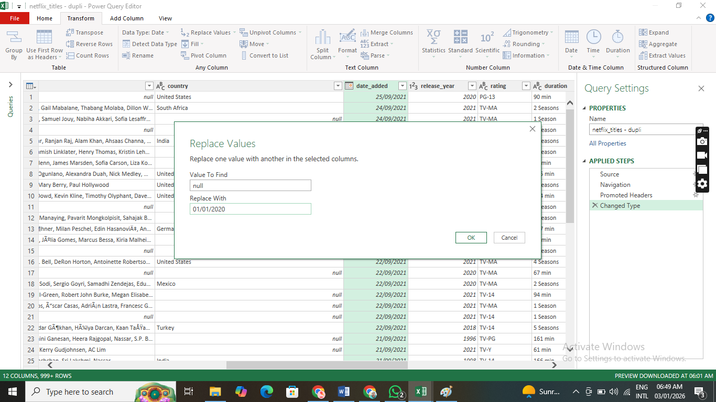
Pick the date with the highest count and use it to replace null values in the date column

Slide 13
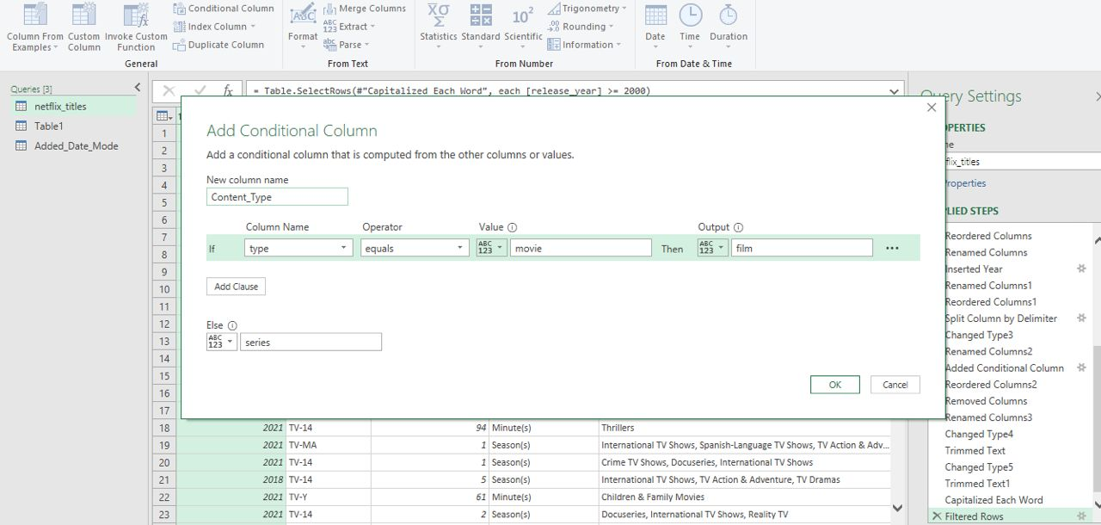
Added column “content_type”

Slide 14
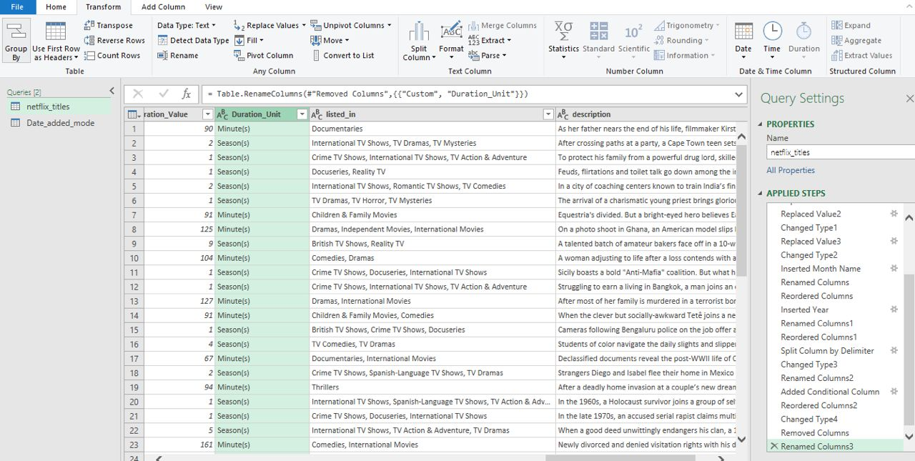
Created separate columns for duration value and duration unit

Slide 15
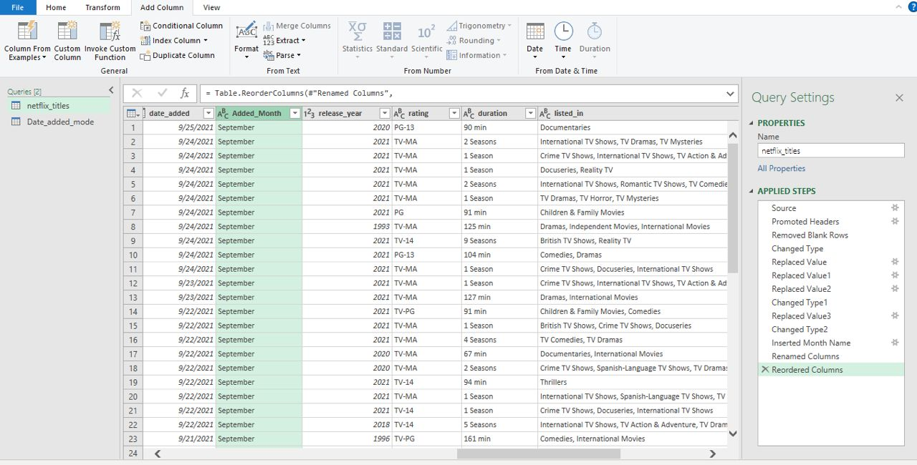
Split date added into added month using the Add column tab

Slide 16
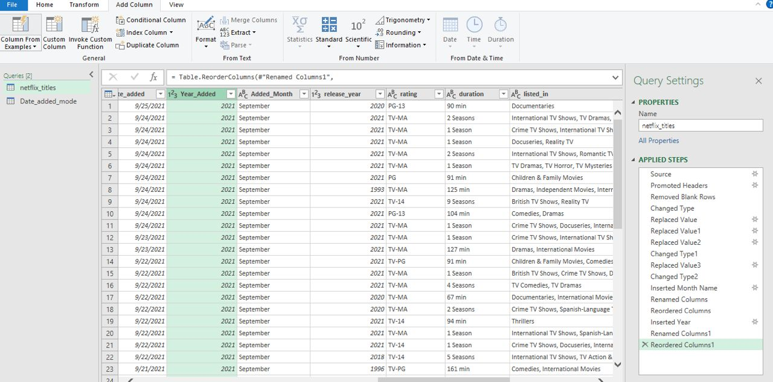
Split date added to Year added using the Add column tab

Slide 17
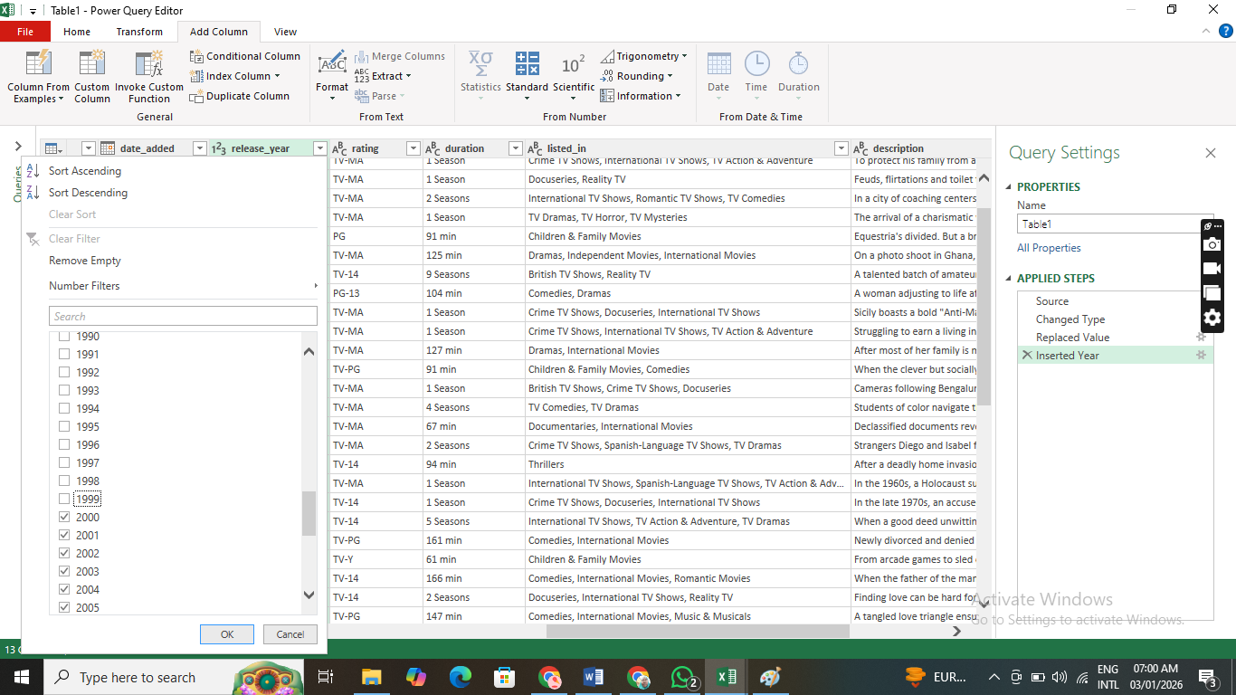
Filtered out release year earlier than 2000. We now have 8282 rows

Slide 18
STEPS
TAKEN TO GET AGGREGATES

Slide 19
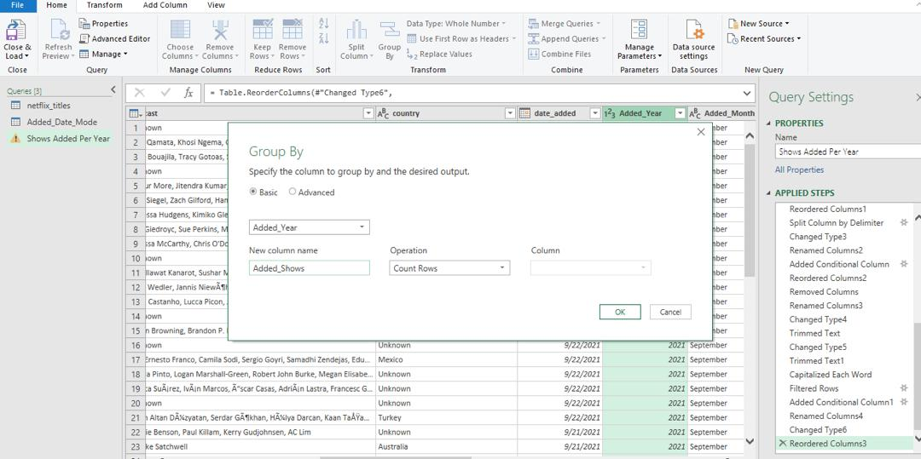
How to get counts of added shows per year

Slide 20
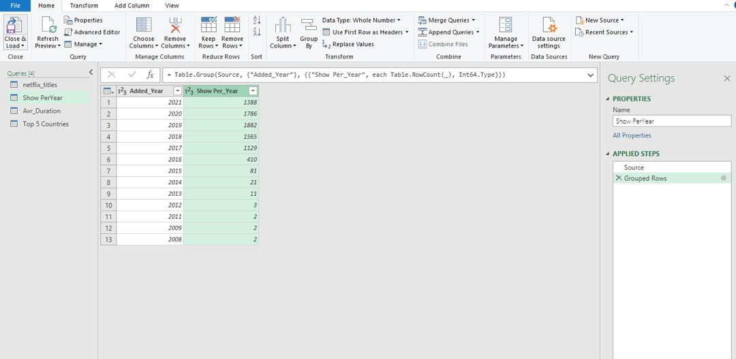
Shows per year

Slide 21
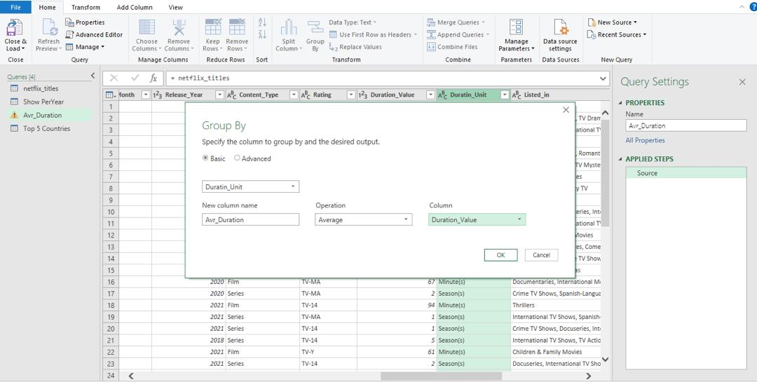
How to get the average duration by duration unit

Slide 22
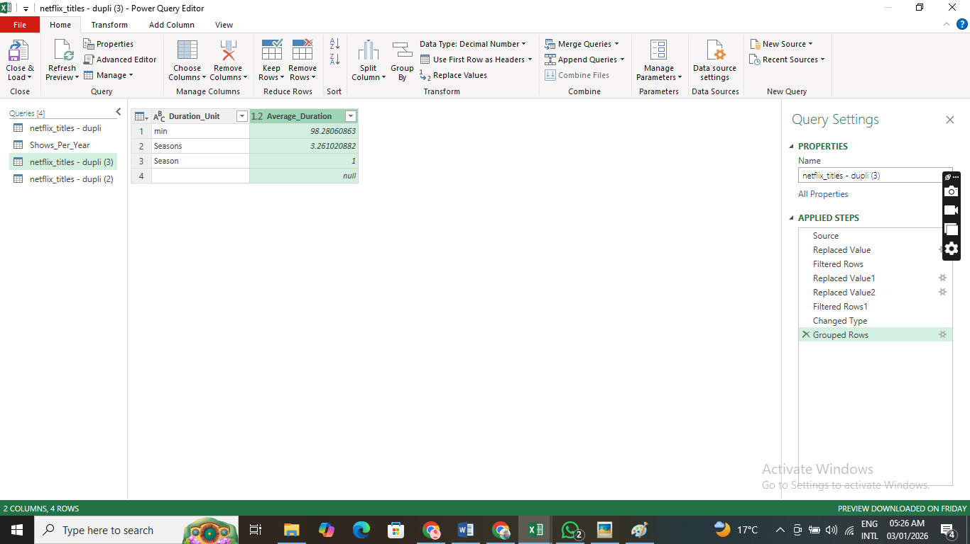
The average duration by duration unit

Slide 23
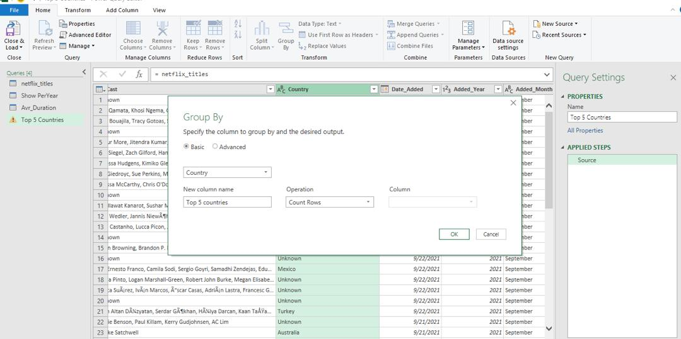
Getting the count for shows by countries

Slide 24
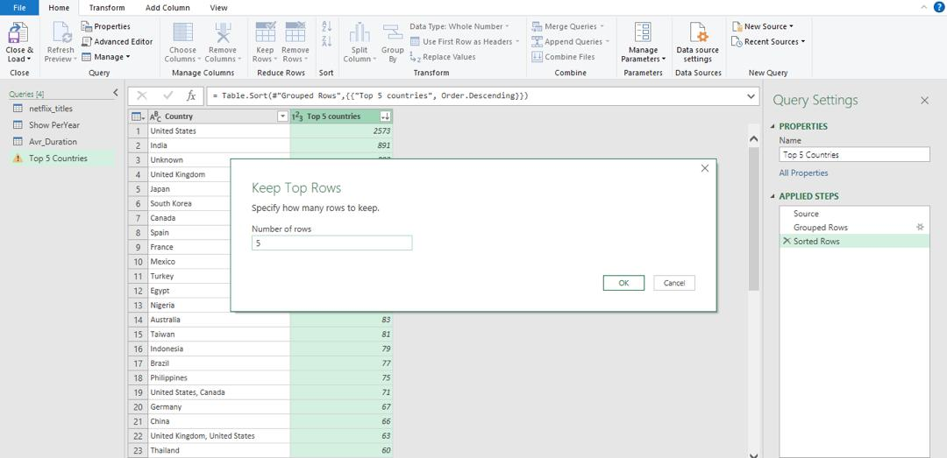
Sort by descending order and keep top five rows

Slide 25
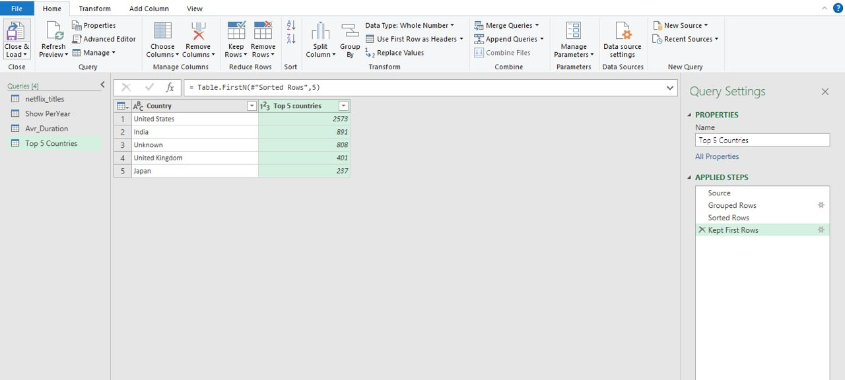
Top 5 countries

Slide 26
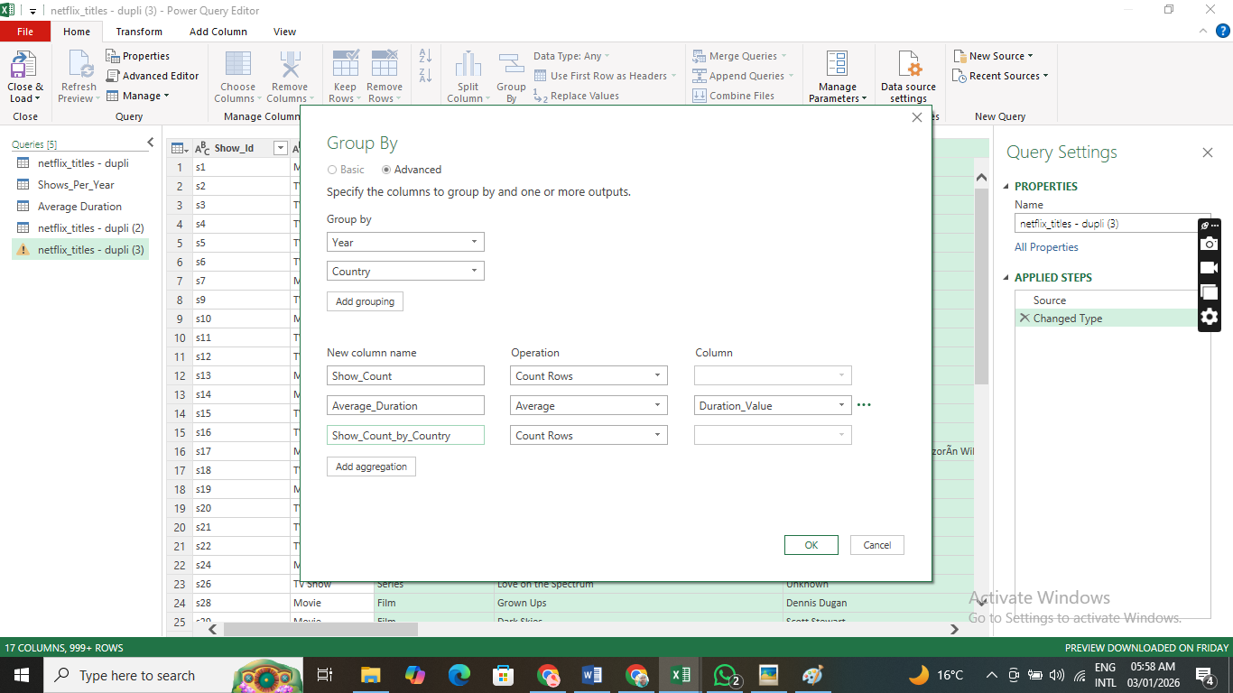
Getting summary of the aggregates

Slide 27
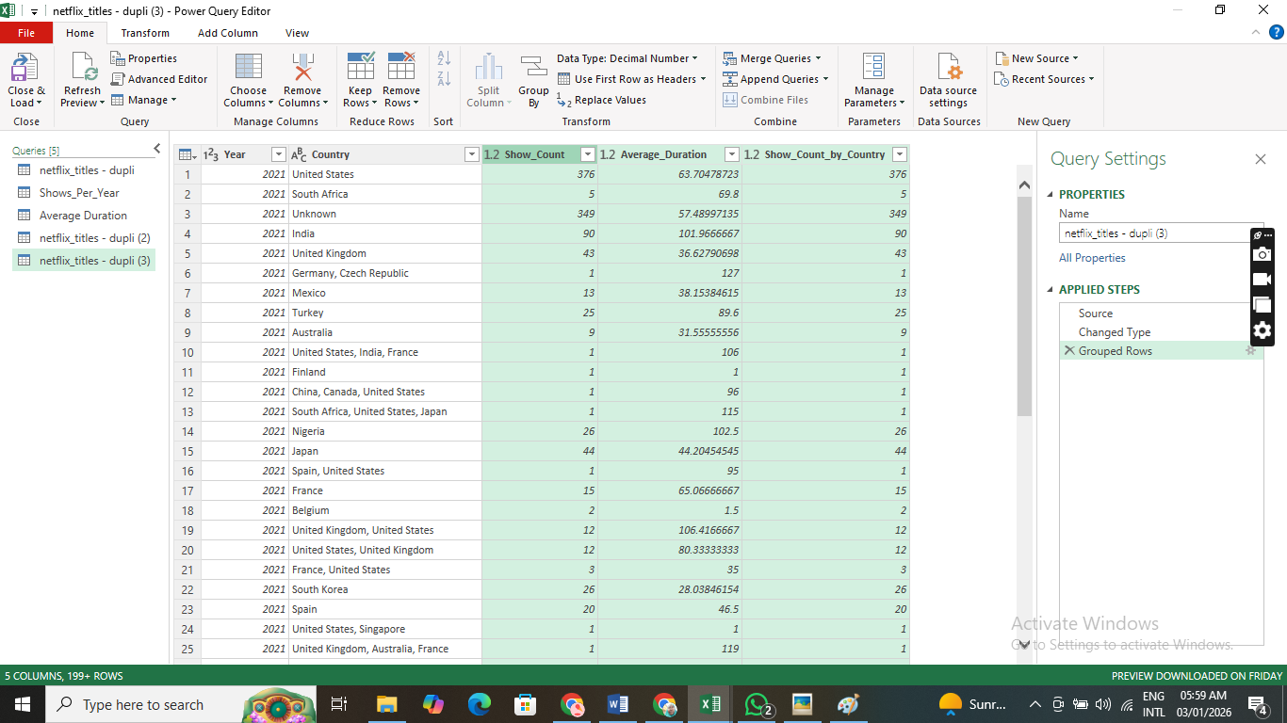
The aggregates in one table

Slide 28
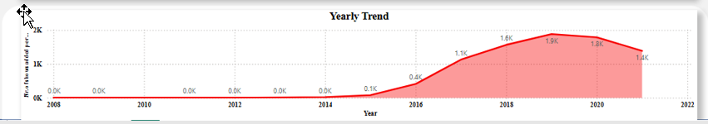

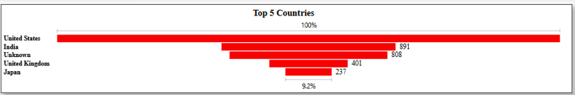
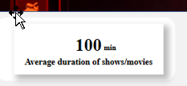
Analysis in Power BI: Visualizing Performance
The cleaned data was loaded into Power BI, enabling detailed analysis of sales and financial performance.

Slide 29
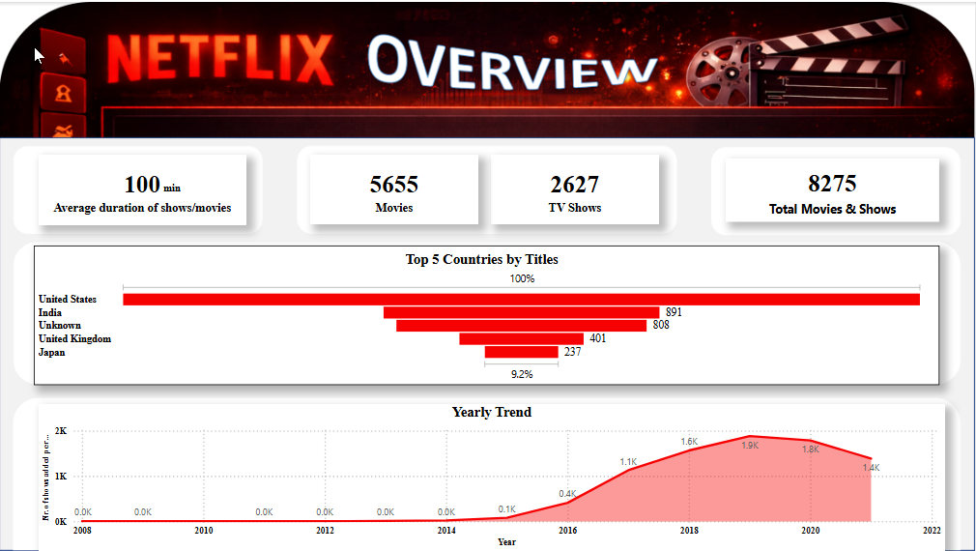

Slide 30
Conclusion: From Chaos to Clarity
The analysis of the Netflix titles dataset reveals a dynamic and rapidly evolving content library.
By addressing missing data and aggregating key metrics, we can draw the following comprehensive conclusions:

Slide 31
Conclusion: Data Integrity and Cleaning
The initial dataset contained significant gaps, particularly in the Director, Cast, and Country columns (over 2,600 missing directors). By systematically replacing these with "Unknown", we transformed the data from a "dirty" state into a structured format suitable for high-level dashboarding.
This process was critical for ensuring that visualizations (like the "Top 5 Countries" chart) accurately reflected the volume of content without excluding significant segments of the catalog.

Slide 32
Conclusion: Content Strategy Shift
Netflix has maintained a strong emphasis on feature films, with Movies (5,655) outnumbering TV Shows (2,627) by a ratio of roughly 2:1.
However, the average duration of 100 minutes suggests a curated focus on "standard" feature-length content that fits the traditional viewing habits of a global audience.

Slide 33
Conclusion: Geographical Dominance vs. Localization
The United States remains the undisputed powerhouse of Netflix content, followed by India.
The high presence of "Unknown" countries (808) highlights a potential area for further data enrichment, as these titles likely represent emerging markets or independent productions where metadata is sparse.
The inclusion of Japan and South Korea in the top rankings underscores Netflix's successful pivot towards Asian content (Anime and K-Dramas), which has become a cornerstone of their international growth strategy.

Slide 34
Conclusion: Growth and Scaling
The "Yearly Trend" shows a parabolic growth curve beginning in 2014, driven by Netflix's transition from a distributor to a heavy producer of original content.
The peak in 2019 (2,016 titles added) represents the "Golden Era" of scaling before the production logistics likely faced challenges during the global pandemic in 2020-2021. Despite this, the sustained volume of content additions (over 1,400 in 2021) demonstrates a resilient and aggressive expansion model.

Slide 35
The Netflix ecosystem is defined by a massive, US-centric but increasingly globalized library.
The strategic focus on standard-length movies and a diverse international portfolio has established Netflix as a dominant global platform, even as it navigates the complexities of data completeness and global production cycles.

Slide 36


