Slide 1
LangChain
Document Loaders
INTERVIEW MODE
Think in one contract:
SOURCE
→ LOADER
→ Document(s)
→ CHUNKS
→ EMBEDDINGS
→ VECTOR DB
Text • CSV • JSON • PDF • Web
A notebook-to-interview revision deck: code, output granularity, metadata, extraction mechanics, OCR, crawling, lazy loading, and RAG hand-off.
Built from the five supplied notebook PDFs and their supporting resources. Visual language follows the supplied slide theme: clean paper, bold labels, colored outlined cards, and flow arrows.
TXT
TextLoader
CSV
CSVLoader
JSON
JSONLoader
PDF
PyPDF / Miner / Plumber
WEB
WebBase / Recursive
transformers.txt
organizations.csv
apparels.json
attention_is_all_you_need.pdf
LangChain Docs URLs
Source basis: csv_loader.ipynb • json_loader.ipynb • pdf_loader.ipynb • text_loader.ipynb • web_loader.ipynb

Slide 2
CORE MENTAL MODEL
1. The common contract: every loader ends in Document(s)
Source
Loader
Document
RAG
TXT / CSV / JSON / PDF / WEB
Source-specific parser / crawler
page_content + metadata
split → embed → retrieve → answer
LangChain Document anatomy
from langchain_core.documents import Document
doc = Document(
page_content="...",
metadata={"source": "..."}
)
Document(
page_content = "what we search / embed",
metadata = {"source": ..., ...}
)
⚠
Loader ≠ chunker. A loader creates Documents; chunking happens after loading unless a loader explicitly offers a splitting mode.
Notebook evidence: TextLoader returns a list whose first item is langchain_core.documents.Document; CSV/JSON/PDF/Web loaders also return Document objects.

Slide 3
TEXT
2. TextLoader — one text file becomes one Document
from pprint import pp
from langchain_community.document_loaders import TextLoader
from pathlib import Path
file_path = Path("../knowledge-source/transformers.txt")
loader = TextLoader(file_path=file_path)
documents = loader.load()
Observed
Type
len(documents) = 1
list[Document]
document[0]
page_content = entire transformers.txt
metadata = {"source": "…/transformers.txt"}
transformers.txt
Document 0
13 sections + notes + MCQs
ALL file text
Behind the scenes (conceptual)
open/read file → decode text → build Document(page_content=text, metadata={source=file_path})
WHY THIS MATTERS FOR RAG
Do not expect TextLoader to create semantic chunks. One source file → one Document is the notebook’s intended behavior; use a text splitter afterward.
Notebook: text_loader.ipynb — path exists=True, types verified, len(documents)=1, metadata contains source.

Slide 4
CSV
3. CSVLoader — one row becomes one Document
from langchain_community.document_loaders.csv_loader import CSVLoader
loader = CSVLoader(
file_path=file_path,
source_column="Industry",
metadata_columns=["Website", "Founded", "Number of employees"],
content_columns=["Description"]
)
documents = loader.load()
Observed
organizations.csv → 1000 Documents
Document 0 page_content
Description: Ergonomic zero administration knowledge user
Document 0 metadata
source = "Online Publishing" ← source_column
row = 0
Website / Founded / Number of employees
ROW → DOCUMENT
Index
Industry
Description
Founded
1
Online Publishing
Ergonomic zero…
1980
Key knobs: source_column changes metadata["source"]; metadata_columns stay out of page_content; content_columns define which columns become content.
Current LangChain Reference: CSVLoader documents one row as one Document and supports source_column, metadata_columns, and content_columns.

Slide 5
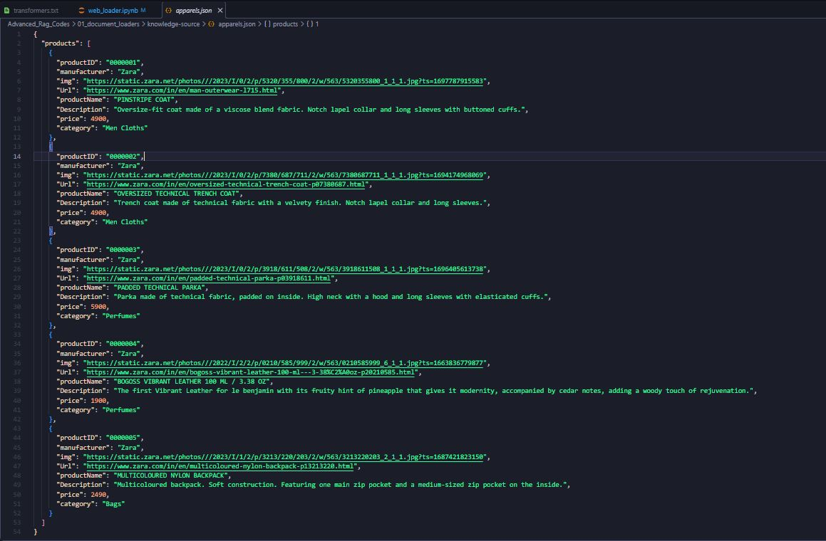
JSON
4. JSONLoader — select records with jq, then shape each Document
from langchain_community.document_loaders.json_loader import JSONLoader
def metadata_func(record, metadata):
metadata["product_name"] = record["productName"]
metadata["category"] = record["category"]
metadata["price"] = record["price"]
return metadata
loader = JSONLoader(
file_path=file_path.as_posix(),
jq_schema=".products[]",
content_key="Description",
metadata_func=metadata_func
)
documents = loader.load()
SUPPORTING JSON SHAPE
{ "products": [ { "productID": "0000001", "productName": "PINSTRIPE COAT", "Description": "…", "price": 4900, "category": "Men Cloths" }, … ] }
Observed
len(documents) = 5
One product object → one Document
page_content = Description
jq_schema = what records?
content_key = what text?
metadata_func = enrich?
Metadata
source + seq_num + product_name + category + price
Notebook: .products[] selects each product; content_key="Description" supplies page_content; metadata_func adds product fields.

Slide 6
PDF FAMILY
5. PDF loaders — same PDF, different extraction engines
Notebook input: attention_is_all_you_need.pdf → 15 pages. With mode="page", each page is exposed as a Document.
PyPDFLoader
PDFMinerLoader
PDFPlumberLoader
Engine: pypdf
Notebook role: page + optional image extraction/OCR
Engine: pdfminer.six
Notebook role: page + optional image extraction/OCR
Engine: pdfplumber
Notebook role: text extraction + metadata
COMMON PDF PIPELINE
PDF bytes
Parser
Per-page text
Document metadata
Optional OCR / images
engine-specific
extra path
⚠
Notebook evidence: PyPDF/PDFMiner/PDFPlumber all return 15 docs for the 15-page PDF, but extracted text and structure differ.
Interview framing: “The loader is an integration boundary. The underlying engine determines how text, layout, tables, and images get reconstructed.”
Current LangChain Reference lists PyPDFLoader→pypdf, PDFMinerLoader→pdfminer.six, PDFPlumberLoader→pdfplumber.

Slide 7
PDF • PYPDF
6. PyPDFLoader — page mode + metadata indexing
from langchain_community.document_loaders.pdf import PyPDFLoader
file_path = Path("../knowledge-source/attention_is_all_you_need.pdf")
pypdf_loader = PyPDFLoader(
file_path=file_path.as_posix(),
mode="page"
)
documents = pypdf_loader.load()
PAGE MAPPING
documents[0]
PDF page 1 | page=0
documents[1]
PDF page 2 | page=1
documents[2]
PDF page 3 | page=2 • page_label="3"
What the notebook inspected
{
"source": "…attention_is_all_you_need.pdf",
"total_pages": 15,
"page": 2,
"page_label": "3",
"creator": "LaTeX with hyperref"
}
len(documents) → 15
documents[2].page_content → Transformer architecture text
documents[2].metadata → source, total_pages, page, page_label + PDF metadata
⚠
Notebook comment says “fetch the first page” but uses documents[2] — that is the third PDF page (Python is 0-based).
Notebook: mode="page" produces 15 Documents; metadata shows zero-based page index and human-facing page_label.

Slide 8
PDF • IMAGE / OCR
7. PyPDFLoader + RapidOCR — recover text from images inside the PDF
from langchain_community.document_loaders.parsers import RapidOCRBlobParser
pypdf_image_loader = PyPDFLoader(
file_path=file_path.as_posix(),
mode="page",
extract_images=True,
images_parser=RapidOCRBlobParser(),
images_inner_format="html-img"
)
documents_with_images = pypdf_image_loader.load()
PDF page
Extract image
RapidOCR
OCR text
Page content
ONNXRuntime
OCR
Notebook evidence on PDF page 3
Output contains <img alt="Output …> plus OCR-like labels: Softmax, Linear, Add & Norm, Feed Forward, Multi-Head Attention, Positional Encoding, Embedding.
What RapidOCR is doing
Why this matters for RAG
The PDF parser extracts image blobs; the image parser runs OCR; images_inner_format="html-img" tells the loader how the image/OCR result is represented inside page_content.
A figure may contain labels or facts that are not in the PDF’s text layer. Without an image/OCR path, those tokens can disappear before chunking and embedding.
NOTE
The notebook imports TesseractBlobParser too, but the configured loader actually uses RapidOCRBlobParser.
Notebook logs show RapidOCR using ONNXRuntime and PP-OCRv6 detection/recognition models.

Slide 9
PDF • PDFMINER
8. PDFMinerLoader — alternate PDF text parser + the same OCR hook
from langchain_community.document_loaders import PDFMinerLoader
loader = PDFMinerLoader(
file_path=file_path.as_posix(),
mode="page",
extract_images=True,
images_parser=RapidOCRBlobParser(),
images_inner_format="html-img"
)
documents_with_images = loader.load()
TABLE 1 — OBSERVED EXTRACTED TEXT
Layer Type
Self-Attention O(n²·d)
Recurrent O(n·d²)
Convolutional O(k·n·d²)
Restricted SA O(r·n·d)
Sequential Operations / Max Path Length
O(1) / O(1)
O(n) / O(n)
O(1) / O(logₖ n)
O(1) / O(n/r)
Notebook output
Behind the scenes
RAG caution
len(documents_with_images) = 15
Page 3 image OCR appears in content
Page 6 table text is extractable
pdfminer.six reconstructs page text; the loader can also hand extracted images to RapidOCR and append the image representation.
The table’s cell relationships are flattened into text. Content survives, but row/column semantics may be harder to recover.
Extra notebook check: doc.metadata["page"] == 7 targets PDF page 8 and prints Table 2 (BLEU / training-cost results).
Notebook specifically prints page-3 image OCR and Table 1 text; current reference confirms PDFMinerLoader wraps pdfminer.six and supports image extraction.

Slide 10
PDF • PDFPLUMBER
9. PDFPlumberLoader — text extraction with a visible reading-order pitfall
from langchain_community.document_loaders import PDFPlumberLoader
plumber_loader = PDFPlumberLoader(
file_path=file_path.as_posix()
)
documents_with_metadata = plumber_loader.load()
len(documents_with_metadata) # 15
Observed metadata
source • file_path • page • total_pages • Author / CreationDate / Creator / …
OBSERVED PAGE-2 TEXT
What this demonstrates
Recurrentneuralnetworks,longshort-termmemory…
Attentionmechanismshavebecomeanintegralpart…
3 ModelArchitecture…
The notebook’s extracted sample shows words joined together (e.g., “Recurrentneuralnetworks”), a reading/spacing quality issue even though the underlying page text is present.
⚠
Interview takeaway: “Extraction quality is not just document count. Reading order, whitespace, tables and figures affect downstream retrieval.”
Notebook output for documents_with_metadata[1].page_content visibly contains joined words; metadata is richer/different in shape from PyPDF’s sample.

Slide 11
WEB
10. WebBaseLoader — load known URLs into Documents
from langchain_community.document_loaders import WebBaseLoader
url_1 = "…/pypdfloader"
url_2 = "…/pdfminer"
url_3 = "…/pdfplumber"
loader = WebBaseLoader(
web_paths=[url_1, url_2, url_3]
)
documents = loader.load()
Observed
Default parser
3 URLs → 3 Documents
HTML parser (notebook output shows language metadata)
Document 2 metadata
source = …/pdfplumber
language = “No language found.”
BEHIND THE SCENES
HTTP GET
HTML bytes
HTML parser
Document
extract text + metadata
⚠
Notebook warnings: USER_AGENT was not set. RecursiveUrlLoader also emitted XMLParsedAsHTMLWarning while parsing a discovered XML-like resource with an HTML parser.
Notebook: WebBaseLoader(web_paths=[…]) → len(documents)=3; metadata observed includes source and language.

Slide 12
WEB • RECURSIVE
11. RecursiveUrlLoader — crawl links, then stream with lazy_load()
from langchain_community.document_loaders import RecursiveUrlLoader
base_url = "https://docs.langchain.com/oss/python/integrations/document_loaders"
loader = RecursiveUrlLoader(
url=base_url,
max_depth=2
)
documents = loader.load()
len(documents) # 79 in notebook
CRAWL MODEL
depth 0
depth 1
base URL
linked pages
79 docs
depth 2
observed
linked pages of links
Observed content
Observed crawl pitfall
documents[0].page_content[:500] starts with raw HTML: <!DOCTYPE html><html …>
metadata includes source, content_type, title, description, language.
The 79 results include HTML assets and even CSS/JS sources in the notebook output. A recursive crawler needs scope / filtering to keep RAG ingestion clean.
docs_lazy = loader.lazy_load()
# returns a generator
for document in docs_lazy:
print(document.page_content[:300])
...
if counter == 20: break
Why lazy_load()
Yield documents incrementally instead of materializing the entire crawl up front; notebook demonstrates a 20-document stop condition.
Notebook: max_depth=2, len(documents)=79, page_content begins as raw HTML, lazy_load() returns a generator.

Slide 13
COMPARISON
12. Five loaders — side-by-side interview map
Loader
Input unit
Document granularity
Key knobs
Notebook evidence
TextLoader
file
1 file → 1 doc
file_path; encoding-related options exist in current API
len=1; entire .txt in page_content
CSVLoader
row
1 row → 1 doc
source_column; metadata_columns; content_columns
len=1000; row 0 shown
JSONLoader
jq-selected object
1 selected object → 1 doc
jq_schema; content_key; metadata_func
len=5; Description + custom metadata
PyPDFLoader
PDF page
1 page → 1 doc in mode="page"
mode; extract_images; images_parser; images_inner_format
len=15; OCR + figure text
PDFMiner / Plumber
PDF page
1 page → 1 doc in page mode
engine-specific PDF parsing
15 docs; table / spacing differences
WebBaseLoader
URL
1 URL → 1 doc
web_paths; headers; SSL/proxy/RPS knobs
3 docs; source/language metadata
RecursiveUrlLoader
linked URL tree
1 crawled page/resource → 1 doc
url; max_depth; lazy_load
79 docs; raw HTML + generator
⚠
Interview heuristic: first identify the source’s natural unit (file / row / object / page / URL), then choose the loader and configure how much becomes page_content vs metadata.
Current reference checked 24 Sep 2026; notebook outputs preserved as observed evidence rather than re-benchmarked here.

Slide 14
INTERVIEW CHEAT SHEET
13. Final revision: how to explain any loader in 60 seconds
1. What is the source?
2. What becomes one Document?
3. Where does structure go?
4. What can go wrong?
TXT / CSV / JSON / PDF / Web
file / row / object / page / URL
page_content vs metadata
encoding / layout / OCR / tables / crawl scope
RAG HAND-OFF
Loader
Document(s)
Text splitter
Embeddings
Qdrant
Retriever / LLM
Say this about Text / CSV / JSON
Say this about PDF / Web
“The loader converts source-native records into LangChain Documents, and I control what becomes searchable page_content versus filterable metadata.”
“PDF loaders depend on extraction engines; OCR and layout affect recall. Web loaders add HTTP/parsing, and recursive crawlers need depth and scope controls.”
⚠
Remember: loader quality is an ingestion concern. Bad extraction becomes bad chunks, bad embeddings, and eventually bad retrieval.
Deck preserves notebook-specific outputs and observations; current API names/semantics checked in LangChain Reference.

