Slide 1


SMART INDIA HACKATHON 2024
Problem Statement ID – 25129
Problem Statement Title – Automating GPO Customization and Deployment Based on CIS Guidelines
Theme – Smart Education
PS Category – Software Team ID – 27113
Team Name – Cannon Crew

Slide 2



Cannon Crew
CIS-GPO AUTOMATOR FOR AIR-GAPPED SECURITY
Detailed Explanation of the Proposed Solution
How It Addresses the Problem?
Innovation and Uniqueness of the Solution
Local LLM Execution: Runs LLMs offline using Ollama for advanced AI capabilities in air-gapped environments.
Integrated RAG Pipeline: Uses FAISS to efficiently process CIS guidelines. End-to-End Automation: Streamlines security processes from guideline ingestion to script application.
Adaptive Learning: Processes new guidelines through PDF uploads to stay current with security standards.
Offline AI-Powered Security: Provides a unique cybersecurity solution for sensitive environments by combining local AI processing, policy management, and system hardening.
Desktop App / CLI: A lightweight tool capable of automating GOP Customization based on CIS Guidelines Local AI: We use Local AI and LLMs to automate the customization process.
PDF Upload: Users upload CIS guidelines as PDF, accessed by the LLM via RAG pipeline.
Easy Testing: Our in-house suite of tools ensures the GOP’s are enabled properly
Import and Export Settings: GOP settings can be easily imported and exported in any file format.
Saving and Documentation: Save Group configurations for future use with rich documentation.`
Automation: Turn CIS guidelines into PowerShell, reducing manual work for complex security setups.
Air-gapped Friendly: Runs locally, ideal for high-security environments without internet. Even the AI component.
Customizable: Tailors GPO settings to user needs while adhering to CIS standards.
Consistent: Exports/imports policies for easy application across systems. Validated: Includes security tests to ensure compliance.
Documented: Maintains clear records of applied security measures.

Slide 3
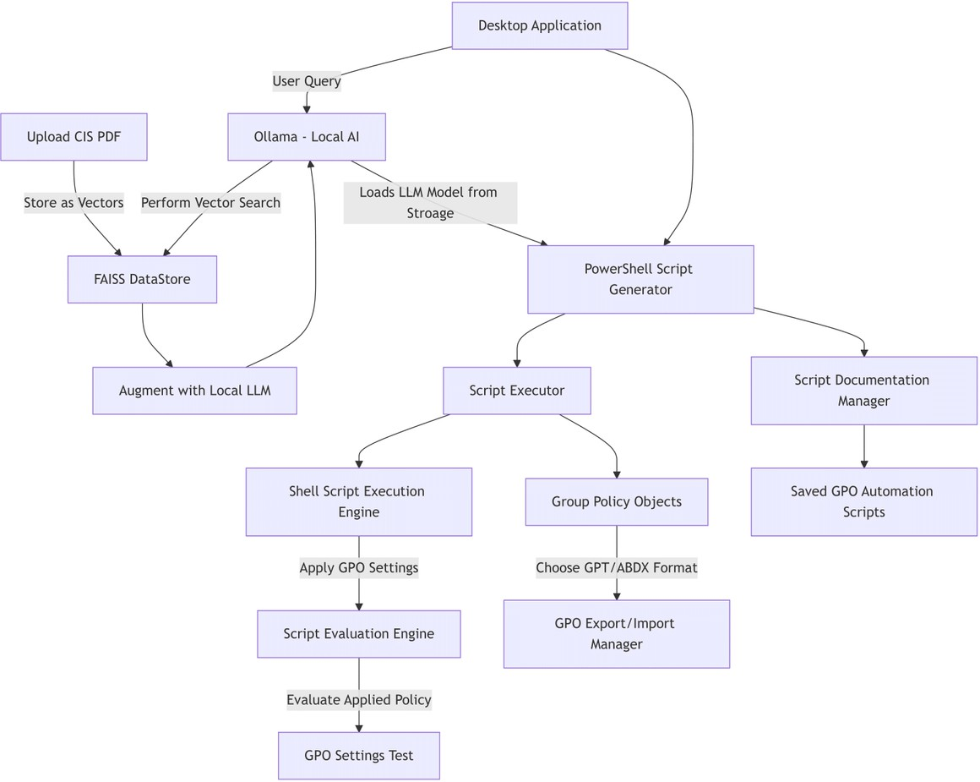








TECHNICAL APPROACH
Cannon Crew
A R C H I T E C T U R E
Chain of LLM agents with access to an admin shell.
Use of power shell scripts to automate GPO application.
LLM ( Mistral) generates Power Shell script using CIS guidelines stored in FAISS ( RAG Database)
Admin Shell executes Powershell Script and implements GPO rules
GPO rules are tested with in- house testing and analysis tools.
C O M P O N E N T S :
Script Engine: Automates GPO generation and customization. Database: Stores and manages CIS guidelines, and user-
defined settings.
Deployment Module: Deploys the GPOs on air- gapped/ standalone systems via admin shell.
Auditing/ Testing Tool: Verifies system compliance post- deployment.
TECHNOLOGY STACK
Mistral AI
Mongo DB
Com
<
Electron.js
Ollama
Chroma AI
PowerShell

Slide 4

ANALYSIS OF THE FEASIBILITY OF THE IDEA
Technical and Operational Feasibility: Proven scripting techniques and tools like Ollama allow for full remote management and 100% offline functionality, ideal for secure, high- security environments.
Efficiency and Compliance: The system requires less computing power and ensures compliance with CIS standards, even on standalone, air-gapped systems using up-to- date RAG status indicators.
POTENTIAL CHALLENGES
Administrative Access Required: Dependence on admin rights could limit deployment across environments with restricted access.
Integration Complexity: Integrating with diverse and potentially outdated systems could complicate seamless operation and compatibility.
STRATERGIES TO OVERCOME CHALLANGES
Role-Based Access Control Implementation: An RBAC system can efficiently manage access, ensuring system integrity and security.
Robust Testing and Configuration Management: A thorough testing suite and configuration database help manage system updates and minimize integration issues.

Slide 5

IMPACT AND BENEFITS
Cannon Crew
IMPACT
FOR INSTANCE: USER STORY
Enhanced Security Compliance
Scalability and Efficiency
Reduced Human Error
Scenario
A government agency, operating in a highly secure environment with no internet access, adopts our system for managing and deploying GPOs across its network of standalone, air-gapped computers.
Impact
Increased Security Compliance: The agency benefits from the system's 100% offline capability, eliminating the risk of external breaches and enhancing the security of sensitive data.
Operational Efficiency: The agency uses less computing resources and benefits from an up-to-date, error-free configuration due to the system's efficient RAG updates and robust in-house testing.
Benefits
Improved GPO Management: With the ability to save and recall past configurations, the agency streamlines its process for testing and deploying new policies, reducing downtime and operational disruptions.
Cultural Change: The adoption of an RBAC system ensures that only authorized personnel can access critical system settings, promoting a culture of accountability and meticulous access control within the agency.
BENEFITS
Streamlined Management Process
Enhanced System Security Compliance and Cost Efficiency Power of AI without Internet

Slide 6

RESEARCH AND REFERENCES
Cannon Crew
RAG
Mistral
Ollama
CIS Benchmark
Powershell module
Air gapped systems
Gpo Overview
SSH Tunneling

