Slide 1


SMART INDIA HACKATHON 2024
Stay Informed, Stay Safe
Problem Statement ID- SIH-1616
Problem Statement Title- The Technological Solutions for capturing AQI values through mobile and other forms of stations
Theme- Clean & Green Technology
PS Category- Software
Team ID-
Team Name- AK11

Slide 2
IDEA TITLE
AK11
Proposed Solution
We have 2 solutions to for capturing AQI values through mobile and other forms
  Automatic Dron surveys at morning and evening
  AQI device at street poles

Slide 3
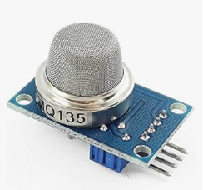
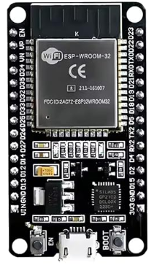

TECHNICAL APPROACH
AK11
Here we are using following tech:-
  MQ gas sensors
  ESP32 WROOM-32 Development Board CP2102 USB Driver 2.4GHz Dual Core WiFi + Bluetooth (30 PINS) by OceanLab
  Drone

Slide 4



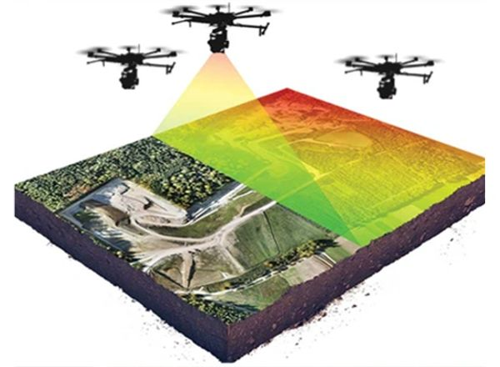

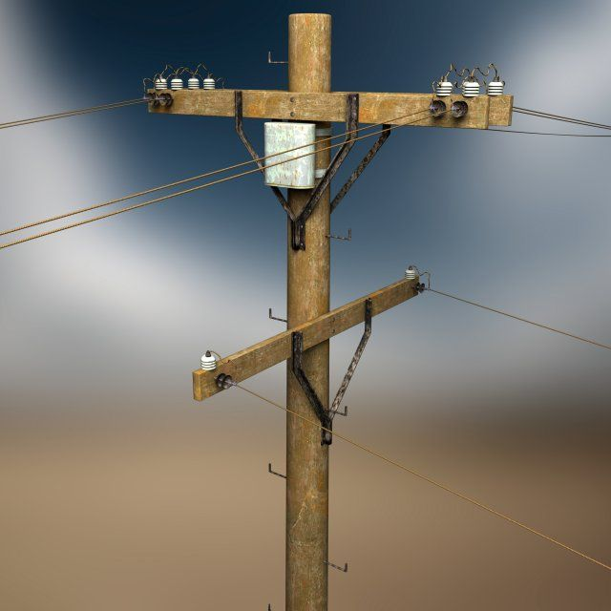



AK11
Methodology and process for implementation:-
  AQI data collection drone
  At street poles the data of real-time AQI is keep circulating by a system of network to data center
Making Making drone survey Collect Readings AI will Analyse Data User can access
customize drone with 10 drones taken by drone and highlight it on Map Data from App
AI will Analyse Data
and highlight it on Map
Data Server
All AQI sensor are connected And send Data to Data Server
AQI sensor At street pole
For instant AQI user need to scan QR code on street pole

Slide 5
FEASIBILITY AND VIABILITY
AK11
Challenges are :-
  Maintenance and buying of drone.
  Continuous supply of Power to street pole devices and installation of device.
Strategies for overcoming these challenges:-
  Drone Data maintenance and making of Drone should be given to Universities .
  At street pole give a small battery or solar panel to the devices

Slide 6


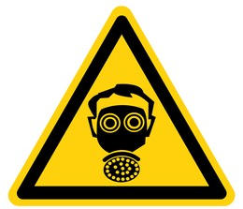
IMPACT AND BENEFITS
AK11
People stay informed of real time AQI of there area.
People may get encourage to save and plant trees.
We can trace efficiently the high pollution making Company, farms, fire forest, etc.
Through App user will get Alert of high AQI and learn the basic precaution and help to reduce AQI

