Slide 1


SMART INDIA HACKATHON 2024
TITLE PAGE
Problem Statement ID – SIH1607
Problem Statement Title – Smart Ai Based Traffic Management System
Theme - smart automation
PS Category- Software
Team ID-
Team Name (Registered on portal) :
AIKYAM

Slide 2
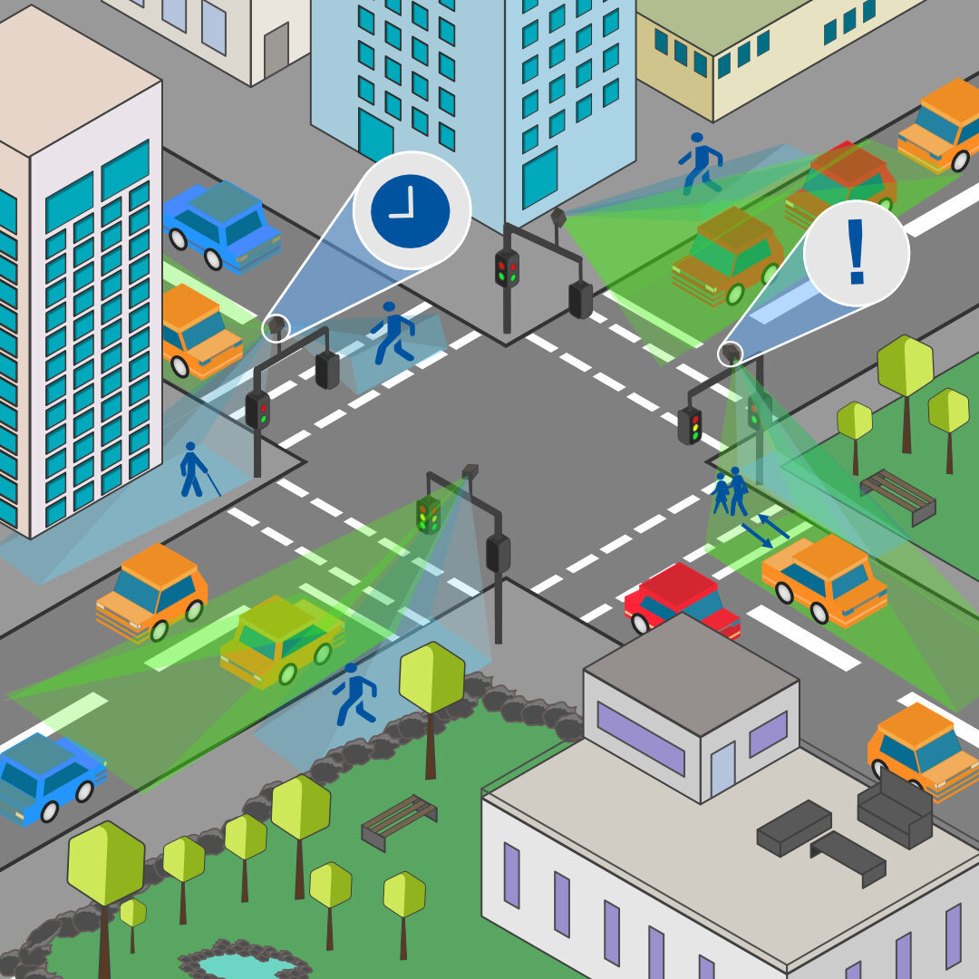
IDEA TITLE
TEAM
AIKYAM
“A smart AI based solution for traffic management on routes with heavy traffic from different directions, with real-time monitoring and adaptation of traffic light timings”
Solution
Explanation
The technology has transcended all barriers it has now become easy to solve most human problems and one of these problems include traffic congestion.
Traffic congestion has increased drastically over the years and has had negative impacts
One of the many causes of traffic congestion is improper traffic management systems.
A number of papers have been published with an aim to overcome the
disadvantages of the traditional traffic light system.
Innovation & Uniqueness
The main purpose of the smart traffic managements system is to allot timings to a traffic signal based on the level of traffic on a lane.
By image processing we can find the level of traffic in the area. Based on the vehicles present in a section the level of traffic is classified as low, medium and high

Slide 3
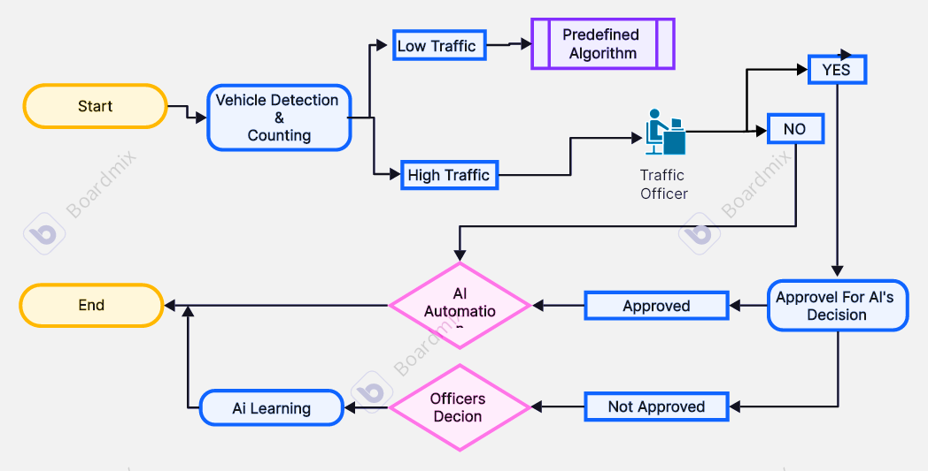
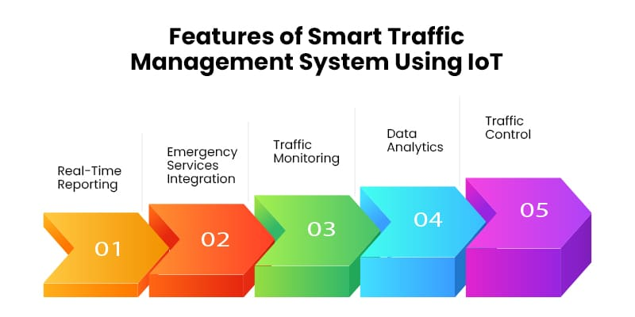
TECHNICAL APPROACH
TEAM
AIKYAM
At start by vehicle detection traffic is analysed
If traffic is low system switch to the predetermined algorithm.
If traffic is high,
Traffic officer is present:- The suggestions are provided to the officer, these suggestions are approved or rejected by the officer. The rejected decisions are considered and stored in the AI learning.
Traffic Officer is not present:- The AI automation technique is activated for traffic management as per stored information for specific situation.
Technologies and Tools
Backend: Python with Django
Frontend: JavaScript with React
Database: MongoDB

Slide 4
FEASIBILITY AND VIABILITY
TEAM
AIKYAM
Feasibility of the Idea:
AI traffic management systems are increasingly feasible and practical
due to advancements in technology
Potential & Challenges:
AI traffic management system offer many benefits but they also face several challenges and risks of Data Privacy and Security, System Reliability, Initial cost, etc.
Strategies to overcome the above challenges are:
For data privacy and Security we should implement strong encryption protocols & we should maintain transparency.
For system reliability regular maintenance and testing is necessary.
Maintain detailed and accessible documents for system operations and troubleshooting.
Regular audit AI system for biases and correct any unfair outcomes.

Slide 5
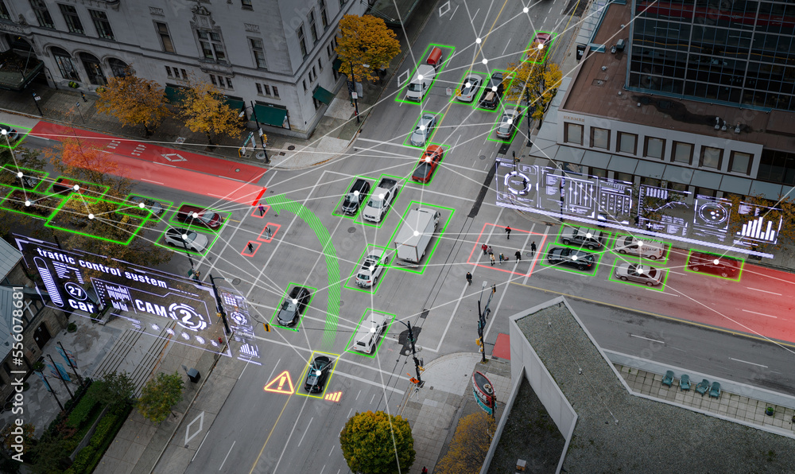
IMPACT AND BENEFITS
TEAM
AIKYAM
Potential impact on the target audience:
Traffic management services are essential for ensuring the safety, efficiency and sustainability of road networks
Benefits of the solution :
Improved traffic flow
Enhanced safety
Efficient use of resources
Real time monitoring and reporting
Enhanced public satisfaction

Slide 6


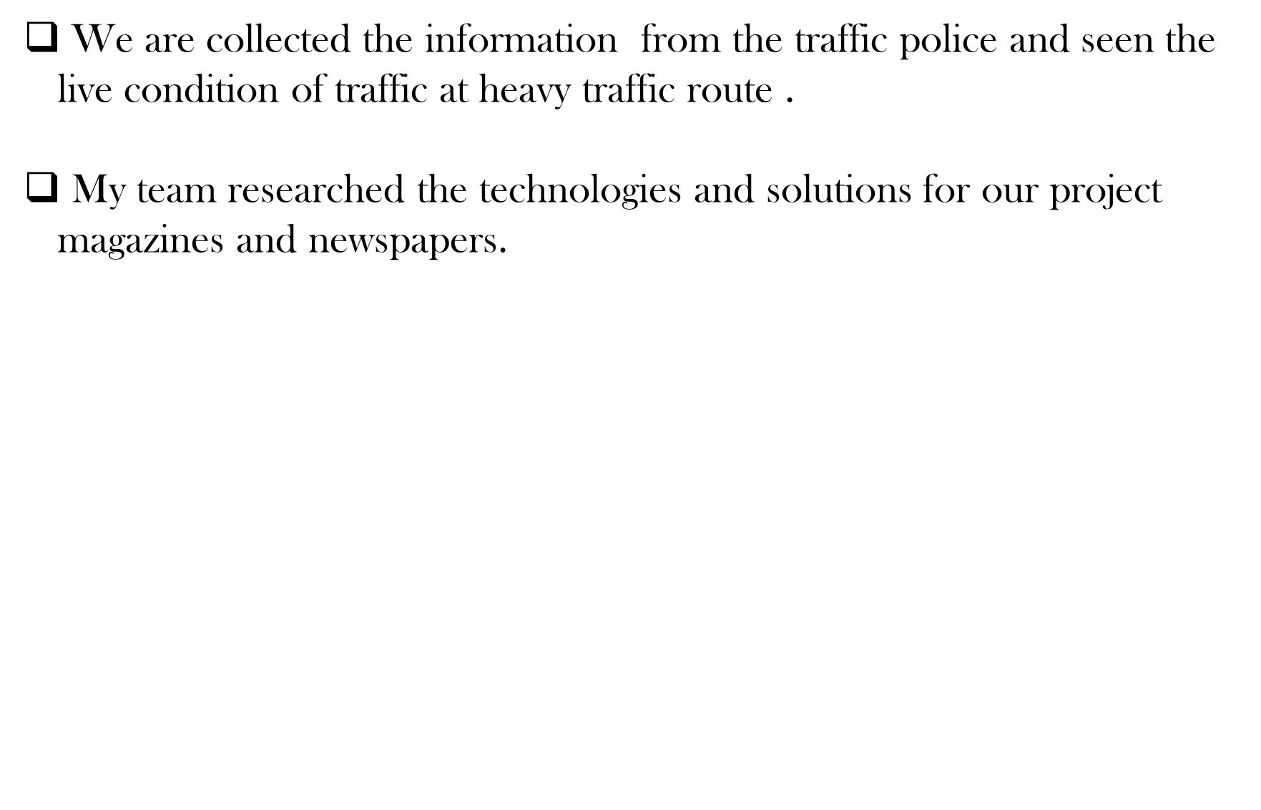
RESEARCH AND REFRENCES
@SIH Idea submission- Template
6

