Slide 1


SMART INDIA HACKATHON 2024
TITLE PAGE
Problem Statement ID – 1683
Problem Statement Title - Development of AI/ML based solution for detection of face-swap based deep fake videos
Theme- Miscellaneous
PS Category- Software
Team ID-
Team Name (Registered on portal) : dy/dx

Slide 2
IDEA TITLE
dy/dx
Detailed explanation of the proposed solution
  AI/ML-Based Detection: Utilizes Convolutional Neural Networks (CNNs) to detect inconsistencies in facial features and video frames, identifying deepfake videos with high accuracy.
  Blockchain Integration: Stores the hash of detected deepfake videos on the blockchain, ensuring an immutable and verifiable record of each video’s authenticity.
  Verification System: On re-upload, compares video hashes against the blockchain to confirm authenticity and prevent the spread of known deepfakes.
  Enhanced Transparency: Provides verifiable records of deepfake detection, promoting transparency and accountability in digital media verification.
How it addresses the problem
  Accurate Identification: Addresses the challenge of deepfake detection by providing a precise and reliable method for identifying manipulated videos.
  Prevents Re-Upload: Stops the spread of deepfakes by ensuring that once a video is identified as fake, its hash is recorded and checked for future uploads.
  Forensic Insights: Enhances investigations with detailed reports on the authenticity of videos, aiding in the detection and prevention of misinformation and fraud.
Innovation and uniqueness of the solution
  Hybrid Detection Approach: Combines state-of-the-art AI/ML algorithms with blockchain technology, leveraging both advanced video analysis and secure, immutable records.
  Scalable and Adaptable: Offers a scalable solution that evolves with new deepfake techniques, maintaining robustness and effectiveness in detection.
  Enhanced Transparency: Provides verifiable records of deepfake detection, promoting transparency and accountability in digital media verification.

Slide 3
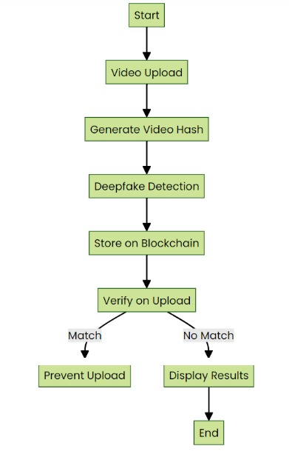
TECHNICAL APPROACH
dy/dx
Technologies to be Used:
Backend Development
Python: Backend logic
web3.py: Blockchain integration
Smart Contracts & Blockchain
Solidity: Smart contracts
Ethereum: Smart contract deployment
Ganache: Blockchain testing
Metamask: Wallet integration
Web Application Development
Streamlit: Web app framework
Deep Learning & AI
TensorFlow/PyTorch: Deep learning models
Keras: Model training
OpenCV: Video processing
Methodology and process for implementation:

Slide 4
FEASIBILITY AND VIABILITY
dy/dx
Feasibility
Technical Feasibility:
  Data Availability: Access to diverse datasets with genuine and deep fake videos.
  Algorithm Complexity: Use of advanced methods (CNNs, RNNs, Capsule Networks) is feasible with current tech.
  Integration: Modular design allows combining multiple detection techniques effectively.
Economic Feasibility:
  Development Costs: High due to computational resources and data acquisition, but manageable with cloud infrastructure.
  Operational Costs: Ongoing maintenance and updates are required but can be offset by system's impact.
Viability
Impact:
  Security: Enhances detection of malicious deep fakes, mitigating risks in politics, fraud, and misinformation.
  Utility: Provides actionable insights and detailed reports for forensic analysis.
Scalability:
  Infrastructure: Cloud-based deployment supports scalability.
  Adaptability: System updates and retraining can address evolving deep fake techniques.
Sustainability:
  Long-term Benefits: Robust detection and reporting systems will offer long-term value in protecting digital content integrity.

Slide 5
IMPACT AND BENEFITS
dy/dx
Impact
1. Enhanced Security: Strengthens the ability of security agencies and forensic experts to detect and investigate deepfakes, reducing misinformation and wrongful accusations.
2. Increased Trust: Builds public trust by verifying the authenticity of media content, crucial for consumers, media, and legal entities.
3. Forensic Utility: Provides detailed forensic reports, aiding law enforcement in prosecuting deepfake-related crimes..
Benefits of the Solution
1.Proactive Prevention: Prevents the spread of harmful deepfakes, protecting personal rights and reducing potential damage.
2. Scalable and Cost-Effective: Offers a scalable solution adaptable to various sectors, reducing costs associated with manual verification and legal disputes.
3. Long-Term Integrity: Maintains the authenticity of digital content, offering lasting protection against evolving deepfake technologies.

Slide 6
RESEARCH AND REFERENCES
dy/dx
Details / Links of the reference and research work:
"Hybrid Deep Learning Model for Deepfake Detection"
Link: https://ieeexplore.ieee.org/document/10363477
This paper discusses a hybrid deep learning approach for detecting deepfakes, which serves as a crucial reference for designing and optimizing the CNN model in our project.
"Decentralized Deepfake Detection Blockchain Network Using Dynamic Algorithm Management"
Link: https://arxiv.org/pdf/2311.18545.pdf
his paper explores the use of blockchain for decentralized deepfake detection, focusing on dynamic algorithm management to enhance detection accuracy and system resilience.
3. "Web3.py Documentation: Python Library for Ethereum"
Link: https://web3py.readthedocs.io/en/stable/
This documentation provides detailed guidance on using Web3.py, a Python library for interacting with the Ethereum blockchain, crucial for i mplementing smart contracts in the deepfake detection system.
4. "Streamlit Documentation: The Fastest Way to Build and Share Data Apps"
Link: https://docs.streamlit.io/
This documentation offers comprehensive resources for using Streamlit, a powerful tool for building interactive web applications, ideal for creating the user interface of the deepfake detection system.

