Slide 1
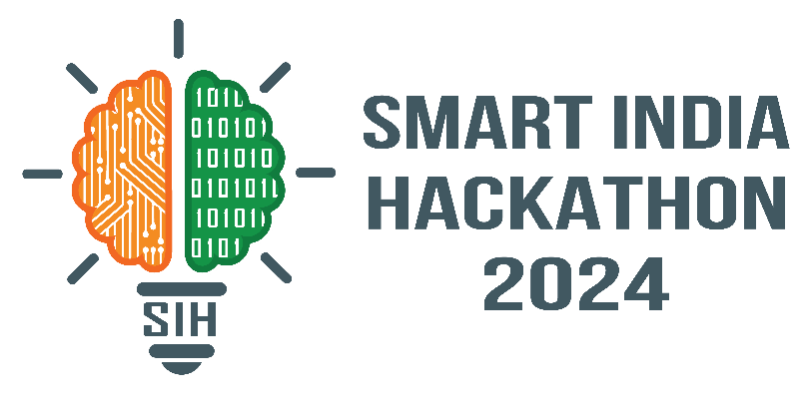

SMART INDIA HACKATHON 2024
TITLE PAGE
Problem Statement ID –1638
Problem Statement : AI-Driven Crop Disease Prediction and Management System
Theme- Agriculture, FoodTech & Rural Development
PS Category- Software/Hardware
Team ID-
Team Name (Registered on portal): CropCode

Slide 2
CROP CURE AI
CropCode
Proposed Solution
The proposed solution is a web-based application that allows farmers and agricultural experts to upload images of crops to automatically identify crop diseases using machine learning (ML). By leveraging advanced image recognition techniques, utilizing plant disease detection ML models, and AR/VR to show real-time analytics.
How it addresses the problem
Timely Disease Identification: The application allows farmers to quickly identify crop diseases without needing expert knowledge, reducing the time between disease onset and intervention.
Cost-Effective: Reduces the need for expensive laboratory tests or expert consultations, providing a cost-effective alternative for disease diagnosis.
Real-time Scalability: The solution can be easily scaled to include more crops and diseases as more data becomes available, and the model can be retrained periodically to improve accuracy, showing seeding/flowering/vegetative phase in augmented reality.
Innovation and uniqueness of the solution
Multi-Language Support: To cater to a global audience, the application can support multiple languages, making it accessible to farmers worldwide.
AR/VR Model Analysis: Farmer inputs his crop image in real-time, prompting AR to show different stages of crop disease, its side-effects, and parts of plant body affected. Our model suggests farmer to apply required fertilizers & insecticides to accelerate crop growth.

Slide 3
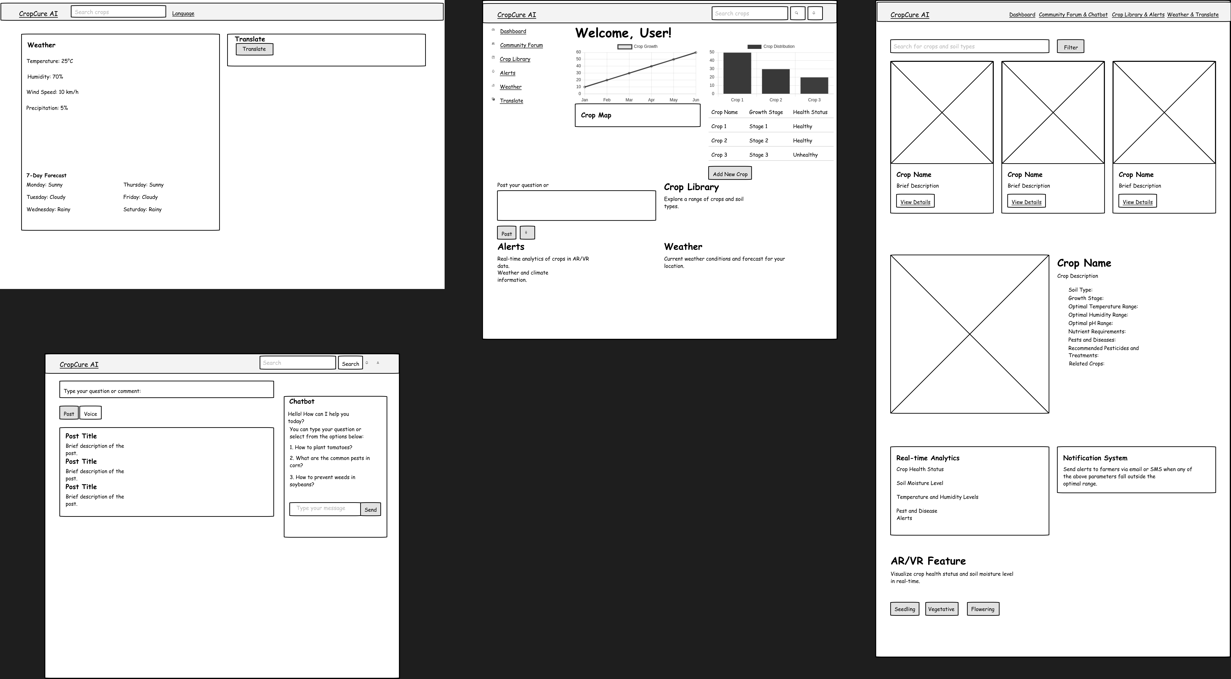
TECHNICAL APPROACH
CropCode
Frontend: Svelte,
SvelteKit
Backend: Node.js,
Express.js,
MongoDB
Axios or Fetch API (for HTTP requests)
JWT (JSON Web Tokens)

Slide 4
FEASIBILITY AND VIABILITY
CropCode
Analysis of the Feasibility of the Idea
- Technically feasible with ML models like CNNs for crop disease detection.
- Web-based platform possible with modern technologies (React, Node.js, Django/Flask).
- Integration of AR/VR, chatbot, weather data, and alert systems is achievable.
- Market potential is high in agriculture-dependent regions with growing tech adoption.
- Financially viable with potential revenue from subscriptions, ads, and partnerships.
Potential Challenges and Risks
- High-quality data collection for ML models is challenging.
- Models may not generalize well in diverse real-world conditions.
- User adoption could be slow due to technological unfamiliarity and poor connectivity.
- AR/VR integration may face device compatibility issues.
- Language diversity complicates accurate translations.
- Data privacy and security are critical concerns.
- Overcoming these challenges requires targeted strategies and collaboration with stakeholders.
Strategies for Overcoming These Challenges​
​
- Collaborate with agricultural bodies for high-quality data collection.​
- Use continuous learning frameworks for model improvement.​
- Develop lightweight, device-compatible versions for broader accessibility.​
- Leverage NLP models and local expertise for accurate translations.

Slide 5
IMPACT AND BENEFITS
CropCode
Potential Impact on the Target Audience
Increased Crop Yield: Early detection of diseases can reduce crop loss, leading to higher yields.
Empowered Farmers: Access to real-time data and analytics enables informed decision-making.
Knowledge Sharing: The community forum allows farmers to share experiences and best practices.
Accessibility: Language translation and a user-friendly interface ensure wider adoption among diverse farmer groups.
Risk Reduction: Alerts for disease outbreaks and adverse weather conditions help mitigate risks.
Adoption of Technology: Encourages the use of modern technology in agriculture.
Benefits of the Solution (Social, Economic, Environmental, etc.)
Social Benefits: Fosters community building and collaboration among farmers, experts, and agricultural bodies.
Economic Benefits: Reduces crop losses, increases productivity, and potentially lowers costs, leading to higher incomes.
Environmental Benefits: Minimizes the overuse of pesticides and fertilizers through precise disease detection, reducing environmental impact.
Knowledge Enhancement: Provides farmers with education and resources on sustainable farming practices.
Resilience Building: Supports farmers in adapting to climate change by providing timely weather and climate information.

Slide 6
RESEARCH AND REFERENCES
CropCode
Mohanty, S. P., Hughes, D. P., & Salathé, M. (2016). Using Deep Learning for Image-Based Plant Disease Detection. *Frontiers in Plant Science*, 7, 1419. doi:10.3389/fpls.2016.01419.
Ferentinos, K. P. (2018). Deep learning models for plant disease detection and diagnosis. *Computers and Electronics in Agriculture*, 145, 311-318. doi:10.1016/j.compag.2018.01.009.
Singh, A., Kumar, R., & Pathak, P. (2020). Precision Agriculture and Internet of Things (IoT). *IEEE Internet of Things Journal*, 7(11), 10275-10286. doi:10.1109/JIOT.2020.2999471.
Ayaz, M., Ammad-Uddin, M., Sharif, Z., Mansour, A., & Aggoune, E. H. M. (2019). Internet-of-Things (IoT)-based smart agriculture: Toward making the fields talk. *IEEE Access*, 7, 129551-129583. doi:10.1109/ACCESS.2019.2932609.

