Slide 1

SMART INDIA HACKATHON 2024
TITLE PAGE
Problem Statement ID – SIH-1728
Problem Statement Title- Development of a Paperless Scholarship Disbursement System for PMSSS
Theme- Miscellaneous
PS Category- Software
Team ID- 18409
Team Name (Registered on portal) :- INNOV-VERTEX

Slide 2







IDEA TITLE
INNOV-VERTEX
Objective
INNOVATION & UNIQUENESS OF THE SOLUTION
“Our goal is to make the PMSSS scheme paperless and fully digitalized, facilitating faster and easier disbursement without the need for hard copies & implement a document verification system for quick verification. To achieve this, we’re creating a special online portal.”
User-friendly Interface: A user-friendly interface for students to upload and manage their documents.
Digital Transformation: Fully digital, replacing paper- based processes, streamlining workflows on Dashboard.
Automated Verification: Faster, accurate document checks, reducing manual errors.
Real-time Updates: Students can track their application,
enhancing transparency manually and also on AI chatbot.
24/7 AI-powered Chatbot: An AI chatbot provides round- the-clock assistance, answering student queries instantly and improving their overall experience.’
Role-based Access Control: The system provides secure, role-specific access for Students, SAG Bureau, and Finance Bureau, ensuring data privacy and secure handling.
Backup: If ever any attack performed on the website the all data is secured because of special security system.
Smooth user friendly: if too much traffic are on web then it’s special feature is to handle easily and no crashing issue.
Multi-language Support: There will be multilingual
support along with local language assistance.
Address The Problem
Lengthy Process: The Entire Process is very long and often experiences delays.
Time-Consuming Paperwork: The paperwork involved is extensive, which can be especially challenging for people in remote areas like J&K and Ladakh.
Document Verification: In document verification, student face many challenges in old process.
Data Loss: Filled forms and important documents sometimes get lost in the office, causing disruptions.
Secure Authentication: Lack of secure document authentication and verification.

Slide 3










































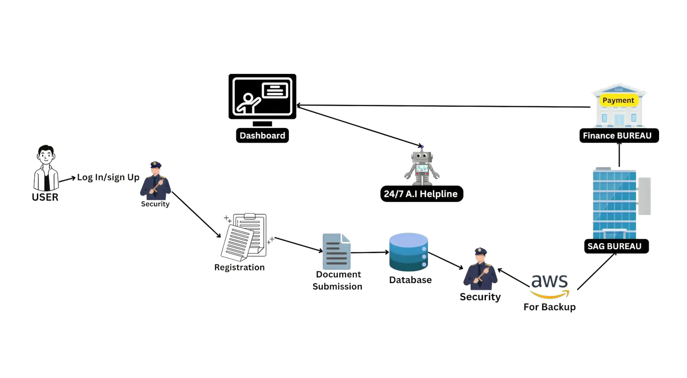

TECHNICAL APPROACH
INNOV-VERTEX
Frontend:
React.js (front-end Design and Structure)
Backend:
Node.js, Django, Ruby, (backend runtime for executing java Script on the server)
Database Management System:
MySQL, MongoDB, (Database for storing and
managing Data)
Cloud Service: AWS (cloud hosting Platform for deploying the application)
Visualization and AI: Tableau, Google Chart, AI (Python, Apache)
Authentication and Security system: OAUTH, SSL.
Rest API: Google API, UIDAI, SendGrid, (communication between frontend & backend)
USED TECHNOLOGY
React.js
Node.js
Ruby
Django _{Z}
Python
Apache
Chart

Slide 4














































FEASIBILITY AND VIABILITY
INNOV-VERTEX
Technical Feasibility:
  Cloud servers and AI technology ensure smooth operations, even with high user traffic.
Operational Feasibility:
  Automated Document Transfer between departments.
  Real-time updates for students
regarding their scholarship status.
Financial Feasibility:
  Reduces costs by eliminating paper usage.
  Faster payments help lower long- term administrative costs.
2. Potential challenges and Security risk:
Data Security and Privacy: Handling sensitive data, that chances of data breaches.
Limited Access to Technology:
Strategies for overcoming challenges:
  Data Security :-
    Use encryption and secure logins to protect sensitive data.
2.Support for rural students:
Internet accessibility challenges, especially in rural areas.
Lack Knowledge to use digital systems.
Ensure forms save and auto-sync once the internet is restored to avoid submission failures.
3. High Traffic During Application:
3. Handling High traffic : Using newest cloud technology that can adjust automatically to handle more users.
System overload and server errors caused by high demand.
Eligibility Criteria
Document Submission
Document Verification
Merit List
Preparation
Scholarship Allocation
Scholarship
Disbursal
Monitoring & Evaluation

Slide 5








IMPACT AND BENEFITS
INNOV-VERTEX
IMPACT ON FINANCE BUREAU
Faster Payment Processing
Reduced Workload
Real-time Financial Tracking
Fraud Prevention and Risk Management
BENEFITS:
User Satisfaction: Access the portal anytime, user-friendly & smooth interface.
Automated Workflow: Streamlined workflows for faster approvals and disbursements.
Data Security: Enhanced security measures protect sensitive student information better than physical records.
Instant Notifications: Automated alerts for submissions, approvals, and additional requirements keep students updated.
Real-Time Status Updates: Track application status in real-time to reduce uncertainty and anxiety.
Document Management: Easy upload and management of documents eliminate the need for physical submissions.
Comprehensive Support: Access FAQs, 24/7 AI chat support, and tutorials for smooth navigation through the application process.
IMPACT ON STUDENTS
Less Manual Effort for Students
Reduced Paper Work & Time
24/7 AI Chatbot Support
Faster Application Process
24/7 AI Chat bot Support
IMPACT ON SAG BUREAU
Optimized Verification Process
Enhanced Data Management
Reduced Administrative Burden
Real-time reporting and analytic
IMPACT ON UNIV./COLLEGES
Timely payment distribution

Slide 6
RESEARCH AND REFERENCES
INNOV-VERTEX
Data Security in Educational Systems:
  Source: National Institute of Standards and Technology (NIST). (2020). Guide to Securing the Remote Workforce.
  Summary: Offers guidelines and standards for maintaining data security in educational institutions, crucial for protecting student information during online application processes.
  Link: [NIST Guide](https://doi.org/10.6028/NIST.SP.800-46)
User Experience in Online Platforms:
  Source: The Value of User Experience in Digital Services.
  Summary: The importance of designing user-friendly interfaces to maximize usability in online platforms.
"Upon reviewing multiple government websites, I observed that many of them exhibit suboptimal design layouts. However, there are notable exceptions with well-executed designs, including NIC, NSP, and AICTE."

