Slide 1

SMART INDIA HACKATHON 2026
PRAMAAN
Secure Evidence Vault
Problem Statement ID – SIH26190
Problem Statement Title – Secure Digital Document Management System for law enforcement agencies, courts and investigative departments
Theme – Cybersecurity and Blockchain
PS Category – Software
Team ID – SIH-UPES-2026-T250
Team Name (Registered on portal) – leet
Organisation: Ministry of Home Affairs · National Crime Records Bureau (NCRB)
Separate the trust. Verify before release. Record every access.
Standalone, fully on-premise · no dependency on any external system
Notes:
PRAMAAN = "proof / evidence". One-line positioning:
"PRAMAAN is a standalone tamper-evident evidence vault that separates metadata, encrypted
evidence and key material, and verifies integrity before evidence is released."
Q: Who is the primary user?
A: An authorised evidence custodian or investigator. Secondary users: reviewers, auditors and
explicitly authorised recipients. Not "everyone".
Q: What is the main innovation?
A: The combination of separated trust domains, per-chunk cryptographic isolation, and mandatory
integrity verification before evidence is released. (Do NOT answer "AI + blockchain + AES".)
NOTE: fill in Theme and Team ID from the SIH portal before uploading.

Slide 2
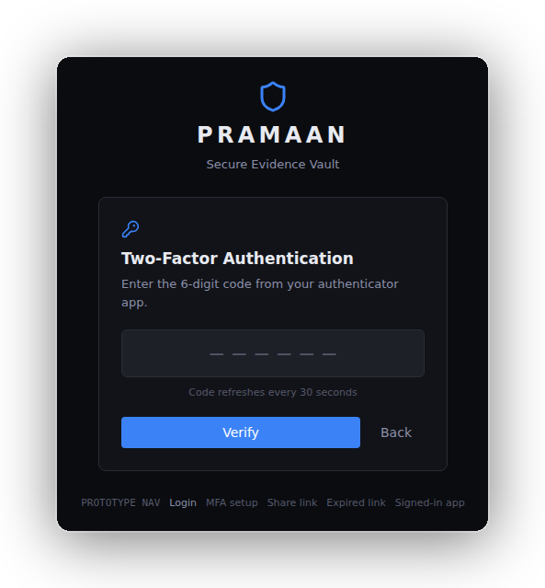
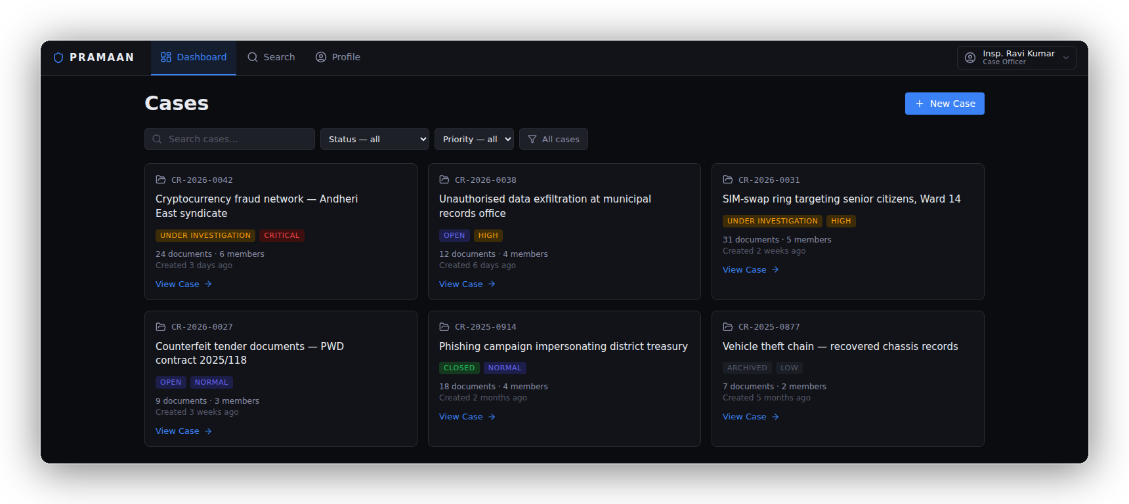
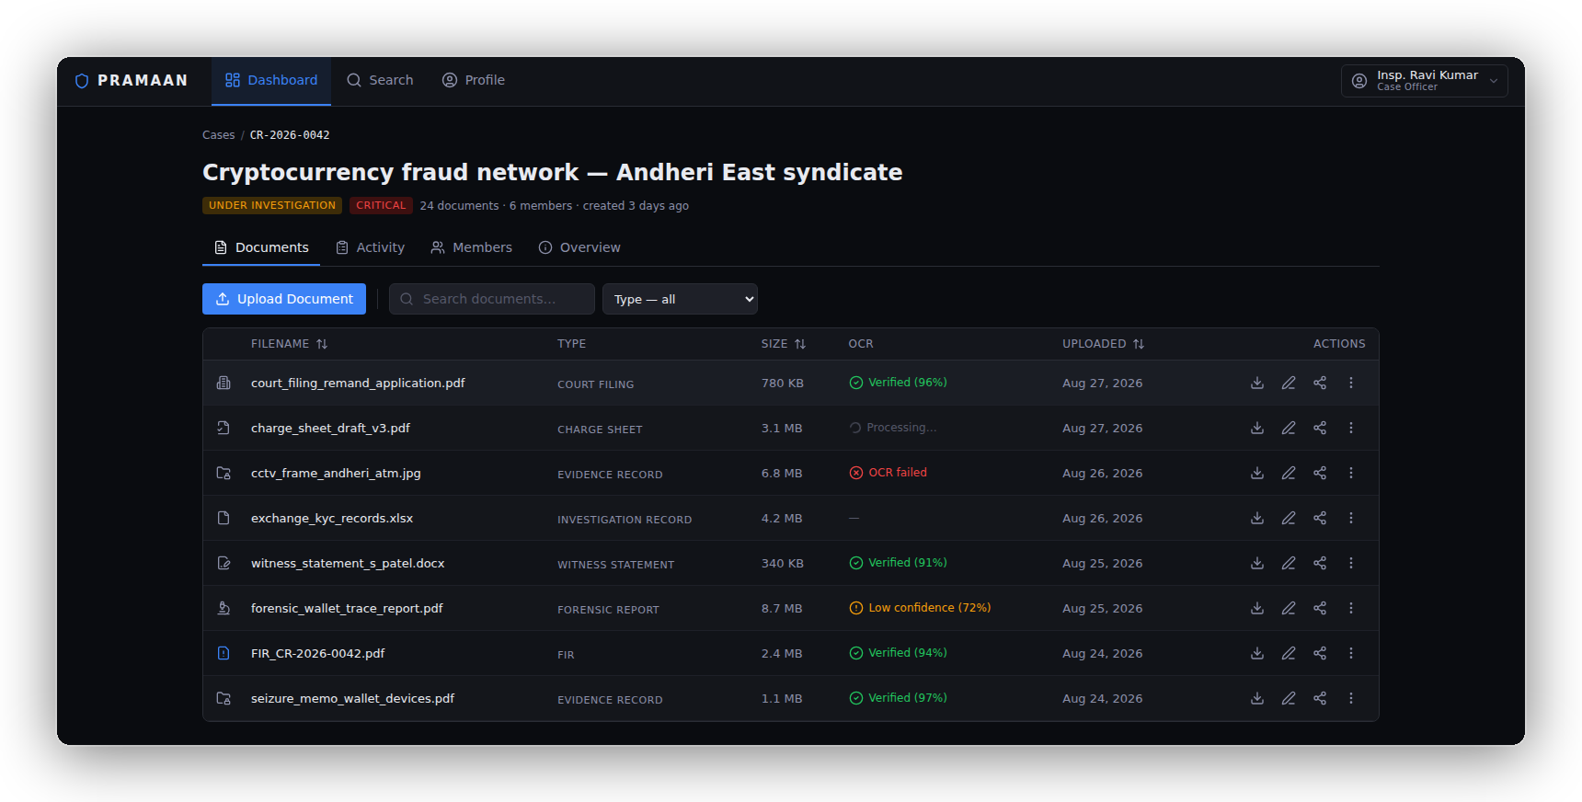
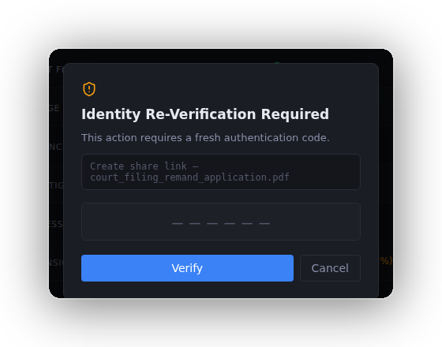
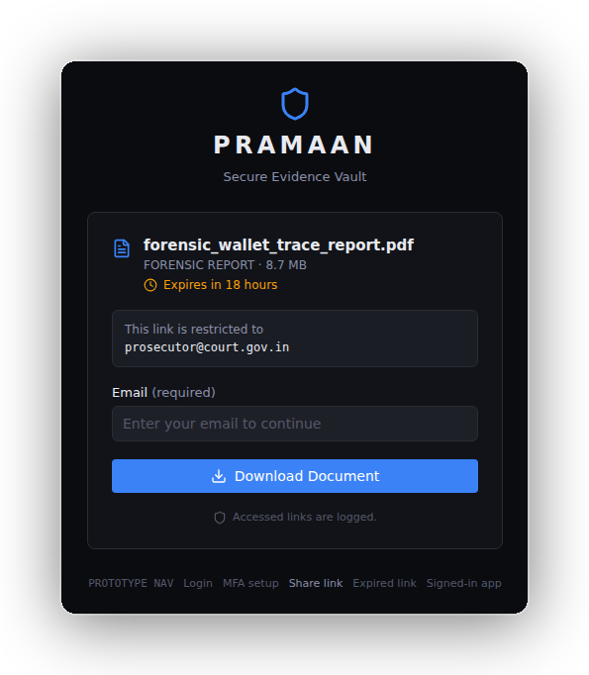
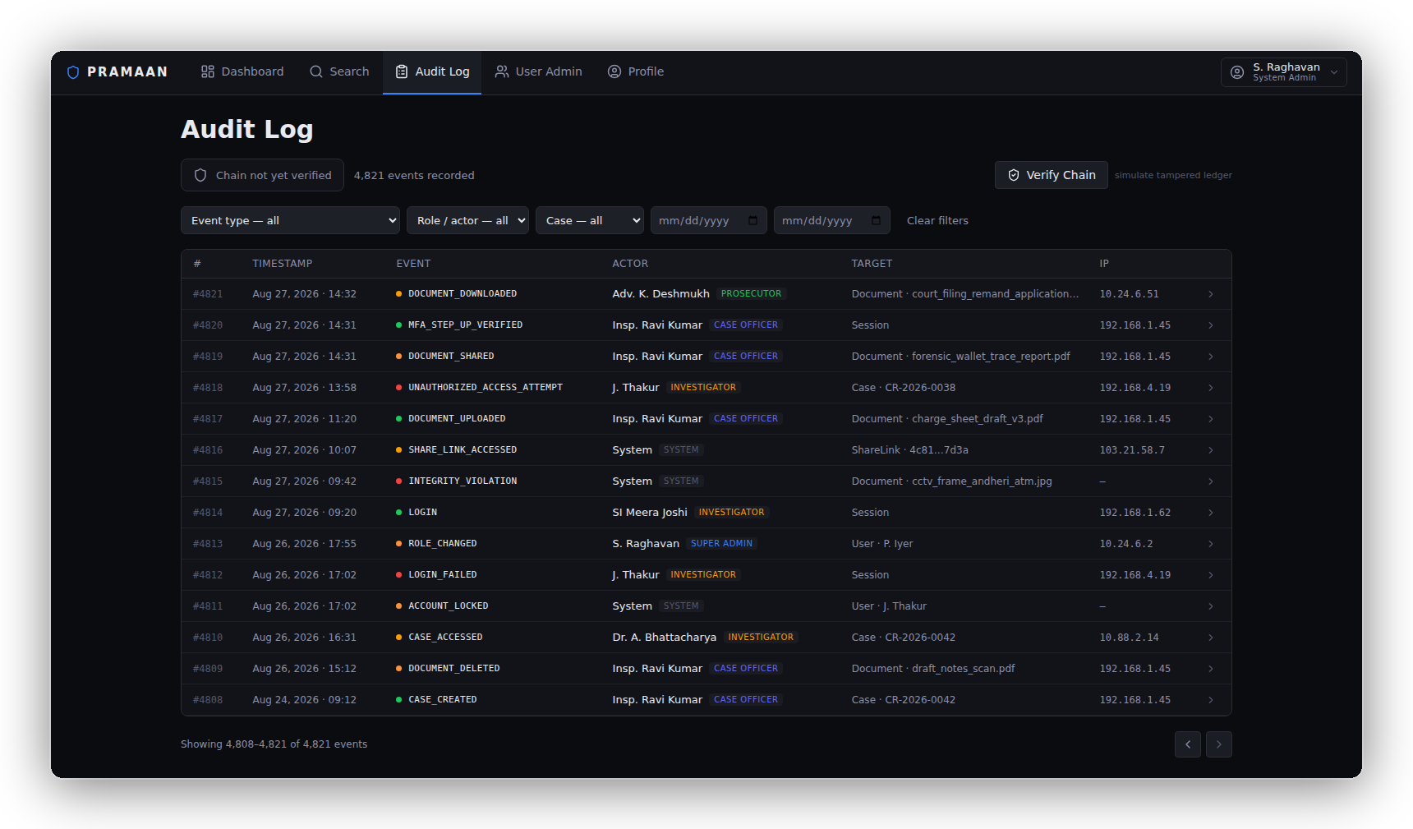
PRAMAAN — SECURE EVIDENCE VAULT
leet
Proposed Solution (Idea / Prototype) | How it addresses the problem | Innovation and uniqueness of the solution
PRAMAAN — THE EVIDENCE LIFECYCLE, FROM THE RUNNING PROTOTYPE
Today this is a paper register and a shared drive with no way to prove anything was never altered. Below is what replaces it — six real screens from the build.
SIGN IN — MFA ENFORCED
CASE-SCOPED DASHBOARD
UPLOAD, OCR & VERIFY
STEP-UP MFA TO SHARE
RECIPIENT OPENS VIA OTP
EVERY STEP AUDIT-LOGGED
1
2
3
4
5
6
One rule holds all of it together: evidence is never released if its integrity cannot be verified.
Notes:
THIS SLIDE IS WHAT THE SYSTEM DOES. Slide 3 is how it is secured — do not explain
chunking, keys or the storage split here.
TOP: four sentences on how a case file is held today — scattered, co-located, unprovable,
unaccountable. Do not linger.
THEN: walk the eight features. One line each, then move on. The presenter should be able to point
at a card and speak without reading it.
PRAMAAN is a complete, standalone evidence system covering capture, custody, retrieval and
controlled sharing. It is not a middle layer bolted onto anything else, and it does not depend on
any external system to function.
Q: Who is the primary user? A: An authorised evidence custodian or investigator. Secondary users:
reviewers, auditors and explicitly authorised recipients. Not "everyone".
Q: What is the main innovation? A: The combination of separated trust domains, per-chunk
cryptographic isolation, and mandatory integrity verification before evidence is released — shown
on slide 3. Do NOT answer "AI plus blockchain plus AES".
Q: Does OCR weaken security? A: It runs on-premise and writes only derived text to the search
index; the original file stays encrypted, and the text inherits the same case-scoped access control
as the document it came from.

Slide 3
TECHNICAL APPROACH
leet
Technologies to be used | Methodology and process for implementation (Flow Charts / Images / working prototype)
SECURITY ARCHITECTURE — one document, end to end
OFFICER
browser holds no keys and no plaintext
APPLICATION SERVER
every request authenticated and authorised; stores no bytes
THE EXHIBIT
up to 500 MB (prototype limit)
SPLIT INTO 1 MB CHUNKS
streamed — never held whole in memory
A DERIVED KEY PER CHUNK → AES-256-GCM
HKDF from the master key · fresh 96-bit IV · SHA-256 per chunk, then one document hash
SERVER A
PostgreSQL · metadata only
chunk order · IV · chunk hashes · document hash · search index · audit chain
✗ no document bytes, ever
SERVER B
encrypted chunk store · ciphertext only
one AES-GCM object per chunk, each carrying its own authentication tag
✗ no keys, no plaintext
KMS
key material only
one master key per document; chunk keys are derived on use, never stored
✗ no ciphertext to unlock
RELEASE
decrypt · stream in chunk order · access recorded
ALL CHECKS
PASS ?
BLOCK
HTTP 422 · 0 bytes served · integrity violation recorded — the demo
Nothing is streamed before every chunk hash, every authentication tag and the document hash have passed.
React SPA · Flask REST API · PostgreSQL · encrypted chunk store · key management service · Tesseract OCR | AES-256-GCM · HKDF-SHA256 · SHA-256 · Ed25519 · bcrypt · TOTP · JWT
Notes:
THIS SLIDE IS THE SECURITY ARCHITECTURE. Slide 2 was the feature set — do not repeat it.
WALK THE PICTURE, TOP TO BOTTOM:
Row 1: the officer's browser holds nothing. The application server checks every request but stores
no document bytes. The exhibit is split into 1 MB chunks; each gets its own derived key, is locked
with AES-256-GCM, and is fingerprinted with SHA-256.
Storage tier: three machines holding three different things. Point at each and say what it CANNOT
give an attacker — Server A has no bytes, Server B has no keys, the KMS has no ciphertext.
Gate: every retrieval funnels through one check. Pass, release. Fail, zero bytes.
Q12 (hard): Split trust on limited hosts? A: Metadata and ciphertext sit on two independent
servers, so neither host alone holds a reconstruction path. That is logical plus host separation,
not full physical trust separation. Production adds independent credentials per domain and an
isolated KMS boundary. Do not argue — the question is valid.
Q4: Why AES-GCM? A: Authenticated encryption — confidentiality and integrity in one standardised
construction, so tampering is detected on decrypt.
Q5: Why HKDF? A: Independent keys derived from one key with controlled context separation, rather
than reusing a single key for every chunk.
Q6: Why not one key per document? A: Per-chunk derivation limits cryptographic exposure and gives
each chunk an independent encryption context.
Q7: Master key compromised? A: Derived chunk keys become recoverable — it stays the critical trust
boundary. Production needs hardened KMS controls, rotation, backup, recovery and a compromise
procedure. Do NOT claim immunity.
Q8: A chunk is modified? A: Verification fails, retrieval is rejected, nothing is released, and the
event is recorded.
Q14: Why not blockchain? A: No need for decentralised consensus — only tamper detection and audit
verification. A hash chain is simpler with lower operational complexity.
Q18/19: 1 MB chunks and the 500 MB cap are prototype figures, to be benchmarked.

Slide 4
FEASIBILITY AND VIABILITY
leet
Analysis of the feasibility of the idea | Potential challenges and risks | Strategies for overcoming these challenges
FEASIBILITY — a 9-day build on commodity hardware, with no external system dependency
DAYS 1–2
Auth · MFA · RBAC
DAYS 3–4
Chunked crypto ★
DAY 5
Audit chain
DAY 6
Search · OCR
DAYS 7–8
Signatures · sharing
DAY 9
Tamper demo
✓ Open-source stack — no per-seat licence
✓ On-premise — no mandatory cloud hosting fee
✓ No GPU and no internet egress required
✓ Standard audited crypto libraries — nothing home-made
THREAT MODEL — what the prototype defends against, and what it does not
DEFENDED IN THE PROTOTYPE
• Compromise of the metadata server alone
• Compromise of the encrypted chunk store alone
• A database administrator reading evidence content
• Stolen credentials without the second factor
• Cross-case and unauthorised API access
• Modification of stored ciphertext
• Retroactive edits to the audit trail
PARTIALLY ADDRESSED
• Compromise of the application server
• Compromise of the KMS or a document master key
• A stolen live authenticated session
• Backup media holding metadata, ciphertext or keys
• A privileged account rewriting the whole audit chain
OUT OF SCOPE FOR THE PROTOTYPE
• Full root or operating-system compromise of a host
• Physical access to the machines
• A compromised cryptographic library
• Formally verified implementation
• Production disaster recovery and high availability
• Certified PKI / e-signature deployment
PRAMAAN does not claim compromise is impossible. It limits the impact of partial compromise, and refuses to release evidence it cannot verify.
Notes:
The key-risks column was removed to keep this slide readable. Those answers now live here.
Q12 (hard): Split trust on limited hosts? A: Metadata and ciphertext sit on two independent
servers, so neither host alone holds a reconstruction path. Logical plus host separation, not full
physical trust separation. Hardening adds independent credentials per domain, network segmentation
and an isolated KMS boundary.
Q7/Q11 (master key / KMS): We do not claim immunity. Per-chunk derivation limits exposure per key,
but the master key remains the critical boundary. Key generation, storage, rotation, backup,
revocation and compromise response are documented as required hardening — not as things already
built.
Q13 (hard): Can a DBA rewrite the audit chain? A: A database-only hash chain gives tamper evidence,
not absolute immutability. Someone with enough privilege could rewrite history and recompute hashes
into a new internally consistent chain. That is why hardening anchors audit roots in an
independently protected store. Our claim is tamper detection, not immutable storage. UPDATE and
DELETE are revoked on the audit table at the database level, and /audit/verify names the first
failing event.
Q24 (insider): MFA, RBAC, case-scoped permissions, audit logging, controlled sharing, session
revocation. Be honest — audit does not prevent every insider action; it provides accountability
and detection.
Q20 (scale): The architecture separates metadata, ciphertext and key services, which gives a path
to independent scaling. Large-scale load testing is not complete, so distinguish architectural
scalability from demonstrated scalability.
Q21-23 (reliability): losing PostgreSQL, chunks or keys each needs backup, restoration and
integrity verification. Do NOT claim disaster recovery until it is designed and tested.

Slide 5
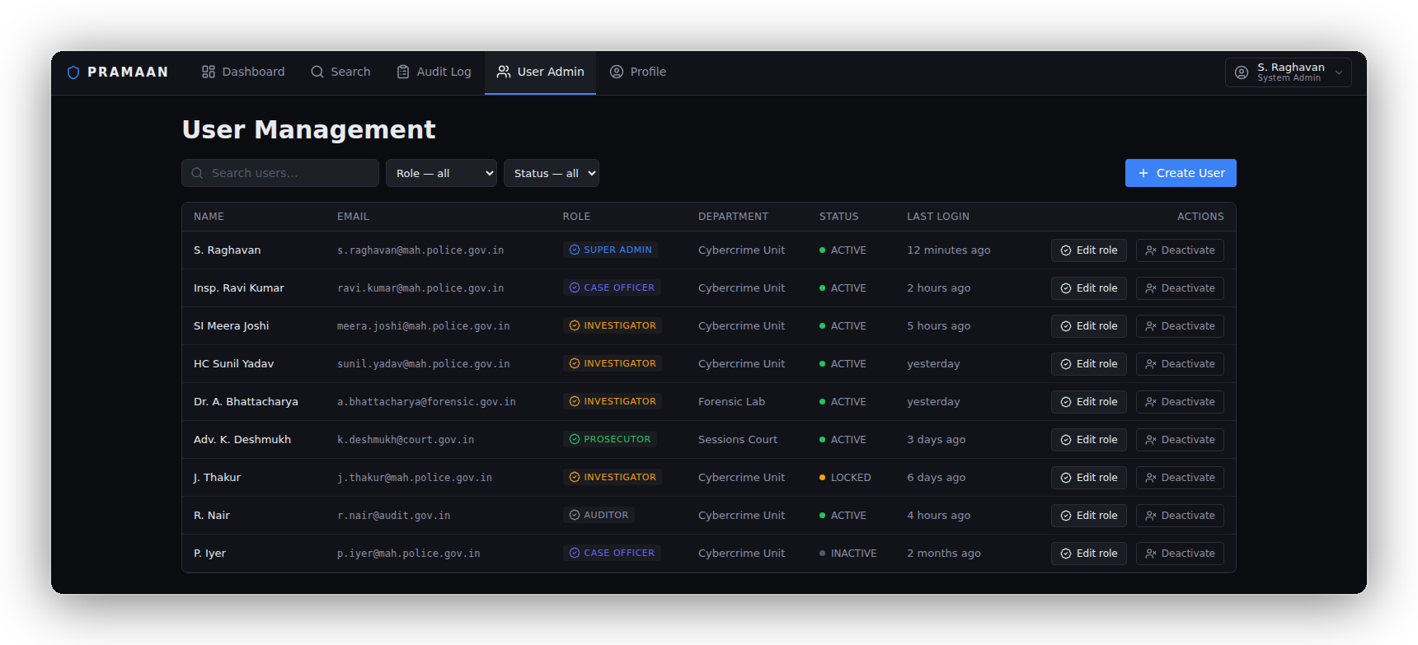
IMPACT AND BENEFITS
leet
Potential impact on the target audience | Benefits of the solution (social, economic, environmental, etc.)
ONE APP, ROLE-SCOPED — WHAT EACH PERSON ACTUALLY SEES
CASE OFFICER
COURTS & PROSECUTORS
AUDITORS & OVERSIGHT
SYSTEM ADMIN
Roles and access are managed centrally — six roles, one console, every change logged.
Uploads evidence into an indexed, encrypted case file — replaces station registers and shared drives.
Recompute the hash-chained audit log on demand; verification names the first event that fails.
Receive an exhibit only through a step-up-verified, recipient-bound, time-limited share.
WHAT WE WILL MEASURE — stated as targets; figures reported from the prototype, not claimed now
Blast radius of a single compromised host
Response to an integrity failure
Retrieval and verification time
Neither storage server on its own yields a readable document.
0 bytes served, HTTP 422, and an audit event recorded.
To be benchmarked at 10 MB, 100 MB and 500 MB.
Notes:
Every number on this slide is a stated target, not a measured result. If a judge asks
"have you measured that?" the answer is: "Not yet — these are the targets and the method. We will
report measured figures with the prototype." Never invent a benchmark.
Deliberately NOT claimed here: "retrieval in seconds replaces hours", "fairer trials", "zero
cost", environmental savings. All were removed as unsupported.
Q16: Why a 48-hour link? A: The prototype demonstrates time-limited controlled sharing. Hardened
deployment binds the share to an authenticated recipient and enforces explicit access policy
rather than relying on possession of a URL. Do NOT market "no account needed" as a security
advantage.
Q17: Why is this a DMS and not encrypted file storage? A: The security layer is the differentiator,
but the system also maintains case associations, metadata, authorisation, search, access history,
evidence lifecycle state and controlled sharing. The MVP prioritises the secure evidence lifecycle
over broad enterprise-DMS features. Only claim what exists.
Q25/26 (legal): Never answer "yes" to legal admissibility or legal validity. Hashing and signing
support integrity verification; admissibility depends on the applicable evidentiary framework,
collection process, chain of custody and certification.

Slide 6
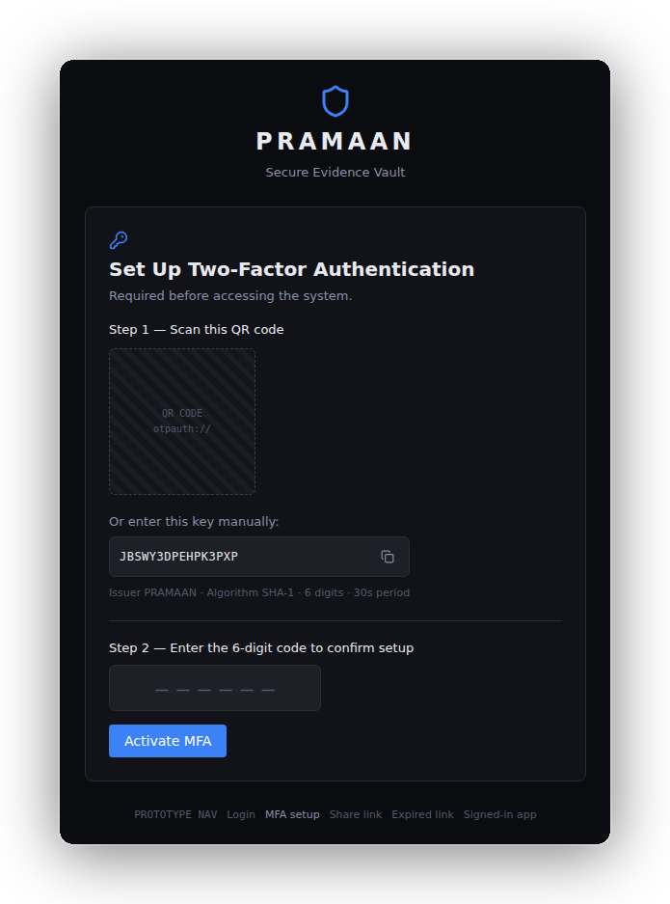
RESEARCH AND REFERENCES
leet
Details / Links of the reference and research work
CRYPTOGRAPHIC STANDARDS WE IMPLEMENT
SECURITY ENGINEERING REFERENCES
TECHNOLOGY & PRIOR ART STUDIED
NIST SP 800-38D
AES-GCM mode, IV construction and tag length — our per-chunk cipher. nvlpubs.nist.gov
RFC 5869 — HKDF
Extract-and-expand key derivation; the basis of our per-chunk keys. rfc-editor.org/rfc/rfc5869
RFC 8032 — Ed25519
Deterministic EdDSA signatures; no per-signature nonce to reuse. rfc-editor.org/rfc/rfc8032
RFC 6238 — TOTP
Time-based one-time passwords for the second factor. rfc-editor.org/rfc/rfc6238
NIST SP 800-57 Part 1 Rev.5
Key-management lifecycle — generation, storage, rotation, destruction.
OWASP ASVS 4.0
The verification checklist our access-control and crypto-storage requirements map to. owasp.org
OWASP Top 10 (2021)
Broken access control and cryptographic failures drove the 404-not-403 scoping rule.
NIST SP 800-92
Log management guidance behind the audit event schema and retention design.
Saltzer & Schroeder (1975)
Least privilege and complete mediation — why authorisation is re-checked per request.
Threat-model sources
Each threat on slide 4 traces to one of the above rather than to intuition.
pyca/cryptography
AESGCM, HKDF and Ed25519 primitives — audited implementations, no custom crypto. cryptography.io
PostgreSQL 16
Full-text search, GIN indexes and transaction-scoped advisory locks. postgresql.org/docs
Tesseract OCR + Indic tessdata
Fully offline OCR with Devanagari, Tamil, Telugu, Bengali and Gujarati packs.
MinIO · HashiCorp Vault
Studied as production swap-ins behind our chunk-store and KMS interfaces.
Ollama · sentence-transformers
Studied for the future on-premise AI layer — not part of the core system.
HOW THE RESEARCH SHAPED THE BUILD
OUR OWN DESIGN RECORD
• Eleven feature plans plus architecture, security, API and cross-cutting edge-case documents.
• Every cryptographic and access-control decision was written down and threat-modelled before implementation.
WHAT THE READING CHANGED
• SP 800-38D → per-chunk HKDF keys instead of one key per file, so an IV cannot repeat under a key.
• OWASP ASVS → 404 instead of 403 on case-scoped resources, so existence is never confirmed.
• NIST SP 800-92 → audit events carry actor, action, case, document and result, not just a message.
FUTURE SCOPE — AI OUTSIDE THE EVIDENCE BOUNDARY
• Context Retrieval — semantic search over a read-only derived index, filtered to cases the officer can already access.
• Document Summarisation — a local model drafts summaries on-premise; no evidence leaves the network.
• Secure Session Playground — the ephemeral sandbox summarisation runs in, wiped on close, nothing retained unless saved.
• The AI layer reads a derived copy and can never modify original evidence.
Notes:
Every reference here supports something in the architecture. Do not cite anything just
because it sounds authoritative — a judge may ask "what did you use that for?"
Legal and regulatory references were deliberately removed from this version. If asked about legal
standing: "PRAMAAN demonstrates the technical integrity layer. Legal admissibility depends on the
applicable evidentiary framework, collection process, chain of custody and certification, which is
outside this prototype's scope."
Q15: Is Ed25519 legally recognised? A: The prototype uses Ed25519 for cryptographic signing and
integrity verification. We are not claiming the prototype signature by itself establishes legal
recognition; production would need the appropriate e-signature / PKI mechanism.
AI positioning: do not lead with AI. The security problem does not require AI. State plainly:
"AI operates outside the evidence trust boundary and cannot alter original evidence."
CLOSING LINE: "PRAMAAN is not built on the assumption that attacks will never happen. It is built
on the assumption that components can be compromised. By separating storage domains and verifying
evidence before release, it limits the impact of partial compromise and prevents corrupted
evidence from being silently served."

