Slide 1



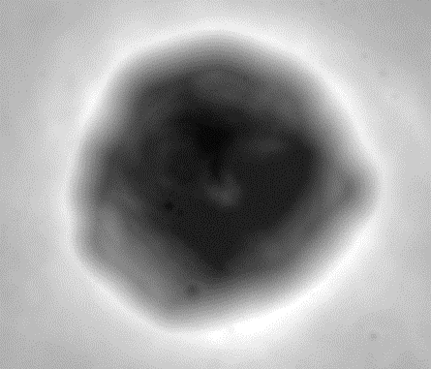
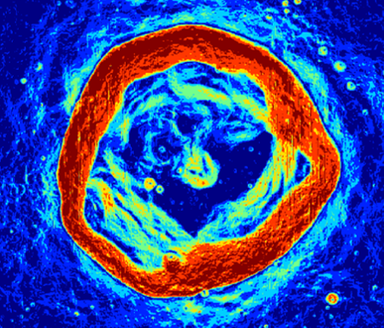
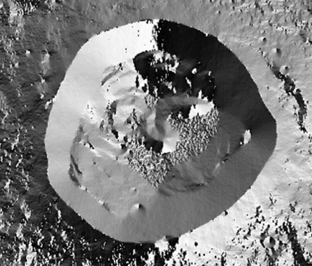
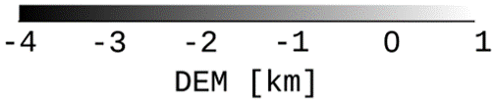
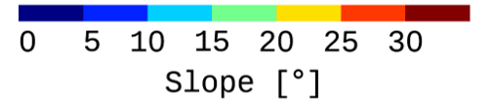

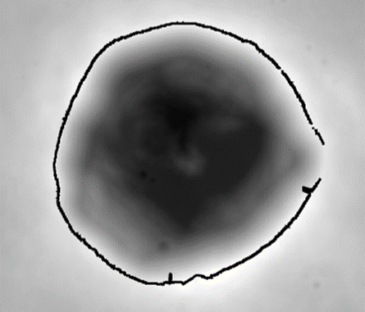
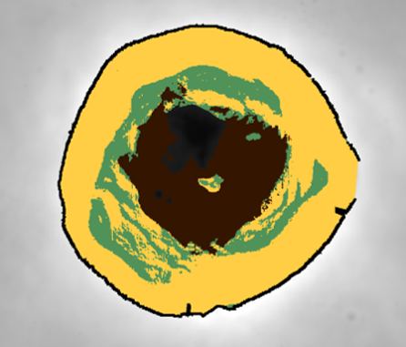
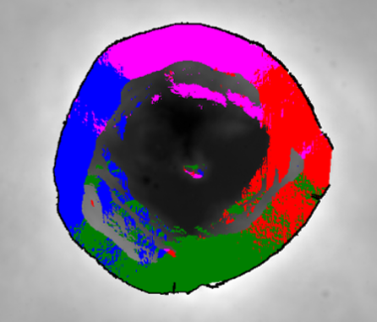


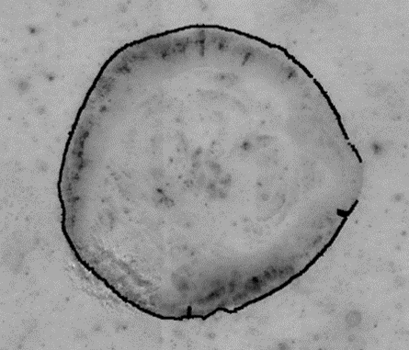
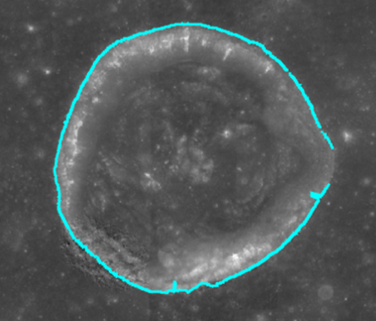
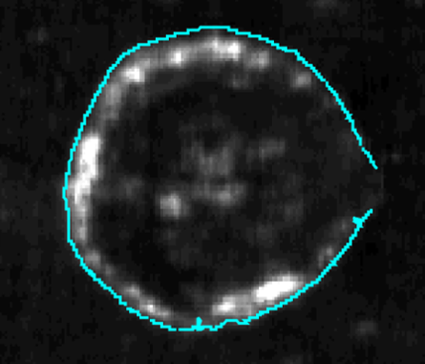

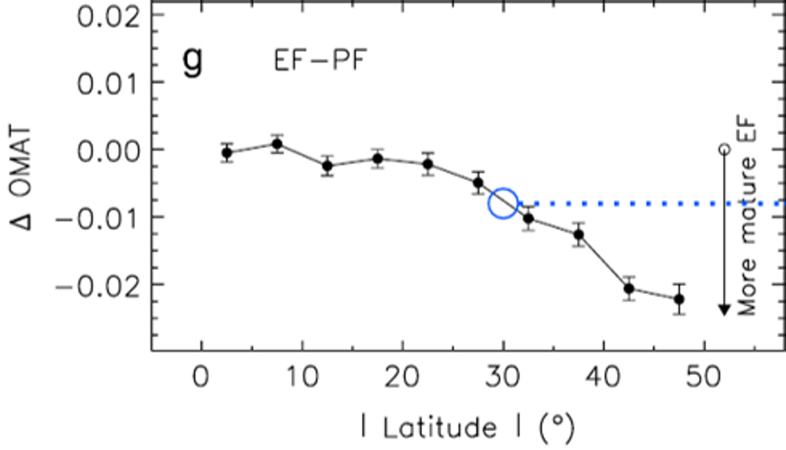
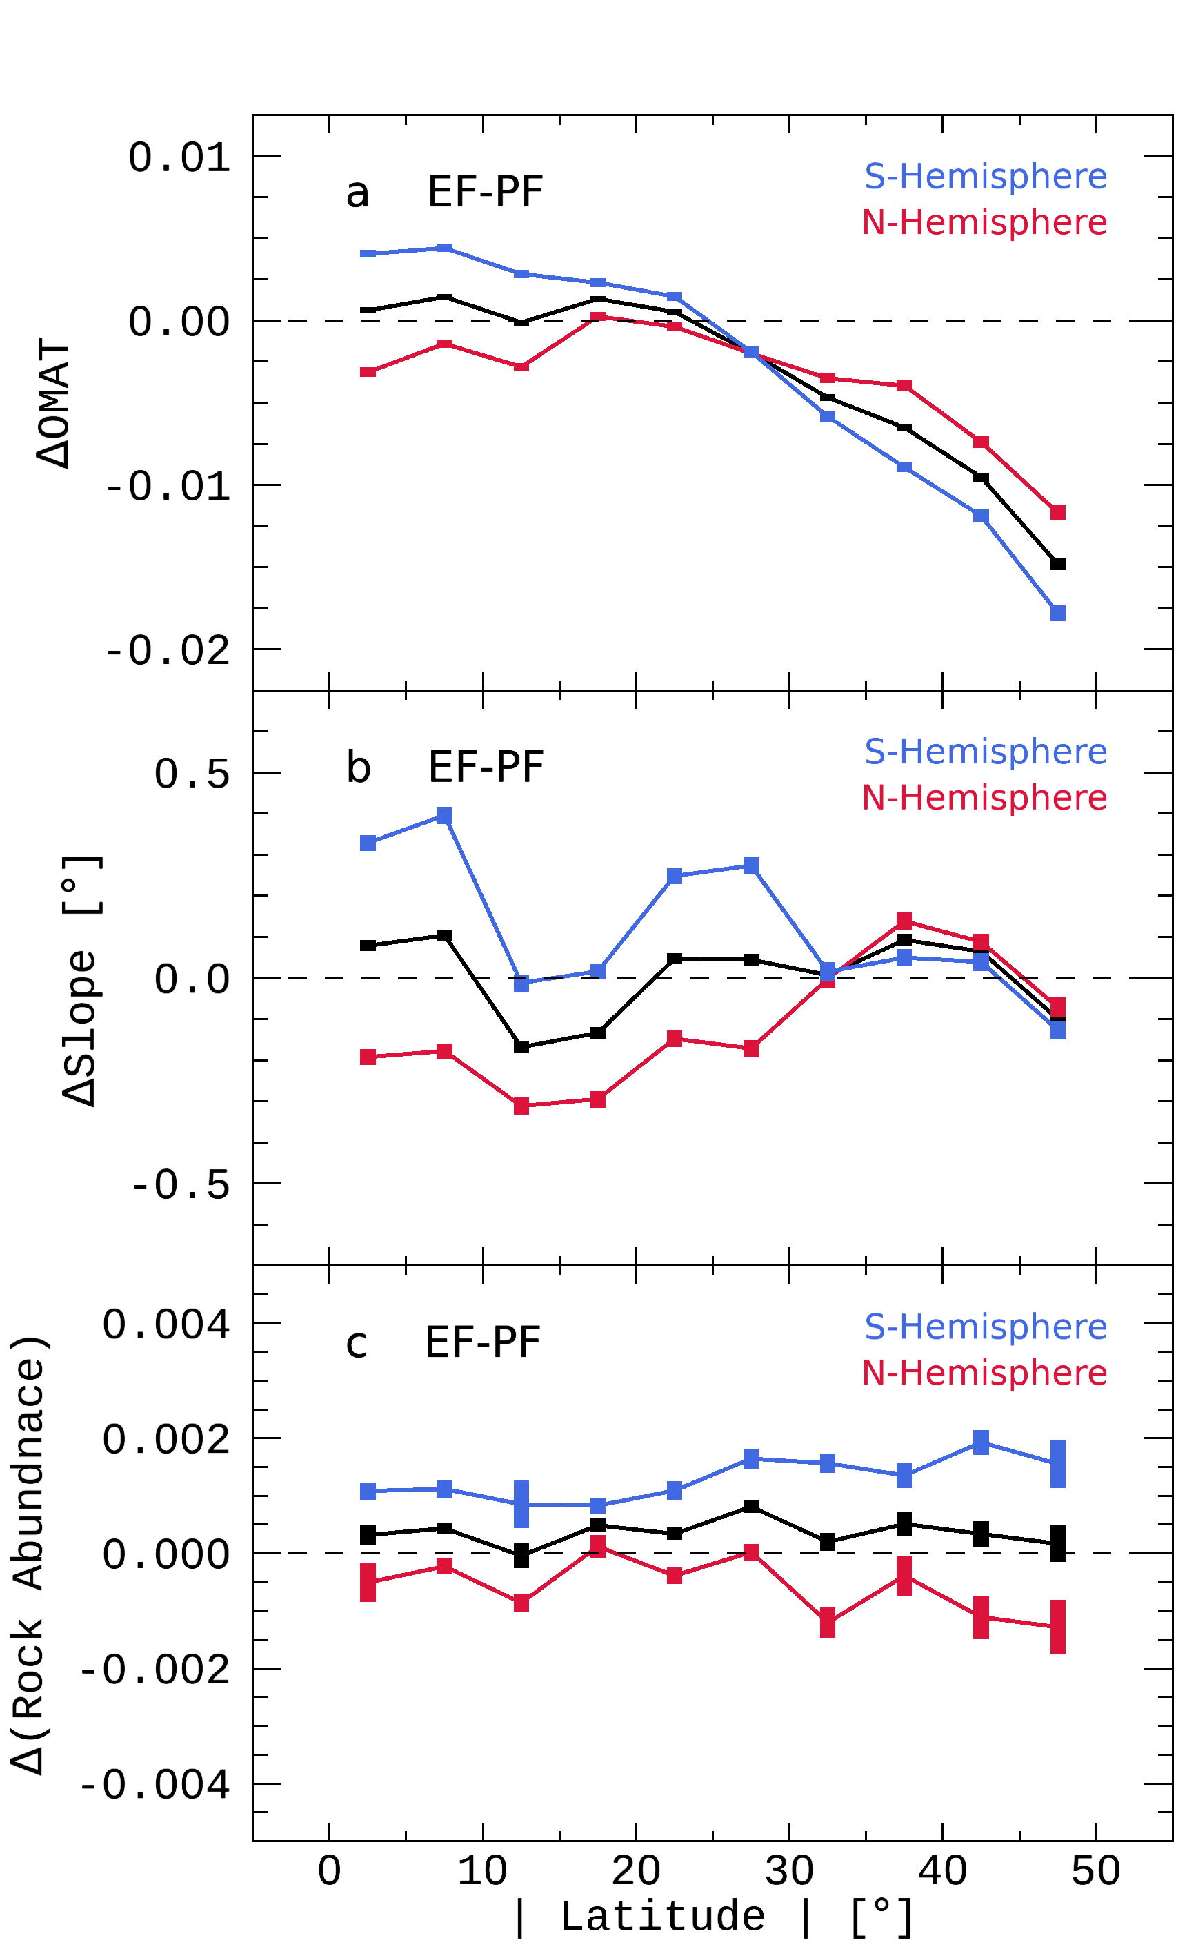
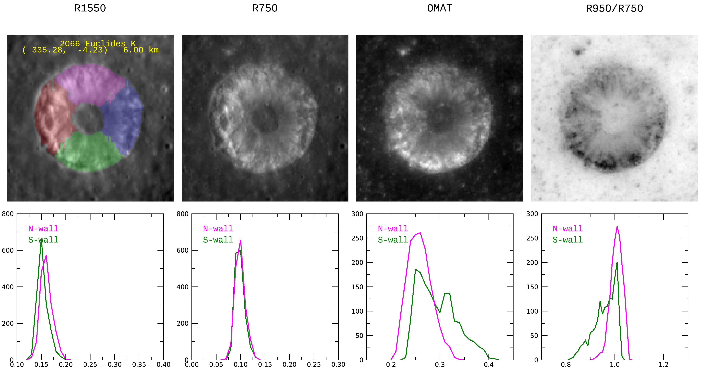

Opposite Trends of Optical Maturity
in Northern and Southern Hemispheres on the Lunar Surface
Kilho Baek¹, Sungsoo S. Kim¹, Chae Kyung Sim²
¹Kyung Hee University, ²Korea Astronomy and Space Science Institute
kilho.baek@gmail.com
kilho.baek@khu.ac.kr
ABSTRACT
The wall-quadrants of lunar craters are good tools for analyzing the optical maturity (OMAT) difference caused by the flux of space weathering agents (solar wind particles, micro-meteorites, …).
We find that the OMAT differences between the equator-facing (EF) and pole-facing (PF) walls have opposite trends in the northern and southern hemispheres at lower latitude.
Below 25 degrees, the EF wall is more mature than the PF wall in the northern hemisphere, but it is the opposite in the southern hemisphere.
Unlike previously known, the hemispheres seem not to be symmetrically affected along the ecliptic plane.
Similar trends are confirmed with wall slope and rock abundance estimated using Lunar Orbiter Laser Altimeter (LOLA) and Diviner data of the Lunar Reconnaissance Orbiter (LRO), respectively.
1. INTRODUCTION
3. METHODS
What Happened on the Lunar Surface?
We improved the analysis methods of Sim et al. (2017).
1. Extract the DEM of craters & Produce slope and azimuth angle of each pixel.
At higher latitudes,
lunar regolith has
brighter reflectance
less red
less mature
caused by lower flux.
Lower Flux
Lat.
-4
-3
-2
-1
0
3 dimensional
vector calculation
0
5
10
15
20
25
30
-180
-120
-60
0
60
120
180
Equator
DEM [km]
Slope [°]
Azimuth Angle [°]
Which space weathering agents enter along the ecliptic plane and affect soil maturation more?
Solar wind particles or Micro-meteorites?
2. Detect crater structures & Divide wall-quadrants using the topographic data.
Apr. 2022
Crater Rim
Inner Structures
Wall-Quadrants
Hemingway et al. (2015) Icarus
DEM
Slope
Azimuth
rim
Solar wind particles enter along the ecliptic plane! Reduced flux should occur both at swirls and toward higher latitudes.
Aug. 2015
Jeong et al. (2015) ApJS
-4
-3
-2
-1
0
Micro-meteorites (as well as solar wind particles) enter along the ecliptic plane! Grain size monotonically increases as the latitude increases.
Floor
Terrace
wall
E-wall
N-wall
S-wall
W-wall
Nov. 2015
3. Extract reflectance and roughness data of craters & Align to the DEM data of them.
Sim et al. (2017) GeoRL
Color
( = 750 nm / 950 nm Reflectance)
OMAT
( Lucey et al. 2000, JGR )
Rock Abundance
( Bandfield et al. 2011, JGR )
Solar wind particles weather the lunar regolith more than micro-meteorites!
Pole-facing walls are brighter and less red (i.e. less mature) than their equator-facing counterparts as latitude increases.
N
Equator
Facing
Trang et al. (2019) Icarus
Nov. 2017
Pole
Facing
Both of them, but it is difficult to estimate what affects more…
Nanophase and microphase iron abundances are lower at higher latitudes,
which suggests lower solar wind and micro-meteoroid impact flux at these latitudes.
Fresh
Mature
Mature
Fresh
Low
High
Lat.
Equator
Nov. 2018
4. Analyze latitudinal trends using EF and PF walls.
Pole
Facing
Apr. 2022
We are carrying on with Sim et al. (2017) with more craters.
Thanks a lot for your research!
Impact flux of space weathering agents is
stronger on EF wall than on PF wall!
As latitude increases,
flux difference of EF and PF wall increases.
(= Δflux [flux_{EF wall} – flux_{PF wall}] increases.)
space weathering agents
Equator Facing
S
Stronger
Flux
2. DATA
4. RESULTS
Lunar Crater Database
We adopt the lunar crater database provided by Robbins et al. (2018) to consider more and smaller craters than Sim et al. (2017), which used lunar impact crater database provided by the Lunar and Planetary Institute (LPI).
In this study, our algorithm for detecting craters identifies craters with well-preserved inner structure, particularly outer rim and wall-quadrants.
Figure 1. Result of Sim et al. (2017)
Latitudinal Trends of Δ (= [Equator Facing] – [Pole Facing])
ΔOMAT of all craters (dark solid line in Figure 2a) is consistent with the previous study (Figure 1), it should be close to zero near the equator and increases toward higher latitudes.
It means that incident angles of EF and PF walls are similar near the equator because space weathering agents are known to enter along the ecliptic plane.
For the similar reason, Northern (N) and southern (S) hemispheres should be symmetrical.
We analyze the ΔOMAT in N and S hemispheres separately in order to confirm the symmetry using more craters than the previous study.
However, the ΔOMAT in the N (red solid line) and S (blue solid line) hemispheres are not close to zero near the equator and have opposite trends below 25° of latitude.
ΔSlope and Δ(Rock Abundance) also have the asymmetries and the opposite trends throughout the latitude.
 | Sim et al. (2017) | This Study
Database | LPI (2015) | Robbins et al. (2018)
# of craters | 1872 (of 8716) | 26,802 (of ~1.3 million)
Information | Central Latitude & Longitude Diameter of Major/Minor-axis
Diameter | 5 ~ 120 km | 2 ~ 120 km
Latitude | -50° ~ +50° | -60° ~ +60°
Figure 2. Results of this study
※ Craters smaller than 2 km in diameter cannot be recognized due to spatial resolution ※ (~60 m/pixel) of lunar global map data, even though they are well-preserved.
S-wall is fresher
than N-wall
Causes of the opposite trends below 25°
Many craters below 25° of latitude have fresh regions more on S-wall than on N-wall.
$\left\{\begin{matrix}\text{Δ}\text{OMAT}\text{ < 0 }\text{in} \text{the} \text{N} \text{hemisphere} \\ \text{Δ}\text{OMAT}\text{ > 0 }\text{in} \text{the} \text{S} \text{hemisphere}\end{matrix}\right\}$ near the equator doesn’t mean that N-wall is more weathered by space weathering.
This means that S-wall become fresh by meteorite hundreds of meters in diameter.
We assume that the opposite trends near the equator are caused by asymmetric impacts of meteoroids on the Moon.
Lunar Global Map Data
DEM : the improved lunar digital elevation map created by the LOLA and DEM : SELENE Kaguya teams at a typical vertical accuracy ~3 to 4 m
Reflectance : ultraviolet-visible (415, 750, 900, 950, 1001 nm) and Reflectance : near-infrared (1000, 1050, 1250, 1550 nm) of SELENE multiband imager
Rock abundance : level 3 gridded data record of LRO Diviner
S-wall is steeper
than N-wall.
Mission | LRO + SELENE | SELENE | LRO
Instrument | LOLA + Terrain Camera | Multiband Imager | Diviner
Data Type | DEM | Reflectance (UV—Visible) | Rock Abundance
Resolution | ~60 m/pixel |  | ~240 m/pixel
Mature
Fresh
Mature
Fresh
OMAT
OMAT
※ All data cover latitudes within ±60°.
S-wall has more rocks
than N-wall
5. CONCLUSIONS
기존 연구 결과들과 다르게 북반구와 남반구의 위도에 따른 우주 풍화 경향이 대칭이 아님을 발견했다.
광학적 특성인 색상과 OMAT 뿐만 아니라 지형적 특성인 벽면의 기울기와 Rock Abundance에서도 반대 경향이 나타난다.
이는 황도면에 평행한 방향으로 입사하는 것으로 알려진 태양풍 입자와 미소유성체 외에 우주 풍화에 영향을 주는 다른 요인이 있다는 것을 의미한다.
북반구와 남반구의 위도 경향이 엇갈리는 위도인 25도만큼 비스듬하게 입사하는 우주풍화 요인이 있을 것으로 추측한다.

