Slide 1

B.Tech · BCSE497J Project-I
Token-Efficient LLM Interaction on CPU-Only Hardware
Team members:
Arrsh Tripathi (23BCI0191)
Alok Singh (23BCI0158)
Dev Singh (23BCE0794)
Faculty guide : Dr Sathya K
School of Computer Science and Engineering

Slide 2

Approval Mail From Guide
Approval obtained from the faculty guide for the title, objectives,
scope and expected outcomes of this project.
[ Paste the approval mail screenshot here before submitting. ]

Slide 3
Aim
Cut the token cost of talking to a small language model on a CPU-only laptop —
without changing the meaning of any request.
Seven optimisation modules plus an always-on fidelity gate. Every module PROPOSES a
change; one orchestrator COMMITS it, and only after the gate has checked it.
Because every module is independently switchable, the system is a 2^4 factorial
experiment rather than a fixed pipeline — which is what makes the headline result
measurable at all.

Slide 4
Abstract
Prompt compression, semantic caching, KV-cache reuse, routing and output budgeting each
reduce token cost. They are published ALONE, each against an uncompressed baseline.
We survey 40 papers, derive six research gaps, and build all of these techniques into one
instrumented pipeline so their INTERACTION can be measured.
Result: 33.9% fewer tokens with zero loss of answer accuracy (92.5% → 97.5% on 40 gold
items, no regressions). Savings do NOT compound — an additivity shortfall of 1.63 pp.
Prefill is 92–99% of CPU time at ~8.5 ms per input token. And the cache thresholds
published as safe would serve the opposite answer on our adversarial set.

Slide 5
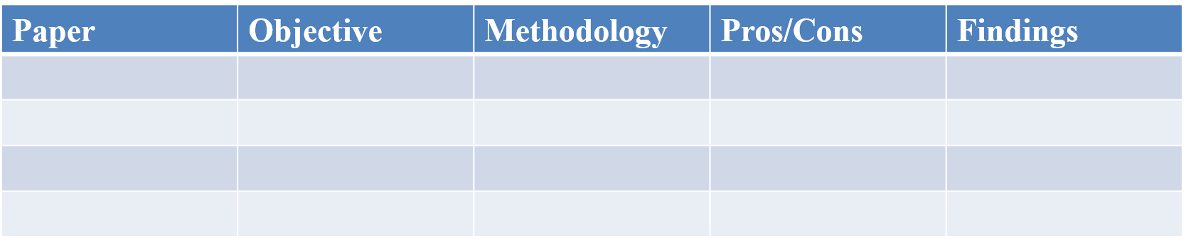

Literature Review

Slide 6
Research Gap
Gap 1 Composition is unmeasured
Every technique is evaluated alone. Whether savings ADD when composed is unknown.
Gap 2 CPU prefill/decode split uncharacterised
The literature measures GPU throughput. Which half a laptop pays for is unestablished.
Gap 3 Compression x cache interaction
Normalising before the cache should raise hit rate. Does it raise FALSE hit rate?
Gap 4 Published cache thresholds unvalidated
0.85–0.92 is quoted safe; nobody reports where opposite-meaning pairs actually sit.
Gap 5 Does a calibration transfer?
Thresholds are published as universal. Nobody re-runs the protocol without re-tuning.
Gap 6 Does mined policy transfer?
Self-improving systems are evaluated on the data they were mined from.

Slide 7
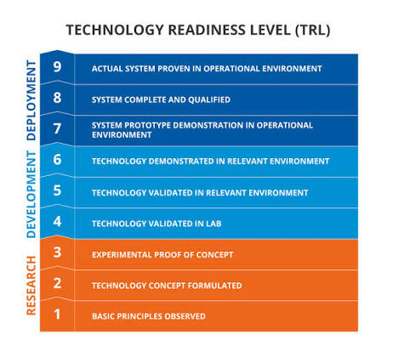

Objectives
RQ1 When techniques are composed, do their savings add — and if not, by how much short?
RQ2 On CPU, which half of a request dominates, and what is one input token worth in ms?
RQ3 Can a cache be made safe against opposite-meaning pairs without a second model pass?
RQ4 Does a calibration transfer to a different configuration without re-tuning?
Contribution 1 The additivity shortfall, measured: 1.63 pp, 95% CI [-0.02, +3.23] —
and shown to be a property of the CONFIGURATION, not a constant.
Contribution 2 CPU cost structure: prefill 92–99%, ~8.5 ms/input token; and the price of
prompt order — 212 ms vs 18,914 ms for the same content.
Contribution 3 A verifier that makes reuse safe without a second model: 26.7% → 0.0%.
Contribution 4 Transfer tested both ways: ratios transfer, mechanisms do not; and mined
policy pays only above ~5–10% traffic repetition.
Identified: Sustainable Development Goals | | Outcomes ((Patent / Conference (Scopus)
/ Journal (Scopus) / Start-up/ Product/ Others}

Slide 8
Framework/Architecture/Block Diagram
Modules PROPOSE · one orchestrator COMMITS · the gate checks every proposal
M6a Deterministic router Answers maths and dates exactly, with no model 23 tokens -> 0
M2 Semantic cache Reuses an earlier answer; three-zone accept/verify/rejectprompt never sent
M3a History selector Keeps only the prior turns that matter (MMR) 8 turns -> 6
M3b History arranger Orders the kept turns order changes cost
M1a Tier 1 boilerplate Strips greetings, politeness, markdown 28 -> 17 tokens
M1b Tier 2 redundancy Deletes a sentence repeating a known fact 36 -> 26 tokens
M1c Tier 3 word level Shortens wording, with a negative-yield guard rejects zero-yield
M4 Prefix-stable assemblerInvariant text first, so the KV cache is reusable 212 ms vs 18,914 ms
M5 Output budgeter Caps answer length by question class 48 ... 640 tokens
M6b Escalation router Decides whether a bigger model is warranted calibrated, off
M8 FIDELITY GATE Checks EVERY proposal above; refuses any that drops a number, name, negation or qualifier26.7% -> 0.0% false answers

Slide 9
Functional Requirements
F1 Every module independently switchable, so a factorial cell means what it claims.
F2 Stage order is configuration, validated against a reads/writes dependency graph.
F3 Every stage writes a ledger row — including stages that did nothing.
F4 No transformation is applied until the fidelity gate has approved it.
F5 A run that asks for the real model and cannot reach it REFUSES rather than
silently falling back to the deterministic stand-in.
F6 Every reported figure regenerates from raw logs with one command (~100 s).
Non-functional: CPU-only, 8 GB RAM, fully offline; middleware overhead under 120 ms;
dependencies limited to numpy, tokenizers, typer, rich, pytest.

Slide 10
Modules
Each module is switchable independently, which is what makes the ablation valid.
M6a Deterministic router Answers maths and dates exactly, with no model
M2 Semantic cache Reuses an earlier answer; three-zone accept/verify/reject
M3a History selector Keeps only the prior turns that matter (MMR)
M3b History arranger Orders the kept turns
M1a Tier 1 boilerplate Strips greetings, politeness, markdown
M1b Tier 2 redundancy Deletes a sentence repeating a known fact
M1c Tier 3 word level Shortens wording, with a negative-yield guard
M4 Prefix-stable assembler Invariant text first, so the KV cache is reusable
M5 Output budgeter Caps answer length by question class
M6b Escalation router Decides whether a bigger model is warranted
M8 FIDELITY GATE Checks EVERY proposal above; refuses any that drops a number, name, negation or qualifier

Slide 11
Experiments and Results
Headline — savings do not compound
M5 output budgeter +13.44 pp (eta^2 0.556)
M3 history manager +11.82 pp (eta^2 0.430)
M2 semantic cache +1.94 pp
M1 compressor +0.23 pp
Full stack: +33.9% total token reduction
Additivity shortfall: 1.63 pp, 95% CI [-0.02, +3.23]
Prefill dominates on CPU
146 tokens -> 1,360 ms prefill (91.7% of total)
1,338 tokens -> 11,609 ms prefill (98.8% of total)
~8.5 ms per input token => 100.6 s saved across the corpus, 383 ms/request
Safety: the verifier, not the threshold
Adversarial negation pair sits at cosine 0.924 — ABOVE every genuine paraphrase
False-answer rate 26.7% -> 0.0% at tau >= 0.92, on 45 adversarial + 45 controls
Quality is not the price
Gold accuracy, real model: baseline 92.5% -> full stack 97.5%
Zero regressions: not one answer the baseline got right was lost

Slide 12
Conclusion
The literature has a rich toolbox and a thin account of what happens when the tools
are used together. The contribution here is a MEASUREMENT INSTRUMENT: eight techniques
in one harness, each independently switchable, every decision written to a ledger.
What it found, repeatedly, is that published operating points are configuration-specific.
A threshold quoted as safe is unsafe here. A placement strategy justified by a well-cited
attention result is 80x more expensive here. A calibration transfers as a ratio but not as
a mechanism. An escalation premise that holds at 70B does not hold at 3B.
For this class of system the deliverable is a CALIBRATION PROCEDURE, not a number.
Status: 719 automated tests passing; 39 architecture decision records; all figures
regenerate from raw logs in about 100 seconds.

Slide 13
References
[1] Y. Li, B. Dong, C. Lin, F. Guerin, "Compressing Context to Enhance Inference Efficiency of Large Language Models," EMNLP, 2023.
[2] H. Jiang, Q. Wu, C.-Y. Lin, Y. Yang, L. Qiu, "LLMLingua: Compressing Prompts for Accelerated Inference of Large Language Models," EMNLP, 2023.
[3] F. Bang, "GPTCache: An Open-Source Semantic Cache for LLM Applications," NLP-OSS at EMNLP, 2023.
[4] W. Kwon et al., "Efficient Memory Management for Large Language Model Serving with PagedAttention," SOSP, 2023.
[5] N. F. Liu et al., "Lost in the Middle: How Language Models Use Long Contexts," TACL, vol. 12, pp. 157–173, 2024.
[6] L. Chen, M. Zaharia, J. Zou, "FrugalGPT: How to Use Large Language Models While Reducing Cost and Improving Performance," arXiv:2305.05176, 2023.
[7] I. Ong et al., "RouteLLM: Learning to Route LLMs with Preference Data," arXiv:2406.18665, 2024.
[8] "An Empirical Study on Prompt Compression for Large Language Models," ICLR, 2025.
[9] "From Similarity to Vulnerability: Key Collision Attack on LLM Semantic Caching," arXiv:2601.23088, 2026.
[10] "Enhancing adversarial resilience in semantic caching for secure retrieval augmented generation systems," Scientific Reports, 2026.
Full 40-paper survey with limitations and metrics: docs/13-review2-dossier.md

