Slide 1

1
TrackMe
Software Engineering 2
A.Y. 2018/2019
Team: Paolo Romeo, Andrea Scotti, Francesco Staccone
Notes:
1

Slide 2
2
Main actors and goals
Third party
Individual
G1) Third parties can monitor the health status of the individuals
G2) Third parties can access the anonymized data of the groups of individuals
G11) A third party can organize a race and define the path for the run
G3) The user can accept or refuse the requests concerning the treatment of his/her personal data by the third parties
G10) A user can participate to the available races
G12) The user can enable/disable the AutomatedSOS service at any time

Slide 3
3
Main functions
Data4Help
-Monitor an individual
-Request for anonymous aggregated data
AutomatedSOS
-SOS assistance
Track4Run
-Organize running events
-Enroll to runs or follow running events

Slide 4
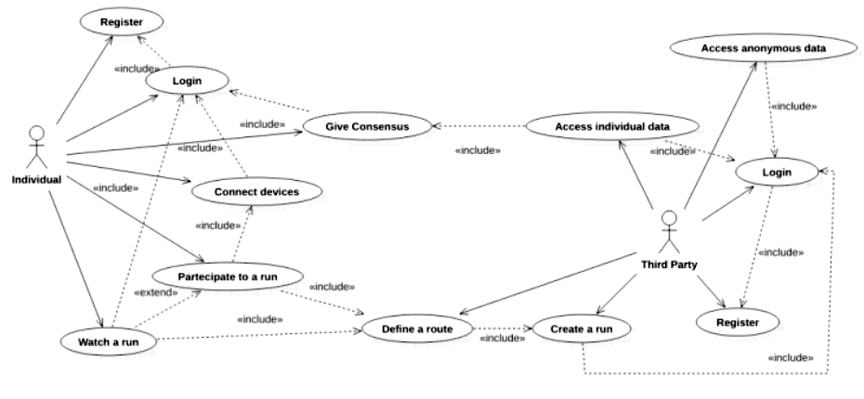
4
Use cases

Slide 5
5
World, shared and machine phenomena
Shared
World
Machine
SOS encodings
Third parties organize runs
Third parties request data
Individuals accept/refuse requests
Data acquisition
Data aggregation
Anonymity check
Maximum number of participants to the run check
Disease detection
API queries
Pressure and heartbeat change
Health diseases happen
Ambulances move
Running events happen
Runners move
Notes:
5

Slide 6
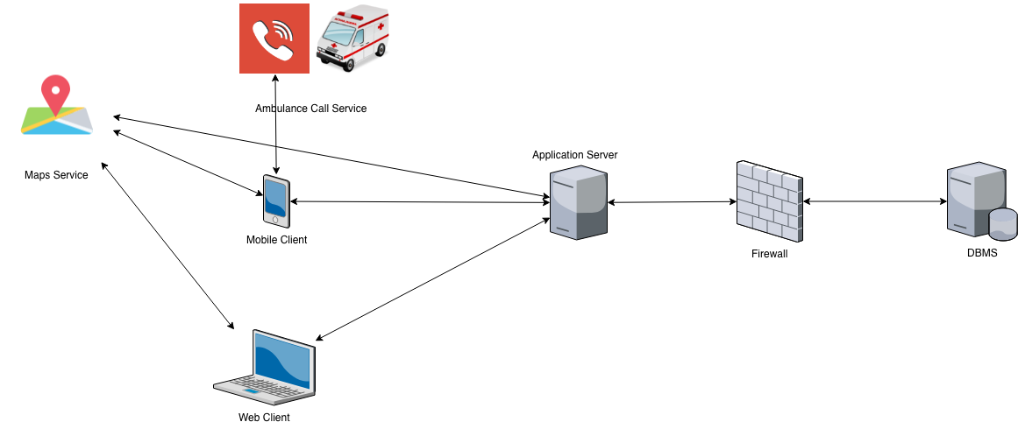
6
Architectural overview
Notes:
6

Slide 7
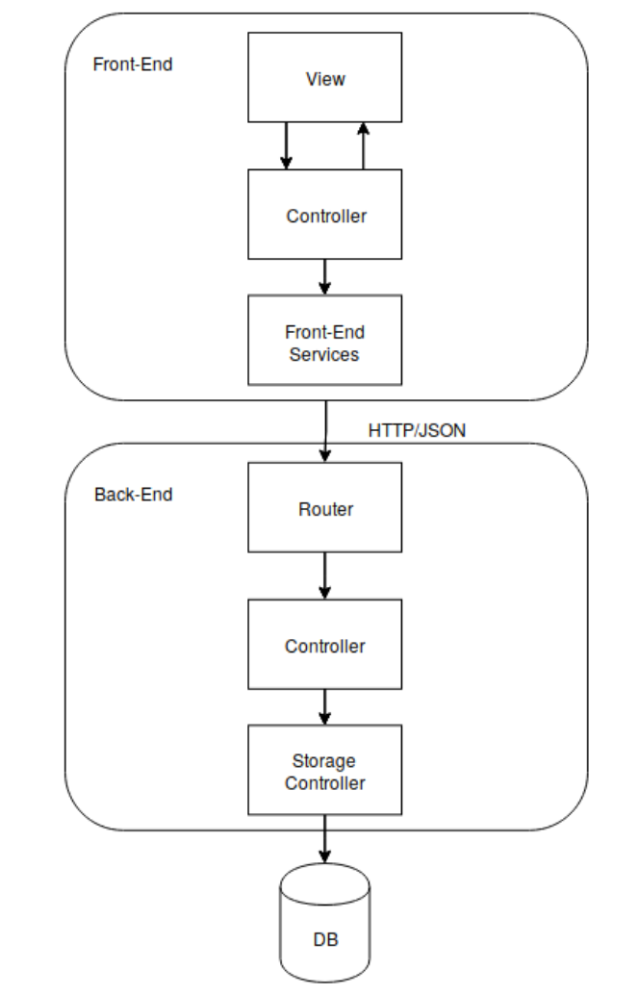
Architecture
Three-tier architecture
Scalability
Maintainability
Hidden Database structure
Hybrid client
Automated SOS
RESTful paradigm
Uniform interface
Stateless
MVC Design Pattern

Slide 8
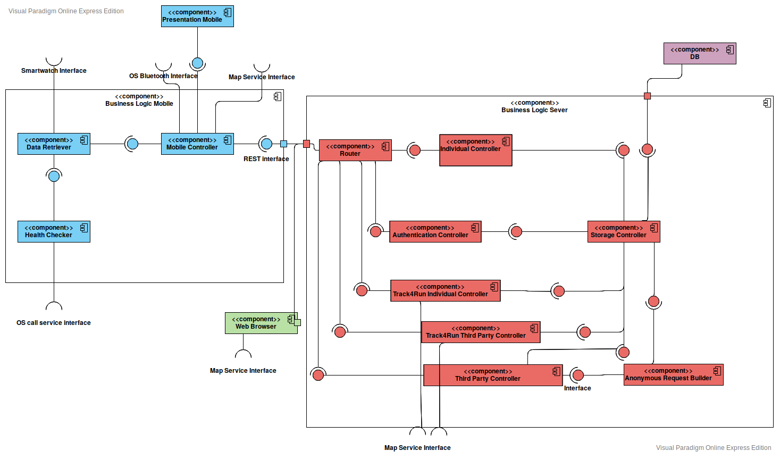
8
Component diagram
Notes:
Logical division;
External interfaces;
Storage Controller realizes the Object Relational Mapping
Individual Client vs Third Party Client
8

Slide 9
8
Our Implementation
Data4Help
AutomatedSOS

Slide 10
9
Spring
Spring Boot
Spring is a light weight framework which provides comprehensive infrastructure support for developing Java applications.
It achieves the loose coupling through dependency injection and interface based programming.
It minimally invasive development with POJO.
Inversion of control.
Spring Data JPA makes it easy to easily implement JPA based repositories.
An extension of Spring which eliminated the boilerplate configurations required for setting up a Spring Application.
To ease the Java-based applications Development, Unit Test and Integration Test Process.
To increase Productivity.
It helps create a stand-alone application with few configurations.

Slide 11
10
Angular
Ionic
One of the most powerful front-end frameworks.
Allows the extension of
HTML’s syntax to express application’s components in a brief and clear manner.
It can automatically synchronize with models and views.
Promotes Code Reusability.
Faster application development.
Data Binding.
A complete open-source SDK for hybrid mobile app.
Ionic provides tools and services for developing hybrid mobile apps using Web technologies like CSS, HTML5.
Built on top of AngularJS and Apache Cordova.
Ionic is a really “Native Like” framework.
Ionic integrates easily with native functionalities.

Slide 12
12
Implementation strenghts
Modularity
Security
Dynamic anonymity

Slide 13
13
Maybe a fat client would have been a better choice for the third party?

Slide 14
14
Testing
Bottom-Up
approach
Integration Testing
with
DbUnit
API Testing
With
Postman
Unit Testing
With
JUnit

Slide 15
15
Thank you for your attention

