Slide 1
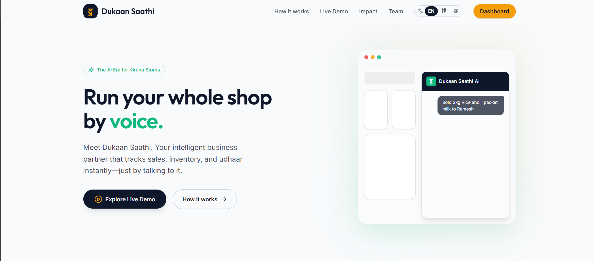
Dukaan Saathi
The AI Era for Kirana Stores
Team Name: [Zero Friction]
Notes:
Hello everyone, we are presenting Dukaan Saathi—an intelligent AI business partner built specifically for traditional Kirana stores and local shops to digitize their business with zero friction.

Slide 2
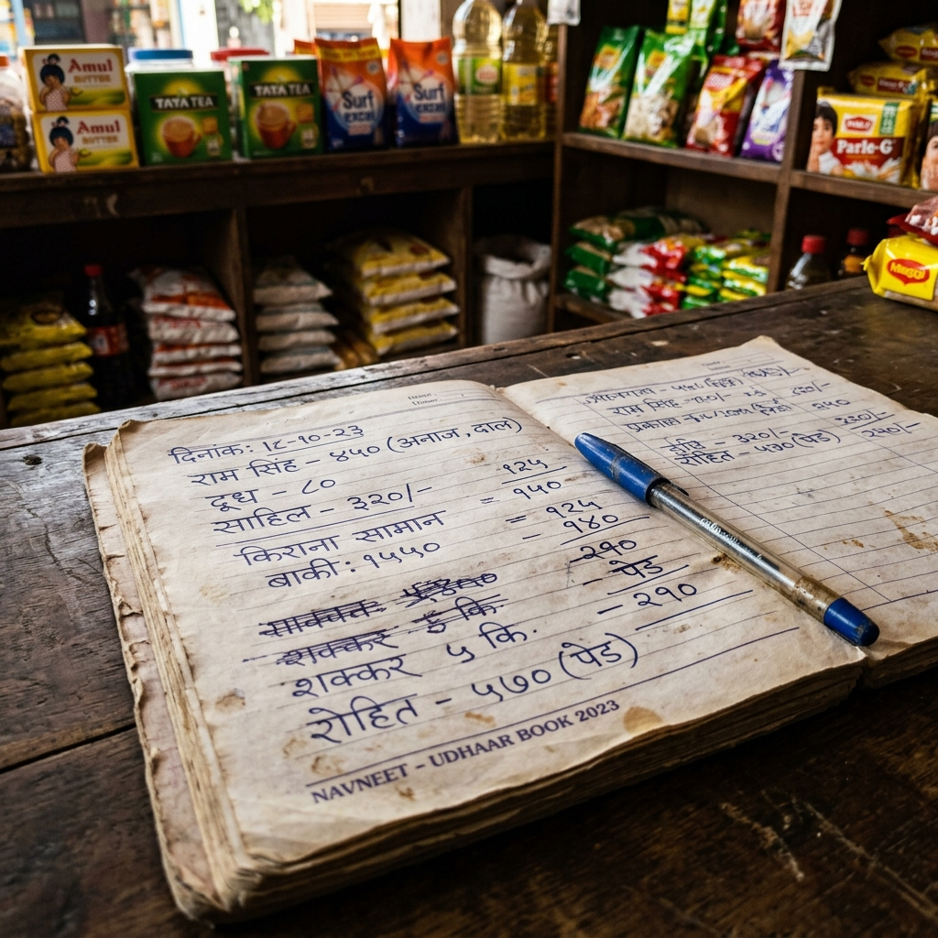
The Problem
Traditional shops rely on pen and paper.Udhaar (Credit) tracking is messy and error-prone.No analytics or real-time inventory tracking.Existing software is too complex for rural shop owners.
Why existing software fails
Notes:
Today, millions of Kirana stores still run on physical notebooks. Tracking daily sales, managing credit (Udhaar), and knowing what's out of stock is a massive headache. Existing software solutions are built for supermarkets, not for small shopkeepers, because the learning curve is too steep.

Slide 3
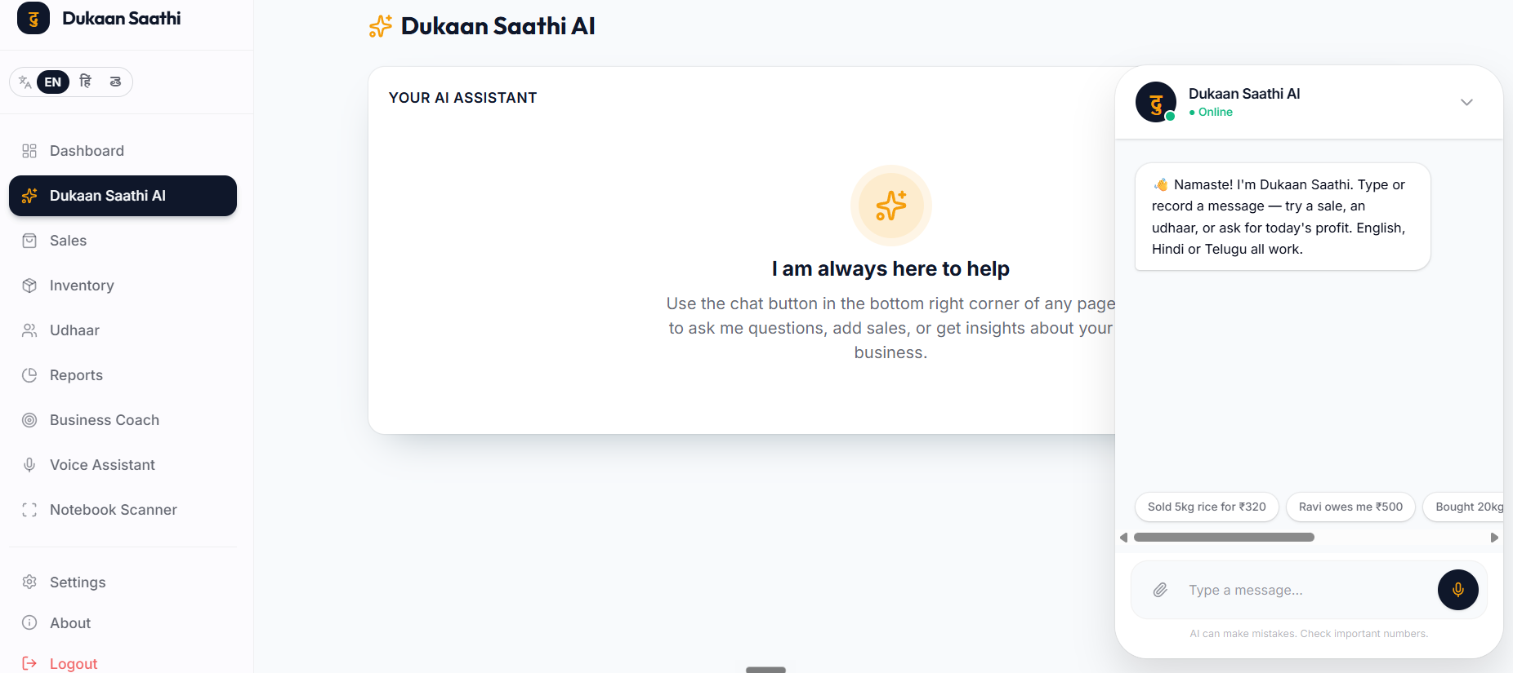
The Solution
Zero Learning CurveVoice-First AI LoggingMultilingual Support (English, Hindi, Telugu)Designed for Mobile & Desktop
Meet Dukaan Saathi
Notes:
Our solution is Dukaan Saathi. It’s an intuitive, voice-first dashboard that requires zero technical skills to use. It speaks the shopkeeper's language—literally—with full support for regional languages so anyone can use it immediately.

Slide 4
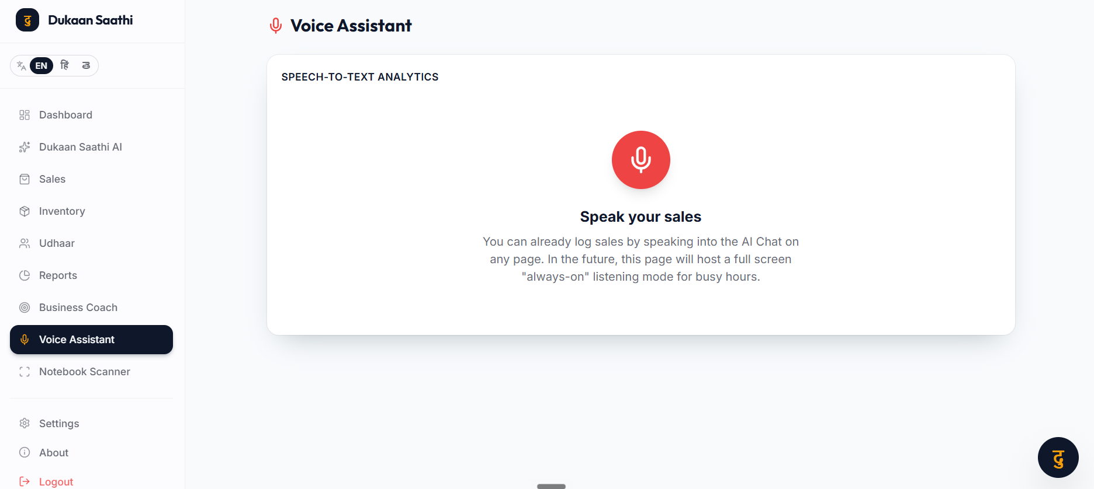
Feature 1: AI Voice Assistant
Log sales naturally via voice.NLP Parsing automatically extracts items, prices, and names.Updates inventory instantly.
Talk, Don't Type
Notes:
The core of our app is the AI Assistant. A shopkeeper doesn't have time to navigate complex menus while dealing with a line of customers. With Dukaan Saathi, they just tap the microphone and say 'I sold 2 kilos of sugar to Ramesh for 100 rupees', and our AI automatically parses the natural language and logs the sale and updates the inventory.

Slide 5
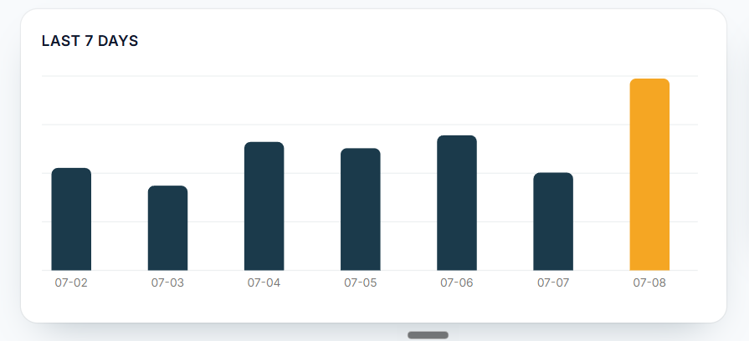
Feature 2: Smart Dashboard
Real-time Sales AnalyticsDaily & Monthly Revenue TrackingBeautiful, intuitive UI for quick insights
Real-time Analytics at a glance
Notes:
All those voice inputs feed directly into a real-time smart dashboard. For the first time, a small shop owner can see their daily revenue, top-selling items, and overall growth at a glance, helping them make better business decisions.

Slide 6
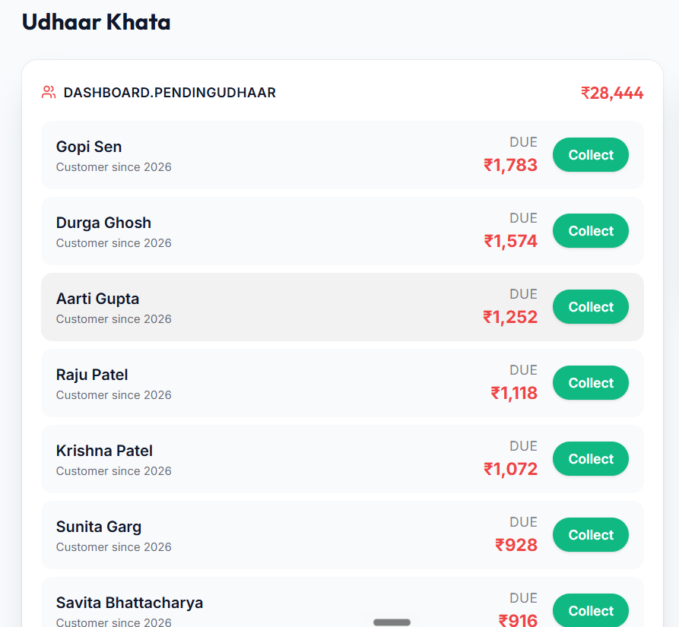
Feature 3: Digital Udhaar Book
Replace the physical Khata BookTrack individual customer balancesOne-click settlements
Never lose track of credit
Notes:
Credit, or Udhaar, is the backbone of local Indian commerce. We built a dedicated Udhaar tracker that automatically creates customer profiles when the AI detects an unpaid sale, ensuring no money is ever lost to lost notebooks.

Slide 7
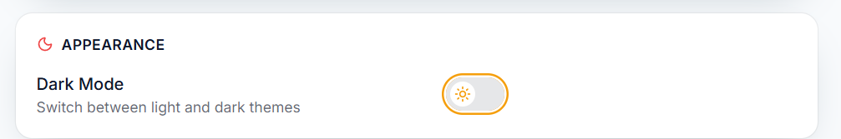
Feature 4: Premium UI/UX
Accessibility meets Design
World-class UI/UXSystem-wide Dark Mode supportLightning-fast responsive interface
Notes:
We believe utility shouldn't mean ugly. We engineered a premium, lightning-fast UI with dynamic Dark Mode support and responsive design, ensuring it looks and works perfectly whether the shopkeeper is using a cheap Android phone or a desktop computer.

Slide 8
Technical Architecture
Frontend: React + Vite, Tailwind CSS (v4)Animations: Framer MotionBackend: Node.js, Express.jsDatabase: SQLite (Lightweight, local-first)
What powers Dukaan Saathi
Notes:
Under the hood, Dukaan Saathi is powered by a modern Vite/React frontend styled with Tailwind CSS for rapid, responsive UI development. The backend runs on Express and Node.js, utilizing SQLite to keep data lightweight and easily deployable.

Slide 9
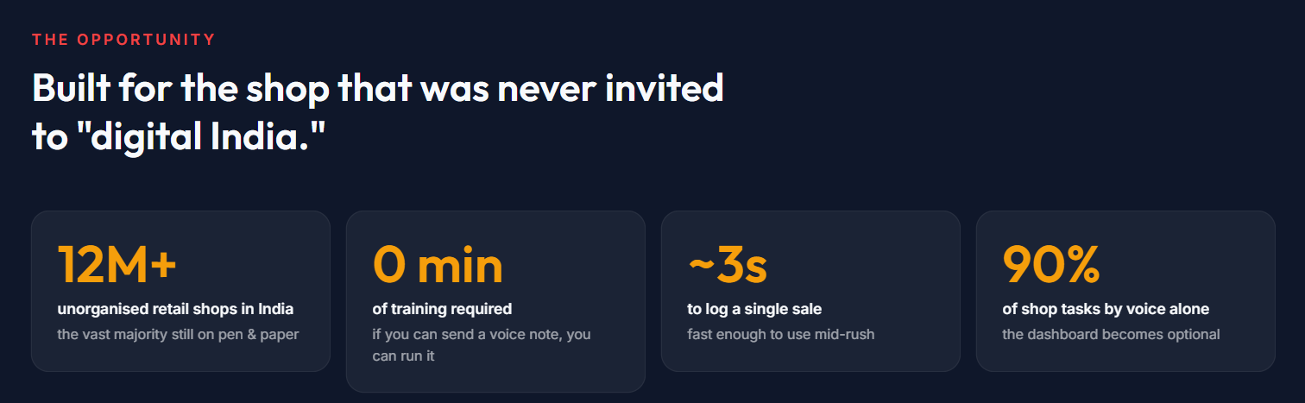
Future Roadmap
Where we go from here
Direct Integration (receipts)Native Android/iOS App deploymentPredictive AI (Stock alerts)
Notes:
For our next steps, we plan to integrate WhatsApp APIs so receipts can be sent instantly to customers. We also plan to wrap this PWA into a native Android application, and introduce predictive AI that tells the shopkeeper exactly what to restock before they run out.

Slide 10
Thank You!
Try it live: https://dukaan-saathi-new.onrender.com/onboarding
~ TEAM ZERO FRICTION
Notes:
Thank you for your time. Dukaan Saathi is live right now—feel free to scan the QR code to try it yourself, and we'd be happy to show you a live demo and answer any questions.

