Slide 1
RFM Customer Segmentation Analysis
Tushar Gupta
07 October 2025

Slide 2

Introduction & Objectives
Urban retail faces challenges in inventory planning, engagement, and retention.
This project applies RFM segmentation used by leading e-commerce platforms.
Objective: Segment customers and derive actionable marketing strategies.

Slide 3
Data Overview
Transactional customer-level dataset.
Key fields: CustomerID, OrderID, PurchaseDate, TransactionAmount, Location.
Data cleaned to remove duplicates and invalid transactions.

Slide 4
Methodology
Data cleaning and preprocessing using Python.
Customer-level RFM metric calculation.
Quantile-based scoring and segmentation.

Slide 5
RFM Metrics
Recency: Days since last purchase.
Frequency: Number of unique orders.
Monetary: Total spending by customer.

Slide 6

RFM Scoring Approach
Customers ranked into 5 quantiles for each metric.
Scores range from 1 (low) to 5 (high).
Higher score indicates higher customer value.

Slide 7
Customer Segments
<Axes: title={'center': 'Customer Distribution by Segment'}, xlabel='Segment'>
Champions
Loyal Customers
Potential Loyalists
At Risk
Lost Customers

Slide 8
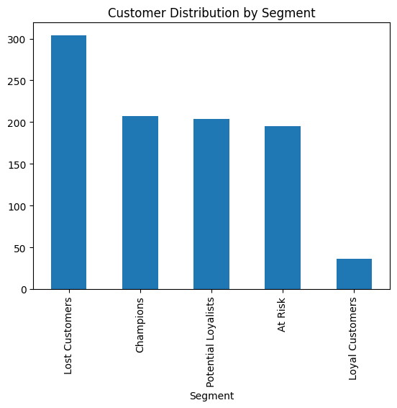
Customer Distribution Across Segments
Champions and Loyal Customers are fewer but high-value.
At Risk and Lost Customers form a larger volume.
Indicates churn risk and growth opportunity.

Slide 9
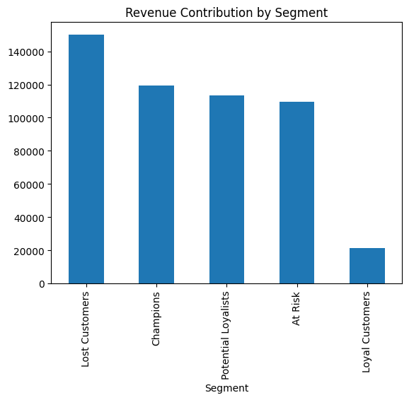
Revenue Contribution by Segment
<Axes: title={'center': 'Revenue Contribution by Segment'}, xlabel='Segment'>
Champions contribute the highest share of revenue.
Loyal Customers provide stable recurring revenue.
Low-value segments contribute minimal revenue.

Slide 10
Behavioral Insights
High-value customers purchase frequently and recently.
Low-value segments show long inactivity periods.
Engagement drops sharply before churn.

Slide 11
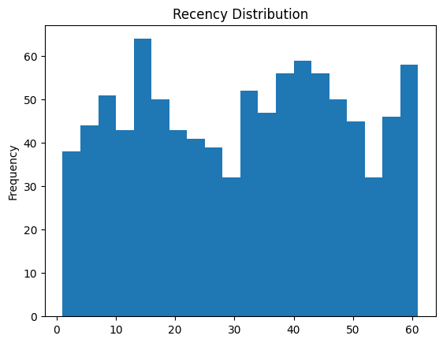
Recency Distribution
<Axes: title={'center': 'Recency Distribution'}, ylabel='Frequency'>
The distribution shows customers spread across different recency ranges (0–60 days).
A significant number of customers fall in the 30–60 days range, indicating moderate inactivity.
Customers in the lower recency range (0–15 days) represent recently active users and are more likely to convert again.
The distribution indicates an opportunity to target mid-range customers (20–40 days) before they move into the churn zone.

Slide 12
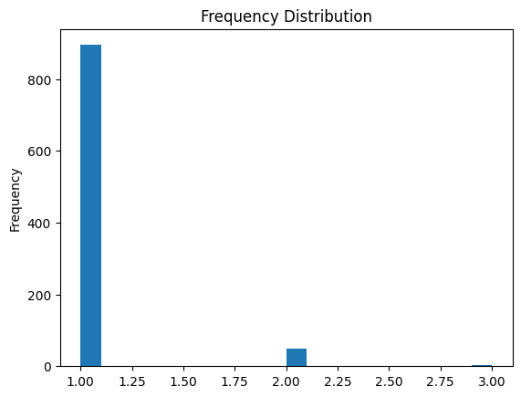
Frequency Distribution
<Axes: title={'center': 'Frequency Distribution'}, ylabel='Frequency'>
The majority of customers have made only 1 purchase, indicating a high proportion of one-time buyers.
A very small segment of customers shows 2 or more purchases, highlighting limited repeat buying behavior.
The sharp drop after frequency = 1 suggests low customer retention.
Repeat customers (frequency ≥ 2) represent a high-value growth opportunity.
Increasing frequency even slightly (from 1 to 2 purchases) can significantly improve revenue.

Slide 13
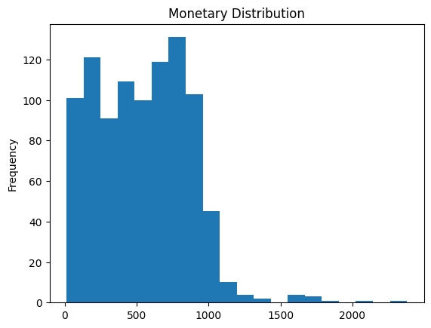
Monetary Distribution
<Axes: title={'center': 'Monetary Distribution'}, ylabel='Frequency'>
The majority of customers fall in the low to mid spending range, indicating moderate purchase value.
A small group of customers shows very high spending, creating a long right tail in the distribution.
The distribution is positively skewed, meaning a few high-value customers contribute significantly to revenue.
High-spending customers represent the Champions segment, critical for profitability.
There is an opportunity to increase average order value among mid-tier customers through bundling and upselling.

Slide 14
Strategic Recommendations
Premium offerings for Champions.
Loyalty programs for Loyal Customers.
Re-engagement offers for At Risk customers.

Slide 15

Marketing Strategy by Segment
Exclusive access for Champions.
Discounts for Potential Loyalists.
Win-back campaigns for Lost Customers.

Slide 16
Inventory & Product Strategy
Stock premium SKUs for high-value regions.
Bundle products for cross-selling.
Reduce focus on low-demand products.

Slide 17
Conclusion
“When we started this analysis, we had raw transactional data.
After applying RFM segmentation, we uncovered clear customer behavior patterns.
We identified:
Who drives the majority of revenue,
Who is likely to churn,
And where the biggest growth opportunity lies.
The key insight is that growth does not come from acquiring more customers —
it comes from increasing retention and maximizing the value of existing customers.
By focusing on Champions, nurturing Potential Loyalists, and re-engaging At Risk customers,
a business can significantly improve revenue, marketing ROI, and customer lifetime value.
This approach mirrors real-world e-commerce practices and enables sustainable, data-driven decision-making.”

Slide 18
Acknowledgements & References
Python (Pandas, Matplotlib)
RFM marketing framework
Self-executed personal project

