Slide 1


AdWiser: Decentralized Ads, Wiser Payment Control
Revolutionizing digital advertising with blockchain technology
Leveraging Solana for fast and low-cost transactions
by Vasiulla

Slide 2


The Problem with Traditional Ad Platforms
Lack of Transparency
High Commission
Delayed Payments
Advertisers cannot accurately track their budget and where their ads are placed
Centralized platforms charge fees up to $40%
Publishers often wait 30-90 days to receive earned revenue

Slide 3
AdWiser: The Solution
Decentralized Platform
SOL-Based Payments
Escrow System
Real-time Analytics
Advertisers lock SOL; publishers paid for valid clicks
Funds secured and released after click verification
Transparent, actionable ad performance data
Built on Solana blockchain for full transparency

Slide 4
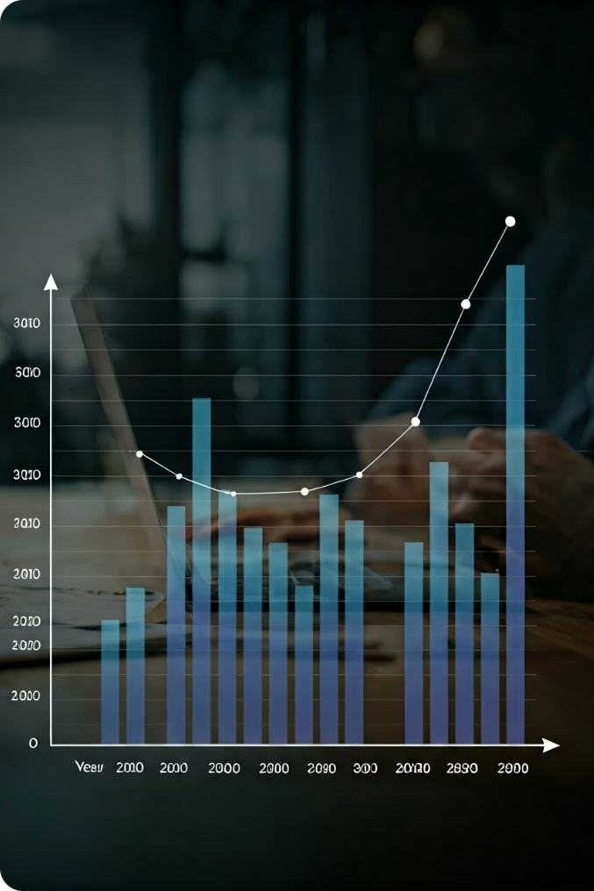
Revenue Model & Market Opportunity
Minimum Assumptions:
CPC = $0.25 = 0.00167 SOL
100K valid clicks/month = 167 SOL in payout
5,000 campaigns/month = 25 SOL rent
Monthly Revenue:
5% Commission: 8.35 SOL (~$1,252.50)
Rent Reversal: 25 SOL (~$3,750)
Total: 33.35 SOL (~$5,002.50)
Yearly Revenue:
~400.2 SOL/year ≈ $60,030/year
Market Size & Opportunity:
Replacing 0.01% of Google AdSense market ($667B) yields $3.41M/year in revenue

Slide 5
Competitive Analysis
Feature
AdWiser
Google AdSense
Others
Decentralized
Yes
No
Varies
Low Commission
Yes (5%)
No (Min 35%)
No (Min 40%)
Instant Payments
Yes (Daily / Weekly)
No (30 - 45 days delay)
No (Min 30 Days)
On-chain Escrow
Yes
No
No
Solana Integration
Yes
No
No
Budget Control
Full
Limited
Limited

Slide 6

What We've Built So Far: Solana Contracts & Backend
Smart Contracts
Handle ad creation, escrow, and click verification
Backend Infrastructure
APIs enable advertiser and publisher interactions
MVP Ready
Basic functions tested and ready for users

Slide 7




Future Roadmap
Q3 2025
Frontend Development: Build Dashboard UI for Advertisers and Publishers
Q3 2025
Full Integration: Connect all components (Smart Contracts, Backend and Frontend) into working product
Q4 2025
Final Deployment: Move from Devnet to Mainnet with production deployment

Slide 8




Let’s Make It Happen!
AdWiser is live on Solana Devnet with a complete backend and minting system. Now, I’m looking for testers, partners, and feedback to take it further!
Creator
Vasiulla (Vasi)
Discord
vasie13

